Slide 1

Northeastern University - Seattle
CS6650 Building Scalable Distributed Systems
Vishal Rajpal

Slide 2
Week 2 – Concurrency
Topics we will cover today:
Why Threads?
Simple threads in Java
Problems with threading
Synchronization primitives
Thread coordination
Thread states
Thread pools
Thread-safe collections

Slide 3
Why Threads?
Concurrency is Fundamental to Many Systems
Distributed systems are inherently concurrent
Events happen on different nodes at the same time
Unpredictable order of events
Concurrency needed on each node to provide:
Responsiveness to requests
Throughput
Ability to handle multiple simultaneous requests
Notes:
Threads are essential to have concurrency.

Slide 4
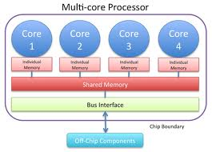
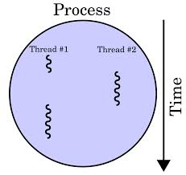
Why Threads?
Why Concurrency?
Concurrent execution is necessary in many systems:
Natural solution to many problems
Increase performance, e.g. do work while waiting for disk accesses
Necessary to exploit multicore
Notes:
A single core processor can handle a single process at a given time.
A multi core processor can handle multiple threads in a process on multiple cores at the same time providing throughput and low latency.

Slide 5
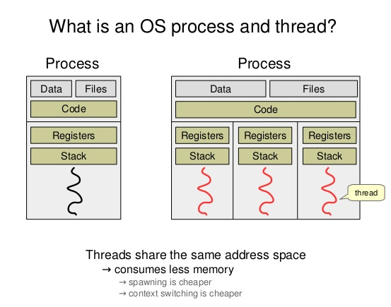
Why Threads?
Address Space
Notes:
Every process has its own data and set of resources including address space.
Threads within a process share the address space
Context Switch – when there are multiple threads the CPU context switches if it needs to switch between threads. Because these threads are part of the same process context switching is cheaper as compared to context switching between processes as that involves the Operating System.

Slide 6
Why Threads?
Units of Concurrency
Processes - different executables – comprise of
virtual address space
Code
Security context
Environment variables
Handles to system object (e.g. sockets)
A main thread of execution
A process can create multiple threads

Slide 7
Why Threads?
Threads
Threads are lightweight compared to processes
share the same address space and share data and code
Allocated their own stack space to support independent execution
Context switching between threads is less expensive than between processes
Cost of thread intercommunication is lower than process intercommunication

Slide 8
Simple Threads In Java
Java Threads
public class Thread extends Object implements Runnable
public interface Runnable {
void run();
}
class NamingThread implements Runnable {
private String name;
// default constructor
public NamingThread() {}
public NamingThread(String threadName) {
System.out.println("Constructor called: " + threadName) ;
name = threadName ;
}
public void setName (String threadName) {
name = threadName;
}
public void run() {
//Display info about this thread
System.out.println("Run called : " + name);
System.out.println(name + " : " + Thread.currentThread());
// and terminate silently ....
}
}

Slide 9
Simple Threads in Java
Java Threads
public class SimpleThreadExample {
public static void main(String[] args) {
// create 3 threads and give them names
NamingThread name0 = new NamingThread("thread0");
NamingThread name1 = new NamingThread("thread1");
NamingThread name2 = new NamingThread("thread2");
//Create the threads
Thread t0 = new Thread (name0);
Thread t1 = new Thread (name1);
Thread t2 = new Thread (name2);
// start the threads
t0.start(); t1.start(); t2.start();
try {//delay the main thread for a second
Thread.currentThread().sleep(1000);
} catch (InterruptedException e) {}
//Display info about the main thread and terminate
System.out.println(Thread.currentThread());
}
}
public class MyThread extends Thread {
public void run(){
System.out.println("MyThread running");
}
}
// and to create and start ….
MyThread myThread = new MyThread();
myThread.start();
Notes:
We call the start method and the JVM calls the run method for it to control the execution. Calling the start method makes the thread available for the JVM to execute.
The main thread is independent of other threads.
Threads in JVM are executed in a non deterministic fashion i.e. the order is not determined and controlled by your code. The order is determined by the scheduler of the JVM which interacts with the OS.

Slide 10
Simple Threads in Java
Wait for threads to terminate
private static int NUMTHREADS = 10;
NamingThread[] runnables = new NamingThread[NUMTHREADS]; for (int i = 0; i < NUMTHREADS; i++) { runnables[i] = new NamingThread("thread:" + i); }
Thread threads[] = new Thread[NUMTHREADS]; for (int i=0; i < NUMTHREADS ; i++ ) { threads[i] = new Thread (runnables[i]); threads[i].start(); } // wait for each one to finish try { for (int i=0; i < NUMTHREADS ; i++ ) { threads[i].join(); } } catch (InterruptedException e) {} System.out.println(Thread.currentThread());
Notes:
Waiting for a period of time for threads to finish execution is not a good idea.
We need to be able to determine exactly when the thread is terminated.
This is achieved by the join method.
Join method returns when a thread has finished its execution and terminated.

Slide 11
Simple Threads in Java
Key Points
Create Threads by implementing a Runnable
Start threads with .start() method, which returns immediately
Threads execute independently until completion
Order of thread execution is non-deterministic. Statements overlap.
Objects are basically state machines
State transitions invoked when methods called
Threads define an execution context
Manipulate objects (state) they have reference to
The methods they call execute in the context of the calling thread
Notes:
- Multiple threads can change state of an object by calling its methods in the context of itself. All of those calls to methods aer managed on the individual threads call stack independently.

Slide 12
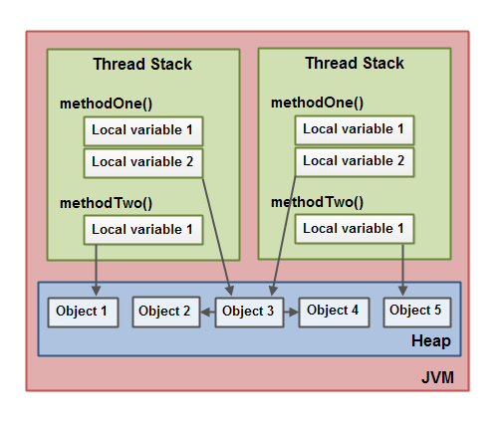
Simple Threads in Java
Notes:
- Objects can be shared between threads which can lead for threads to become tricky.

Slide 13
Problems with Threads
Concurrency makes things challenging
Problems with concurrency
Race conditions
Deadlocks
Source of problems
Non-determinism
Interleaving's
Notes:
Race conditions:
Interleavings – Overlapping of statements on shared data.

Slide 14
Problems with Threads
Problem 1: Shared Variables
Multiple independent threads make changes to same variable at same time
read value from memory to register
change value in register
write register value back to memory
thread 1: x=x+6
thread 2: x=x+1
The result?
Notes:
read, change and write are independent and not atomic operations

Slide 15
Problems with Threads
Race Conditions
Same program, different results
Depends on the manner in which CPU schedules execution
Different interleaving's produce different outcomes
Extremely hard to debug
Not reproducible
These are extremely unpleasant when they occur in production systems
Thread 1 | Thread 2
Reads (x) into register
Register value + 6
Writes register value to (x)
 | Reads (x) into register
 | Register value + 1
 | Writes register value to (x)
Thread 1 | Thread 2
Reads (x) into register
Register value + 6
 | Reads (x) into register
 | Register value + 1
 | Writes register value to (x)
Writes register value to (x)
Notes:
- The second example is an example of a race condition.

Slide 16
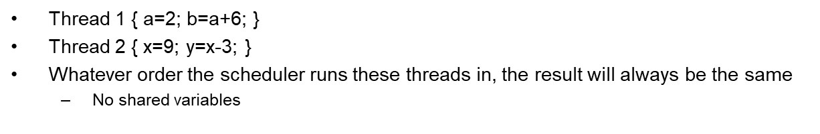
Problems with Threads
Root cause: Non determinism
Sequential programs exhibit deterministic behavior
Race conditions are caused by non-deterministic behavior
Notes:
- Solution is to impose ordering on this non deterministic behavior to get correct results. Aka Synchronization Primtives

Slide 17
Problems with Threads
Race Condition
public class RequestCounterBad {
private static final int NUM_THREADS = 100000;
private int count = 0;
public void inc() {
count++;
}
public int getVal() {
return this.count;
}
public static void main(String[] args) throws InterruptedException {
final RequestCounterBad counter = new RequestCounterBad();
for (int i = 0; i < NUMTHREADS; i++) {
Runnable thread = () -> { counter.inc(););
new Thread(thread).start();
}
Thread.sleep(5000);
System.out.println("Value should be " + NUM_THREADS + " - It is " + counter.getVal());
}
}
The results:
Value should be equal to 100000 it is: 99988
Value should be equal to 100000 it is: 99989
Notes:
Solution is to impose ordering on this non deterministic behavior to get correct results. Aka Synchronization Primitives.

Slide 18
Synchronization Primitives
Removing Race Conditions
Use locks to impose ordering constraints
Lock shared variables so they can be accessed only by a single thread at once
Serialized access to shared resources
Each thread wishing to access a variable:
takes the lock
changes the variable
releases the lock
If the lock is set, all other threads wait for it to be released
Which thread proceeds next?
Locks sometimes known as semaphores

Slide 19
Synchronization Primitives
Java synchronization methods
public class SynchronizedCounter {
private int c = 0;
public synchronized void increment() { c++; }
public synchronized void decrement() { c--; }
}
Synchronization keyword: only one thread can execute this method at a time. Others will be be blocked
Known as critical section
it is not possible for two invocations of any synchronized methods on the same object to interleave
less error-prone as release is automatic

Slide 20
Synchronization Primitives
Monitor Locks
Synchronization is implemented using monitors. In JVM, Each object in Java is associated with a monitor, which a thread can lock or unlock.
Only one thread at a time may hold a lock on a monitor.
synchronized (this);
synchronized(Object);
Any other threads attempting to lock that monitor are blocked until they can obtain a lock on that monitor.
Notes:
When a thread accesses a synchronized method it acquires the monitor lock.
All other threads calling any synchronized methods in that object will be blocked.

Slide 21
Synchronization Primitives
Shared variable Modification
Another possible Solution – Atomic Variables
public class SharedVariable {
private final AtomicInteger val= new AtomicInteger();
public void incrementNumber() {
val.getAndIncrement();
}
public int getNumber() { val.get();}
Rest stays the same
Notes:
- Access to atomic integer is serialized.

Slide 22
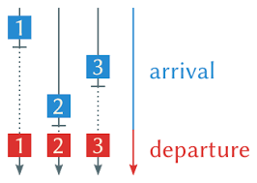
Synchronization Primitives
Barrier Synchronization
Notes:
Another way to synchronize is barrier synchronization.
There are number of threads and completion is non deterministic.
We only want continue execution in the main thread when all threads have reached a particular stage.

Slide 23
Synchronization Primitives
Countdown Latch
Implements a barrier
Initialized with a given count – typically initialized with the number of threads.
await() blocks until count is zero
countdown() method decrements value
When count is zero, all threads resume
await() returns
This is a one-shot phenomenon -- the count cannot be reset.
If you need to reset the count, use a CyclicBarrier.
Notes:
A few ways to implement a barrier in Java. One of them being Countdown Latch.

Slide 24
Synchronization Primitives
Barrier Synchronization – Latch
public class RequestCounterBarrier {
private static final int NUM_THREADS = 1000;
private int count = 0;
synchronized public void inc() {
count++;
}
public int getVal() {
return this.count;
}
public static void main(String[] args) throws InterruptedException {
final RequestCounterBarrier counter = new RequestCounterBarrier();
CountDownLatch completed = new CountDownLatch(NUM_THREADS);
for (int i = 0; i < NUMTHREADS; i++) {
Runnable thread = () -> { counter.inc(); completed.countDown(););
new Thread(thread).start();
}
completed.await();
System.out.println("Value should be " + NUM_THREADS + " - It is " + counter.getVal());
}
}

Slide 25


Lab 2
The Dining Philosophers Problem
Notes:
- Introduced by Dijkstra.
This illustrates the problem when multiple threads need to access the same resource also known as Resource contention.
All philosophers eat or think.
And they have shared forks/chopsticks.
To eat they need to acquire both chopsticks so that they can eat.

Slide 26
Lab 2
Pseudocode
while(true) {
// Initially, thinking about life, universe, and everything
think();
// Take a break from thinking, hungry now
pick_up_left_fork();
pick_up_right_fork();
eat();
put_down_right_fork();
put_down_left_fork();
// Not hungry anymore. Back to thinking!
}

Slide 27
Lab 2
public class Philosopher implements Runnable {
private final Object leftFork;
private final Object rightFork;
Philosopher(Object left, Object right) {
this.leftFork = left;
this.rightFork = right;
}
private void doAction(String action) throws InterruptedException {
System.out.println(Thread.currentThread().getName() + " " + action);
Thread.sleep(((int) (Math.random() * 100)));
}
public void run() {
try {
while (true) {
doAction(System.nanoTime() + ": Thinking"); // thinking
synchronized (leftFork) {
doAction(System.nanoTime() + ": Picked up left fork");
synchronized (rightFork) {
doAction(System.nanoTime() + ": Picked up right fork - eating"); // eating
doAction(System.nanoTime() + ": Put down right fork");
}
doAction(System.nanoTime() + ": Put down left fork. Returning to thinking");
}
}
} catch (InterruptedException e) {
Thread.currentThread().interrupt();
}
}
}
Example Run - Deadlock
Philosopher 4: Thinking
Philosopher 0: Thinking
Philosopher 1: Thinking
Philosopher 2: Thinking
Philosopher 3: Thinking
Philosopher 4: Picked left
Philosopher 1: Picked left
Philosopher 3: Picked left
Philosopher 0: Picked left
Philosopher 2: Picked left

Slide 28
Lab 2
Deadlock
2 threads sharing access to 2 shared variables via locks
thread 1: takes lock a
thread 2: takes lock b
thread 1: blocks on b
thread 2: blocks on lock a
Deadlock!!
Neither thread can proceed
Caused by resource contention
Circular wait

Slide 29
Lab 2
Impose total ordering on acquisition of resources.
For our example: chopstick[0] < chopstick[1] < chopstick[2] < chopstick[3] < chopstick[4].
For Philosopher 0 this means it will attempt to acquire chopstick[0] before they acquire chopstick[1].
This breaks the potential circular wait deadlock.
Solution
for (int i = 0; i < philosophers.length; i++) {
Object leftFork = forks[i];
Object rightFork = forks[(i + 1) % forks.length];
if (i == 0) {
// The first philosopher picks up the right fork first
philosophers[i] = new Philosopher(rightFork, leftFork);
} else {
philosophers[i] = new Philosopher(leftFork, rightFork);
}
Thread t = new Thread(philosophers[i], "Philosopher " + (i + 1));
t.start();
}
Notes:
General solution is to impose total ordering on the acquisition of the resources.
Any philosopher acquired chopstick 0 before they acquire chopstick 1 and so on.

Slide 30
Lab 2 – Synchronization is Hard
Too few ordering constraints => race conditions
Too many ordering constraints => deadlocks
Hard/impossible to reason about based on modularity
If an object is shared by multiple threads, need to think about what all threads could do
Thorough testing is impossible
Non-determinism leads to an infinite number of possible interleavings
Controlled by the scheduler and events, not the program

Slide 31
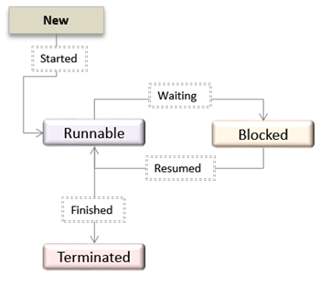
Thread States
New Thread state (Ready-to-run state)
Created but not started
Runnable state (Running state)
Started and either running or waiting to run
Blocked
Dead state
Stop() called or run() terminates
Notes:
Note that Java has its own states to manage its schedulers state machine. These states are general thread states.

Slide 32
Thread States
Not Runnable
A thread is Not Runnable if one of the following occurs:
When sleep() is invoked
Thread.currentThread().sleep(1000);
When suspend() is invoked
When the wait() method is invoked
waits for notification of a free resource
waits for completion of another thread
waits to acquire a lock of an object.
The thread is blocking on an I/O request
Thread Resumption
If a thread is asleep:
the sleep period must elapse or interrupt() method called
If a thread is suspended:
its resume() method must be called
If a thread is waiting on a condition variable,
an object owning the variable must relinquish it by calling either notify() or notifyAll().
If a thread is waiting on I/O, then I/O must complete
Notes:
- When we call sleep, the thread is basically in blocked state until the timer expires.
- File I/O or network I/O typically causes the thread to wait.

Slide 33
Thread Priority
In Java every thread has a priority
Higher priority threads get scheduled more frequently than lower priority threads
A Java thread inherits its priority from its parent
MIN_PRIORITY (0) Lowest Priority
NORM_PRIORITY (5) Default Priority
MAX_PRIORITY (10) Highest Priority
Notes:
Java scheduler is a priority scheduler.

Slide 34
Thread Scheduling
The thread scheduler chooses the Runnable thread with the highest priority for execution.
When multiple threads to choose from, scheduler chooses one in a round-robin fashion. The chosen thread will run until:
a higher priority thread becomes Runnable. (Pre-emptive)
it yields, or its run() method exits
its time allotment has expired (time-slicing)

Slide 35
Reentrancy
Every Java object has a lock associated with it
Known as the intrinsic lock
Aka monitor or mutex locks
Synchronized methods exploit this intrinsic lock
Lock acquired by executing thread before entering a synchronized block
Lock released automatically when the thread exits the synchronized block
Is this a deadlock?
public class hipsterBaseClass {
public synchronized void doHipsterStuff() {
// random hipster behaviour
}
}
public class capitolHillBar extends hipsterBaseClass {
public synchronized void orderDrinks() {
// get drinks order
super.doHipsterStuff();
}
}
Notes:
-

Slide 36
Reentrancy
Intrinsic locks are reentrant
If a thread tries to acquire a lock it already holds, it succeeds
Each lock has an acquisition count and owning thread
Count can only be incremented above 1 by same owning thread
Reentrancy facilitates encapsulation of locking behavior, and simplifies OO concurrent code

Slide 37
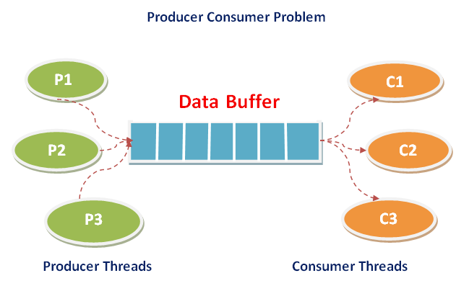
Thread Co-ordintion
Need to ensure
Consumer waits if buffer empty
Consumer can remove item when buffer not empty
Producer waits if buffer full
Producer can add item if buffer has free space
Guards
Producer-Consumer style examples require ‘guards’
Producer stores message in a shared buffer
Except when full
Consumers retrieve messages from buffer
Wait when empty
Producer
Consumer
Notes:
Way to achieve this in concurrent programming is to use Guards.
If a producer tries to write to a buffer the condition will stop the write from occurring until the condition fails and opposite for consumer.

Slide 38
Java Guards
Wait() and notify() statements
Wait and notify provide thread inter-communication that synchronizes on the same object.
final void wait(long timeout) throws InterruptedException
final void wait() throws InterruptedException
final void notify()
final void notifyAll()
Let’s work through an example
see ProducerConsumerExample
Notes:
When buffer is empty the consumer must wait.
A thread can we woken up if another thread calls notify on the same object.

Slide 39
Producer Consumer Example
public class Buffer {
// Message buffer between producer to consumer.
private String message;
// True if consumer must wait for producer to send //message,
// false if producer must wait for consumer to retrieve message.
private boolean empty = true;
public synchronized String retrieve() {
// Wait until message is available.
while (empty) {
try {
System.out.println("Waiting for a message");
wait();
} catch (InterruptedException e) {}
}
// Toggle status.
empty = true;
// Notify producer that buffer is empty
notifyAll();
return message;
}
public synchronized void put(String message) {
// Wait until message has been retrieved.
while (!empty) {
try {
wait();
} catch (InterruptedException e) {}
}
// Toggle status.
empty = false;
// Store message.
this.message = message;
// Notify consumer that message is //available
notifyAll();
}
}
Notes:
Call producer once – succeeds
Call producer again.- wait
Call consumer again – succeeds – notified producer

Slide 40
Performance and Scalability Issues with Threads
Thread safety requires an internal state of an object protected from concurrent updates.
Updates must be atomic and serialized.
What if an object has no state that persists between calls?
Or the state cannot be modified by a calling thread?
Is this thread safe?
Notes:
Necessary to protect state of an object otherwise there would be race conditions.
Adding synchronized methods adds an overhead and makes the code slower.

Slide 41
Stateless Servlet
public class StatelessFactorizer extends GenericServlet implements Servlet {
public void service(ServletRequest req, ServletResponse resp) {
BigInteger i = extractFromRequest(req);
BigInteger[] factors = factor(i);
encodeIntoResponse(resp, factors);
}
Notes:
Stateless and Immutable objects are always thread-safe

Slide 42
Thread Pools
The java.util.concurrent package contains a range of utilities to simplify multithreaded programs
Executor framework – Framework to execute collections of threads and execute asynchronously.
Thread-safe collections

Slide 43
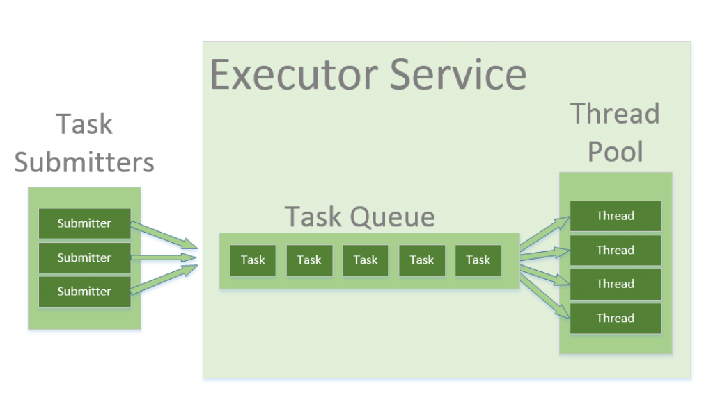
Thread Pools
Threads consume resources
Creation
Context switching
Memory per Thread
Thread pools provide a mechanism for an application to control number of threads.
Reuse threads to minimize creation cost.
Fixed memory size
Support a task-based programming model.
Executor Framework
An object that executes submitted Runnable tasks.
For example, rather than invoking new Thread(new(RunnableTask())).start() for each of a set of tasks,
Executor executor = anExecutor;
executor.execute(new RunnableTask1());
executor.execute(new RunnableTask2());
Notes:
Reuse threads – Instead of letting a thread die we reuse it by giving it another task.
Since it is a fixed size thread pool we know the amount of memory we are going to use.
Task based thread pool – assign tasks to thread pools based on the execution policies.
Submitters send tasks to ExecutorService. These tsks are held in a queue.
ExecutorService will execute your tasks asynchronously.

Slide 44
Thread Pools
Executors
Decouples task submission from task executions
Supports different task execution policies
Executors provide a factory method to create an Executor with desired policies.
Executor executor = Executors.newSingleThreadExecutor()
Executor executor = Executors.newFixedThreadPool(10)
Executor executor = Executors.newCachedThreadPool()
executor.getPoolSize();
executor.getQueueSize();
Notes:
CachedThreadPool – starts with 0 and can grow infinitely.

Slide 45
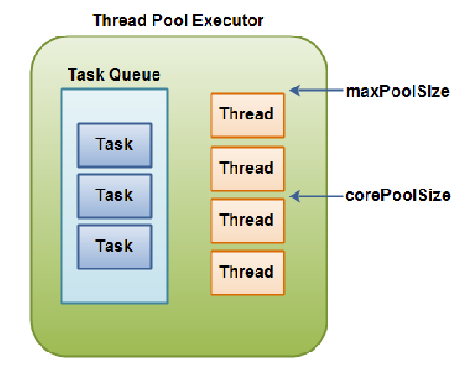
Executor Fixed Size Thread Pool
ExecutorService executorService = Executors.newFixedThreadPool(SIZE);
executorService.execute(new Runnable() {
public void run() {
System.out.println(“new task");
}
});
executorService.shutdown();
Notes:
An Implementation of ExecutorService is ThreadPoolExecutor.

Slide 46
Executor Policies
Executors decouple the submission of a request from the execution policy used
Makes it easy to change policies to suit deployment hardware – just choose a different Executors interface
Policies specific things like:
How many concurrent threads?
How many queued requests?
What to do if server overloaded?
Execution priorities/order (LIFO, FIFO), etc …
There is no way to obtain the result of a Runnable
Or find out when threads have completed
You will have to use ExecutorService which is a sub interface of Executor that accepts Runnables and Callables
From Runnable you can return a Future
From Callable you can return a value.

Slide 47
Executor Service methods
Submit(Runnable)
Future future = executorService.submit(new Runnable() {
public void run() {
System.out.println("Asynchronous task");
}
});
future.get(); // returns null if the task has completed correctly.
Submit(Callable)
Future future = executorService.submit(new Callable(){
public Object call() throws Exception {
System.out.println("Asynchronous Callable");
return "Callable Result";
}
});
System.out.println("future.get() = " + future.get());

Slide 48
Executor Service shutdown()
Must shutdown an executor
executorService.shutdown();
Stops accepting new requests but does not shutdown immediately
Completes all tasks in queue.
This method will return when all the threads have finished execution.
executorService.awaitTermination();

Slide 49
Thread safe Collections
Sharing Structures
Consider a LinkedList with an explicit size variable.
Read size variable
Add new element to the list at the end
Increment and write back size variable.
Size variable and list elements must be synchronized.
Concurrent access of non thread safe structures is dangerous.

Slide 50
Thread safe Collections
None of the classes in java.util.* package are thread safe except Vector and HashTable
Because synchronized methods are slow.
Either wrap your calls to these collections with a synchronized method or
Use Collections factory method to create thread safe versions for us.
List<String> list = Collections.synchronizedList(new ArrayList<>());
Synchronized wrappers still incur performance penalty.
While collection locked while a single thread makes a modification
Java 5.0 and above includes java.util.concurrent package specifically designed for efficient multithreaded access.
java.util.concurrent package includes additions to the Java Collections Framework. Desiged to be thread safe in multi threaded programs.
BlockingQueue: FIFO that blocks or times out when you attempt to add to a full queue, or retrieve from an empty queue.
ConcurrentMap is a subinterface of java.util.Map that defines useful atomic operations. Also ConcurrentHashMap, which is a concurrent analog of HashMap.
CopyOnWriteArrayList when we want to iterate over a list in a thread-safe way without an explicit synchronization.

Slide 51
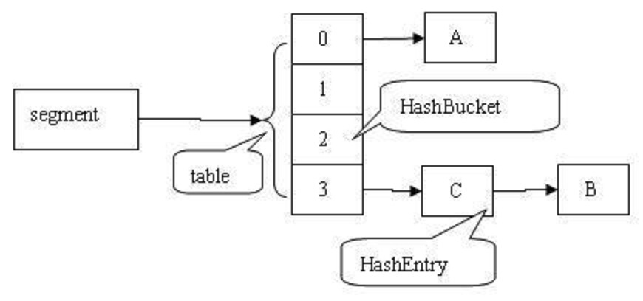
ConcurrentHashMap
HashMap divided into buckets
16 by default
A lock is applied at the bucket level
Allows safe concurrent modification
Atomic operations:
putIfAbsent()
remove()
replace()
Trade-offs - relaxed consistency for
Map.size()
Map.isEmpty()
iterators
Notes:
Iterator – Iterator will have all the items at the time it was created. May or may not have elements which are added after the iterator is created.

Slide 52
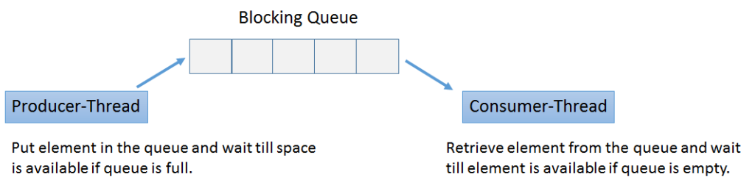
BlockingQueue
class Producer implements Runnable {
private final BlockingQueue queue;
Producer(BlockingQueue q) { queue = q; }
public void run() {
try {
while (true) { queue.put(produce()); }
} catch (InterruptedException ex) { ... handle ...}
}
Object produce() { ... }
}
class Consumer implements Runnable {
private final BlockingQueue queue;
Consumer(BlockingQueue q) { queue = q; }
public void run() {
try {
while (true) { consume(queue.take()); }
} catch (InterruptedException ex) { ... handle ...}
}
void consume(Object x) { ... }
}
class Setup {
void main() {
BlockingQueue q = new LinkedBlockingQueue();
Producer p = new Producer(q);
Consumer c1 = new Consumer(q);
Consumer c2 = new Consumer(q);
new Thread(p).start();
new Thread(c1).start();
new Thread(c2).start();
}
}

Slide 53
CopyOnWriteArrayList
Thread-safe variant of ArrayList
Mutators(add, update and set) create a snapshot of the underlying array.
Each thread using an iterator sees its own version of the snapshot of the array created while initializing the iterator of the list.
Useful in multithreaded code when reads are frequent and updates are rare.
Any mutations to CopyOnWriteArrayList will not reflect during iteration since the iterator was created.
Notes:
When the thread gets an iterator – it gets its own copy.
Any modification is made to that copy and not to the actual data structure.
Reads are quick since the data structure is immutable.
Writes essentially make a new copy of the data structure.

Slide 54
Summary
Concurrency is fundamental to software systems
Introduces problems of race conditions and deadlocks
Synchronization required as a solution
Threads move through various states during their lifetime
Scheduler makes decisions on which thread to run based on their state and priority
Executors and concurrent utility classes simplify threaded programs

Slide 55
Questions?

