Slide 1
xqDoc

Slide 2
Javadoc for XQuery
And more …
  Overview Tool
  Learning Tool
  Integrated Documentation Tool
  Cross-Reference Mapping Tool
  Vendor Neutral Tool
  Open Source Tool (Apache 2.0 License)
  Solution based on experience

Slide 3
xqDoc Mission
The goal of xqDoc is to provide a simple vendor neutral solution for documenting XQuery library and main modules, as well as tools to generate a user friendly presentation of this documentation and cross referencing information.

Slide 4
Some Quotes …
"xqDoc provides one of the core pieces of infrastructure needed to make XQuery successful. As the size of people's XQuery code has grown from a handful of files to full code libraries, including libraries from other people, xqDoc lets us keep a handle on all that code." [Jason Hunter]
"Wow, this is great! It will solve almost all of my documentation problems. In particular, I like the listing of referenced functions and the possibility to view the corresponding code section." [Wolfgang Meier]
“Many XQuery developers write short queries and don't use libraries. xqDoc won't be helpful for them. But for those of us who write and use libraries, especially when these libraries get large, xqDoc may be very helpful indeed.” [Jonathan Robie]

Slide 5
What can xqDoc do for me?
Use existing XQuery code
  Library Modules
  Main Modules
No xqDoc embellishments
  No knowledge of xqDoc
Benefits
  Cross Reference Tool
  Learning Tool
  View Source
Standard Demo

Slide 6
“How did they do that?”
Start with existing XQuery code
Convert XQuery to XML using xqDoc Conversion package
Store the XML into an XML database
Use the xqDoc Presentation Scripts for display
More details to follow …

Slide 7
Components of xqDoc
xqDoc Comment
xqDoc Schema
xqDoc Conversion Package
xqDoc Drivers
xqDoc Presentation Scripts

Slide 8
xqDoc Comment - BNF
  Library Module
    ModuleDecl
    ModuleImport
    VarDefn
    FunctionDefn
  Main Module
    MainModule
    ModuleImport
    VarDefn
    FunctionDefn

Slide 9
xqDoc Comment - syntax
XQuery comment style
  (: … :)
XQuery Pragma
  (:: pragma … ::)
xqDoc Comment style
  (:~ … :)

Slide 10
xqDoc Comment - tags
@author
The @author tag identifies the author for the documented component. Zero or more @author tags can be specified (one per author)
@author Darin McBeath

Slide 11
xqDoc Comment - tags
@version
The @version tag identifies the version of the documented component. Zero or more @version tags can be specified (one per version) but in reality only a single @version tag would normally make sense. The value for the @version tag can be an arbitrary string.
@version 1.0

Slide 12
xqDoc Comment - tags
@since
The @since tag identifies the version when a documented component was supported. Zero or many @since tags can be specified, but in reality only a single @since tag would normally make sense. The value for the @since tag can be an arbitrary string but should likely match an appropriate version value.
@since 1.0

Slide 13
xqDoc Comment - tags
@see
The @see tag provides the ability to hypertext link to an external web site, a library or main module contained in xqDoc, a specific function (or variable) defined in a library or main module contained in xqDoc, or arbitrary text. To link to an external site, use a complete URL such as http://www.xquery.com. To link to a library or main module contained in xqDoc, simply provide the URI for the library or main module. To link to a specific function (or variable) defined in an xqDoc library or main module, simply provide the URI for the library or main module followed by a ';' and finally the function or variable name. To provide text, simply include the 'text'. Multiple @see tags can be specified (one per link or string of text).
@see http://www.xquery.com
@see xqdoc/xqdoc-display
@see xqdoc/xqdoc-display;build-link
@see xqdoc/xqdoc-display;$months

Slide 14
xqDoc Comment - tags
@param
The @param tag identifies the parameters associated with a function. For each parameter in a function, there should be a @param tag. The @param tag should be followed by the parameter name (as indicated in the function signature) and then the parameter description.
@param $name The username

Slide 15
xqDoc Comment - tags
@return
The @return tag describes what is returned from a function. Zero or one @return tags can be specified.
@return Sequence of names matching the search criteria

Slide 16
xqDoc Comment - tags
@deprecated
The @deprecated tag identifies the identifies the documented component as being deprecated. The string of text associated with the @deprecated tag should indicate when the item was deprecated and what to use as a replacement.
@deprecated As of 1.0 and replaced with add-user

Slide 17
xqDoc Comment - tags
@error
The @error tag identifies the types of errors that can be generated by the function. Zero or more @error tags can be specified. An arbitrary string of text can be provided for a value.
@error The requested URI does not exist

Slide 18
xqDoc Comment – example 1
(:~
: This module provides the functions that control the Web presentation
: of xqDoc. The logic contained in this module is not specific to any
: XQuery implementation and is written to the May 2003 XQuery working
: draft specification. It would be a trivial exercise to convert this
: code to either the Nov 2003 or Oct 2004 XQuery working draft.
:
: It should also be noted that these functions not only support the
: real-time presentation of the xqDoc information but are also used
: for the static offline presentation mode as well. The static offline
: presentation mode has advantages because access to a native XML
: database is not needed when viewing the xqDoc information ... it is
: only needed when generating the offline materials.
:
: @author Darin McBeath
: @version 1.0
:)
module "xqdoc/display"

Slide 19
xqDoc Comment – example 2
(:~
: The controller for constructing the xqDoc HTML information for
: the specified library module. The following information for
: each library module will be generated.
: <ul>
: <li> Module introductory information</li>
: <li> Global variables declared in this module</li>
: <li> Modules imported by this module</li>
: <li> Summary information for each function defined in the module</li>
: <li> Detailed information for each function defined in the module</li>
: </ul>
:
: @param $uri the URI for the library module
: @param $local indicates whether to build static HTML link for offline
: viewing or dynamic links for real-time viewing.
: @return XHTML.
:)
define function print-module($uri as xs:string, $local as xs:boolean) as element()*

Slide 20
xqDoc Schema
Five Sections
  Control
  Module
  Imports
  Variables
  Functions

Slide 21
xqDoc Schema - control
<xqdoc:control>
<xqdoc:date>Tue Apr 12 11:15:54 EDT 2005</xqdoc:date>
<xqdoc:version>1.0</xqdoc:version>
</xqdoc:control>

Slide 22
xqDoc Schema - module
<xqdoc:module type="library">
<xqdoc:uri>xqdoc/xqdoc-display</xqdoc:uri>
<xqdoc:name>xqdoc-display.xqy</xqdoc:name>
<xqdoc:comment>
<xqdoc:description>This module provides … </xqdoc:description>
<xqdoc:author>Darin McBeath</xqdoc:author>
<xqdoc:version>1.0</xqdoc:version>
<xqdoc:since>February 27, 2005</xqdoc:since>
</xqdoc:comment>
<xqdoc:body xml:space="preserve">(: Copyright …</xqdoc:body>
</xqdoc:module>

Slide 23
xqDoc Schema - imports
<xqdoc:imports>
<xqdoc:import>
<xqdoc:uri>xqdoc/xqdoc-display</xqdoc:uri>
</xqdoc:import>
</xqdoc:imports>

Slide 24
xqDoc Schema - variables
<xqdoc:variables>
<xqdoc:variable>
<xqdoc:uri>XQDOC_URIS</xqdoc:uri>
<xqdoc:comment>
<xqdoc:description>This variable contains …</xqdoc:description>
</xqdoc:comment>
</xqdoc:variable>
</xqdoc:variables>

Slide 25
xqDoc Schema - functions
<xqdoc:functions>
<xqdoc:function>
<xqdoc:comment>
<xqdoc:description>Construct the welcome banner for …</xqdoc:description>
<xqdoc:param>$local indicates whether to …</xqdoc:param>
<xqdoc:return>HTML.</xqdoc:return>
</xqdoc:comment>
<xqdoc:name>print-intro</xqdoc:name>
<xqdoc:signature>define function print-intro($local …</xqdoc:signature>
<xqdoc:invoked>
<xqdoc:uri>xqdoc/xqdoc-display</xqdoc:uri>
<xqdoc:name>build-link</xqdoc:name>
</xqdoc:invoked>
<xqdoc:ref-variable>
<xqdoc:uri>xqdoc/xqdoc-display</xqdoc:uri>
<xqdoc:name>XQDOC_URIS</xqdoc:name>
</xqdoc:ref-variable>
<xqdoc:body xml:space="preserve">define function … </xqdoc:body>
</xqdoc:function>
</xqdoc:functions>

Slide 26
xqDoc Conversion Package
Java
  XML database vendor neutral
  No proprietary extensions
ANTLR grammars
  Recognize syntax
  No evaluation

Slide 27
xqDoc Conversion Package
xqDocController Key Methods
  Constructor
  setDefaultFunctionNamespace
  setPredefinedFunctionNamespaces
  setModuleBase
  setEncodeURIs
  process

Slide 28
xqDoc Conversion Package
xqDocController Overview
  Construct the controller with the appropriate W3C XQuery Working Draft version parameter.
  Set the defaults by calling:
    setPredefinedFunctionNamespaces
    setDefaultFunctionNamespace
    setModuleBase
  Process a module by invoking one of the process() methods.
  Use the returned XQDocPayload from the process() method to get the serialized xqDoc XML and xqDoc URI to store the document into the XML database.
  Iteratively invoke process() for the modules to be processed

Slide 29
xqDoc Drivers
xqDoc File Driver
  Process modules from the file system
xqDoc Module Driver
  Process modules from a modules database
xqDoc Zip Driver
  Create offline view of xqDoc documentation

Slide 30
xqDoc Drivers – File Driver
XQDocController controller = new XQDocController(XQDocController.MAY2003);
HashMap uriMap = new HashMap();
uriMap.put(CTS_PREFIX, CTS_URI);
uriMap.put(XDMP_PREFIX, XDMP_URI);
uriMap.put(XPATH_PREFIX, XPATH_URI);
controller.setPredefinedFunctionNamespaces(uriMap);
Controller.setDefaultFunctionNamespace(XPATH_URI);
String[] files = getFiles(args[0]);
for (int i = 0; i < files.length; i++) {
FileInputStream fstream = new FileInputStream(files[i]);
File theFile = new File(files[i]);
XQDocPayload payload = controller.process(fstream, theFile.getName());
File file = File.createTempFile((new File(files[i])).getName(), null);
file.deleteOnExit();
PrintWriter outputStream = new PrintWriter(new FileWriter(file));
outputStream.println(payload.getXQDocXML());
outputStream.close();
createOutputDataSource();
String loadQuery = "xdmp:load('" + file.getPath() + "','"
+ payload.getModuleURI() + "',(),('"
+ XQDocController.COLLECTION + "'),0,'','format-xml')";
executeOutput(loadQuery);
}

Slide 31
xqDoc Presentation Scripts
default.xqy
  Constructs xqDoc home page
get-module.xqy
  Constructs library/main module page
get-code.xqy
  Retrieves code for module or function
xqdoc-display.xqy
  Collection of xqDoc functions

Slide 32
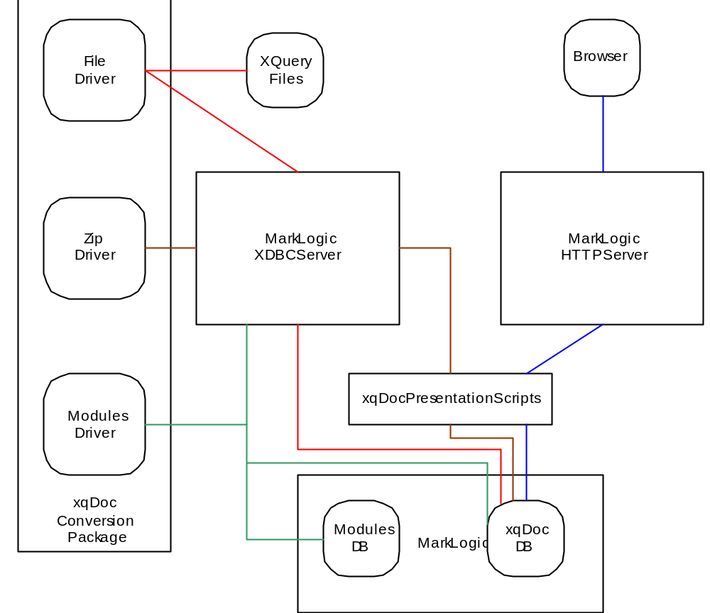
MarkLogic Integration

Slide 33
Supported XML Databases
MarkLogic
  File Driver
  Module Driver
  Zip Driver
  Translation scripts for cts and xdmp modules
eXist
  File Driver
  Module Driver

Slide 34
Assumptions
Modules are valid XQuery
Access to a XML database
JRE 1.4+ and ANTLR 2.7.5+
No default function namespace (by default)
May 2003, Nov 2003, and Oct 2004 W3C drafts

Slide 35
Limitations
Library module URIs must be unique
Main module URIs must be unique
Do not use xqDoc-main for a function name
Invisibility of XQuery comments
Validate expression not recognized (May 2003)

Slide 36
Enhanced Demos
xqDoc comments added
Translated 3rd party modules
  W3C XPath F&O
  Enhanced Demo
Other Translated 3rd party module scripts
  MarkLogic xdmp
  MarkLogic cts

Slide 37
xqDoc is being used ☺
(:~
: Mark Logic CIS Cookie Library
:
: Copyright 2005 Parthenon Computing Ltd.
:
: Licensed under the Apache License, Version 2.0 (the "License");
: you may not use this file except in compliance with the License.
: You may obtain a copy of the License at
:
: http://www.apache.org/licenses/LICENSE-2.0
:
: Unless required by applicable law or agreed to in writing, software
: distributed under the License is distributed on an "AS IS" BASIS,
: WITHOUT WARRANTIES OR CONDITIONS OF ANY KIND, either express or implied.
: See the License for the specific language governing permissions and
: limitations under the License.
:
: @author John Snelson (john@parthcomp.com)
: @version 1.0
:
: @see http://wp.netscape.com/newsref/std/cookie_spec.html
:
:)
module "http://parthcomp.com/cookies"
declare namespace ck="http://parthcomp.com/cookies"

Slide 38
xqDoc will be used ☺
This quick start guide provides instructions for using xqDoc with the eXist Open Source XML database http://exist-db.org. Future versions of eXist will use xqDoc to document eXist's own library modules, so xqDoc will probably be included in the main distribution of eXist. In the meantime, the following describes how to set up eXist for xqDoc.
[Wolfgang Meier]

Slide 39
xqDoc should be used
☺
At least, that is my unbiased opinion.

Slide 40
Possible Future Enhancements
XML Datatype cross-reference linking
Browseable list of functions
Search
ANT scripts to automate some tasks
xqDoc conversion web service
MarkLogic Trigger integration

Slide 41
Future Direction (Desires)
Endorsement from more XML database vendors
  Oracle
  IBM
  Microsoft
IDE integration
  StylusStudio
  jEdit
Open Source Library Module(s)
  xqZone
  xquery.com

Slide 42
But, we need feedback …
What do you like?
What do you dislike?
What features are missing?
Would you like to contribute to this effort?

Slide 43
More Info
Web Site
  www.xqdoc.org
Email
darin@xqdoc.org
Talk to me this week

Slide 44
Thanks
Curt Kohler – ANLTR scripts
Jeff Lash – xqDoc User Interface
Elsevier XQuery Developers
Wolfgang Meier – creator of eXist
MarkLogic (Jason, Ian, Denise, Mary, Ron)
Elsevier
Anyone else I inadvertently forgot to mention

Slide 45
Questions or Thoughts?

Slide 46
Thank
You

