Slide 1
Data Structures
Lecture 4
Red-Black Trees
Yossi Azar and Hanoch Levy
March 2015

Slide 2
Red-Black trees [Bayer 1972] [Guibas-Sedgewick 1978]
External leaves

Slide 3
Red-Black trees
Binary search tree with external leaves
Each node is colored red or black
Each root to leaf path contains the same number of black nodes
The parent of a red node must be black
The root and external leaves are black
External leaves
Implication:
If we show that it is “balanced” and maintain the balance we get logarithmic binary search tree

Slide 4
Red-Black trees
Paths from each node to the leaves have the same black length

Slide 5
Red-Black trees
What is the maximal height of a Red-Black tree containing n nodes?

Slide 6
Height and Black height
2
4
1
1
2
3
0
0
1
1
1
2
0
0
0
0
1
1
0
0
Black height - Number of black nodes on paths from the node to the external leaves (excluding the node)
Height ≤ 2 × black height
Since REDS can only double…

Slide 7
Height of Red-Black trees
Lemma: The subtree of a node of black height k contains at least 2^{k}−1 nodes
Proof: next page
Corollary: The black height of a Red-Black tree containing n nodes is at most log₂(n+1)
Proof: set n =2^{k}−1 in lemma
Corollary: The height of a Red-Black tree containing n nodes is at most 2 log₂(n+1)
Proof: add reds

Slide 8


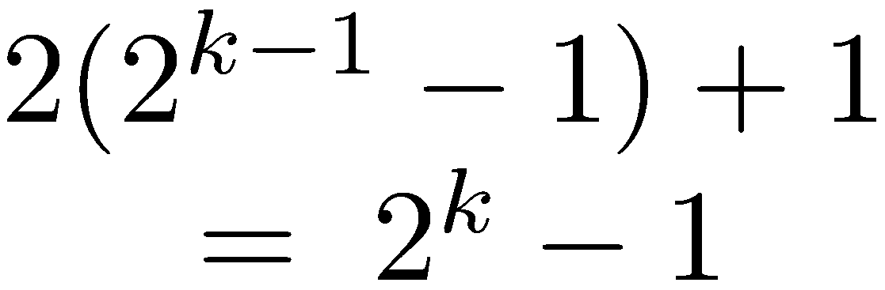
Height of Red-Black trees
Lemma: The subtree of a node of black height k contains at least 2^{k}−1 nodes
k
0
k (red) or k−1 (black)
k or k−1
1

Slide 9
Fold red nodes into their parents
Red-Black trees → 2-4 trees

Slide 10
Fold red nodes into their parents
Red-Black trees → 2-4 trees

Slide 11
Red-Black trees → 2-4 trees
Height of 2-4 tree = black height of Red-Black tree

Slide 12
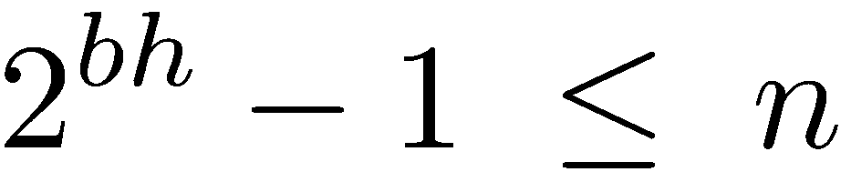
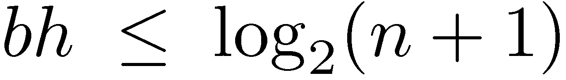
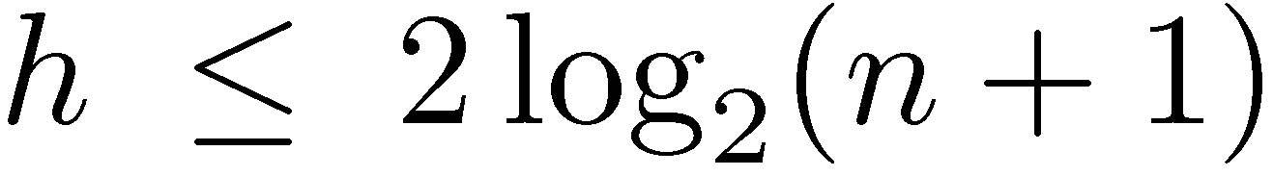
Red-Black trees have logarithmic height

Slide 13
Insert
Principles:
Insert as RED (always leaf)
Too much RED is extra weight – must be reduced
If imbalanced with brother – solve by re-balancing
Else – push problem upwards

Slide 14
Insert

Slide 15
Insert (cont.)

Slide 16
Insert (cont.)

Slide 17
Insert (cont.)

Slide 18
Rotations
y
x
Right rotate
x
C
y
A
A
B
C
B
Left rotate
Shifts height/weight Right ← → Left
How about center?
Do a double (center – right, and then right -- left

Slide 19
Use rotations
x
y
<===>
y
C
A
x
A
B
B
C
y
x
===>
y
z
x
z

Slide 20
Insert (cont.)
x
y
z
====>
y
z
x

Slide 21
Insert (cont.)

Slide 22
Insert (cont.)

Slide 23
Insert (cont.)

Slide 24
Insert (cont.)

Slide 25
Property WATCH
Binary order preservation (letters)
Black depth symmetry preservation
Insert: Case 1a
z’s uncle w is red, z is a right child
C
new z
C
w
A
D
A
D
z
z
α
δ
ε
α
δ
ε
B
B
β
γ
β
γ
Recolor z’s parent, uncle and grandparent
“Black height property” does not change
Red rule violation resolved or moved up the tree

Slide 26
Insert: Case 1b
z’s uncle w is red, z is a left child
new z
C
C
w
y
A
D
A
D
z
z
α
δ
ε
α
δ
ε
B
B
β
γ
β
γ
Symmetric

Slide 27
Insert: Case 2
z’s uncle w is black, z is a right child
C
C
A
δ
B
δ
z
α
z
γ
B
A
β
γ
α
β
Use a left rotation to convert to case 3
Black heights do not change
Note: the roots of α,β,γ,δ are black

Slide 28
Insert: Case 3
z’s uncle w is black, z is a left child
C
B
B
δ
A
C
z
γ
α
β
γ
δ
A
α
β
Use a right rotation to resolve
Note: the roots of α,β,γ,δ are black

Slide 29
All cases covered?
In all cases above, z’s parent is a left child
Case 1: z’s uncle is red
Case 2: z’s uncle is black and z is a right child
Case 3: z’s uncle is black and z is a left child
The other cases (z’s parent is a right child) are mirror images of the cases shown

Slide 30
Fixing a Red-Black Tree after insertion
Can only loop in Case 1
Case 1
Case 2
Case 3
finish

Slide 31
Insert - analysis
Find insertion point – O(log n) time
Insert – O(1) time
Fix the tree – O(log n) time
Fixing the tree:
At most 2 rotations
O(1) amortized time
Total time spent on fixing the tree while inserting n elements is O(n)

Slide 32
Amortized analysis of Fixing the tree
Inserted nodes are colored red
Case 1 is the only non-terminal case
In Case 1:
2 red + 1 black → 1 red + 2 black
Number of red nodes decreases by 1
In n insertions Case 1 can be executed at most n times!
Φ = #red nodes
Total fix-up time in n insertions = O(n)

Slide 33
Red-Black trees - Implementation
x
parent
info
key
left
right
color

Slide 34
Red-Black trees - Implementation
T
∞
x
parent
info
key
left
right
color
Add a dummy root (sentinel)
The dummy root is black and has key ∞
The real root is the left child of the dummy root

Slide 35
Red-Black trees - Implementation
T
Replace all external leaves by another sentinel, called NULL
∞
NULL is a black Tree-Node
Writing to NULL.parent is harmless
NULL

Slide 36
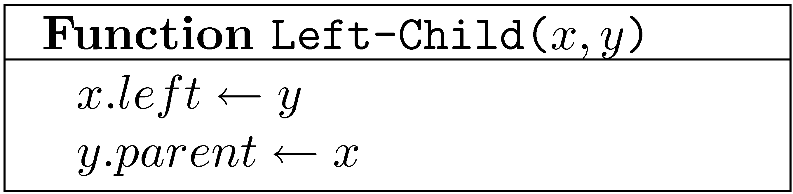
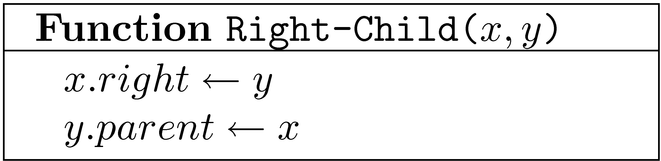
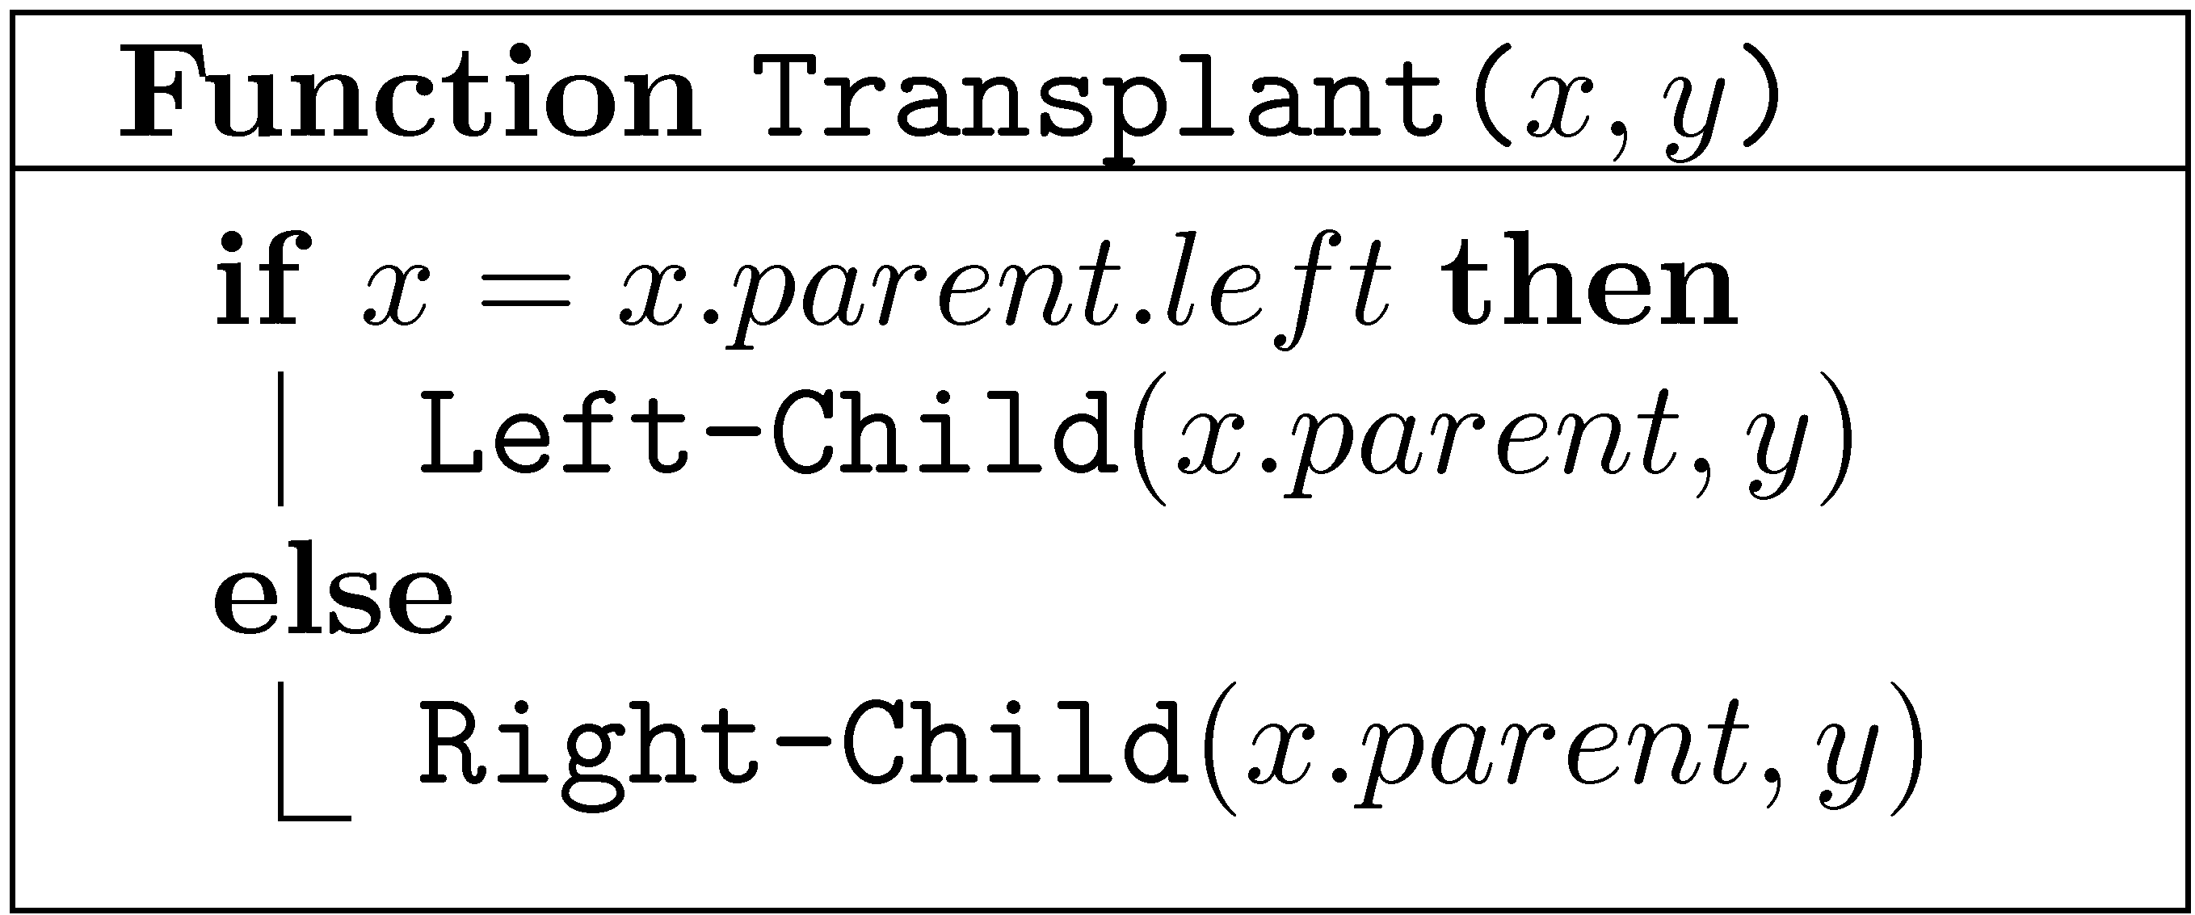
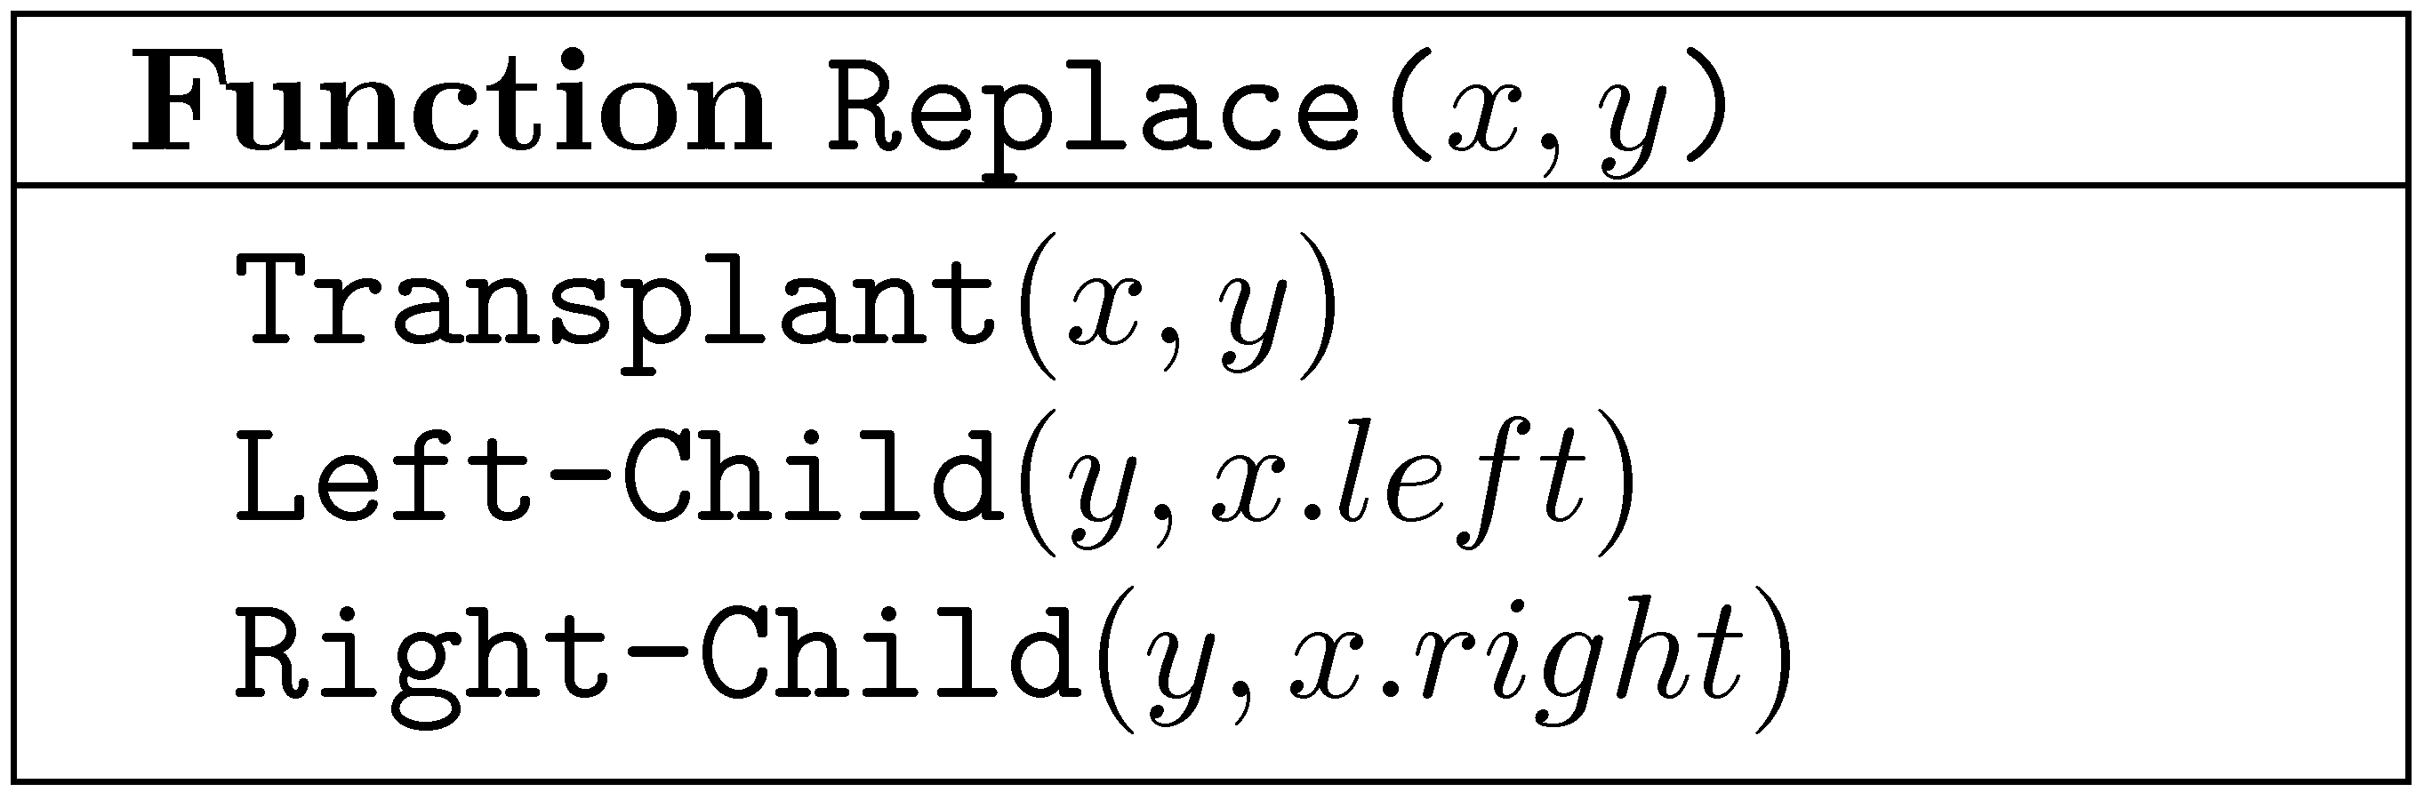
Basic operations
Transplant – Replace the subtree of x by the subtree of y
Replace – Replace x by y
x may be the (real) root

Slide 37
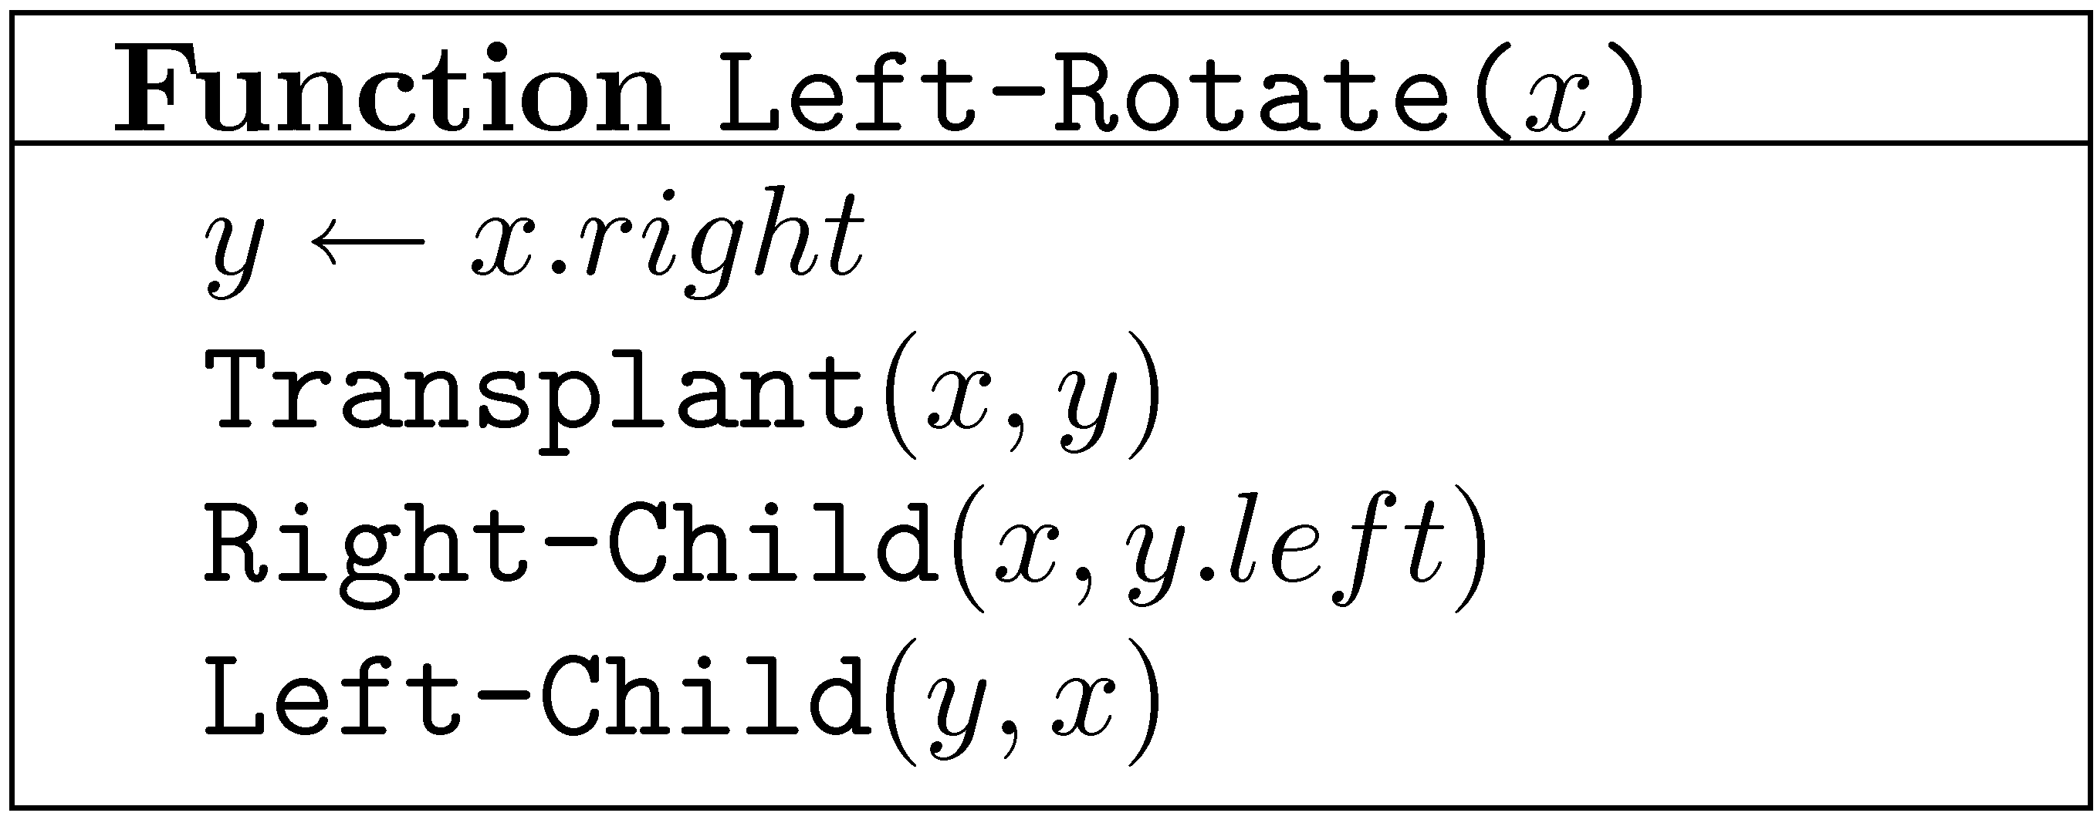
Left Rotation
x
y
α
γ
y
x
β
γ
α
β
All special cases handled automatically!
α,β,γ may be NULL. x may be the root.

Slide 38
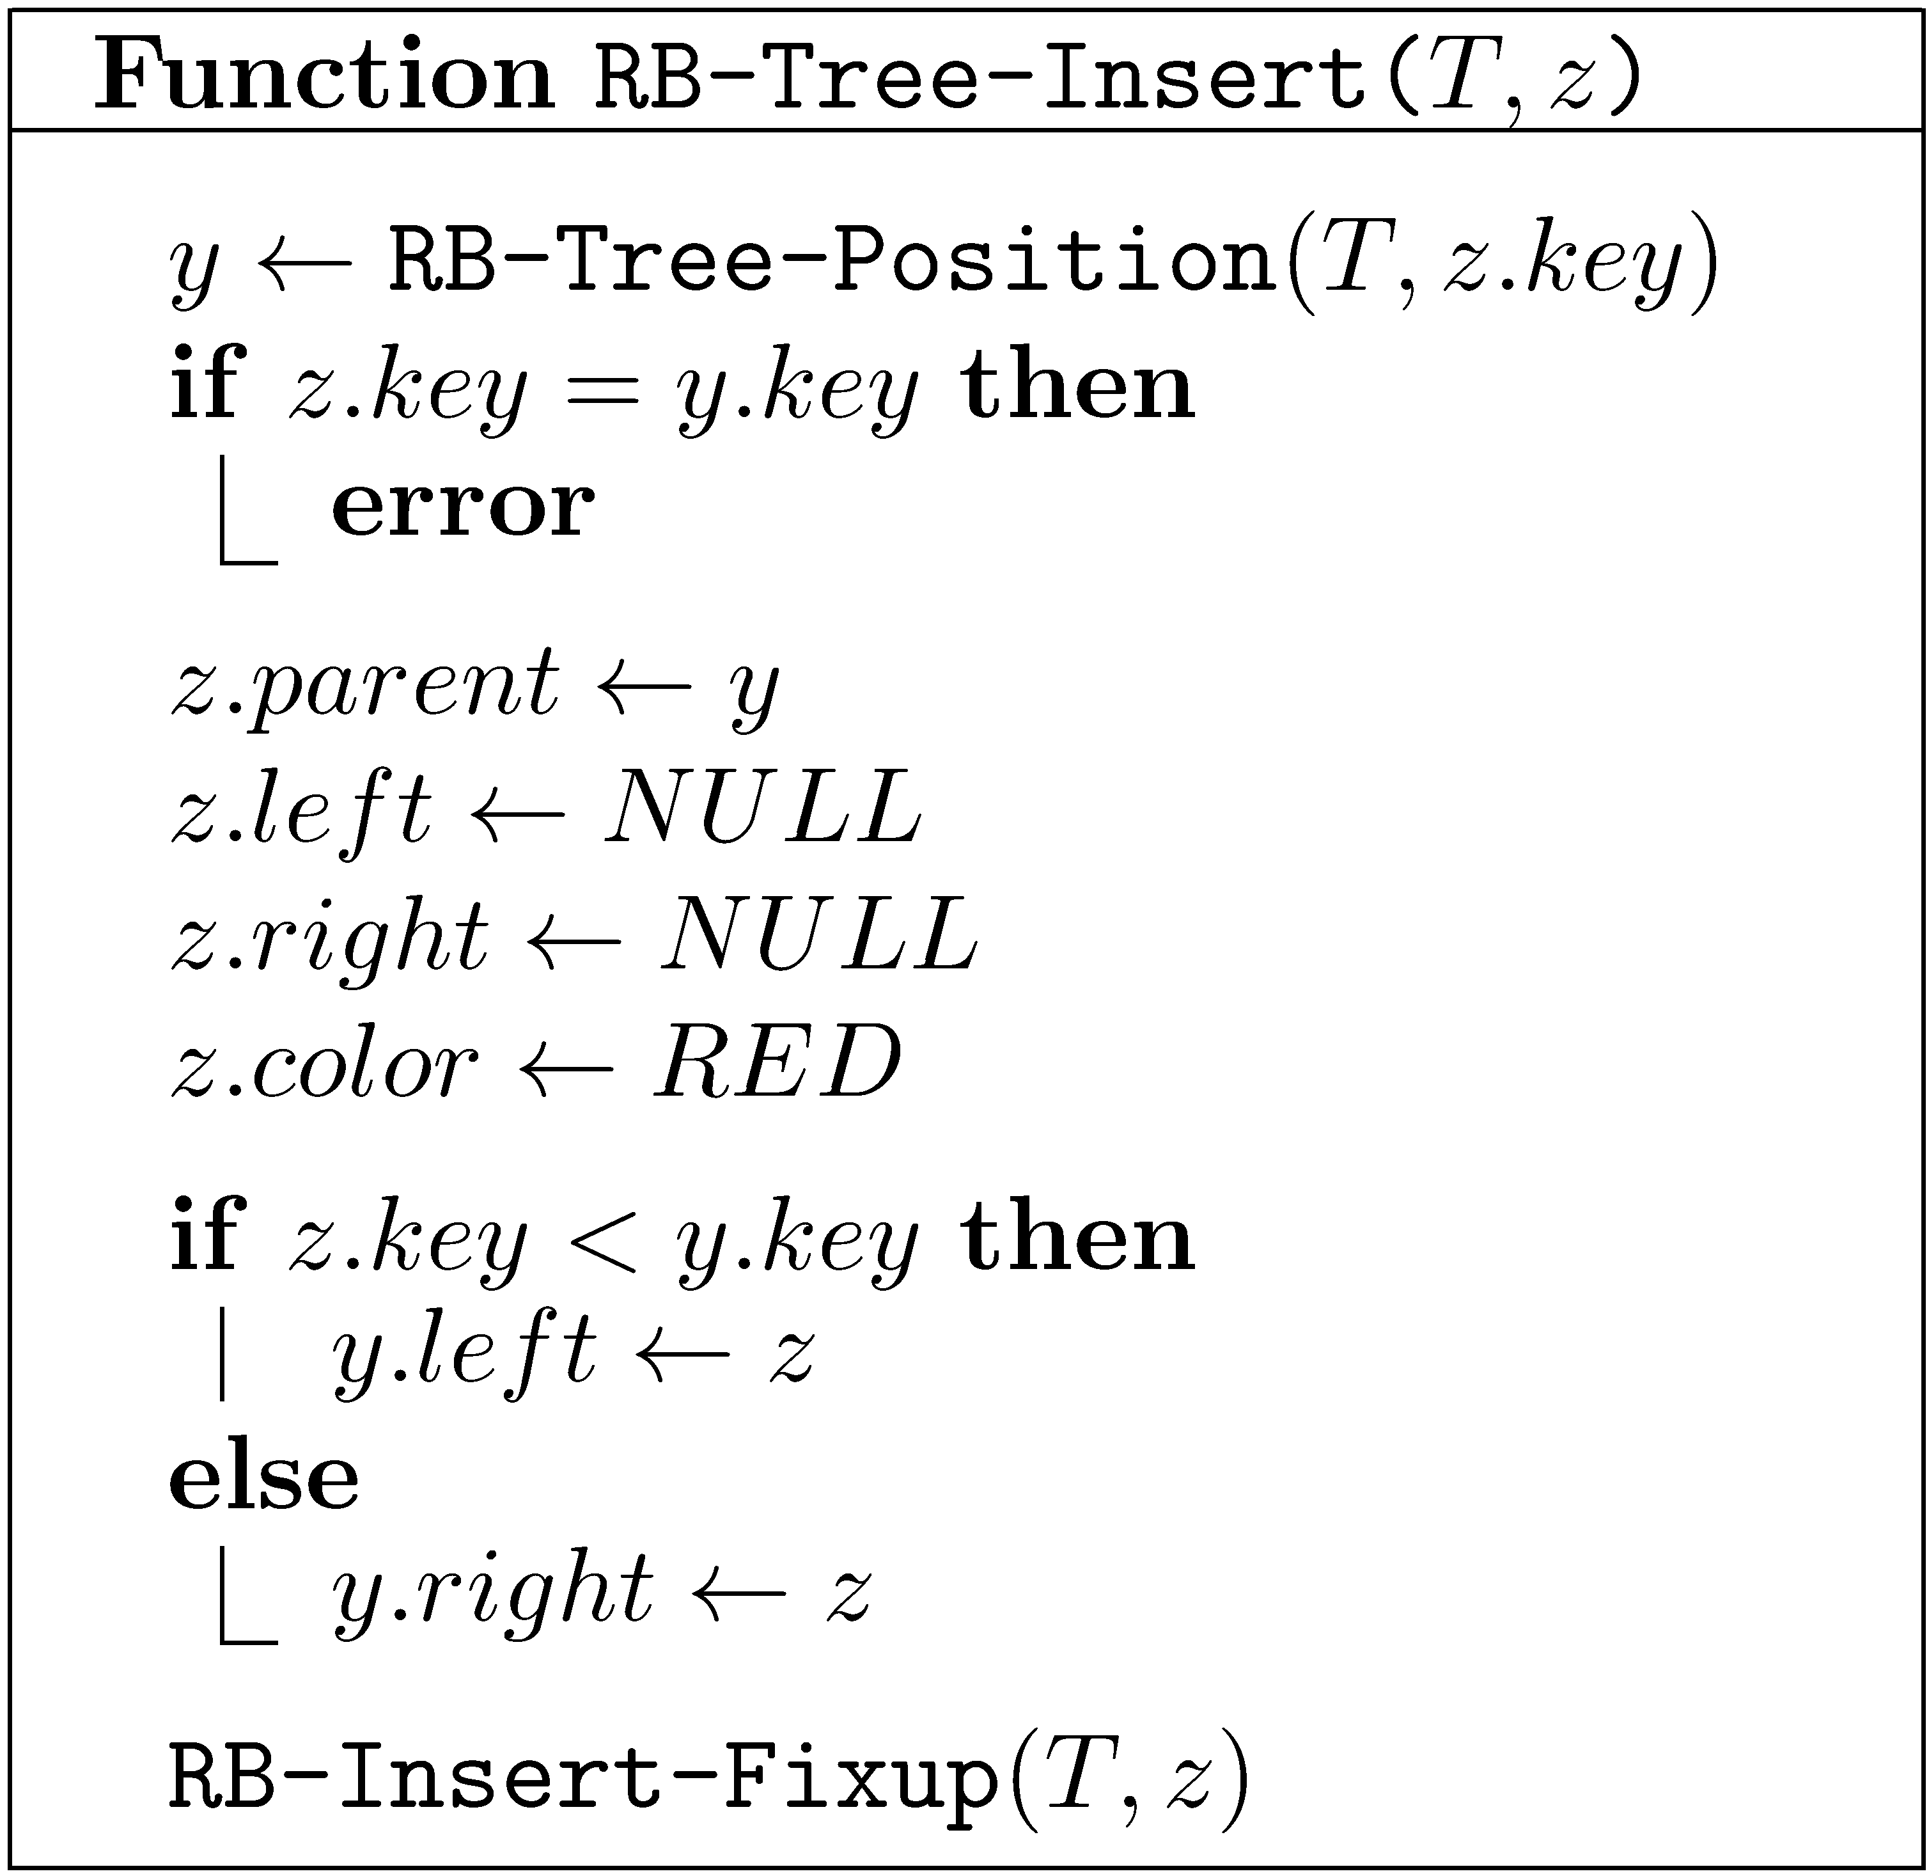

Slide 39
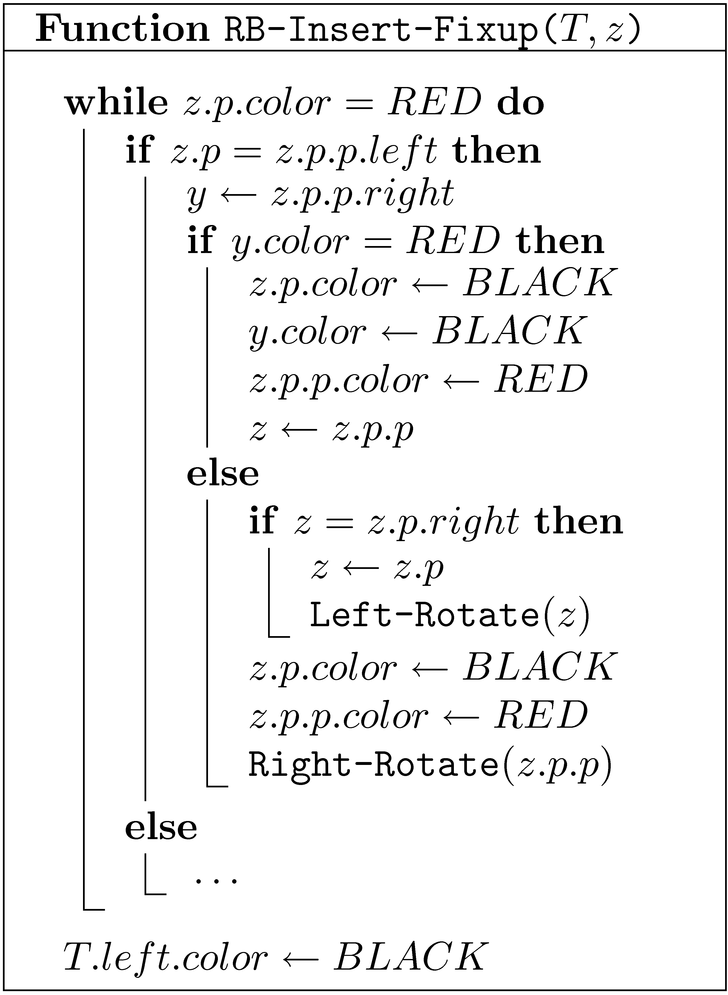
See also CLRS Chapter 13
Case 1
Case 2
Case 3
p ≡ parent

Slide 40
Deletions from Red-Black trees
Similar in nature to insertions
Slightly more complicated
If the node to be deleted has two children, we delete its successor from the tree and use it to replace the node to be deleted
➔ Deleted node has at most one child!!!
Let’s see some examples…

Slide 41
Delete
Note:
Blacks - the holly structure; must be balanced
Reds – you can get rid easily

Slide 42
Delete

Slide 43
Delete

Slide 44
Delete

Slide 45
Delete (cont.)

Slide 46
Delete (cont.)

Slide 47
Delete (cont.)

Slide 48
Delete (cont.)

Slide 49
Delete (cont.)

Slide 50
Delete (cont.)

Slide 51
Deleting a node from a Red-Black tree
Remove the node from the tree
If it was red or had a red child we are done
Otherwise we get a node that requires “extra blackness”
Apply a transformation that either moves the “extra blackness” up the tree, or gets rid of it
An “extra blackness” at the root may be removed

Slide 52
Delete:
Look at x’s sibling : red or black?
B
x
A
C
w
α
β
γ
δ
Who said x has a sibling?
Since it is “double black”

Slide 53
Delete: Case 1
x’s sibling w is red
B
C
x
A
C
w
B
δ
α
β
x
γ
δ
A
γ
α
β
“Extra-blackness” went down
This can only happen once ( black)
γ

Slide 54
Delete: Case 2
Things are balanced. Lets push problem upwards
x’s sibling w is black, and both children of w are black
B
new x
B
x
A
D
w
A
D
w
α
β
α
β
C
E
C
E
γ
δ
ε
ζ
γ
δ
ε
ζ
If B is red, it is made black and we are done

Slide 55
Property WATCH
Binary order preservation (letters)
Black depth symmetry preservation
Delete: Case 2
Properties to watch
B
new x
B
x
A
D
w
A
D
w
α
β
α
β
C
E
C
E
γ
δ
ε
ζ
γ
δ
ε
ζ
Binary order preservation: just follow the letters
Black depth symmetry preservation: for each node all black paths downwards are the same

Slide 56
Delete: Case 3
Property WATCH
Binary order preservation (letters)
Black depth symmetry preservation
x’s sibling w is black, w’s left child is red, and w’s right child is black
B
B
x
A
D
w
x
A
C
new w
α
β
α
C
E
β
γ
D
γ
δ
ε
ζ
δ
E
:
ε
ζ

Slide 57
Property WATCH
Binary order preservation (letters)
Black depth symmetry preservation
Delete: Case 4
x’s sibling w is black, and w’s right child is red ➔
Left rotate and paint
B
D
x
A
D
w
E
B
α
β
ε
ζ
C
E
C
A
ζ
α
β
γ
δ
γ
δ
ε
“Extra-blackness” disappeared!

Slide 58
Deletions from Red-Black Tree
Case 1
All cases above
Case 3
Case 2r
Can only loop in Case 2b
Case 4
Finish
B
new x
B
A
D
A
D
C
E
C
E
Case 2b

Slide 59
Delete - analysis
Find the successor (if needed) – O(log n) time
Delete – O(1) time
Fix the tree – O(log n) time
Fixing the tree:
At most 3 rotations
O(1) amortized time
Total time spend on fixing the tree while performing a sequence of n insert and delete operations is O(n)

Slide 60
Delete + Insert – Non-terminal cases
Insert: Case 1a
(Possibly )
Delete: Case 2
Φ =
#(
)
+
2 #(
)

Slide 61
Joining two Red-Black trees
x
T₁
T₂
Join(T₁,x,T₂)
Suppose that all keys in T₁ are less than x.key and that all keys in T₂ are greater than x.key
Simply joining them would create a very unbalanced tree
Black rule may be violated

Slide 62
Joining two Red-Black trees
T₂
Assume bh(T₁) ≤ bh(T₂)
T₁
y
Join(T₁,x,T₂)
x
z
Find a black node z on the left spine of T₂ with the same black height as the black height of the root of T₁
Color x red
Fix red rule as in insert
O(log n) time
O(bh(T₂)−bh(T₁)+1) time, if bh’s maintained explicitly

Slide 63
Splitting
a
a
b
E
b
E
x
c
F
d
F
A
d
H
G
c
e
G
e
A
B
f
B
f
C
x
C
D
D
H

Slide 64

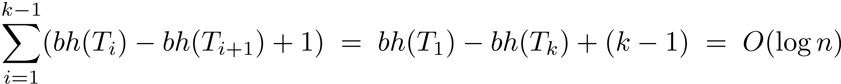
Balanced and Efficient Splitting
y
x
O(log n) time!
Suppose we join T₁ ,T₂ ,…,T_{k} where bh(T₁) ≥ bh(T₂) ≥ … ≥ bh(T_{k})
Time is ≈ (exact argument is a little more complicated)

Slide 65
Additional dictionary operations
Select(D,i) – Return the i-th largest item in D (indices start from 0)
Rank(D,x) – Return the rank of x in D, (i.e., the number of items x is larger than)
Can we still use Red-Black trees?
Keep sub-tree sizes!

Slide 66
10
3
6
1
1
3
2
1
1
1
x.size = x.left.size + x.right.size + 1

Slide 67
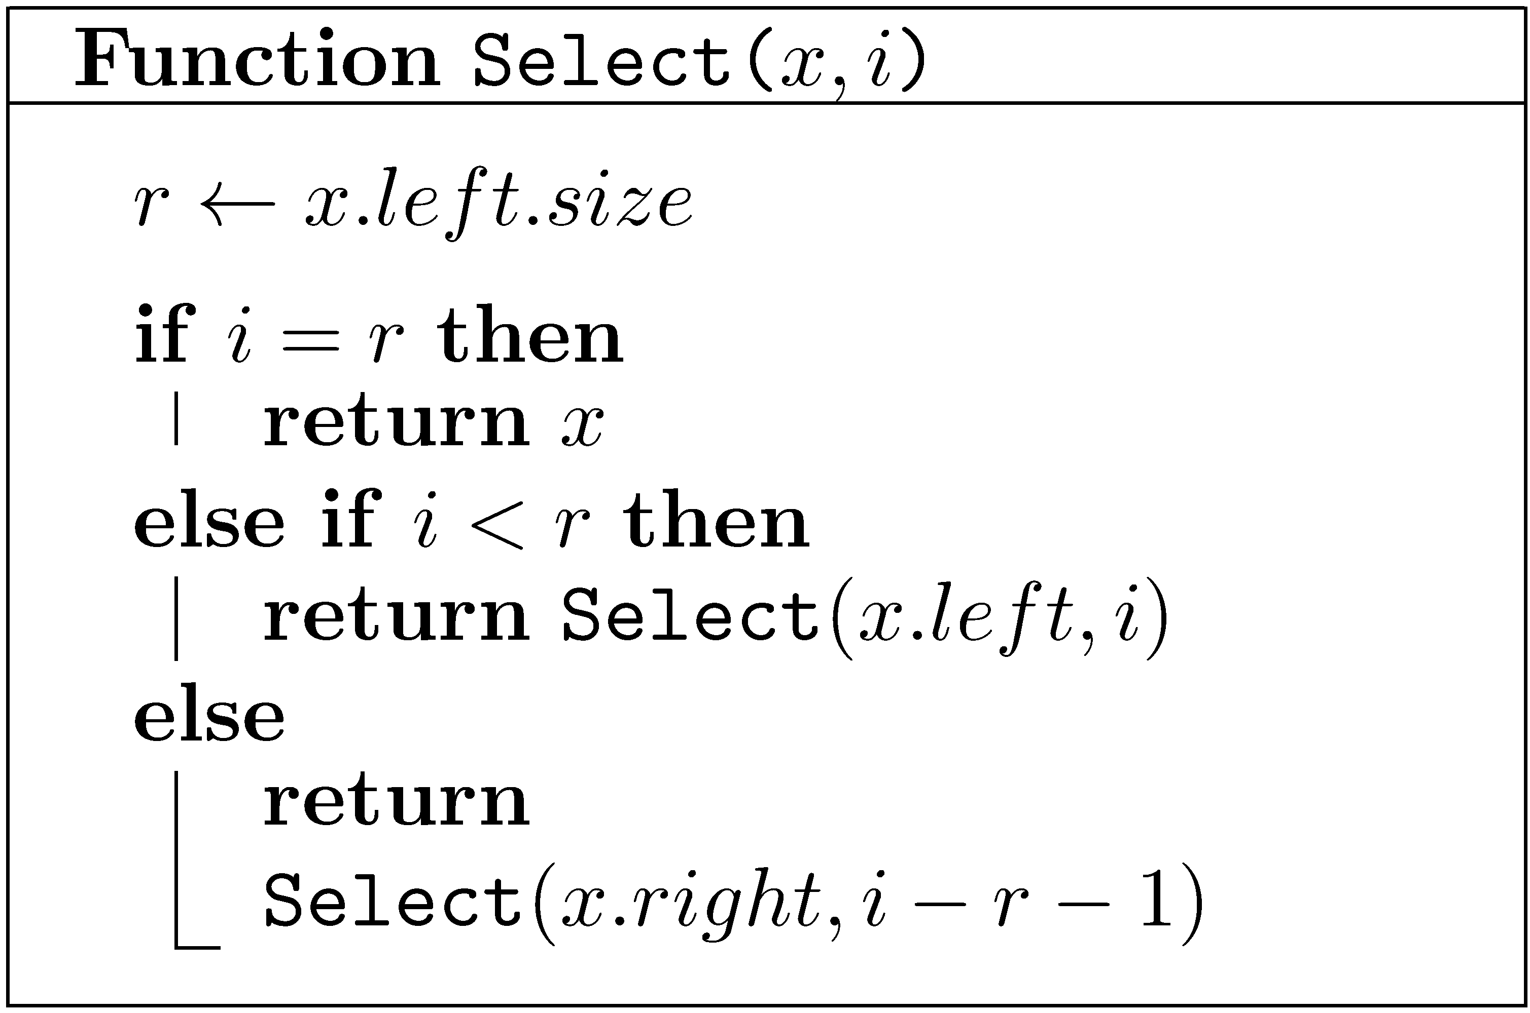
Selection
10
3
6
1
1
3
2
1
1
1
Note: 0 ≤ i < n

Slide 68
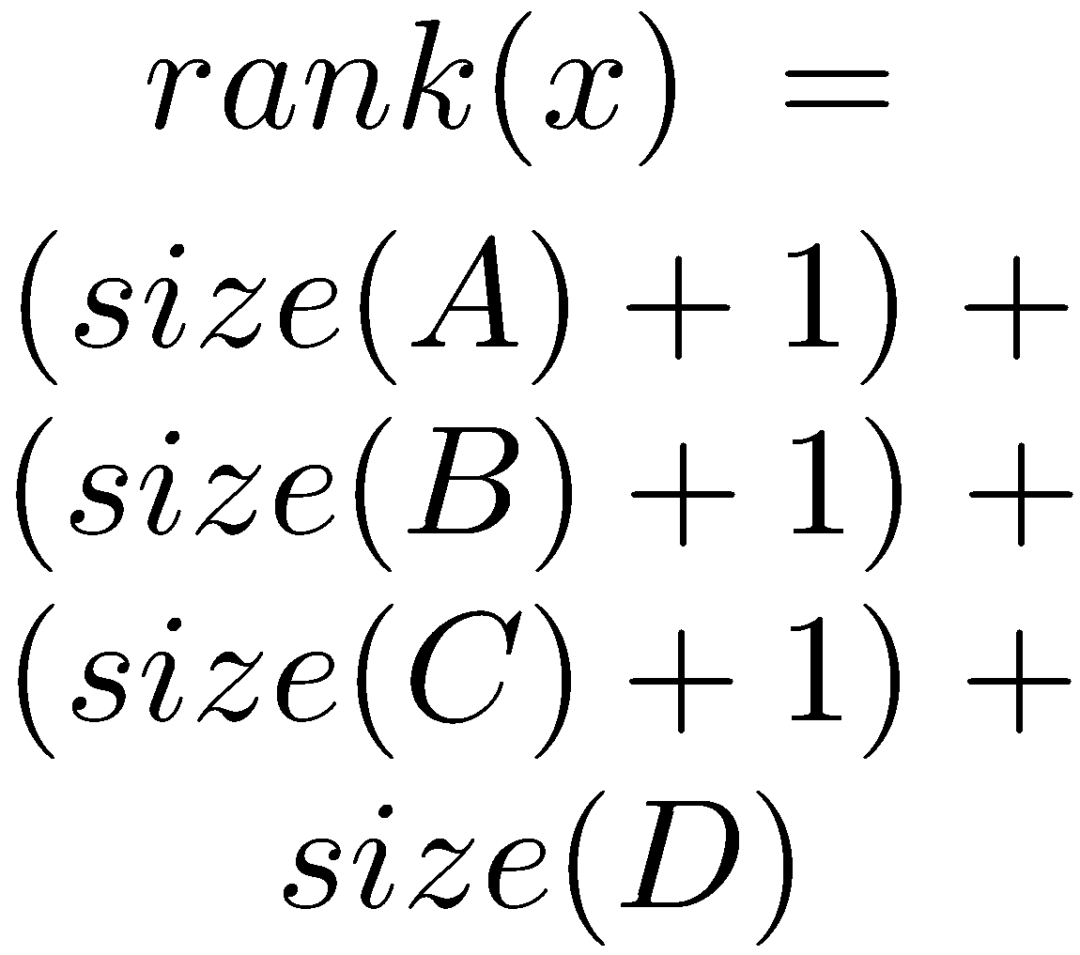
Rank
a
b
E
c
F
A
d
e
G
B
f
C
x
D
H

Slide 69
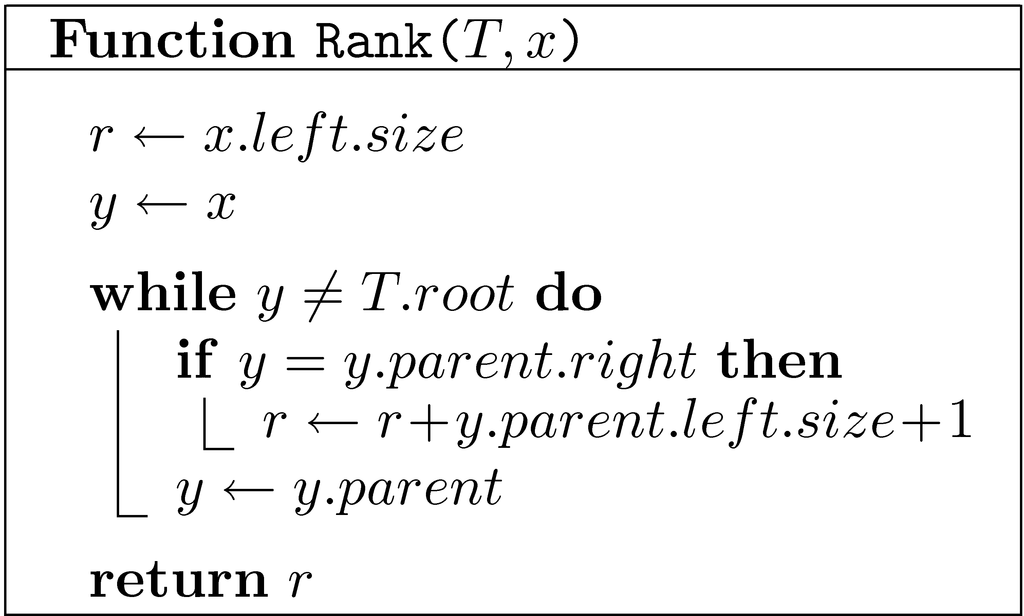
Rank
a
b
E
c
F
A
d
e
G
B
f
C
x
D
H
Assume NULL.size=0

Slide 70
Easy to maintain sizes
y
x
Right rotate
x
c
a
y
C
A
a
b
b
c
A
B
C
B
y.size = b.size + c.size + 1
x.size = a.size + y.size + 1

Slide 71
Finger Search trees
Maintain a pointer to the minimum element
Select(T,k) in O(log k) time
T

Slide 72
Lists as Trees
[ a b c d e ]
3
d
0
a
1
b
4
e
1
b
0
a
c
5
f
4
e
2
3
d
5
f
2
c

Slide 73
Lists as Trees
Maintain the items in a tree: i-th item in node of rank i
List-Node → Tree-Node
Tree-Nodes have no explicit key (Implicitly maintained ranks play the role of keys)
Retrieve(L,i) → Select(L,i)
Select, Insert-Fixup and Delete-Fixup do not use keys

Slide 74
Lists as Trees: Insert
To insert a node z in the i-th position, where i<n:
Find the current node of rank i.
If it has no left child, make z its left child.
Otherwise, find its predecessor
and make z its right child.
To insert a node z in the last position (i=n):
Find the last node and
make z its right child
Fix the tree (Insert-Fixup)

Slide 75
Lists as Trees: Delete
Delete a node z in the same way a node is removed from a search tree

Slide 76
Implementation of lists
 | Circular arrays | Doubly Linked lists | Red-Black Trees
Insert/Delete-First Insert/Delete-Last | O(1) | O(1) | O(log n)
Insert/Delete(i) | O(i+1) | O(i+1) | O(log n)
Retrieve(i) | O(1) | O(i+1) | O(log n)
Concat | O(n+1) | O(1) | O(log n)

Slide 77
AVL TREE
Similar to RB-tree (but different)
Counts the height of each sub-tree explicitly
PROPERTY: For sub-tree T:
| Height (Right(T)) – Height (Left(T)) | <= 1
H-2
H-1

Slide 78
n(h): the minimum number of internal nodes of an AVL tree of height h
n=1, 2 easy.
For n>2 an AVL at height h contains:
root
1 sub-tree of height h-1
1 sub-tree of height h-2
➔ n(h) = 1 + n(h-1) + n(h-2)
➔ n(h) > 2n(h-2)

Slide 79
AVL – principle of operation
Principles:
Insert + delete as in binary search tree.
After operation: the balance principle may be violated.
From bottom to top:
Update height
Examine balance
If balance is violated – violation by at most 1
➔ correct by rotation.
4 cases of rotation: LL RR LR RL (two of them symmetric to each other)

Slide 80
AVL trees G.M. Adelson-Velskii and E.M. Landis (1962)
k
The depth of two siblings differs by at most 1
k−1
k−2
Need only one extra bit per node

Slide 81
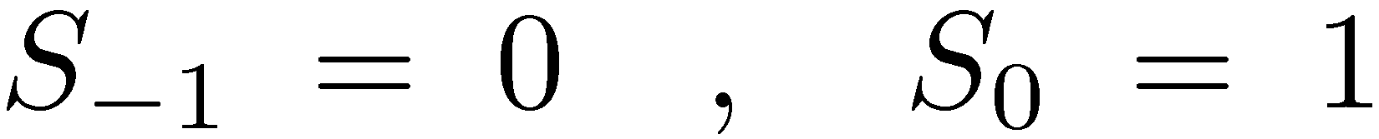
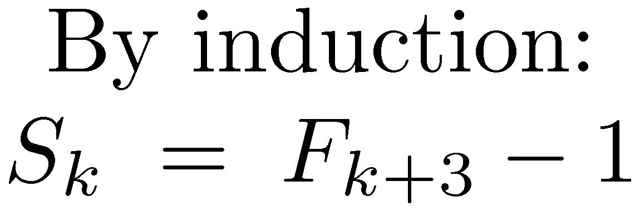
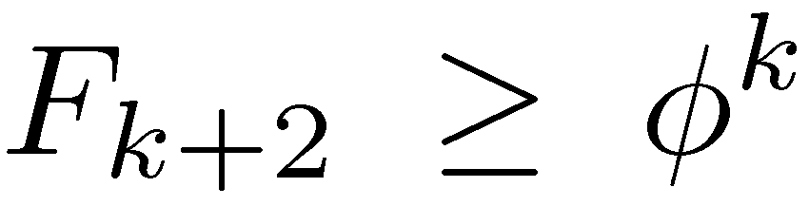
AVL trees G.M. Adelson-Velskii and E.M. Landis (1962)
k
S_{k} – minimal number of nodes in an AVL tree of depth k
k−1
k−2
Balance maintained through rotations

