Slide 1
Workshop in Information Security Building a Firewall within the Linux Kernel
Ilor Ifrach

Slide 2
Main Subjects
My firewall- Big overview
Cgit directory traversal attack
DLP
Conclusion
Challenges
Sources

Slide 3
My Firewall

Slide 4
Introduction
In the workshop we will study the basic design of firewalls, and recreate the basic firewall functionality using just elementary building blocks of the GNU/Linux operating system. We will extend the Linux kernel with packet analysis capabilities, interface it with userspace programs, and experiment with using this firewall for blocking real-world attacks.

Slide 5
The Structure
The firewall uses two tables:
The static rule table – the user loaded rules table to the firewall and the firewall blocks packets that don’t fit the rules.
The dynamic connection table – The kernel checks that any packet execute the hand-shake in suitable time.
The kernel transfers some packets (TCP packets only) to the proxy for advanced tests. For example: Magic number, Content length, Cgit attack & DLP.
The proxy wrote in python in Linux environment. The main idea of the design of the proxy is to …. .It opens new thread for any new packet ……….. Bla bla bla from ex4.

Slide 6
Cgit Directory Traversal Attack

Slide 7
Directory Traversal attack
A web server is a closed environment.
There is usually a big server behind the scenes and you’re not supposed to have access to any of that.
A directory traversal attack aims to access files and directories that are stored outside the web root folder or home directory.
A directory traversal attack is a very simple attack but it can be fatal if ignored.

Slide 8
What is a Directory Traversal attack?
Also known as Path Traversal Attack.
Properly controlling access to web content is crucial for running a secure web server.
Directory Traversal is an HTTP attack which allows attackers to access restricted directories and execute commands outside of the web server’s root directory.
Web servers provide two main levels of security mechanisms:
Access Control Lists (ACLs)
Root directory

Slide 9
Access Control Lists (ACLs)
An Access Control List is used in the authorization process.
It is a list which the web server’s administrator uses to indicate which users or groups are able to access, modify or execute particular files on the server, as well as other access rights.
The root directory is a specific directory on the server file system in which the users are confined.
Users are not able to access anything above this root.
In order to perform a directory traversal attack, all an attacker needs is a web browser and some knowledge on where to blindly find any default files and directories on the system.

Slide 10
What an attacker can do if your website is vulnerable
An attacker can make use of this vulnerability to step out of the root directory and access other parts of the file system.
This might give the attacker the ability to view restricted files, which could provide the attacker with more information required to further compromise the system.
Depending on how the website access is set up, the attacker will execute commands by impersonating himself as the user which is associated with “the website”. Therefore it all depends on what the website user has been given access to in the system.

Slide 11
Cgit directory traversal
Cgit directory traversal is an example of a directory traversal attack.
This module exploits a directory traversal vulnerability which exists in cgit < 1.2.1 cgit_clone_objects(), reachable when the configuration flag enable-http-clone is set to 1 (default), as demonstrated by a cgit/cgit.cgi/git/objects/?path=../ request.

Slide 12
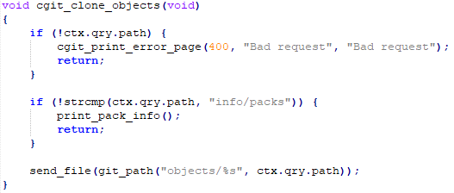
Explaining the Exploit
Looking deeper into the code we see the vulnerability is in the function cgit_clone_objects(void).
send_file() is a function that simply sends the data stored at the given filesystem path out over the network.
git_path() partially rewrites the provided path and prepends the base path of the repository.
Therefore we can see there is no security check to the path that can block directory traversal attacks.
A malicious attacker can add to the path multiple ../../../ And access sensitive files that we didn’t intend to expose to the user in any way.

Slide 13
Attack Example
$ curl http://127.0.0.1/cgit/repo/objects/?path=../../../../../../../../../etc/passwd root:x:0:0:root:/root:/bin/sh
We can see the attcker issues a curl request to the cgit server and by using a path that includes ../../ he gains acces to the sensetive password file.

Slide 14
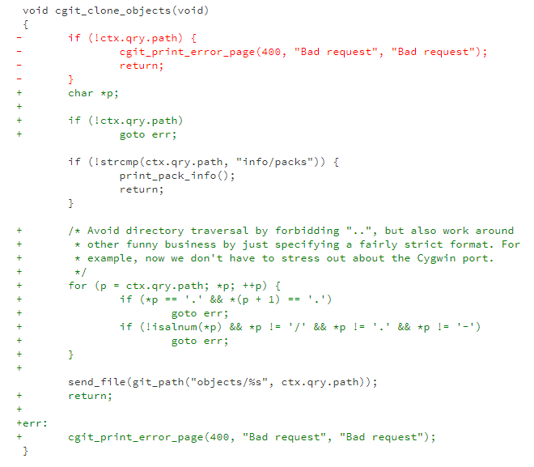
Official solution (Server code)
Looking at the official cgit release (V 1.2.1) the programmers of the code fixed the exploit by forbidding .. In the path provided to the function and by the way added some more protection to be on the safe side.
So now before we send a file we check no one is trying to access files outside the official repository on the server.

Slide 15
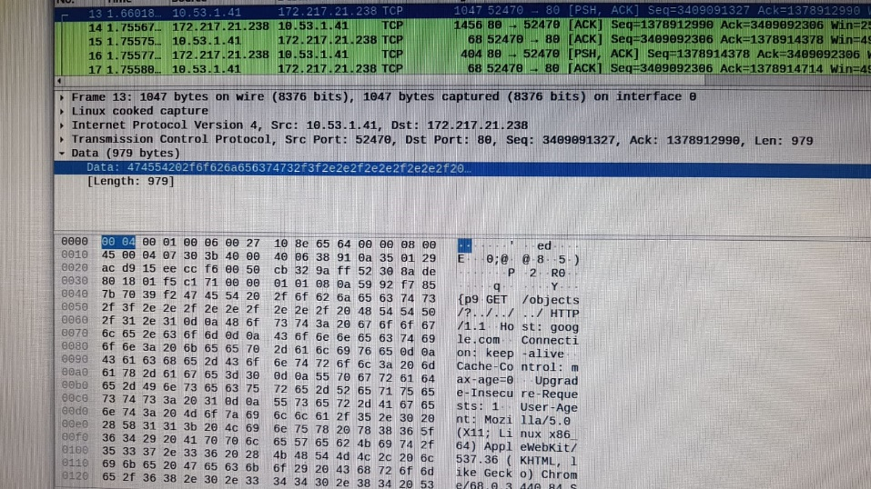
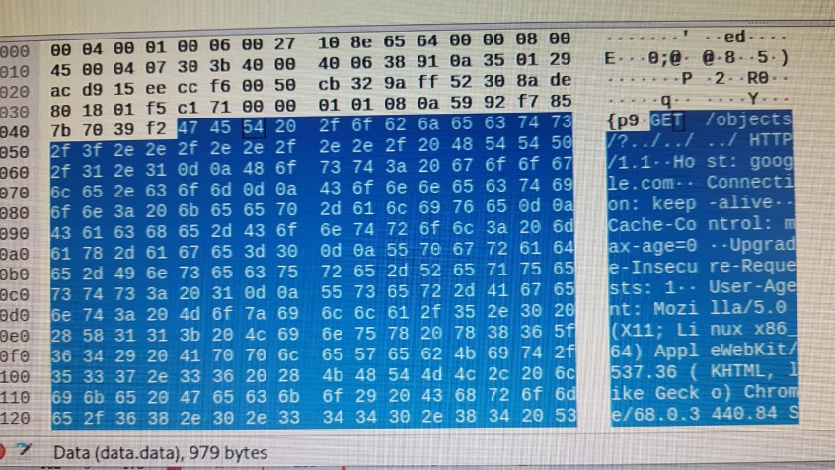
HTTP Packet
These pictures represent GET HTTP request that included coding of path to file in the server.
We can see the structure of GET HTTP request in Wireshark. It will help the proxy in the project to parse the packet and check if it contains malicious path.

Slide 16
My solution
If the version of cgit is smaller than 1.2.1 (the fixed version) we want to prevent the directory traversal attack on the cgit server.
My solution is based on the cgit fixed version (V 1.2.1), is an open source. I implemented the solution in my proxy.
The proxy get HTTP packet, parse the body packet (GET <path of cgit> <user path>) and check the user path isn’t included ..
Note that the attack occuers even if the attacker uses .. In asci format (%2E). Therefore, The proxy converts the packed to regular format (In particular %2E Converted to .) and then check the path.

Slide 17
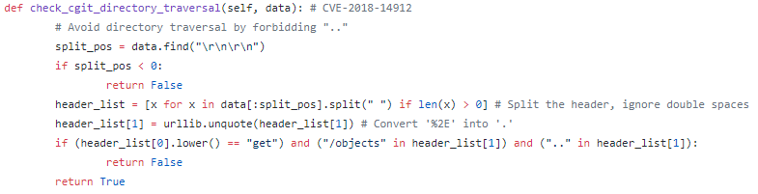
Explanation of my proxy code
If the server port is 80 (HTTP) we should do two defense tests:
Check the content length and the magic numbers (ex4)
Check the cgit directory attack.
The following code represents the test of cgit directory attack in the proxy. The proxy parses the body packet and checks if it is GET request. Then the proxy checks that the path doesn't contain .. (To prevent access to sensitive files of the cgit server). If the proxy discovers attempt to directory traversal attack the packet will be blocked.

Slide 18
DLP

Slide 19
Data loss prevention (DLP) software
Data loss prevention (DLP) is a strategy for making sure that end users do not send sensitive or critical information outside the corporate network. The term is also used to describe software products that help a network administrator control what data end users can transfer.

Slide 20
C vs Txt
I explored the differences between C code and native txt.
My focus is on the text/plain mime-type because it is the common between the two.
 | C code File | Txt Native File
Extension | .c | .txt
Mime-type (Content-type in HTTP packet) | text/plain text/x-c | text/plain text/html text/xml text/csv text/css text/cmd …
Sources | media-types/media-types.xhtml content-type

Slide 21
Protocols
We required to implement the distinguish between C code the txt file over 2 protocols: HTTP, SMTP.
I implemented the DLP differently over the two and in dependence of the limitations.
We will understand the differences between the two and it will explain the implementation.

Slide 22
HTTP Request
HTTP means HyperText Transfer Protocol. HTTP is the underlying protocol used by the World Wide Web and this protocol defines how messages are formatted and transmitted, and what actions Web servers and browsers should take in response to various commands.
For example, when you enter a URL in your browser, this actually sends an HTTP command to the Web server directing it to fetch and transmit the requested Web page. The other main standard that controls how the World Wide Web works is HTML, which covers how Web pages are formatted and displayed.

Slide 23
Request methods
GET: The GET method requests a representation of the specified resource.
HEAD: The HEAD method asks for a response identical to that of a GET request, but without the response body.
POST: The POST method requests that the server accept the entity enclosed in the request as a new subordinate of the web resource identified by the URI.
PUT: The PUT method requests that the enclosed entity be stored under the supplied URI.
DELETE: The DELETE method deletes the specified resource.
TRACE: The TRACE method echoes the received request so that a client can see what (if any) changes or additions have been made by intermediate servers.
OPTIONS: The OPTIONS method returns the HTTP methods that the server supports for the specified URL.
CONNECT: The CONNECT method converts the request connection to a transparent TCP/IP tunnel.
PATCH: The PATCH method applies partial modifications to a resource
Example to GET HTTP request you can see in the cgit directory attack slides.

Slide 24
SMTP Request
Simple Mail Transfer Protocol (SMTP) is an Internet standard for email transmission. Mail servers and other mail transfer agents use SMTP to send and receive mail messages on TCP port 25.

Slide 25
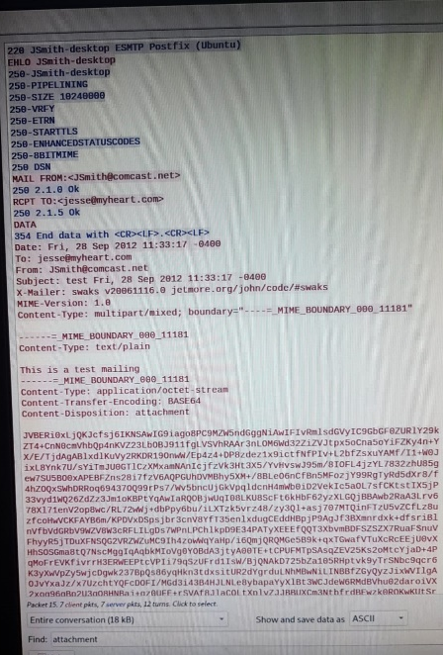
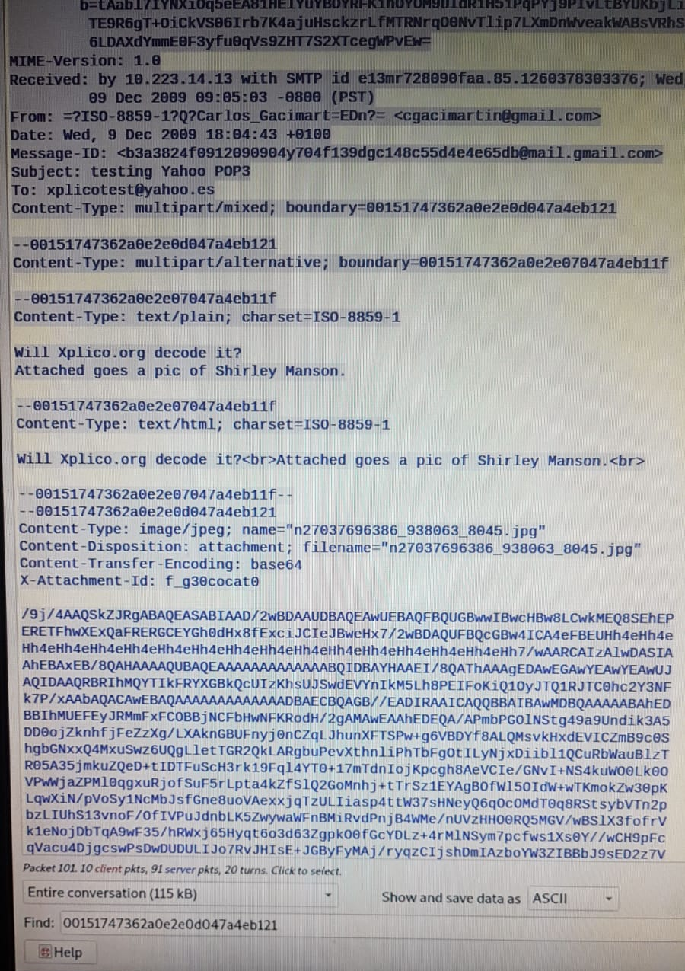
Examples SMTP Packets
You can see examples of SMTP packets.

Slide 26
Implementation for HTTP protocol - Main Idea
First of all, If the extension of the file is .c, we will block the packet. It is a code c file or wrong extension then I suspect to potential attack (regular user will not be mistaken with the extension file).
After this test there is a positive chance to false-positive cases, when we will blocked native text. It occurs due to the limitation of my proxy to distinguish between all the vast space of possibilities of txt files (It is not private case).
To overcome this limitation I decided to enable the user the defense level he wants. I define configurability flag of “Advanced tests of DLP”.
If the advanced tests set to 1, the following tests run:
mimeType check: We will check the mimeType of the file is text\palin - the mimeType of c file. (If the mimtype is for example txt\csv we can assume it is not C file).
Body content check: the test checks if the body content contains saved words that charactize C code: “malloc”, “include”, “alloc”, etc…

Slide 27
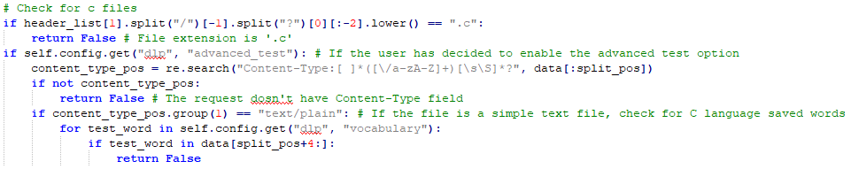
Explanation of the HTTP TEST Code
Check of the extension.
If the user set the advanced test to “1” we check the mimeType and if the file contains saved words.

Slide 28
Implementation for SMTP protocol - Main Idea
In this protocol I checked the extension only, in the same way like in the HTTP protocol.
The motivation is that SMTP coded the attachments in the mail. The decoded of the attachment is not needed and anyway the other tests are advanced and strict. Most of the users don’t run the advanced tests because of the positive chance to false positive cases. Moreover, changing of the extension of C code file is advanced attack and I assume it doesn't occur allot.

Slide 29
Slide Title
Product A
Product B
Feature 1
Feature 2
Feature 3
Feature 1
Feature 2
Feature 3

Slide 30
Conclusion

Slide 31
Challenges
Kernel, debug, singular work,

Slide 32
Sources
wikipedia-Media_type
wikipedia-Data_loss_prevention_software
rapid7-cgit_traversal
exploit-db-exploits/45148
exploit-db-exploits/45195
vulners-metasploit/CGIT_TRAVERSAL
wikipedia-Directory_traversal_attack
acunetix-directory-traversal
course site

