Slide 1
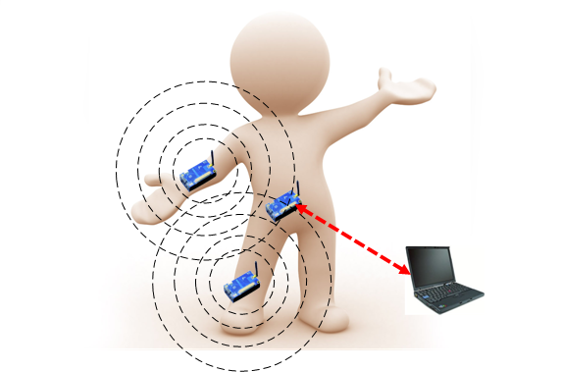

RadioSense: Exploiting Wireless Communication Patterns for Body Sensor Network Activity Recognition
Xin Qi, Gang Zhou, Yantao Li, Ge Peng
College of William and Mary
Notes:
Good afternoon! My name is Xin Qi. Today I will present a paper… This is a joint work with …, …, …

Slide 2
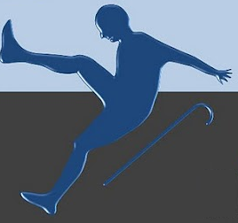

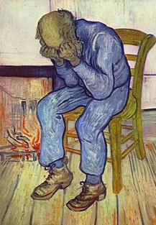
Background - Activity Recognition
Activity Recognition aims to automatically recognize user actions from the patterns (or information) observed on user actions with the aid of computational devices.
Fall Detection
Sleeping Assessment
Depression Detection
Notes:
In computer science, activity recognition aims to …

Slide 3
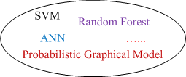
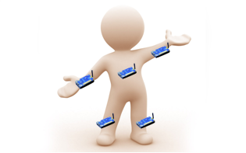
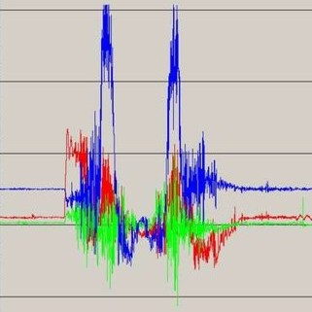
Sensing-based Activity Recognition
Problem setting
Accelerometer
Gyroscope
Temperature
Light
etc.
Running, Walking, Sitting, …
Sensing Data
Notes:
Traditionally, activity recognition is done with sensing technology.
In its problem setting, user wears a group of on-body sensor nodes and each node contains a set of sensors such as … and …
In runtime the sensor nodes collect sensing data and send these data to an aggregator
At the aggregator, received data is used as input to pattern recognition algorithm. The pattern recognition algorithm finally outputs the prediction for user activities.

Slide 4
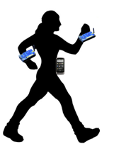

A Dilemma – On One Hand
Sensing data transmission suffers body fading
Accuracy decreased
√
Incomplete data
Notes:
There is a dilemma for the problem setting.
On one hand, sensing data transmission suffers body fading
In this figure, a user wears two sensors nodes on her left and right wrists.
When she is walking, the two sensor nodes send data packets to the aggregator for activity recognition.
It is possible that the transmission of left node fails because of body fading, but the transmission of right node succeeds.
Then the aggregator has to use the incomplete data as the input to the ml algorithm. Of course, the incomplete data will results in reduced accuracy

Slide 5
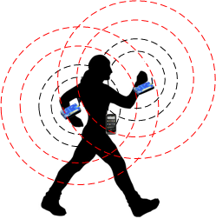
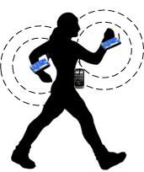



A Dilemma – On the Other Hand
To increase data availability
Increase transmission power
Consequences:
Increase energy overheads
Increase privacy risks
Transmission Range
Notes:
To increase the data availability at the aggregator, we can increase TX power.
However, one consequence is increasing energy overheads
Moreover, increasing TX power enlarges TX range. In consequence, private data may be overheard by other entities.
If the entity is malicious, privacy is compromised. Therefore, increasing TX power also increases privacy risks.

Slide 6
A Dilemma – On the Other Hand
To increase data availability
Using complicated MAC protocols
Consequence:
Increase energy overheads
for retransmissions
Many existing works propose new MAC protocols to improve packet delivery performance in body sensor network.
√
However, the impermeability of human body is a large obstacle for transmission efficiency.

Slide 7
The Idea and Research Question
Idea
As it is difficult to overcome the impermeability of human body, can we utilize it?
It is reasonable to imagine diff. activities have diff. patterns of packet loss and fading, which we call communication patterns.
We use communication pattern for recognizing activities.
Research questions
How to endow the communication pattern with enough discriminative capacity for recognizing diff. activities?
What are the impacts of using communication pattern for AR on other system performance issues, such as energy and privacy?
Notes:
Such as energy and privacy we just talk about

Slide 8
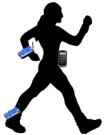
Communication Pattern
Radio as sensor
PDR = Packet Delivery Ratio
RSSI = Received Signal Strength Indicator
Node 1
Aggregator
more nodes
PDR 1
RSSI Feature Set 1
PDR 2
RSSI Feature Set 2
…
Node 2
Communication Pattern
Notes:
Here, I give a definition for communication pattern. To collect communication pattern, we use radio as sensors.
In runtime, each on-body node sends data packets to the aggregator. With received data packets from node 1 during a time window, the aggregator extracts PDR of node 1 and rssi features. RSSI stands for …
In the same way, the aggregator extracts the PDR and RSSI features for node 2 during the same time window and concatenate node2’s node1’s features. If there are more nodes, theirs features will be extracted and concatenated in the same way.
The whole feature vector we call it communication pattern.
In runtime, we use communication pattern as the signature of that time window to recognize activities.

Slide 9
Factors Influencing the Discriminative Capacity of Communication Patterns
Communication patterns
PDR
Influencing factor: transmitting power
RSSI features
Influencing factors: transmitting power, packet sending rate
A common influencing factor: smoothing window size – length of time window for extracting features
How to optimize the above system parameters:
Through benchmarking
Notes:
To endow CP with enough discriminative capacity, we first analyze the influencing factors of CP.
According to our definition in our previous slide, CP includes.
Influencing factor of PDR is TX power, high power results in … low power results in
Influencing factor of RSSI related

Slide 10
RadioSense – a Prototype System
Two on-body sensor nodes
Send simple packets to
base station
Packet::NodeId
Base station
Aggregator logs communication
pattern during both training and
runtime phases

Slide 11
Data Collection
Aim to find insightful relationship between recognition accuracy and system parameters – one subject’s data
Mixing multi-subjects’ data may blur the relationship
7 activities: running, sitting, standing, walking, lying down, cycling and cleaning
4-activity set: running, sitting, standing, walking
6-activity set: 4-activity set + lying down and cycling
7-activity set: 6-activity set + cleaning
Transmission (TX) power level: 1~5 (maximum: 31)
Packet sending rate: 1-4 pkts/s
Totally 20 combinations, we choose 9 of them
Under each combination, each activity is performed for 30 minutes in diff. places (lab, classroom, living room, gym, kitchen, and outdoor)

Slide 12
SVM as Classifier
SVM plus RBF kernel
Use feature selection algorithm to select optimal features
Follow 10-fold cross validation routine to obtain accuracy

Slide 13
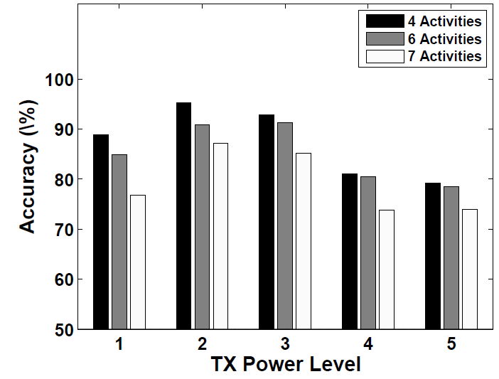
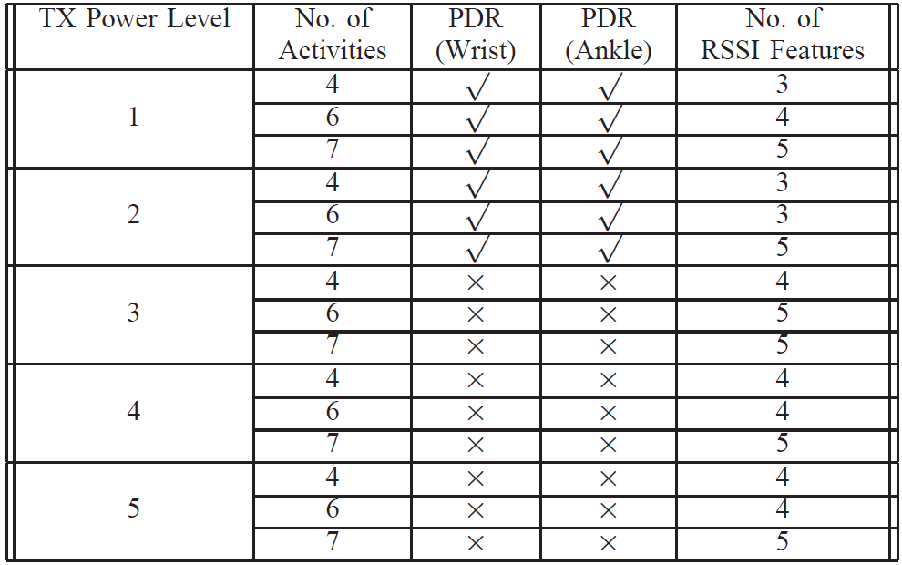
TX Power Level
Accuracy
first increases, then decreases
Packet Sending Rate = 4pkts/s,
Smooth Window= 9 seconds
TX power
PDR’s discriminative capacity
RSSI features
discriminative capacity
Notes:
This figure illustrates how accuracy varies as the TX power level increases
From the figure, we first observe…
To see how the discriminative capacity of the features varies, we summarize the feature selection algorithm results in this table. From the table, we see as the TX power increases, the …For example at TX power level two PDR is selected, but from TX power level 3

Slide 14
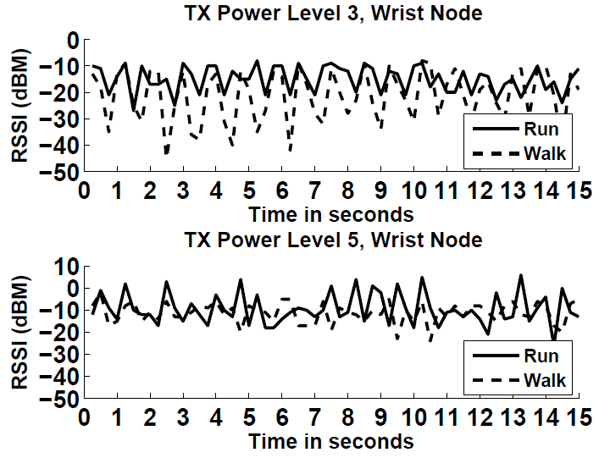
TX Power Level
The variation of PDR features’ discriminative capacity
Human body’s height is limited
At lowest TX power level, PDR is low for all activities, less discriminative
As TX power increases, clear PDR difference for activities
As TX power keeps increasing, PDR distributions become similar
The variation of RSSI features’ discriminative capacity
More discriminative at lower power level
Notes:
This figure contains two typical snapshots of RSSI values at diff. TX power levels.

Slide 15
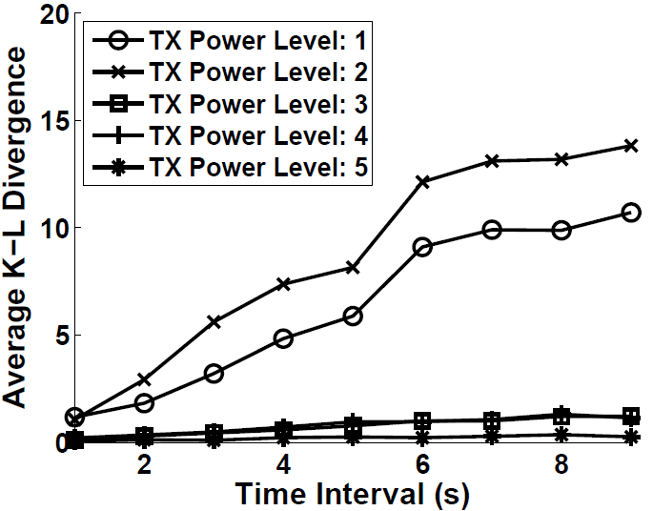
TX Power Level
Quantify PDR’s discriminative capacity
Metric – Average KL Divergence over all activity pairs
KLD: small value = similar; large value = different
most discriminative
highest accuracy
Notes:
Since accuracy is highest when PDR is selected, we plan to use KLD to quantify the PDR’s discriminative capacity and see how it varies.

Slide 16
Optimize TX Power Level
Average KLD quantifies the discriminative capacity of PDR
When PDR is most discriminative, the highest accuracy is achieved
Thus, RadioSense uses average KLD as a metric to select the optimal TX power level for accuracy.
The TX power level with largest average KLD is selected
Average KLD accuracy

Slide 17
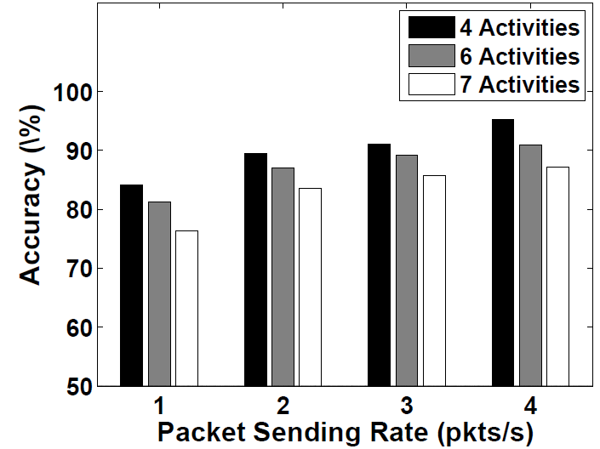
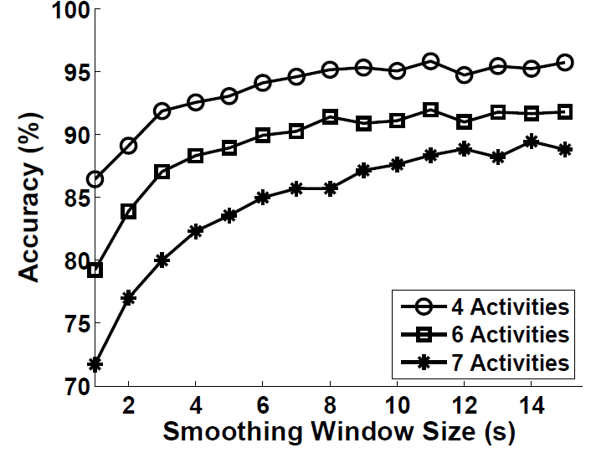
Packet Sending Rate & Smoothing Window Size
Accuracy increases with higher packet sending rate
Higher packet sending rate captures
more information for RSSI variations
Accuracy increases with larger smoothing
window size
TX Power Level = 2, Smooth Window= 9 seconds
Features extracted from larger smoothing window
are more robust to noise
TX Power Level = 2, packet sending rate = 4 pkts/s

Slide 18
Optimize Packet Sending Rate & Smoothing Window Size
Packet sending rate balances energy overhead and accuracy
Smoothing window size balances latency and accuracy
Rules for packet sending rate optimization:
At optimal TX power level, from 1 pkts/s, RadioSense selects i pkts/s if:
i achieves 90% accuracy
i>4, accuracy improvement of i+1<2%
Rules for smoothing window size optimization:
At optimal TX power level and packet sending rate, RadioSense selects i seconds if:
i achieves 90% accuracy
i>10 seconds, accuracy improvement of i+1<2%
Notes:
However, we cannot unlimited increasing packet sending rate and smoothing window size, because large packet sending rate consumes large energy overheads and large smoothing window size introduces large latency. To balance energy overhead and accuracy, we design the following heuristic rules for packet sending rate optimization

Slide 19
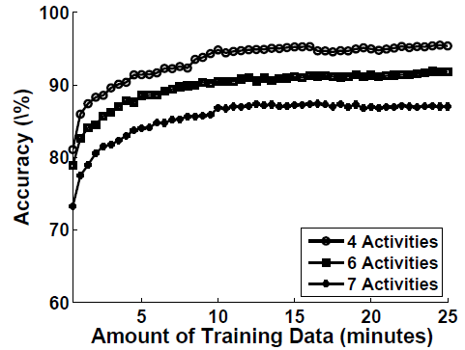
Amount of Training Data
Average accuracy of three subject with different amount of training data
10-minute data is enough for stable accuracy
With 8 seconds as smoothing window size
75 instances of each activity in the training set
Notes:
Besides the 3 system parameters, we also want to identify the minimal amount of training data for stable accuracy

Slide 20
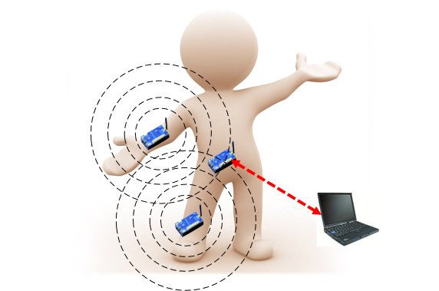
RadioSense Recap
In training phase, we design RadioSense to bootstrap the system following the steps below:
Optimize TX Power Level
10-minute training data for each activity
Optimize Packet Sending Rate
Optimize Smoothing Window Size
Trained Classifier

Slide 21
Up to Now
We have answered …
How to endow the communication pattern with enough discriminative capacity for recognizing diff. activities?
In the evaluation, we will answer…
What are the impacts of using communication pattern for AR on other system performance issues, such as energy and privacy?

Slide 22
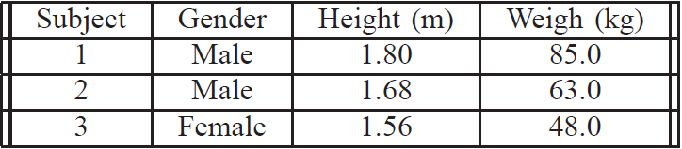
Evaluation – Data Collection
3 subjects
7 activities - running, sitting, standing, walking, lying, riding and cleaning
Different places - lab, classroom, living room, gym, kitchen, and outdoor
During training phase
Each subject performs activities for system parameter optimization
With the optimal parameters, for each activity, each subject collects 10-minute data for training and 30-minute data for testing
Lasts for two weeks
One classifier for each subject

Slide 23
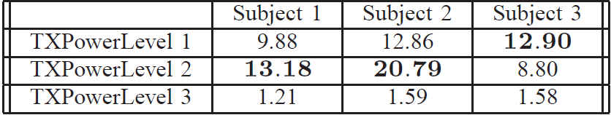
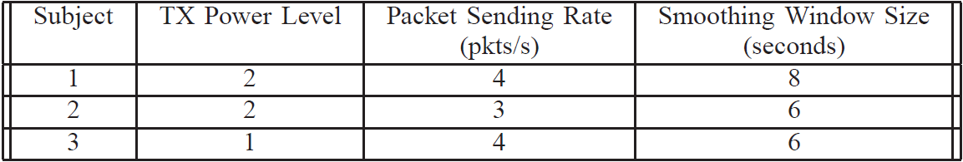
Evaluation – System Parameter Optimization
Average KLD Table
Parameter optimization results
Subject 3 is smaller than the other two
Notes:
This is the average KLD table, each entry in the table is the KLD value for the corresponding subject at the corresponding TX power level.
Smaller TX power level can already result in enough discriminative capacity for subject 3.

Slide 24
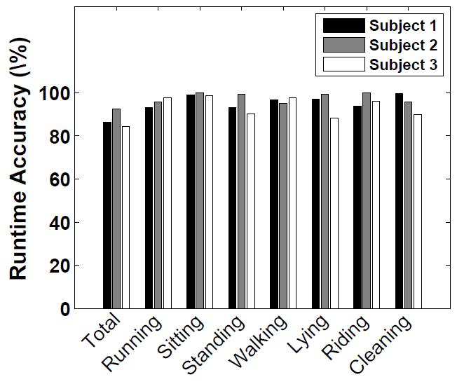
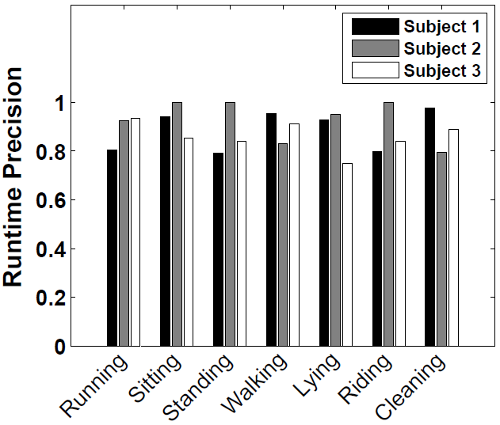
Evaluation – Accuracy and Latency
Most single activity achieves
90% accuracy
86.2%, 92.5%, 84.2%
Ave. KLD: 13.18, 20.79, 12.90
Ave. KLD is a validated metric
Most single activity achieves
0.8 precision
Average latency: 9.16s, 6.46s, 7.12s
Notes:
With the data collected under optimal system parameters

Slide 25
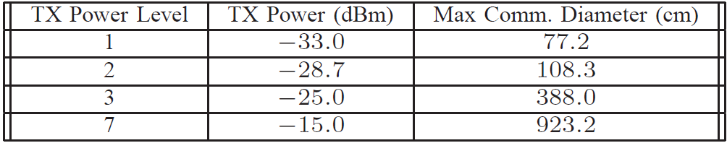
Evaluation – Battery Lifetime and Privacy
Battery lifetime – for each subject’s optimal system parameters
3 Tmotes with new batteries (AA, Alkaline, LR6, 1.5V)
Run RadioSense until batteries die
159.3 hours, 168.7 hours, 175.3 hours
Privacy
Packet::NodeId
Lower TX power and smaller communication range
Privacy risks are reduced!
Minimal power level for 90% PDR, [Mobicom ’09]
Notes:
In this part of evaluation, we use 3 groups of Tmotes, each group of nodes is configured with the optimal system parameters of the 3 subjects. We run the Tmotes with new batteries until the batteries die.
In addition to battery lifetime, we also consider privacy issues in our system.
We measure the communication range of the diff. TX power level , TX power level 7 is …
From the result table, we see that at the TX power levels selected by our system, the communication rage is less that or around 1 meter. In such a small communication range, our system only sends simple packets containing only node id. Compared to the usually methods that use TX power 7, the privacy risks are reduced in our system.

Slide 26
Evaluation - Potential of Coexistence with Other On-body Sensor Nodes
RadioSense - two dedicated on-body sensor nodes, right wrist and ankle, with optimal parameters
Two general purpose on-body sensor nodes, left wrist and ankle, TX power level 7, packet sending rate 4 pkts/s
One subject, for each activity, 10-minute training data, 30-minute testing data
For general purpose nodes:
PDR: 98.0%, 95.6%
In good condition [Sensys ’08], since interference from RadioSense nodes is low
For RadioSense nodes:
Accuracy: 90.8% (with other nodes), 86.3% (without other nodes)
Communication contention with other on-body nodes may amplify the discriminative capacity of communication pattern

Slide 27
Related Work
Using RSSI values for activity recognition
Only recognize simple activities, such as sitting and standing
Do not optimize system parameters such as TX power level for accuracy
Using RSSI values for other applications
Localization
Radio tomography for human indoor motion tracking
Notes:
We divide related work into two groups, the first group uses RSSI values for activity recognition
The works in this group ….
The 2nd group uses RSSI….
In this work, the authors deploy a sensor node array outside a house and use runtime RSSI values to track human indoor motions

Slide 28
Limitations
Strong background noises
Sensing-based approaches will also fail in such case because of high packet loss.
Not Scalable for new activities
It is a common problem for AR system using supervised learning method
Current system is a little bit clunky
In future, we may replace the aggregator with smartphone; energy issues

Slide 29
Conclusion
RadioSense, a prototype system demonstrating the feasibility of utilizing wireless communication pattern for BSN activity recognition.
We reveal that wireless communication pattern:
is most discriminative at low TX power
reduced privacy risk and energy efficiency
prefers packet loss
packet loss boosts accuracy rather than undermines it
results in MAC layer and device simplicity
no requirement for complicated MAC protocol and various sensors; only needs low power radio
allows the coexistence of both RadioSense and other on-body sensor nodes
communication contention with other on-body nodes may amplify its discriminative capacity

Slide 30
Q & A
Thanks for your attention!

Slide 31
Thank You!
The End.

Slide 32
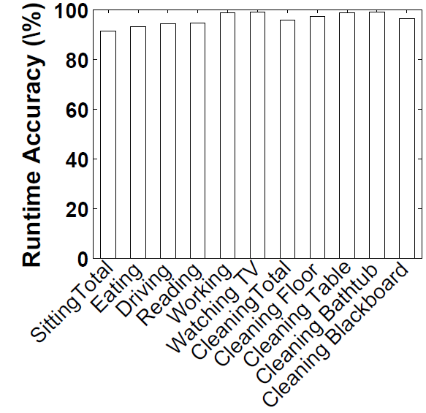
Potentials – More Fine-Grained Activities
One subject
Sitting set - driving, working, reading, eating, and watching TV
Cleaning set - cleaning table, cleaning floor, cleaning bathtub, and cleaning blackboard
10-minute data of each activity for training, 30-minute data of each activity for testing
Sitting - 91.5%, 8.35s
Cleaning – 95.8%, 8.29s

