Slide 1
SAPSM: Smart Adaptive 802.11 PSM for Smartphones
Andrew J. Pyles, Xin Qi, Gang Zhou,
Matthew Keally and Xue Liu*
College of William and Mary,
*McGill University
Notes:
Good Morning
My name is Xin Qi , from…

Slide 2
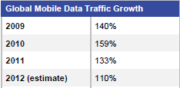
WiFi – A Significant Source of Energy Consumption
Mobile data grows fast
WiFi usage accounts for:
94.2% in 2011
80% (estimated) in 2015
WiFi power consumption
High in Active Mode
(Cisco Visual Networking Index 2011-2016)
[SiFi - Ubicomp `11, Bartendr - Mobicom `10]
Notes:
Recently, as smartphone becomes more and more popular, the mobile data usage keeps growing
Here is a table from a recent cisco report, the mobile data traffic growth speed is fast these year
It also reports that …. It estimates the number will be 80% in 2015
It is well known that
This figure is drawn based on data from recent pubs
The Wifi component consumes much higher power than other component when it is in active mode.

Slide 3
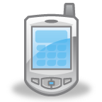




Static PSM
Static Power Save Mode (PSM):
Pros: Saving Energy
Cons: Adding Delay (100~300ms)
Beacon
PS-Poll
(Smartphone)
(Access Point)
Sleeping
Sleeping
Beacon Interval
Beacon Interval
Awake
Awake
Awake
Unacceptable for delay sensitive Apps, such as
Notes:
To reduce WIFi energy consumption…
The smartphone stops polling when no more buffered packets at AP and goes to sleep for a beacon interval
However, such sleeping interval adds delay

Slide 4
Adaptive PSM
Adaptive PSM
Null: Awake
Beacon
buffering
Null : Sleep
no buffering
PS-Poll
(Smartphone)
(Access Point)
PSM
CAM
Awake
Power(CAM) ≈ 20*Power(PSM)
pkt. rate >thr.?
CAM timeout?
True
True
CAM = Constantly Active Mode
Be careful of the switch to CAM.
Notes:
Adaptive PSM is a tradeoff between energy and delay
In Adaptive PSM, when the smartphone is awake, as usual it
However,
In CAM, cancel buffering high power
At the same time,
Switch back to buffer packets
Through experiments, we find that

Slide 5
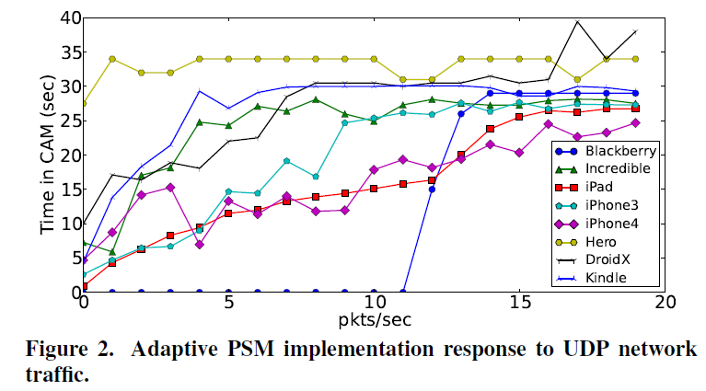
Adaptive PSM Behavior of Different Handheld Devices
Adaptive PSM appears to only use information from MAC layer to control the switch to CAM
We evaluate Adaptive PSM behaviors on different devices
UDP traffic with
random port
All devices switch to CAM with spurious network traffic. Energy waste!
Is it consistent across all devices?
How to improve Adaptive PSM?
Notes:
…
A question arises here is that is this behavior
To find the answer, we …
The results are plotted
X dimension
Y dimension
From the figure you can see all devices are triggered to CAM by this spurious network traffic.

Slide 6
To Be Smart
Utilize information from lay 3 and above in network stack
Prevent “unimportant” traffic from triggering the switch to CAM
“unimportant” traffic - delay tolerant traffic and traffic discarded by TCP/IP stack (no listening port)
STPM (Mobicom `03) considers traffic delay sensitivity assigned by developers
gap between developers and users
65-75% energy consumption of free apps deliver advertisements [EuroSys2012]. Developers may not be motivated to indicate their app is delay tolerant
Notes:
In this paper, we plan to make … smarter
First, we utilize…
With these information, we can prevent…
Previous work such as STPM

Slide 7
Ideas and Challenges
Ideas:
Associates a priority with each app
Users decide the priority of each app
Only high priority (or delay sensitive) app’s traffic can trigger the switch to CAM
Other apps’ traffic cannot
Challenges:
How to assist even non-technical users to decide an app’s priority?
How to track an app’s priority through the system efficiently?
Notes:
To tame the challenges, we have the following ideas

Slide 8
Outline
SAPSM Design
Evaluation
Related Work
Conclusions
Notes:
In the rest of the talk, I will present the design of our system and its evaluation results.
Then, I will briefly talk related work and conclude the talk.

Slide 9
Constraints, Definitions and Hints
Constraints:
minimizes user interaction
respects the critical path
uses hints from system and apps
Definitions - app priorities
Hints
background traffic ≠ delay tolerant traffic, e.g., SipDroid
sets the entire system to be low priority as screen is off
 | delay sensitive traffic ? | allowed to switch to CAM ?
High Priority | Yes | Yes
Low Priority | No | No
Notes:
The design is restricted to the following three constraints
The two hints we use in our design are
For example, sipdroid uses a service to transmit RTP packet in background, we don’t want such traffic to be low priority
Second, we set… since when the screen is off, users do not care the delay anymore.

Slide 10
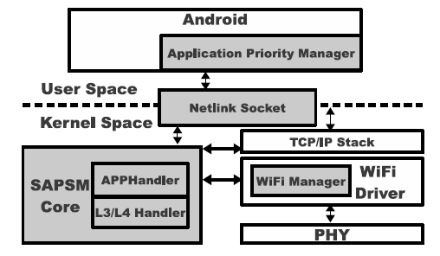
SAPSM Architecture
Exposes driver internals to SAPSM Core
Relays app’s priority from APM to SAPSM Core
Checks the priority of app each packet belongs to
Updates the Adaptive PSM counter if high priority
Collects networking usage of each app
Classifies each app into high priority or low priority
Interacts with users
Notes:
There are mainly four components in SAPSM architecture
Besides, it interacts with users to finally set each app’s priority.

Slide 11
SAPSM Core – Inbound Traffic
Port
being listened?
1 1 mapping
True
×
App1 | UID1
App2 | UID2
… | …
UID
√
TCP/IP
SAPSM Core
WiFi Driver
Packet
High Priority List
Updates the traffic counter
Does nothing
Notes:
SAPSM Core then compares the UID with those of high priority apps

Slide 12
SAPSM Core – Outbound Traffic
Packet
1 1 mapping
UID
×
App1 | UID1
App2 | UID2
… | …
√
TCP/IP
SAPSM Core
WiFi Driver
High Priority List
Resets Type of Service in IP header
Does nothing

Slide 13
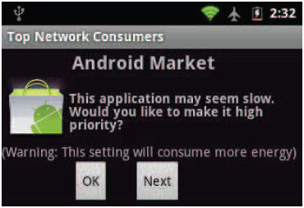
Application Priority Manager
Low priority for each app by default
Polls each app’s data rate by TrafficStats API
Classifies each app to either high priority or low priority
Provides interfaces for user to set priority
Notes:
This interface queries user whether the network latency of this app is acceptable or not.
If it is not acceptable, the user can set the app to be high priority for smaller latency.

Slide 14
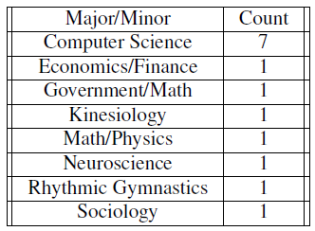
SVM as Classifier
Data collection – a user study
14 participants
6 apps
Network interactive apps: Android Market, web browser
Network non-interactive apps: an offline game
Ambiguous apps: Gmail, Facebook and Twitter
Set the phone to static PSM
Each participant uses each app for 10 minutes and is asked whether the observed latency is acceptable or not
“acceptable” means low priority; otherwise high priority
The RX and TX rates and traffic amounts are collected for each app
Notes:
To train a svm classifier, we did a user study.
In the study, there are 14 participants with different majors
Their network interactive level depends the actual network usage.

Slide 15
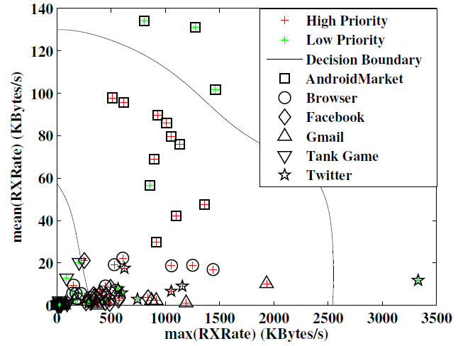
88.1%
Download data in background
RXRate features are preferred
Tank Game is low priority 14/14
Ambiguous apps 47/56
Notes:
From the collected information,
Smartphones are receivers rather than consumers of information
We use cross validation to do the parameter selection
There are three zones in the resulting classifier
First, the classifier can accurately classify all 14 tank game instances into low priority
For the ambiguous apps such as… it can correctly classify 47 out of 56 instances.
The apps in the right upper zone are those with both high and high. They are classified as low.. The results contradict intuition. One explanation could be that all the apps here download data in background and users do not care delay in such case

Slide 16
Evaluation
Do low priority applications save energy over high priority applications?
How does the SAPSM solution save energy with typical use cases?
Does general networking performance suffer for applications placed into high priority?
Notes:
We evaluate our design from three aspects
First, we check whether…
Second we check whether …
Third, we evaluate whether the general networking performance. Here we want to check the overhead of SAPSM.

Slide 17
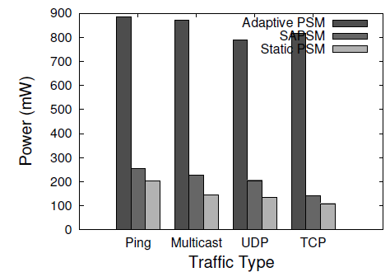
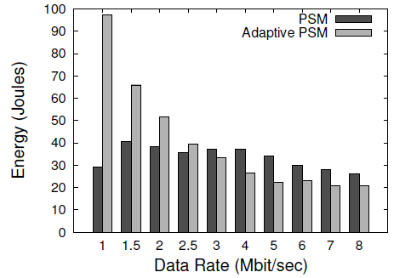
Do low priority apps save energy?
Traffic with no listening socket
SAPSM is higher than Static PSM
Low Priority Energy Inversion
Low priority apps achieve large energy saving at low rate
Notes:
To see whether there is an energy saving for low priority apps,
Second, we investigate the low…
From previous slides, we know the power consumption of PSM is lower than that of CAM. However, the smartphone sends a polling packets for each data packet buffered at AP. When the data rate is high, the number of polling packet will also be high, it is an extra overhead compared to CAM.

Slide 18
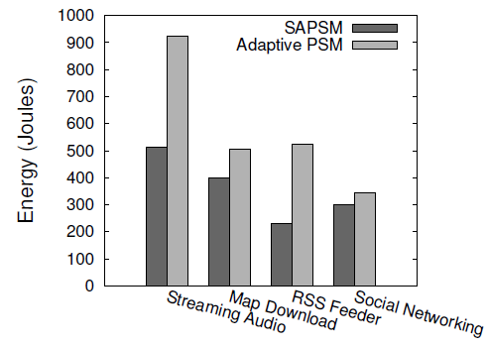
Does SAPSM save energy with typical use cases?
4 clearly low priority apps:
Streaming audio app, 128kbps
Offline map app
RSS reader app
Social networking apps (Gmail, Facebook, and Twitter) running in background when screen is off
Manually set as low priority
Classified as low priority √
Classified as low priority √
Automatically set as low priority √
44%
18%
56%
13%

Slide 19
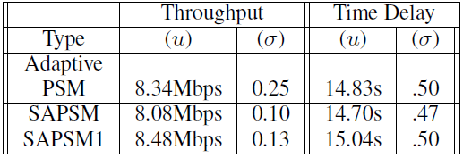
Does general networking performance suffer?
Netperf – a benchmark to measure network performance
SAPSM 1 – implements the socket checking by hashing table
SAPSM achieves similar performance as Adaptive PSM

Slide 20
Related Work
Optimizing PSM behavior, e.g.,
PSMThrottling (ICNP ‘07) uses traffic shaping to add burstiness
Micro power (Mobisys ‘08) predicts small sleep interval to save energy
SAPSM saves energy by prioritizing apps and is hence different
Modifications to network infrastructure, e.g.,
Napman (Mobisys ‘10) reduces contention by staggering beacon period of each client and ensures the fairness of AP scheduling
Avoiding the Rush Hours (Mobisys ‘11) staggers beacon periods by eavesdropping on APs in close proximity
SAPSM runs on client and is hence complementary
Notes:
Infrastructure pronunciation

Slide 21
Conclusions
Effective WiFi power management is important
SAPSM assists users in automatically determining each app’s priority with an offline classifier
In future, we plan to develop personal classifier or one classifier for each potential user group
SAPSM achieves 13%~56% energy saving by
prioritizing apps
only allowing high priority apps to trigger the switch to CAM

Slide 22
Questions?

Slide 23
Thank You!
The End

Slide 24
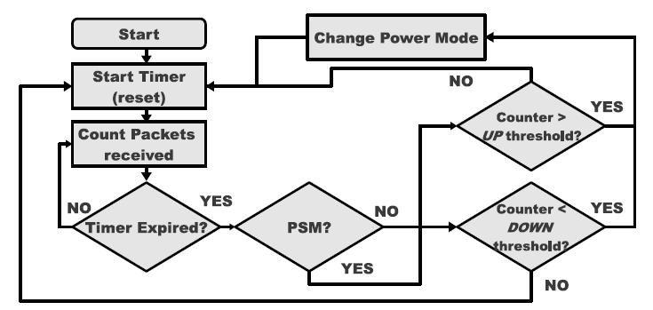
Sprint HTC Hero Adaptive PSM
1 second, non-configurable

Slide 25
Setup
A Linux server runs hostpad as AP
Server varies pkt rates, 30s for each rate
512 bytes pkts for MCAST, UDP and ICMP based unwanted traffic
60 bytes SYN for TCP-based unwanted traffic
Each device is less than one meter away from the AP
Turning off all apps using network and other network interface, e.g., Bluetooth, 3G

Slide 26
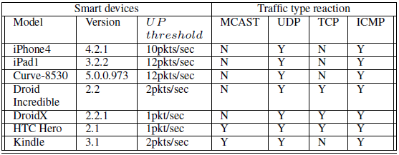
Observations
Various UP thresholds, some of them are small, e.g. 1pkt/s for HTC Hero
All devices are susceptible to unwanted traffic based on UDP and ICMP
Energy waste caused by such unwanted traffic
Notes:
-- Did you zoom in before copying and pasting? This figure (also the one before) looks blurry when displayed. Zoom in first before copying and pasting will make it clear.
Focus on UDP with random port
ICMP ping packets
remove

Slide 27
To Be Smart
Utilize information from lay 3 and above in network stack
Prevent “unimportant” traffic from triggering the switch to CAM
“unimportant” traffic - delay tolerant traffic and traffic discarded by TCP/IP stack (no listening port)
STPM (Mobicom `03) considers traffic delay sensitivity (or priority) assigned by developers
gap between developers and users
65-75% energy consumption of free apps deliver advertisements [EuroSys2012]. Developers may not be motivated to indicate their app is low priority.

Slide 28
Ideas and Challenges
Ideas:
Associates a priority with each app
Users decide the priority of each app
Only high priority (or delay sensitive) app’s traffic can trigger the switch to CAM
Other apps’ traffic cannot
Challenges:
How to assist even non-technical users to decide an app’s priority?
How to track an app’s priority through the system efficiently?

