Slide 1


Predicting State Medicare Spending Per Beneficiary
Xiao Lu
Guanghui Shen
Xuefei Qiao

Slide 2
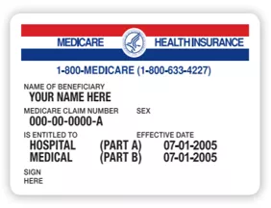
Background
What is Medicare?
Health insurance for people
65 and older
Under 65 with certain disabilities
ALS (Amyotrophic Lateral Sclerosis, also called Lou Gehrig’s disease) without a waiting period
Any age with End-Stage Renal Disease (ESRD)
To get Medicare you must be a U.S. citizen or lawfully present in the U.S. Must reside in the U.S for 5 continuous years.
Why Important?
14% of total federal spending
21% of total national health spending
Reflects medical efficiency, good for state budget planning.
Notes:
Medicare is the federal health insurance program created in 1965 for people ages 65 and over, regardless of income, medical history, or health status. Today, it plays a key role in providing health and financial security to 60 million older people and younger people with disabilities.
Medicare covers many basic health services, including hospital stays, physician services, and prescription drugs.
In 2019, Medicare spending accounted for 14 percent of total federal spending and 20 percent of total national health spending.
Finding out what factors can affect State Medicare Spending can help states plan their budgets wisely.

Slide 3
Source: Kaiser Family Foundation
Dependent Variable - MSPB
State Medicare Spending Per Beneficiary, 2018
Independent Variables
 | Independent Variables | Type | Description
Policy | Obamacare | Qualitative | Whether the State Adopts Obamacare or Not, 2018
Economic Status | Ave_GSP | Quantitative | Gross State Product (in million)/Person, 2018
 | Ave_Income | Quantitative | 2014-2018 Median Annual Household Income (in 2018 dollars)
 | Unemployment_Rate | Quantitative | Unemployment Rate, Sept 2018
Medical Condition | Ave_Hospital | Quantitative | Number of Hospitals per Person, 2018
 | Ave_Physicians | Quantitative | Number of Professionally Active Physicians per Person, September 2020
Health Status | Life_Expectancy | Quantitative | Life Expectancy at Birth (in years), 2010-2015
 | Smoking_Rate | Quantitative | Percentage of Cigarette Use, 2018
 | Vaccined_Rate | Quantitative | Vaccination Rate, 2018-2019
 | Senior_Rate | Quantitative | Persons Age 65 and Older as a Percentage of Total Population, 2018

Slide 4
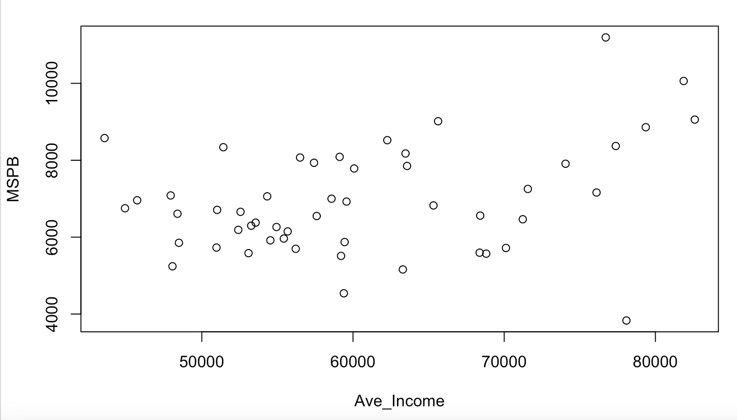
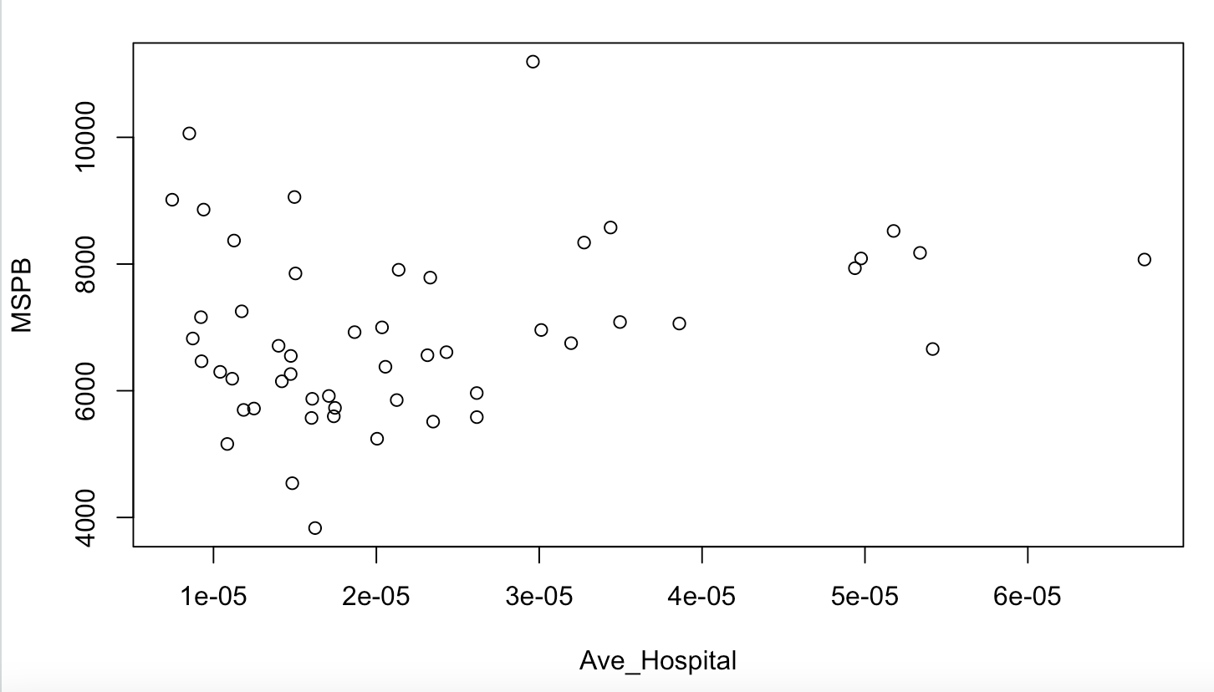
Descriptive Analysis
Average income shows the clearest trend.

Slide 5
Hypothesis
Medicare targets senior people
- MSPB increases when seniors as a percentage of population increases.
Longer lifespan means healthier body
- MSPB decreases as life expectancy increases.
Wealthy states have better medical facilities, hence higher medical bills
- MSPB increases when average income increases.
More hospitals means more chances for medical treatments, hence higher medical cost
- MSPB increases when number of hospital per person increases.
The federal government pays for most Medicare while Affordable Care Act (ACA) plans are usually offered by private health insurance companies
- States that adopts Obamacare might have lower MSPBs.

Slide 6
First-order Model
Our first-order model includes all independent variables.
Summary
Global F-test p-value: 9.293e-05
R-squared: 0.5592
Adjusted R-squared: 0.449

Slide 7
Independent Variables Analysis (First-order Model)
Coefficients that are significant on 0.1 level:
Variables with VIF>5:
Correlation:
Ave_GSP & Ave_Physicians (0.78)
Life_Expectancy & Smoking_Rate (-0.78)
 | Estimate | Std. Error | P-value
Ave_Income | 1.284e-01 | 2.976e-02 | 0.000102 ***
Ave_Hospital | 4.349e+07 | 1.506e+07 | 0.006249 **
Life_Expectancy | -4.798e+02 | 2.247e+02 | 0.038908 *
Unemployment_Rate | 5.357e+02 | 2.732e+02 | 0.056885 .
 | Life_Expectancy | Ave_Physicians | Ave_GSP | Smoking_Rate
VIF | 6.698285 | 5.897321 | 5.660827 | 5.280101

Slide 8
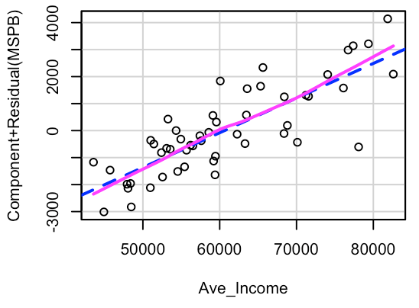
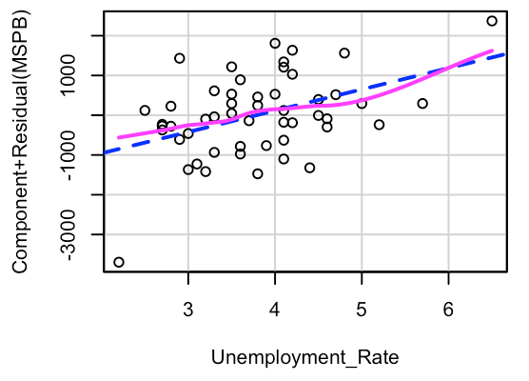
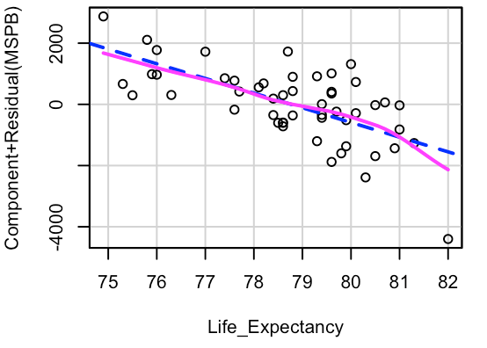
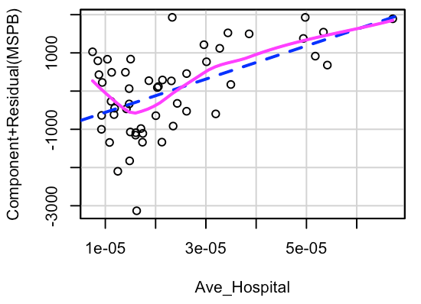
crPlots (First-order Model)
Ave_Hospital’s residual shows heteroscedastic problem.

Slide 9
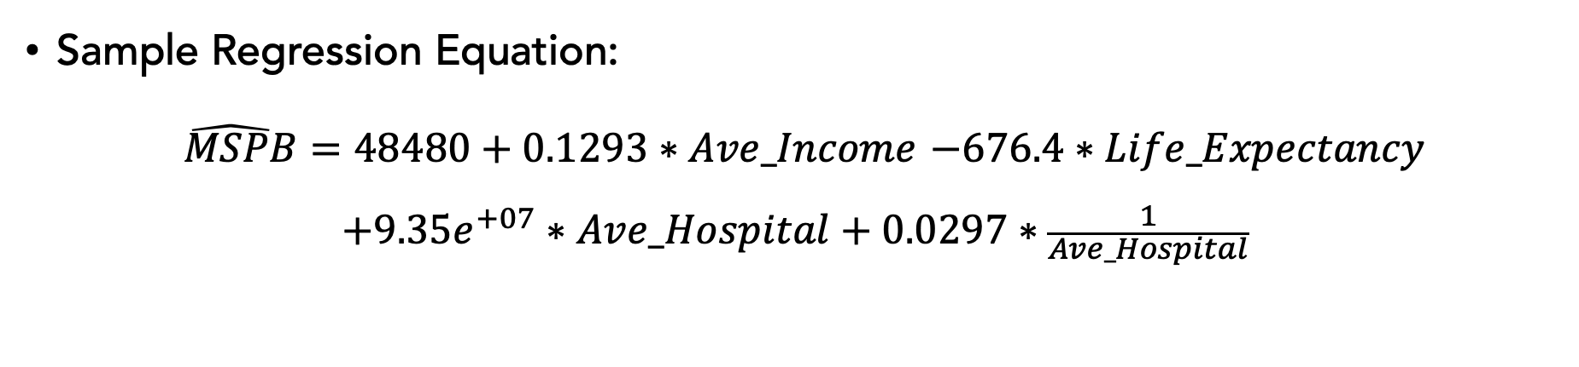
Improved Model
Sample Regression Equation:
$\hat{ MSPB}=48480+0.1293∗Ave_Income$ $−676.4∗Life_Expectancy$
$$+9.35e^{+07}∗Ave_Hospital+0.0297∗\frac{1}{Ave_Hospital}$$
Summary:
Global F-test p-value: 8.164e-09
Adjusted R-squared: 0.57 (>0.449 First-order Model)
R-squared: 0.6044
All coefficients are very significant on the 0.01 level.

Slide 10
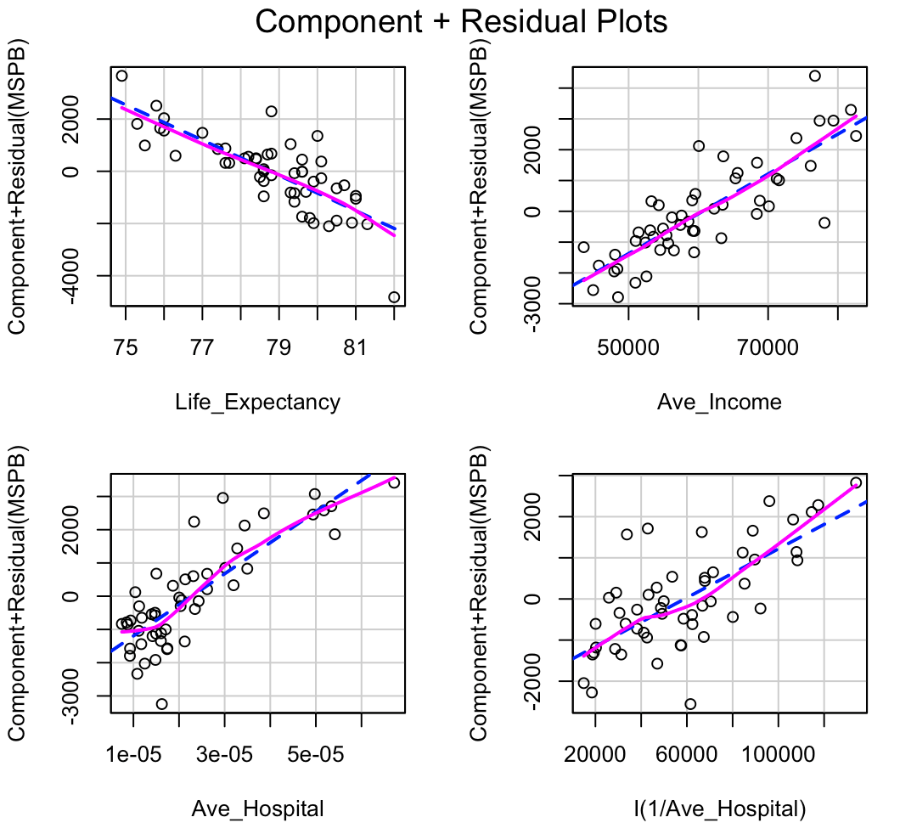
Assumptions Check
No big heteroscedastic problem since no trends are shown in these partial residual plots.
Durbin-Watson Test P-value: 0.742, no correlated residual concerns.
Q-Q normal plots show no normality concerns.
Notes:
From the first three partial residual plots, we can see E(residual of model) and var(residual of model) don't show big problem. The fourth partial residual plot shows problems but based on its low individual t-test p-value (4.14e-05), we still believe that Ave_Hospital has significant influence on MSPB.
From the left plot, observation 12 (Hawaii) is an outlier. Its MSPB is relatively small, but its Ave_Income is relatively large,
Durbin-Watson Test P-value: 0.428, which indicates no evidence of residual correlation.
Our model is a linear regression, so we don't need to concern the non-normality.

Slide 11
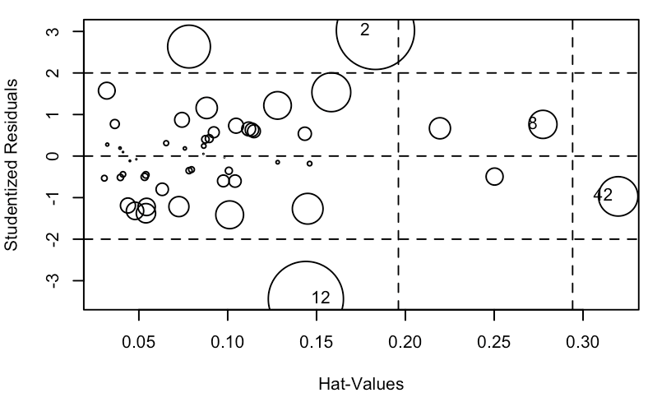
Influence Plot
Outliers with high influence:
#2 Alaska: higher MSPB than the model predicted
#12 Hawaii: lower MSPB than the model predicted

Slide 12
Conclusion
Our improved model predicts that when all else are held constant, state MSPB:
Increases by $0.129 for every 1-dollar increase in median annual household income.
Decreases by $676.4 for every 1-year increase in life expectancy.
Decreases for every additional hospital built when hospital per person is below 1.8e-5, then starts to increase.
Percentage of senior people does not have a significant effect on MSPB.
Obamacare does not have a significant effect on MSPB.
The best way to lower MSPB without harming the healthcare system and state economy is by improving overall health.

Slide 13
Further Analysis…
Add more variables about the number of people under the age of 65 who have been receiving disability benefits for at least two years, and the number of people in the state who receive other Medicare plans, such as Medicare Advantage plan.
Further investigation into the MSPB number for Alaska.
Upgrade our single year observations to a longer time span (average, median).

Slide 14


Slide 15


