Slide 1
CREDIT CARD FRAUD DETECTION Goldman Sachs, London, 20 April 2018 Quy Vu

Slide 2
INTRODUCTION Overview ► Research questions ► The dataset
(Financial fraud action UK, 2017)

Slide 3
INTRODUCTION Overview ► Research questions ► The dataset
"an institution may have state-of-the-art security and fraud detection technologies and procedures to protect its deposit lines of business, but not the same for small business banking”
(N. Rodney, 2008)

Slide 4
INTRODUCTION Overview ► Research questions ► The dataset
What differentiate genuine transactions from fraudulent ones?
Is it possible to develop a framework that is easy to implement but efficient in detecting credit card fraud?

Slide 5
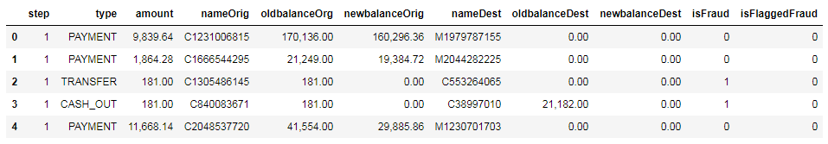
INTRODUCTION Overview ► Research questions ► The dataset
Simulated from the data provided by a multinational mobile financial service provider
Contains ~6.3 million entries representing transactions made in a month

Slide 6
ANALYSIS EDA ► Strategy ► Evaluation & Interpretation of results
1. Is not considered as “big data”:
The dataset has ~ 6.3 million records, size of 500 Mb.
Big data framework (Spark, Hadoop, …) may not be necessary but processing on conventional computers takes time.
Consider working on a subset to obtain preliminary result.

Slide 7
ANALYSIS EDA ► Strategy ► Evaluation & Interpretation of results
2. The dataset is extremely imbalanced:
Fraud/Genuine ratio: 8,213 / 6,362,620 ~ 0.1%
Can get 99% accuracy by classifying all transactions as “genuine”.
Need to implement techniques to address class imbalance problem (Over sampling, under sampling, class weight, …)

Slide 8
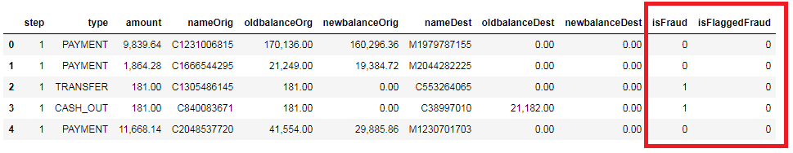
ANALYSIS EDA ► Strategy ► Evaluation & Interpretation of results
3. “isFlaggedFraud” contains no meaning
Flagged only 16 transactions as fraud
Potentially implies the inefficiency of the system
→ Discarded

Slide 9
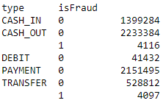
ANALYSIS EDA ► Strategy ► Evaluation & Interpretation of results
4. Frauds only in cash out and transfer transactions
Debit, payment, cash in transactions are discarded
No. of frauds in cash out and transfer transactions are roughly the same.
Hypothesis: Fraud = Transfer then cash out

Slide 10
ANALYSIS EDA ► Strategy ► Evaluation & Interpretation of results
5. Customer ID contains no meaning
In fraudulent transactions:
A few recipient ID repeat once
Sender ID does not repeat
Discarded

Slide 11
ANALYSIS EDA ► Strategy ► Evaluation & Interpretation of results
6. No missing values
No cells contain “NaN”
However some cases have recipient balance equals to zero both before after the transaction.
Strong indicator of fraud
Hypothesis: Fraud detected and halted
 | Count | Percentage
Fraud | 4,067 | 49.63%
Genuine | 1,706 | 0.15%

Slide 12
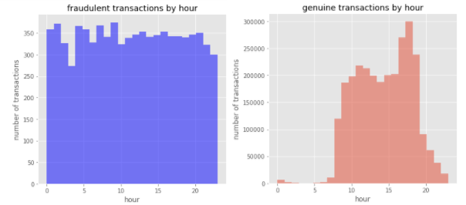
ANALYSIS EDA ► Strategy ► Evaluation & Interpretation of results
7. Time occurred is a strong indicator of fraud
7.1. Hour

Slide 13
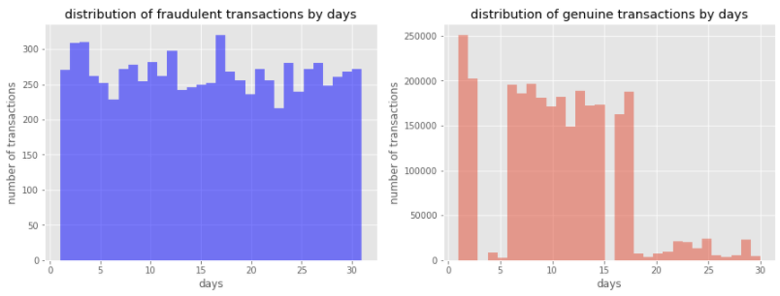
ANALYSIS EDA ► Strategy ► Evaluation & Interpretation of results
7. Time occurred is a strong indicator of fraud
7.2. Date

Slide 14
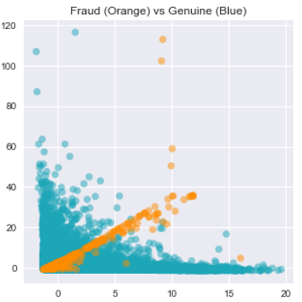
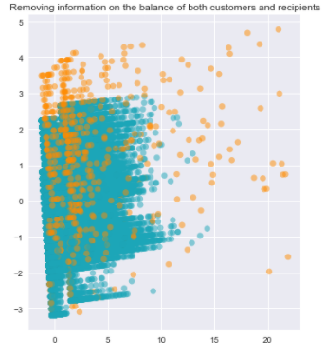
ANALYSIS EDA ► Strategy ► Evaluation & Interpretation of results
8. Account balance is important in detecting fraud
➔ There is definitely patterns in fraudulent transactions

Slide 15
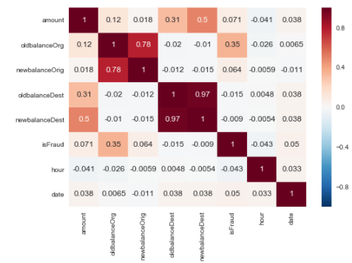
ANALYSIS EDA ► Strategy ► Evaluation & Interpretation of results
9. Strong correlation between recipient’ new and
old balances

Slide 16
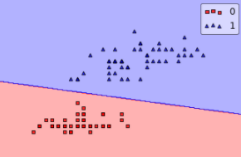
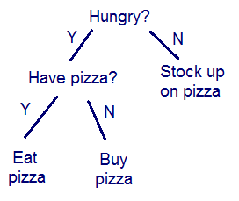
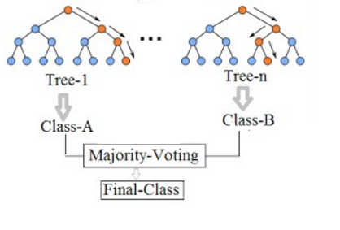
ANALYSIS EDA ► Strategy ► Evaluation & Interpretation of results
1. Algorithm selection
Logistic Regression | Decision Tree | Random forest
Buy pizza
Male | Vegan | Age
0.5 | -0.2 | 0.5

Slide 17
ANALYSIS EDA ► Strategy ► Evaluation & Interpretation of results
1. Algorithm selection
 | Logistic Regression | Decision Tree | Random forest
Pros | Interpretable Cheaper computation Less configuration | Interpretable Cheaper computation Address non-linearity | “Advanced” decision tree Generalisable
Cons | Cannot address non-linearity | May not generalise Need configuration | Expensive computation Less interpretable
Use | Baseline | Understand data Detect fraud on subset and the whole dataset | Detect fraud on the whole dataset

Slide 18
ANALYSIS EDA ► Strategy ► Evaluation & Interpretation of results
2. Model training
 | Logistic Regression | Decision Tree | Random forest
Specs | 1000 max iterations LASSO regularization | Best split | Same as decision tree
Grid search | Regularisation parameter | Max depth # samples to split | Same as decision tree Max no. of trees

Slide 19
ANALYSIS EDA ► Strategy ► Evaluation & Interpretation of results
3. Model evaluation and selection
Performance: True Positive rate, confusion matrix
Computational cost
Interpretability

Slide 20
ANALYSIS EDA ► Strategy ► Evaluation & Interpretation of results
4. Address class imbalance
 | Over sampling | Under sampling | Class weight
Pros | Preserve data | Cheaper computation | Cheaper computation
Cons | Expensive computation | Risk of losing information | Not based on the data, but seeks to minimise a loss function
Apply on | Subset of data | N/A | Whole dataset

Slide 21
ANALYSIS EDA ► Strategy ► Evaluation & Interpretation of results
5. Data preparation
One-hot encode categorical features: “date”, “type”; group “hour” to blocks of 3
Normalise data to 0 mean and unit variance

Slide 22
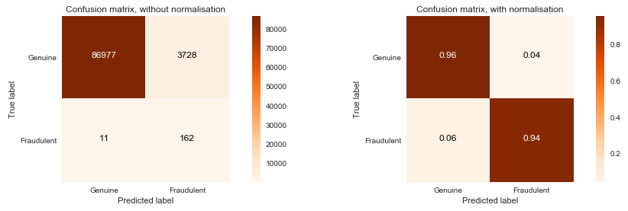
ANALYSIS EDA ► Strategy ► Evaluation & Interpretation of results
1. Logistic regression

Slide 23
ANALYSIS EDA ► Strategy ► Evaluation & Interpretation of results
1. Logistic regression
Type Negative coefficient implies transfers (0) are more likely to be fraudulent. But genuine transactions are 8 times more in Cash out transactions. Discarding this feature did not impact significantly the performance → Misleading and irrelevant

Slide 24
ANALYSIS EDA ► Strategy ► Evaluation & Interpretation of results
1. Logistic regression
Amount and balance No clear pattern was identified in the distribution of values → Misleading
Date and time Consistent with findings obtained in EDA

Slide 25
ANALYSIS EDA ► Strategy ► Evaluation & Interpretation of results
1. Logistic regression
Show weakness in classify data with non-linearity
Baseline: 94% True Negative, 96% True Negative

Slide 26
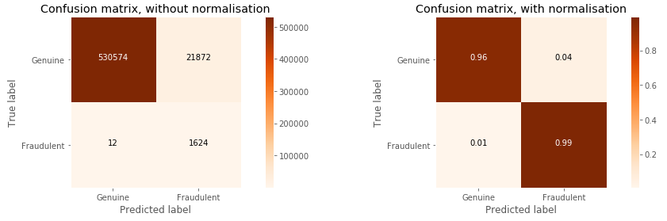
ANALYSIS EDA ► Strategy ► Evaluation & Interpretation of results
2. Decision tree

Slide 27
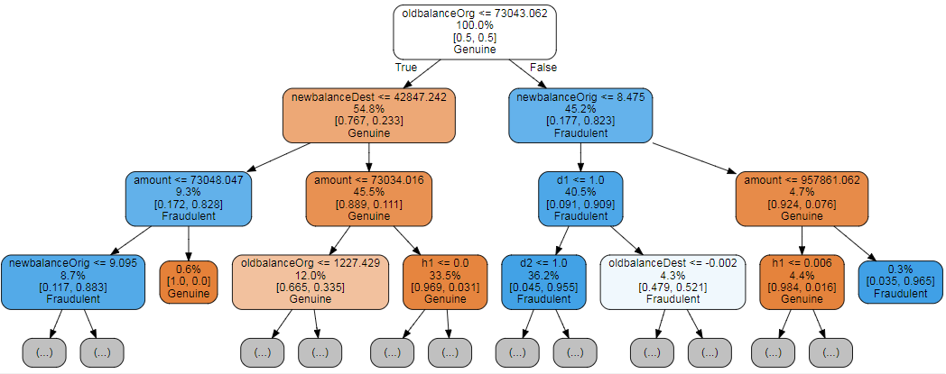
ANALYSIS EDA ► Strategy ► Evaluation & Interpretation of results
2. Decision tree

Slide 28
ANALYSIS EDA ► Strategy ► Evaluation & Interpretation of results
2. Decision tree
Is consistent with EDA
Efficient yet simple to implement and interpretable

Slide 29
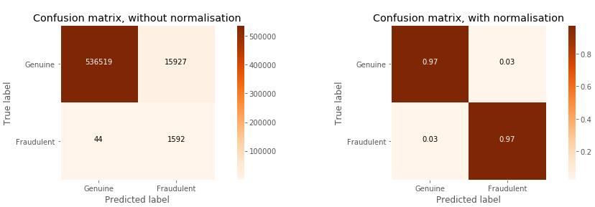
ANALYSIS EDA ► Strategy ► Evaluation & Interpretation of results
3. Random forest

Slide 30
ANALYSIS EDA ► Strategy ► Evaluation & Interpretation of results
3. Random forest
Decision tree with class weight: 90% True Positive
Implemented class weight instead of oversampling → Inferior result

Slide 31

ANALYSIS EDA ► Strategy ► Evaluation & Interpretation of results
4. Further results
Incorporating a feature addressing error in transaction amount did not improve the result: + Logistic regression: 70% True Positive + Decision tree: No change

Slide 32
CONCLUSION Insights ► Research questions ► Limitations, future work ► Lessons
1. Summary of insights
Fraudulent behavior is to transfer then cash out
Transactions are more likely to be fraud if made at night or on a specific set of days
Transaction amount and account balance is important in detecting fraud in this case
→ Further investigation will contribute to understanding

Slide 33
CONCLUSION Insights ► Research questions ► Limitations, future work ► Lessons
2. Research questions revisited
What differentiate genuine transactions from fraudulent ones? Answer: As above
Is it possible to develop a framework that is easy to implement but efficient in detecting credit card fraud? Answer: Yes – Decision tree with oversampled data

Slide 34
CONCLUSION Insights ► Research questions ► Limitations, future work ► Lessons
3. Limitations and future work
May not applicable to other companies with different characteristics
Customer ID were not considered → Analysing customer transaction history may discover interesting insights
Not all transaction types are considered → Can build an anomaly detection system
Marginal improvements can be obtained with state-of-the-art classifiers supported by domain knowledge

Slide 35
CONCLUSION Insights ► Research questions ► Limitations, future work ► Lessons
4. Lesson learned
Data cleaning and preparation is vital
Should start with implementing simple algorithms on a subset of data
Profound understanding of the algorithms is important
Implementing complex, less interpretable algorithms may not worth the computational cost

Slide 36
Q&A

