Slide 1
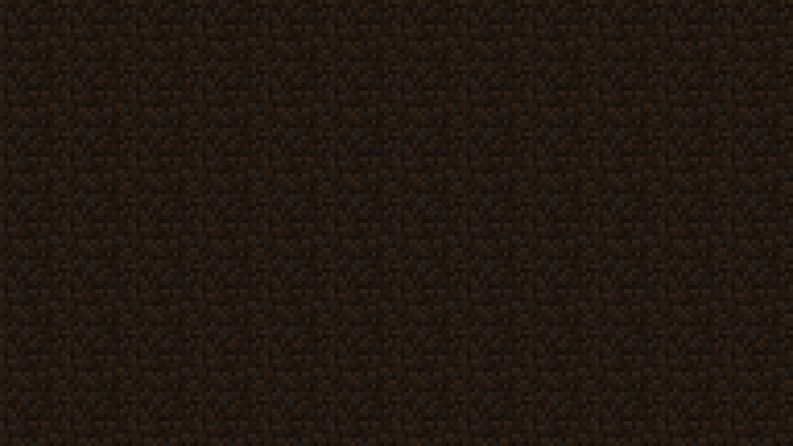

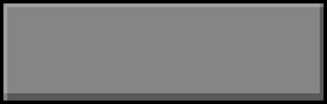
This template is created by @xqwtxon!
This is licensed within MIT License by The Free Software. You can distribute this project for educational, and personal use, etc...
Click to start Minecraft

Slide 2


Slide 3
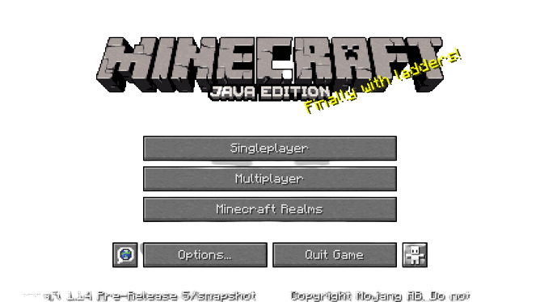

Slide 4
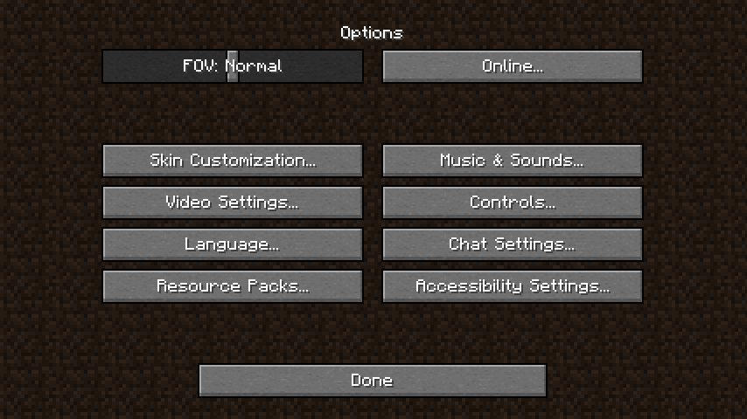

Slide 5
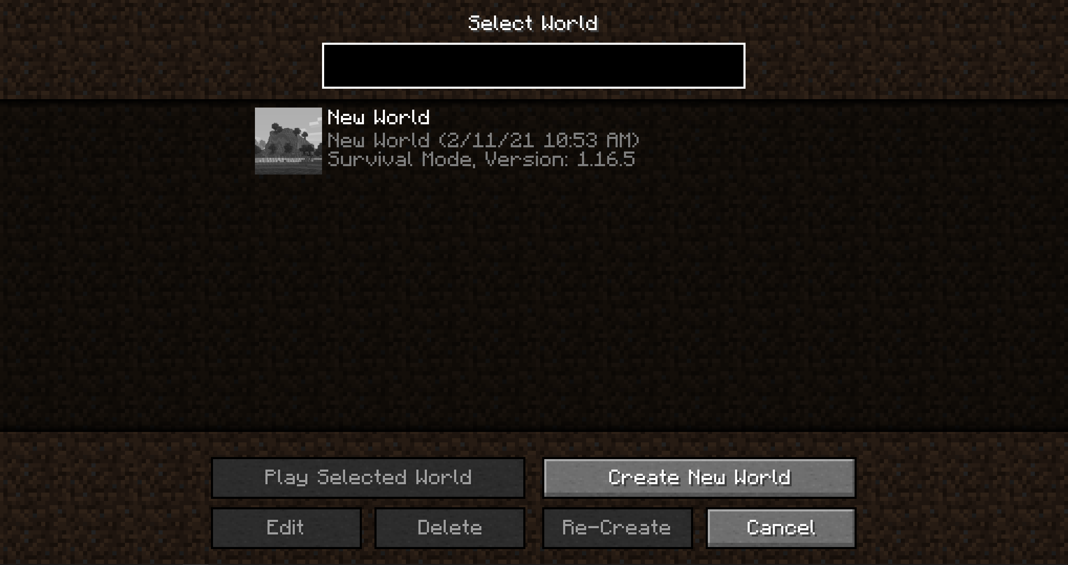

Slide 6
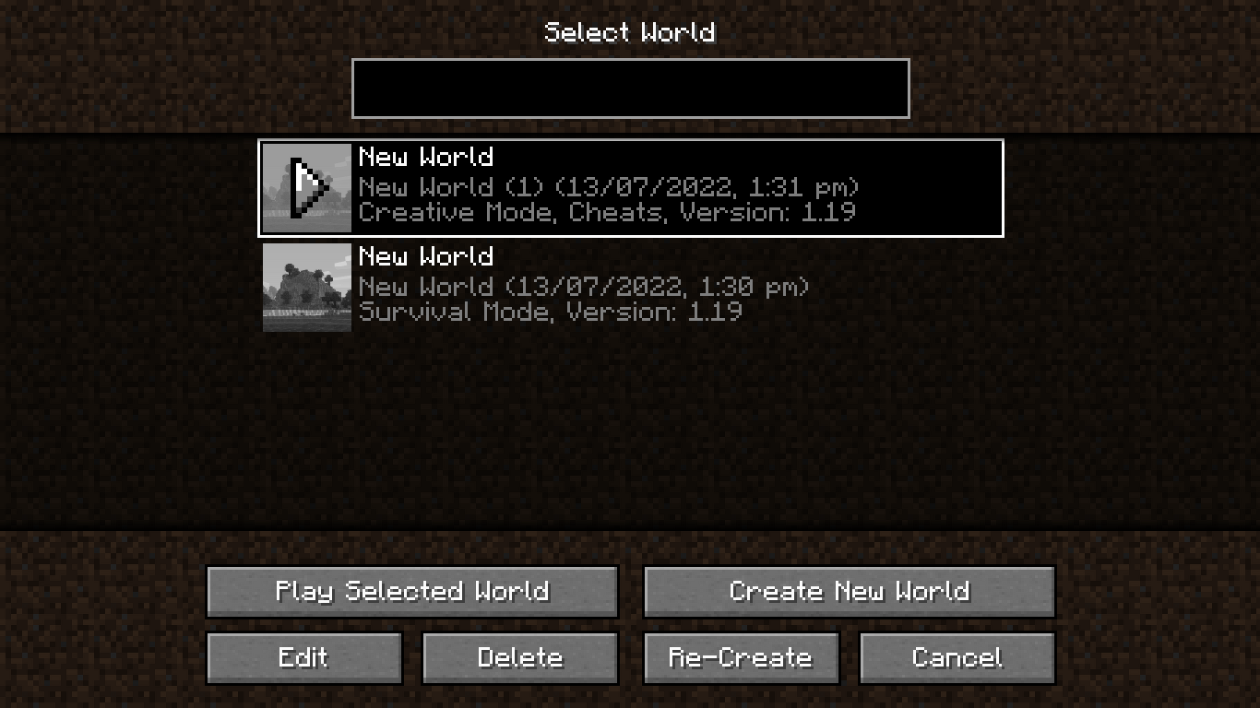

Slide 7
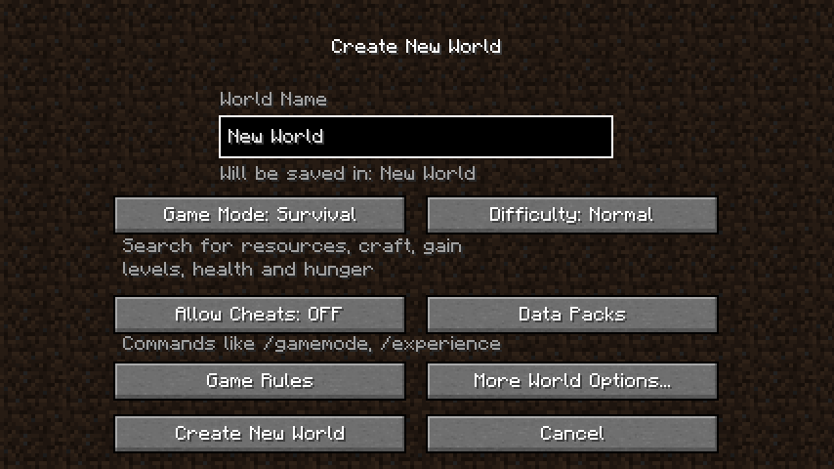

Slide 8
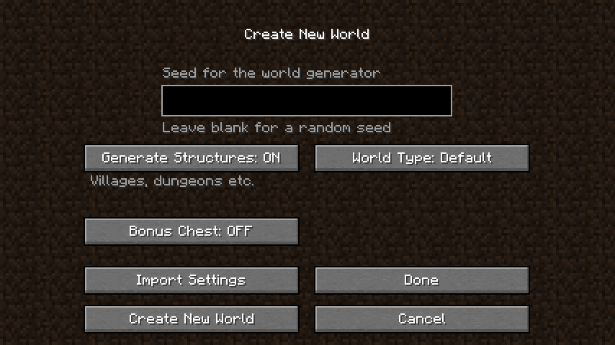

Slide 9
Building terrain..

Slide 10
Loading terrain…

Slide 11
