Slide 1

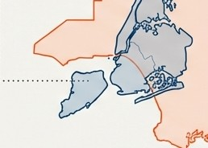
The Los Angeles Paradox
Why does the New York Police Department record more than double the arrests of the Los Angeles Police Department, despite LA County's significantly larger population and geographic area?
New York City (NYPD) ·....··:
••
·························· Los Angeles County (LAPD)
Area:
302 sq miles
Population (2020):
8.8 million
Total Arrests (2010-19):
3.4 million
•
Area:
4,751 sq miles
Population(2020):
9.8 million
Total Arrests (2010-19):
1.3 million
.
•
'
•
••
••
••
Thisanalysiscompares arrest data fromthe NYPD andLAPDbetween 2010and 2019.

Slide 2

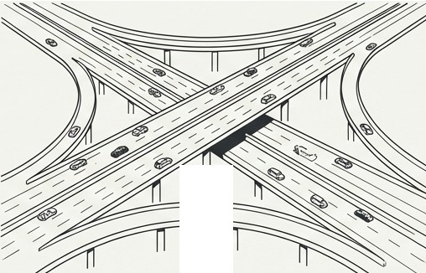
An Investigation into Two Archetypes of the American City
Bl
The Vertical Metropolis
New York City, a compact, transit-oriented city with an exceptional population density of 29,302 people per square mile.
Life is organised around public transit, pedestrian activity, and
high-density living.
The Sprawling Megalopolis
Los Angeles, a vast, car-dependent region. The City of Los Angeles hasa density of 7,754 people per square mile-roughly a quarter of NYC's-shaping a lifestyle built around automotive transport and dispersed communities.
How do these profound differences in urban structure influence patterns of law enforcement and public safety?

Slide 3


Forging the Tools for a Fair Comparison
•
•
� •�
•
•
r'\
> >-->
)
\...,/
NYPD
LAPD
1. Sourcing
Began with over 5 million raw arrest records from NYPD and
1.3 million from LAPD public
data portals.
2. Standardising
Systematically cleaned, validated, and harmonised key analytical fields.
This involved creating common categories for race, age groups, and offence types to enable a direct, apples-to-apples comparison.
3. Aligning
Produced two structurally identical Produced two structurally identical datasets for the 2010-2019 period, ensuring all comparisons are built on a foundation of meticulously prepared and validated data.
Key Takeaway: This rigorous process ensures our investigation is based on reliable and directly comparable evidence.

Slide 4
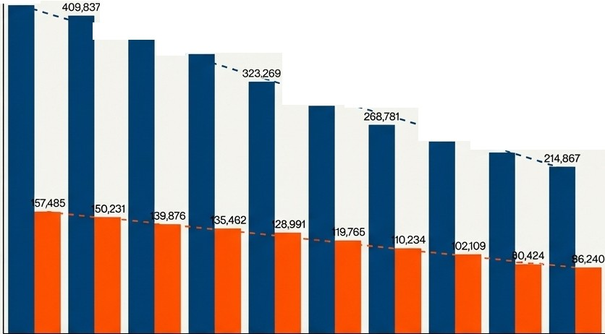
Clue #1: The Timeline Reveals a Consistent Volume Gap, But Identical Patterns
Total Arrests by Year (2010-2019)
Key Findings
Consistent Volume Disparity: NYPD consistently records 2.5-3 timesmore arrests thanLAPD every single year.
22,322
400,000
, ,
382,925
, ,
'
359,871
'
₋Ill
'
' ..
300,000
292,864 ',
Parallel Declining Trends:Both departments show aremarkably similar downward trend. NYPD arrests decreased by ~49% from 2010 to2019,while LAPDarrests fellby ~45%.
Shared Rhythms:Further analysis shows both cities share near-identicalpatterns for day-of-week (mid-week peaks) and month (spring peaks, winter declines).
Ul
Q)
' 247 32
-0
�
l::
,4 ' ' ·232,711
<(
_2l 200,000
E
_{z}:::,
100,000
2010
2011
2012
2013
2014
2015
2016
2017
2018
2019
Year
If arrest volumes aresodifferent, why are the temporal patterns so similar? This suggests
the answerlies beyond simple policing schedules or seasonal factors.

Slide 5
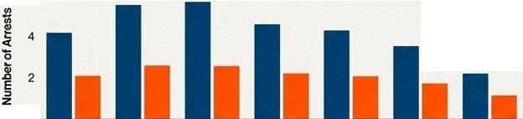





A Deeper Look at the Temporal Evidence
Crime Frequency by Month
300
�
Crime Frequency by Day of Week
6
NYPD ■LAPD
NYPD ■LAPD
Cl>
-
_{c}t_{o}: : 200
0
�
I
• •
• •
• •
,8 100
• •
§
z
0
Monday Tuesday Wednesday Thursday
Mid-week activitypeaks inbothcities.
Friday
Saturday
Sunday
0
May Jun Jul Aug Sep
Jan Feb Mar Apr Oct Nov Dec
Seasonal trends are strongly correlated.
Crime Frequency by Year
.,250
Crime Frequency by Day of Month
250
j 200
NYPD
LAPD
NYPD ■LAPD
'lii200
"'
f
-
-
.li 150
:i 150
0
0
� 100
_{z}:, 50
0
_! 100
E
E
_{z}:, 50
0-------------------------
2010 2011 2012 2013 2014 2015 2016 2017 2018 2019
A decade-long, parallel decline inarrests.
Day1 Day4 Day7 Day11 Day13 Day17 Day19 Day 23 Day 25 Day30 Day 31
NYPD peaks onday11; LAPDpeaks earlier onday 4-the only slight divergence intemporal patterns.
Across years,months,and weeks,therhythm of arrestsis strikingly similar. The primary difference is not when arrests happen, but the sheer volume inwhich they happen. in Graphik

Slide 6
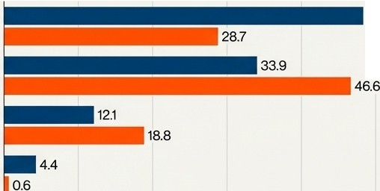
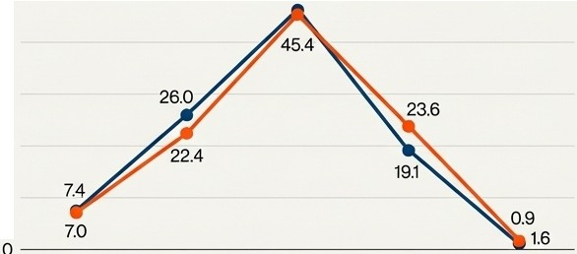
Clue #2: Arrest Demographics Diverge Significantly
by Race, But Not by Age
Race Distribution of Arrestees Age Distribution of Arrestees
50
46.5
48.3
₋ 40
Black
-
Hispanic
*
-
<l1 30
0)
Oil
C
White
� 20
(!)
a...
Asian/Pacific
Islander
10
0
10
20 30
Percentage (⁰/4)
40
50
<18
18-24
25-44
45-64
65+
**Key Findings**
**Divergent Racial Patterns**
NYPD: 48.3%Black, 33.9°/4 Hispanic
LAPD: 46.6% Hispanic, 28.7% Black
**Convergent Age Patterns**
Arrests in both cities peak in the25-44 age group (NYPD: 46.5%, LAPD: 45.4%).
The distribution across all age categories is remarkably similar.
The similar age profiles suggest universal criminologicalconstants. The different racialprofiles point to theinfluence of local demographics and enforcement patterns. What links them?

Slide 7
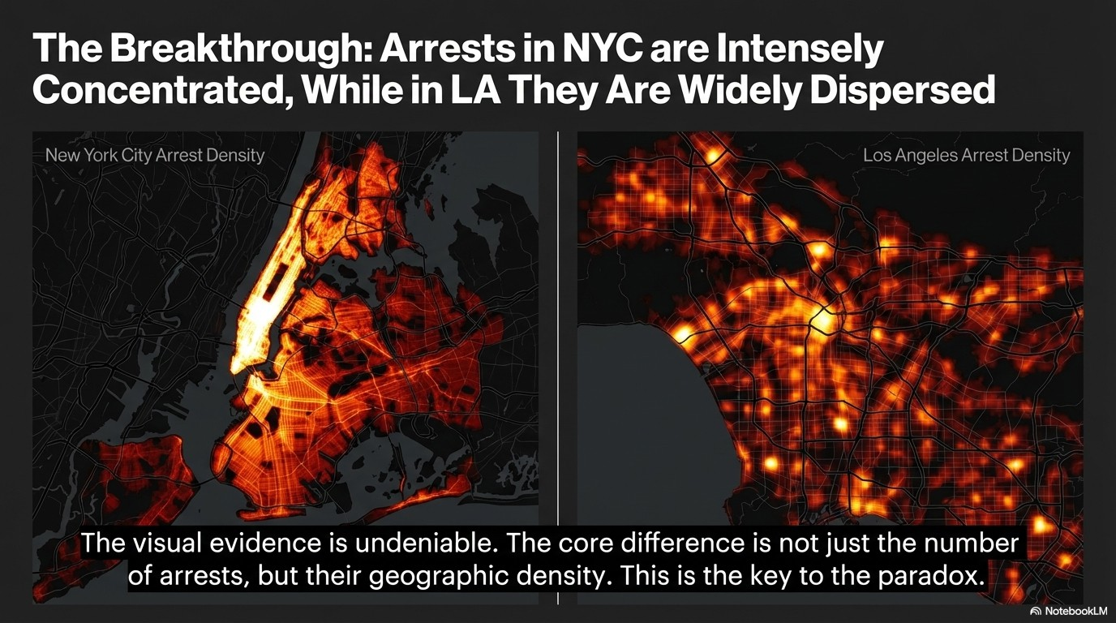

Slide 8
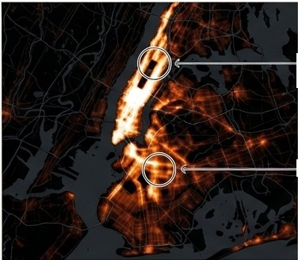
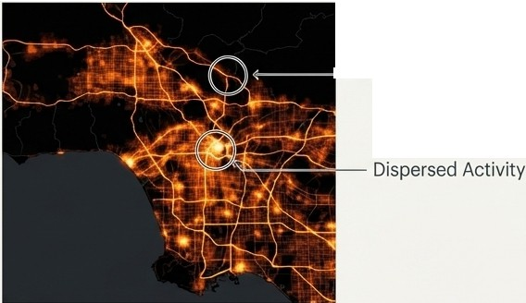
Deconstructing the Geographic Evidence
- Transit-Oriented Hotspots
- Highway-Oriented Patterns
- High-Intensity Zones
New York City: A Story of Concentration
Transit-Oriented Hotspots: Arrest density forms linear patterns along major transit corridors, with extreme concentrations in Manhattan's core.
The Island Effect:Manhattan's geography acts as a natural container, intensifying activity within its boundaries.
High-Intensity Zones:NYC exhibits numerous "white-hot" spots, indicating a much higher concentration of arrests per square mile.
Los Angeles: A Story of Dispersion
Highway-Oriented Patterns: Arrest locations create web-like patterns that mirror the city's sprawling highway system.
Dispersed Activity:Hotspots are fewer, less intense, and spread across a vast geographic area from Downtown to Hollywood.
Lower Overall Intensity: Even LA's densest areas do not reach the peak intensity seen in NYC's core.

Slide 9
The Verdict: The 'Density Effect' is the Primary Driver of Arrest Patterns
High Population Density (NYC)
New York City's exceptional density acts as a 'crime multiplier'.By concentrating millions of people inasmall area, it naturally increases the frequency of interactions that can lead to conflict and criminal activity. This,combined with concentrated policing,explains both the higher volume of arrests and the intense hotspots observed in the spatial data.
,
�
,,
'
'
Increased Human Interaction
' 'V
Concentrated Opportunities forCrime
Intensified Policing in Hotspots
uThis finding aligns with criminological research positing that crime occurs when motivated offenders and suitable targets converge in the absence of capable guardians-a scenario far more common in a dense urban core."
Higher Arrest Volume & Extreme Geographic Concentration

Slide 10


How the Evidence Aligns with Criminological Theory
6A�
Routine Activities Theory
High-density environments like NYC drastically increase the convergence of offenders and targets,creating more opportunities for crime compared to dispersed environments like LA.
�'-._/�
The Law of Crime Concentration
Our maps are a textbook illustration of this law.The effect is amplified inNYC, where crime clusters intensely in specific micro-geographiclocations like transit hubs and business districts.
Crime Pattern Theory
The analysis shows how urban structures-'nodes,paths, and edges'-shape crime. NYC's subway system creates high-traffic paths that concentrate crime,while LA's
highways disperse it.

Slide 11


Policing Strategies Must Be Tailored to a City's Urban Geography
.... ru : .' =-₋
.•••..
,.^{I}, . ⁻ ₋-
₋-
=
::: ti
• • • I
For High-Density Cities (like NYC)
The data supports strategies involving targeted interventions at high-traffic "micro-hotspots" such as major transit stations and commercial centres.
Resource allocation can be highly concentrated and focused on pedestrian-heavy zones.
For Sprawling Cities (like LA)
Effective strategies likely require more dispersed and mobile enforcement to cover a wider, less predictable geographic area.
An understanding of arterial routes and highway networks is more critical than focusing on single nodes.
Key Insight: A 'one-size-fits-all' approach to urban policing is ineffective. A city's physical form is a critical variable in designing public safety initiatives.

Slide 12




Comparing Crime Rates Without Accounting for Density is Fundamentally Misleading
When measured per square mile, the NYPD makes approximately 40 times more arrests
than the LAPD. This statistic doesn't mean NYC is 40 times more dangerous. It demonstrates how profoundly population density shapes the metrics we use to measure and understand crime.
Direct comparisons of crime data between cities with vastly different urban structures can lead to flawed conclusions if density is not considered as a primary contextual factor.

Slide 13



As Cities Evolve, the Link Between Urban Design and Public Safety Becomes Ever More Critical
The "density effect" observed in this 2010-2019 analysis provides a vital baseline for
understanding urban crime.
::::: 8
---
Future research must explore how these
dynamics are changing in the post-pandemic landscape, with shifts in remote work, urban migration, and new mobility patterns.
_,
0
!:?Itll OCl
11: 1-.....J.
t:i Ill oil
:tt::f:t:l::tf::::f-itiro
00"'1-r_;.1.--:..::.
ti to CJll �;-('. .... .,,
For urban planners, policymakers, and law enforcement agencies, understanding the
intricate relationship between a city's physical form and its social outcomes is essential for building safer, more equitable cities for the future.
...
�
/
!>
-
0
0
0

