Slide 1
UNIT-6

Slide 2
FILE HANDLING
Describing the basics of input and output in Java,
read and write data from the console,
File streams, using streams to read and write files, using the path interface to operate on file, using the path interface to operate on directory paths,
using the files class to check, delete, copy, or move a file, or move a directory

Slide 3
File handling in Java
File handling in Java means that how to read from and write to file in Java.
Java provides the basic I/O package for reading and writing streams.
java.io package allows to do all Input and Output tasks in Java .
What is Stream
an object that either delivers data to its destination (screen, file, etc.) or that takes data from a source (keyboard, file, etc.)
  A stream in java is a path along which data flows
It can be of two types :
Byte Stream and Character Stream.
When an I/O stream manages 8-bit bytes of binary data, it is called a byte stream. And, when the I/O stream manages 16-bit Unicode characters, it is called a character stream.

Slide 4
Stream – A sequence of data.
Input Stream: reads data from source.
Output Stream: writes data to destination.
Byte oriented reads byte by byte. A byte stream is suitable for processing raw data like binary files.
Character stream is useful when we want to process text files. These text files can be processed character by character.

Slide 5
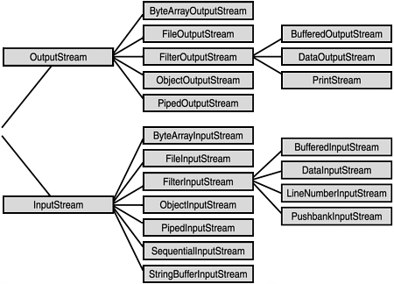
Byte Stream classes:
Byte Stream

Slide 6
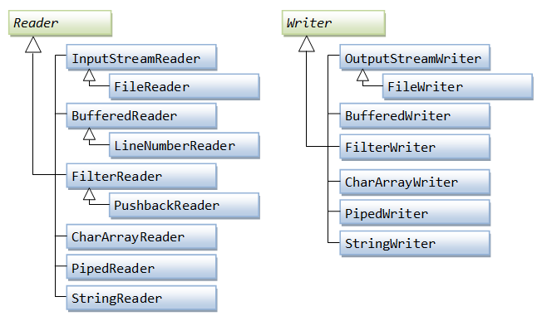
Character Stream classes:

Slide 7
Byte Stream Classes Example: using InputStream and OutputStream
  ByteStreamEx.java
Character Stream Classes Example: using FileWriter and FileReader
  CharacterStreamEx.java

Slide 8
read and write data from the console
In Java, there are three different ways for reading input from the user in the command line environment(console).
  1.Using Buffered Reader Class
  2. Using Scanner Class
  3. Using Console Class

Slide 9
using the path interface to operate on file
The Path interface is located in the java.nio.file package, so the fully qualified name of the Java Path interface is java.nio.file.Path.
A Java Path instance represents a path in the file system. A path can point to either a file or a directory.
A path can be absolute or relative.
An absolute path contains the full path from the root of the file system down to the file or directory it points to.
A relative path contains the path to the file or directory relative to some other path.

Slide 10
Example:
import java.nio.file.*;
public class PathExample {
public static void main(String[] args)
{
Path path = Paths.get("E:\\LPU\\myfile.txt");
System.out.println(path.getFileName().toString());
}
}

Slide 11
Copy a file
} catch (FileNotFoundException e) {
System.err.println("FileStreamsTest: " + e);
} catch (IOException e) {
System.err.println("FileStreamsTest: " + e);
}
}
}
import java.io.*;
class file_copy {
public static void main(String[] args) {
try {
File inputFile = new File("file1.txt");
File outputFile = new File("file2.txt");
FileInputStream fis = new FileInputStream(inputFile);
FileOutputStream fos = new FileOutputStream(outputFile);
int c;
while ((c = fis.read()) != -1) {
fos.write(c);
}
fis.close();
fos.close();

Slide 12
Moving a file
import java.io.File;
public class file_move
{
public static void main(String[] args)
{
try{
File mv =new File("newfile.txt");
if(mv.renameTo(new File("F:\\" + mv.getName()))){
System.out.println("File is moved successful!");
}else{
System.out.println("File is failed to move!");
}
}catch(Exception e){
e.printStackTrace();
}
}
}

Slide 13
Deleting a file
import java.io.*;
public class file_del
{
public static void main(String[] args)
{
File file = new File("newfile.txt");
if(file.delete())
{
System.out.println("File deleted successfully");
}
else
{
System.out.println("Failed to delete the file");
}
}
}

Slide 14
Append to File using PrintWriter: Use PrintWriter to write formatted text to a file.
public static void usingPrintWriter() throws IOException
{
String textToAppend = “Java programming";
FileWriter fileWriter = new FileWriter("c:/samplefile.txt", true); //Set true for append mode
PrintWriter printWriter = new PrintWriter(fileWriter);
printWriter.println(textToAppend); //New line
printWriter.close();
}

Slide 15
Practice Programs
WAP to count vowels in a file
WAP to count the number of characters from a file
WAP to check whether the file is present in the specified location or not

