Slide 1
Java
METHODS & ENCAPSULATION

Slide 2
Topics Covered:
using methods,
method arguments and return values
how arguments are passed to a method
overloading a method
access control, encapsulation
overloading constructor
Nested classes, inner classes
static classes, static methods and variables

Slide 3
using methods
class class_name{
return_type method_name(parameter list)
{
//body of the method
}
}

Slide 4
how arguments are passed to a method
ArraysToMethod(File:ArraysToMethod)

Slide 5
encapsulation
Wrapping up of data under a single unit.
Encapsulation can be achieved by declaring all the variables in the class as private and writing public methods in the class to set and get the values of variables.
Example(File: encapsulationEx)

Slide 6
access control in Java
Access Modifier | within class | within package | outside package by subclass only | outside package
Private | Y | N | N | N
Default | Y | Y | N | N
Protected | Y | Y | Y | N
Public | Y | Y | Y | Y

Slide 7
overloading constructor
Similar like method overloading, you can also overload constructors if two or more constructors are different in parameters.
Example(File:OverloadingConstructor)

Slide 8
A Java constructor name must exactly match with the class name (including case).
A Java constructor must not have a return type.
If a class doesn't have a constructor, Java compiler automatically creates a default constructor during run-time. The default constructor initialize instance variables with default values. For example: int variable will be initialized to 0
Constructors cannot be abstract or static or final.
Constructor can be overloaded but can not be overridden.

Slide 9
Constructor
Types:
  No-Arg Constructor - a constructor that does not accept any arguments
  Default Constructor - a constructor that is automatically created by the Java compiler if it is not explicitly defined.
  Parameterized constructor - used to specify specific values of variables in object

Slide 10
Can a Constructor return any value ?
The answer is the Constructor cannot return any explicit value but implicitly it will be returning the instance of the class.

Slide 11
Access Modifier:- Java provides both Access Specifier and Access Modifiers for creating access to your Java code for other classes. Here modifier is also used to do the same task but there are limitations.
Class Modifier:
  abstract :- This defines the restriction such that objects cannot be created.
  final:- This restricts a class from being inherited.
  strictfp:- it is related to the checking of floating point values irrespective of OS.
Variable Modifier:
  static:no object creation required
  final: cannot be reassigned
  transient: it is not serialized
  volatile: the values are liable for change

Slide 12
Nested classes, inner classes
Define a class within another class. Such a class is called a nested class or inner class.
class OuterClass
{
class NestedClass {
}
}

Slide 13
Nested classes are divided into two categories:
static nested class : Nested classes that are declared static are called static nested classes.
non-static nested class : An inner class is a non-static nested class.

Slide 14
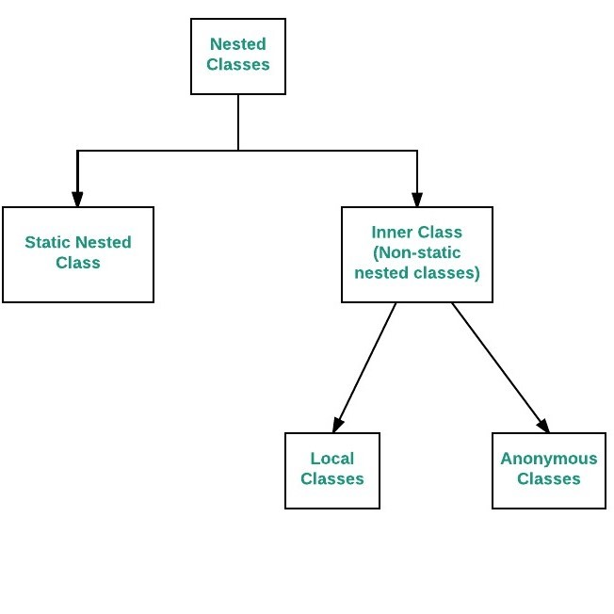

Slide 15
Static nestedClass Example(File:staticNestedClassEx)
Non-Static or inner Class Example(File:innerClassEx)

Slide 16
instantiate an inner class
To instantiate an inner class, you must first instantiate the outer class. Then, create the inner object within the outer object with this syntax:
OuterClass outerObject=new OuterClass();
OuterClass.InnerClass innerObject = outerObject.new InnerClass();

Slide 17
static methods
Static methods are the methods in Java that can be called without creating an object of class. They are referenced by the class name itself .
ClassName.methodName(args)
Example(File: staticMethodEx)

Slide 18
Instance method vs Static method
Instance method can access the instance methods and instance variables directly.
Instance method can access static variables and static methods directly.
Static methods can access the static variables and static methods directly.
Static methods can’t access instance methods and instance variables directly. They must use reference to object.
static method can’t use this keyword

