Slide 1
HANDLING EXCEPTIONS & MULTITHREADING
Unit-5

Slide 2
Syllabus-unit-5
Handling Exceptions: An overview,
catching and throwing exceptions,
propagation of exceptions,
handling multiple exceptions and errors
Multithreading,
thread communication, suspending, resuming,
deadlock and stopping threads

Slide 3
Exception Handling in Java
Exception
Exception is an abnormal condition.
In java, exception is an event that disrupts the normal flow of the program. It is an object which is thrown at runtime.
Suppose there is 10 statements in your program and there occurs an exception at statement 5, rest of the code will not be executed i.e. statement 6 to 10 will not run. If we perform exception handling, rest of the exception will be executed. That is why we use exception handling.

Slide 4
Exception Handling
Exception Handling is a mechanism to handle runtime errors.
Types of Exception:
There are mainly two types of exceptions: checked and unchecked where error is considered as unchecked exception.
Checked Exception
Unchecked Exception
Error

Slide 5
1)Checked Exception:
.Checked exceptions are checked at compile-time.
e.g. IOException, SQLException, ClassNotFoundException etc
2)Unchecked Exception: Unchecked exceptions are not checked at compile-time rather they are checked at runtime.
e.g. ArithmeticException, NullPointerException, ArrayIndexOutOfBoundsException, NumberFormatException etc.
3)Error
e.g. OutOfMemoryError, VirtualMachineError, AssertionError etc.

Slide 6
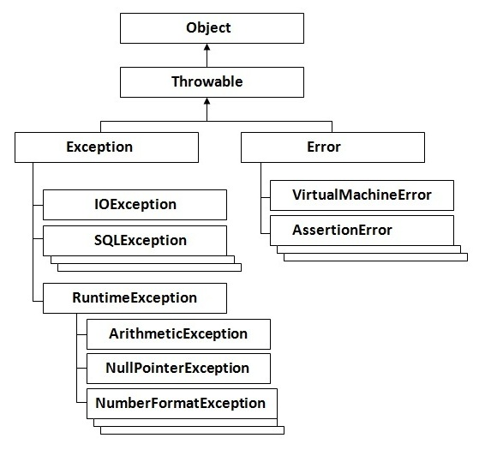
Hierarchy of Exception classes
The Object class is the parent class of all the classes in java by default. In other words, it is the topmost class of java.
Throwable class is the root class of
Java Exception hierarchy

Slide 7
Exception Handling where exceptions may occur
int a=50/0;//ArithmeticException
String s=null; System.out.println(s.length());//NullPointerException
String s="abc";
int i=Integer.parseInt(s);//NumberFormatException
int a[]=new int[5]; a[10]=50; //ArrayIndexOutOfBoundsException

Slide 8
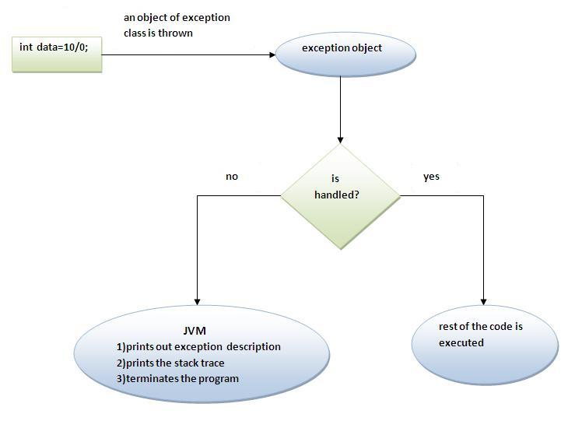
What happens behind the code int a=50/0;

Slide 9
Five keywords used in Exception handling:
try
catch
finally
throw
throws

Slide 10
Multiple catch block:
Rule: At a time only one Exception is occured and at a time only one catch block is executed.
Rule: All catch blocks must be ordered from most specific to most general i.e. catch for ArithmeticException must come before catch for Exception .
Example: tryMultiCatchEx

Slide 11
Nested try syntax:
try {
statement 1;
statement 2;
try {
statement 1;
statement 2;
}
catch(Exception e)
{
}
}
catch(Exception e)
{
} ....
Example: tryNestedTryEx

Slide 12
finally block
The finally block is a block that is always executed. It is mainly used to perform some important tasks such as closing connection, stream etc.
Rule: For each try block there can be zero or more catch blocks, but only one finally block.
Example: finallyBlockEx

Slide 13
Throw/throws keyword
If a method does not handle a checked exception, the method must declare it using the throws keyword. The throws keyword appears at the end of a method's signature.
The throw keyword is used to explictily throw an exception. We can throw either checked or uncheked exception. The throw keyword is mainly used to throw custom exception.
Throw –Example(throwExceptionEx.java)
Throws-Example(throwsExceptionEx.java)

Slide 14
import java.io.*;
public class className
{
public void deposit(double amount) throws IOException
{
// Method implementation
throw new MyException();
}
}

Slide 15
differences
throws Used with method signature while throw used inside method
1) You can declare multiple exception thrown by method in throws keyword by separating them in common e.g. throws IOException, ArrayIndexBoundException etc, while you can only throw one instance of exception using throw keyword e.g. throw new IOException("not able to open connection").
throw keyword can also be used to break a switch statement without using break

Slide 16
int number = 5;
switch(number){
case 1:
throw new RuntimeException("Exception number 1");
case 2:
throw new RuntimeException("Exception number 2");
}

Slide 17
Custom exception
class MyException extends Exception
{
}
Example:-CustomException(invalidInputException.java) and (invalidInputExceptionEx.java)
Exception methods:
printStackTrace():for displaying exception message with details
getMessage(): Only display exception name

Slide 18
Exception Propagation
An exception is first thrown from the top of the stack and if it is not handled, it drops down the call stack to the previous method,If not handled there, the exception again drops down to the previous method, and so on until they are handled or until they reach the very bottom of the call stack.This is called exception propagation.
Example: (exceptionPropagation.java)

Slide 19
Multihreading in Java
multithreading,
thread communication,
suspending, resuming, deadlock and stopping threads

Slide 20
Multithreading in java is a process of executing multiple threads simultaneously.
Multithreading is used to achieve multitasking.
Threads are independent, so it doesn't affect other threads if an exception occurs in a single thread.
It doesn't block the user because threads are independent and you can perform multiple operations at the same time.
You can perform many operations together, so it saves time.

Slide 21
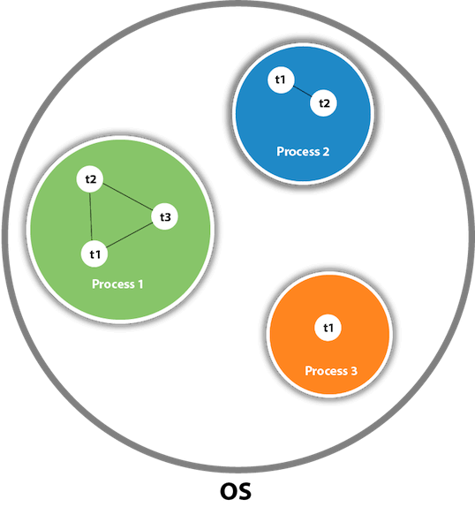
Process
&
Thread

Slide 22
Process means any program is in execution.
Thread is the segment of a process means a process can have multiple threads and these multiple threads are contained within a process.

Slide 23
Differences between process and thread:
Process | Thread
Process means any program is in execution | Thread is the segment of a process means a process can have multiple threads and these multiple threads are contained within a process.
It takes more time for creation. | It takes less time for creation.
Process takes more time to terminate. | Thread takes less time to terminate.
Process is less efficient in term of communication. | Thread is more efficient in term of communication.
Process consume more resources. | Thread consume less resources.
Each process allocates a separate memory area. | Threads share the same address space.
Cost of communication between the process is high. | Cost of communication between the thread is low.

Slide 24
Multithreaded Server: For Serving Multiple Clients Concurrently
Client 1 Process
Server Process
Server
Threads
Internet
Client 2 Process

Slide 25





Web/Internet Applications:
Serving Many Users Simultaneously
PC client
Internet Server
Local Area Network
PDA

Slide 26
Creating threads in Java
Create a class that extends the Thread class
Create a class that implements the Runnable interface

Slide 27
Create a class by extending Thread class and override run() method:
class MyThread extends Thread
{
public void run()
{
// thread body of execution
}
}

Slide 28
Create a thread:
MyThread thr1 = new MyThread();
Start Execution of threads:
thr1.start();
Create and Execute:
new MyThread().start();

Slide 29
Create a class that implements the interface Runnable and override run() method:
class MyThread implements Runnable
{
.....
public void run()
{
// thread body of execution
}
}

Slide 30
Creating Object:
MyThread myObject = new MyThread();
Creating Thread Object:
Thread thr1 = new Thread( myObject );
Start Execution:
thr1.start();

Slide 31
The life cycle of the thread in java is controlled by JVM. The java thread states are as follows:
Basically there are four state:
  New Born
  Runnable/Running
  Non-Runnable/Blocked
  Terminated/Dead

Slide 32
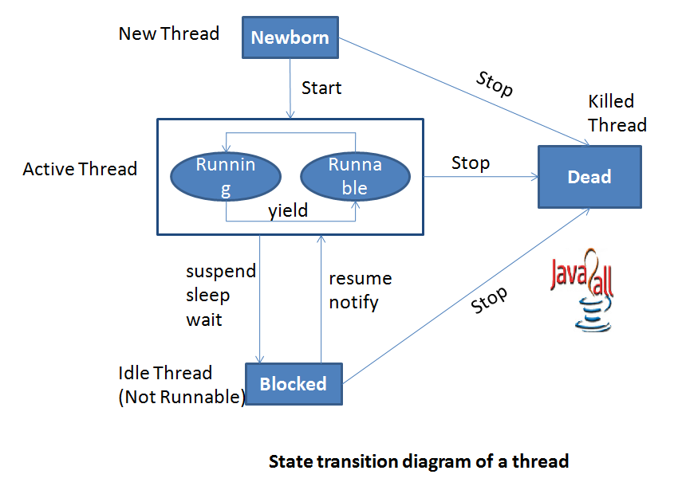

Slide 33
1 Newborn State
When we create a thread it will be in Newborn State.
The thread is just created still its not running.
We can move it to running mode by invoking the start() method and it can be killed by using stop() method.

Slide 34
2 Runnable State
It means that thread is now ready for running and its waiting to give control.
We can move control to another thread by yield() method.
A thread that is ready to run is moved to runnable state. In this state, a thread might actually be running or it might be ready run at any instant of time. It is the responsibility of the thread scheduler to give the thread, time to run.

Slide 35
3 Running State
It means thread is in its execution mode becaause the control of cpu is given to that particular thread.
It can be move in three different situation from running mode.

Slide 36
4 Blocked State
A thread is called in Blocked State when it is not allowed to entering in Runnable State or Running State.
It happens when thread is in waiting mode, suspended or in sleeping mode.

Slide 37
5 Dead State
When a thread is completed executing its run() method the life cycle of that particular thread is end.
We can kill thread by invoking stop() method for that particular thread and send it to be in Dead State.

Slide 38
Thread Priority
In Java, each thread is assigned priority, which affects the order in which it is scheduled for running. The threads so far had same default priority (NORM_PRIORITY) and they are served using FCFS policy.
  Java allows users to change priority:
    Threadobject.setPriority(intNumber)
      MIN_PRIORITY = 1
      NORM_PRIORITY=5
      MAX_PRIORITY=10

Slide 39
Thread Priority Example
class A extends Thread
{
public void run()
{
System.out.println("Thread A started");
for(int i=1;i<=4;i++)
{
System.out.println("\t From ThreadA: i= "+i);
}
System.out.println("Exit from A");
}
}
class B extends Thread
{
public void run()
{
System.out.println("Thread B started");
for(int j=1;j<=4;j++)
{
System.out.println("\t From ThreadB: j= "+j);
}
System.out.println("Exit from B");
}
}

Slide 40
Thread Priority Example
class C extends Thread
{
public void run()
{
System.out.println("Thread C started");
for(int k=1;k<=4;k++)
{
System.out.println("\t From ThreadC: k= "+k);
}
System.out.println("Exit from C");
}
}
class ThreadPriority
{
public static void main(String args[])
{
A threadA=new A();
B threadB=new B();
C threadC=new C();
threadC.setPriority(Thread.MAX_PRIORITY);
threadB.setPriority(threadA.getPriority()+1);
threadA.setPriority(Thread.MIN_PRIORITY);
System.out.println("Started Thread A");
threadA.start();
System.out.println("Started Thread B");
threadB.start();
System.out.println("Started Thread C");
threadC.start();
System.out.println("End of main thread");
}
}

