Slide 1


Linux basics for Python developers
JUNE 18, 2019

Slide 2
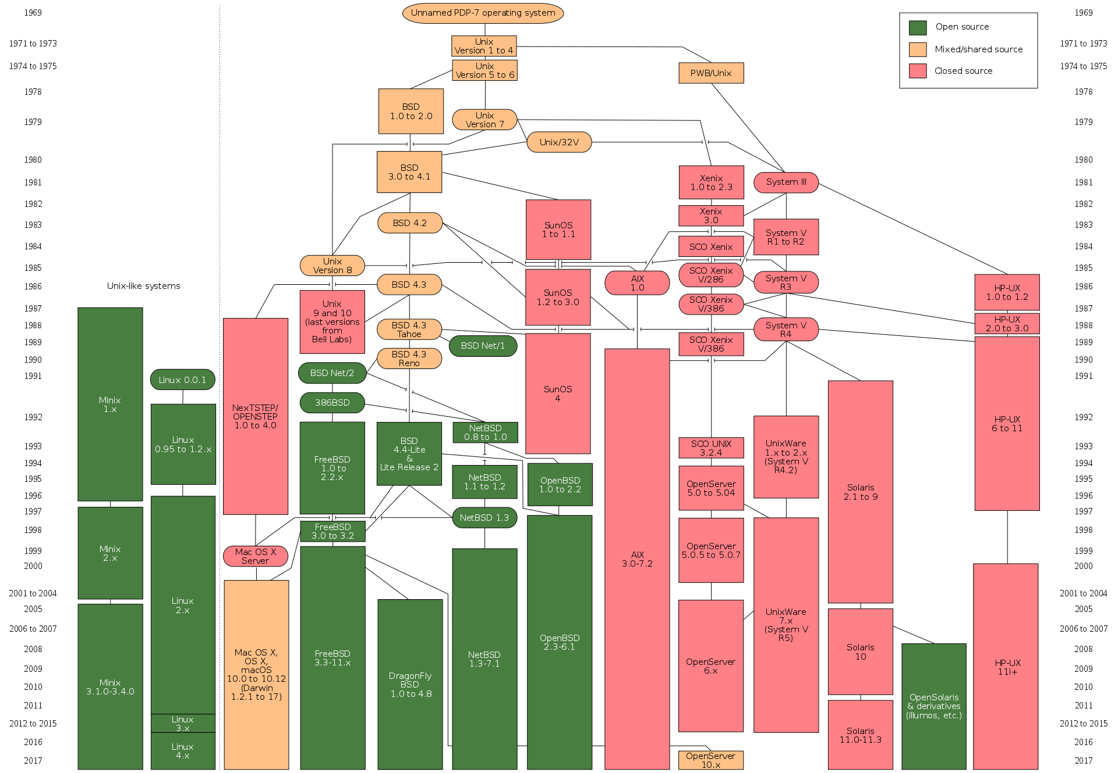
Unix
1969 UNIX
1973 rewritten in the higher language C
1980s SUN, AT&T, Bell Labs, BSD, HP
1990s FreeBSD, NetBSD, OpenBSD
1990s Linux
2000 Mac OS X
POSIX

Slide 3
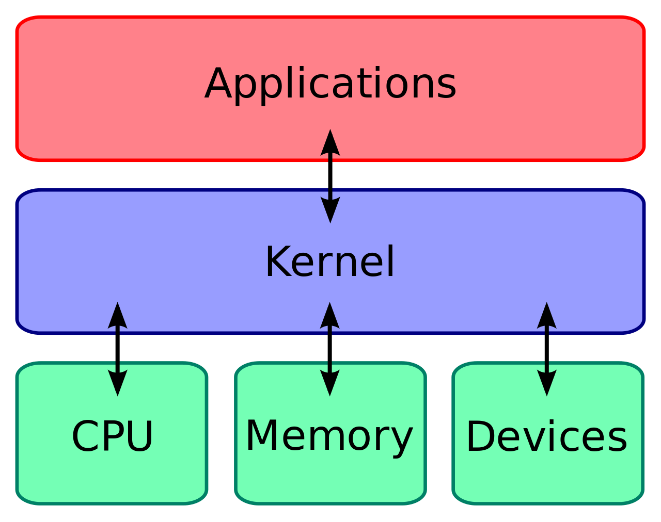
Kernel
Kernel
Userspace
API – syscalls
CLI, GUI

Slide 4
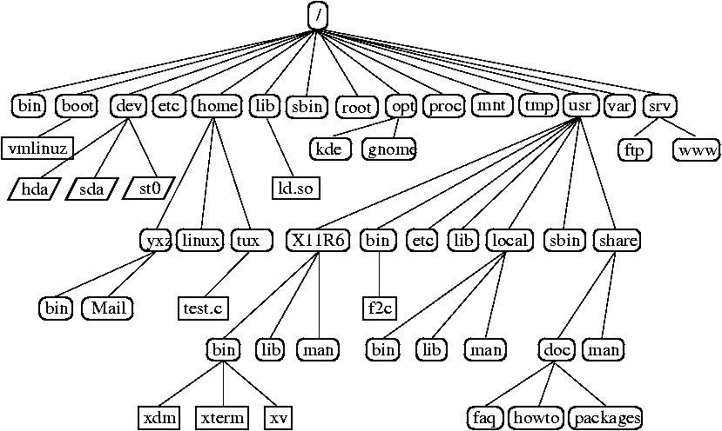
HIER filesystem hierarchy
/etc
/bin
/sbin
/tmp
/root
/home
/dev
/lib
/boot
/var
/usr/{bin,sbin,lib}
/usr/local/{bin,sbin,lib,etc}

Slide 5
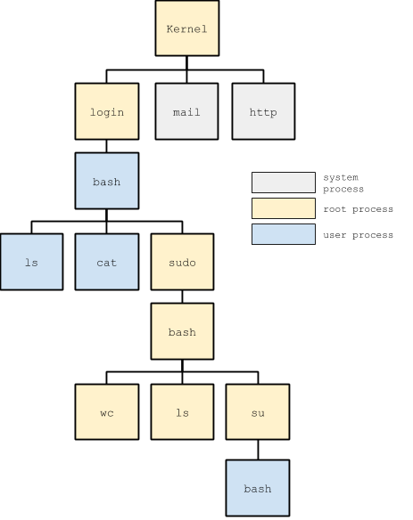
Processes
Kernel processes
User processes
Daemons

Slide 6
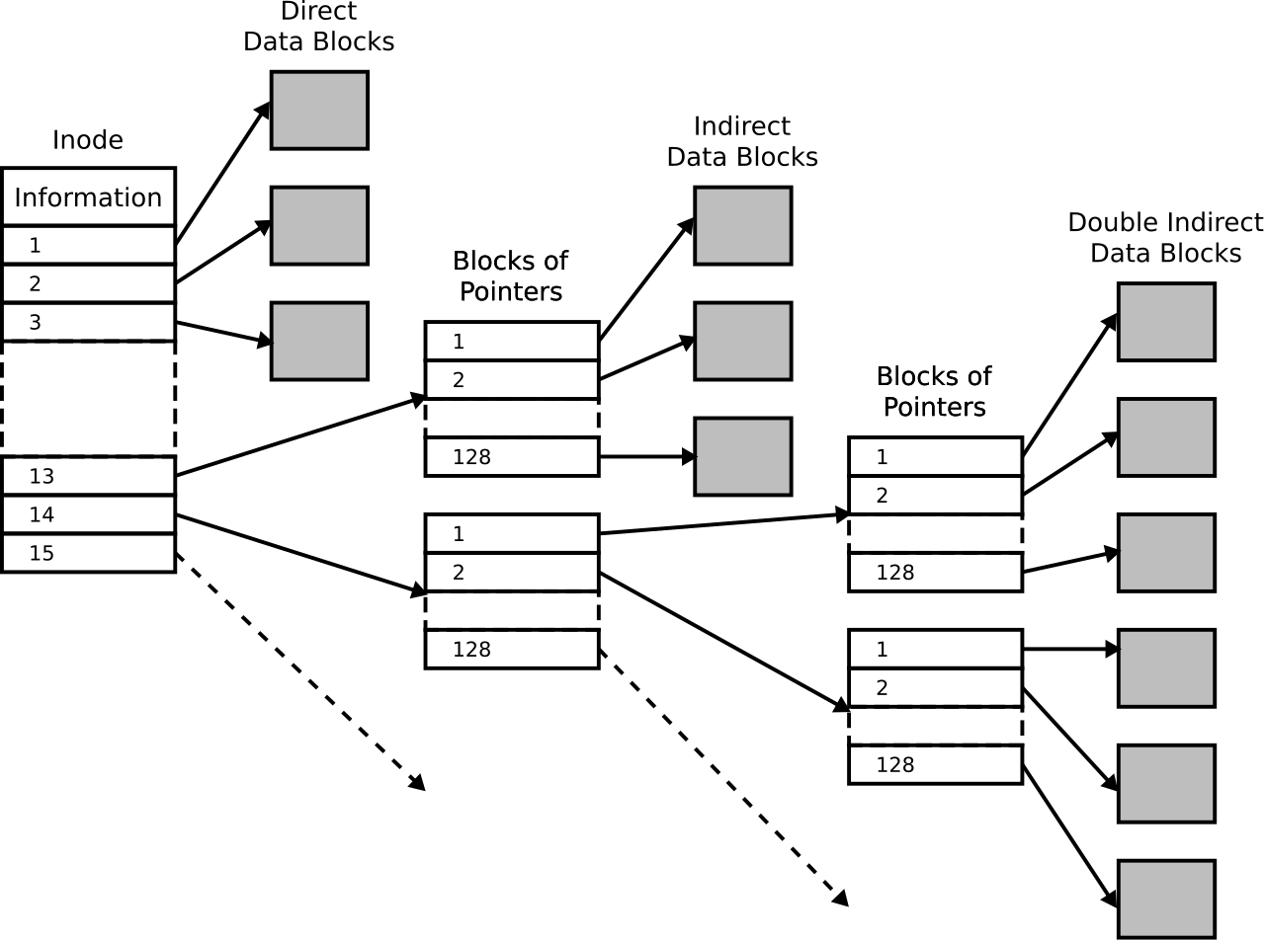
i-node
atime
mtime
ctime
size
Number of links
uid
gid
mode
i-node number

Slide 7
Users and Groups
/etc/passwd
/etc/shadow
/etc/group
/etc/gshadow
adduser, useradd, userdel, usermod

Slide 8
Networking
ifconfig
ip
netstat
ss

Slide 9
Software installation
gcc
make
dpkg, rpm
apt-*, yum

Slide 10
Linux utils, Core utils
https://en.wikipedia.org/wiki/Util-linux
https://en.wikipedia.org/wiki/List_of_GNU_Core_Utilities_commands

Slide 11
Demo
Files and directories
Permissions
Hardlinks, Symlinks
Processes
/proc
/dev

Slide 12
The end

