Slide 1


NETWORKS BASICS: High level protocols HTTP

Slide 2
Высокоуровневые протоколы
SSH
RDP
FTP
DNS
HTTP
SMTP
POP3
NFS
IMAP
LDAP
SNMP
telnet
NTP
finger
BGP
RIP
SIP
OSPF
IS-IS
EIGRP

Slide 3
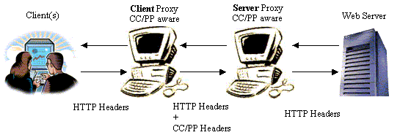
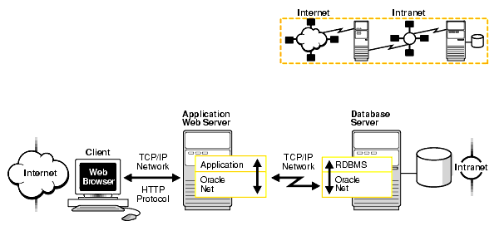
HTTP
Request-response protocol in the client–server computing model
Send Files
Generate Files and Send them

Slide 4
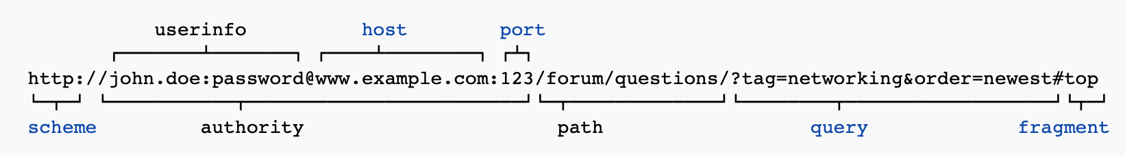
URL
scheme
host
port
Path
query
anchor
>>> urllib.parse.urlparse("https://yandex.ru/mypath/?var1=val1&var2=val2#paragraph1")
ParseResult(scheme='https', netloc='yandex.ru', path='/mypath/', params='', query='var1=val1&var2=val2', fragment='paragraph1')

Slide 5
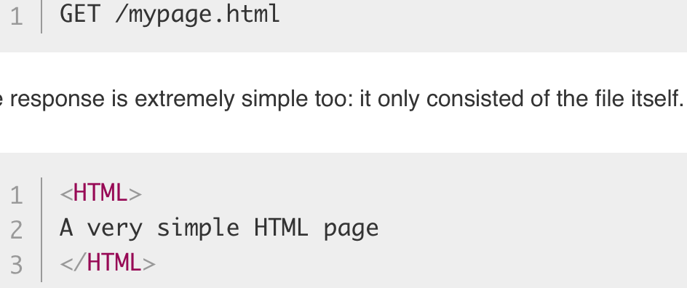
HTTP 0.9
simple client-server, request-response, telnet-friendly protocol
single-line (method + path for requested document)
GET only
hypertext only
single document only
No HTTP headers
No status/error codes
No URL

Slide 6
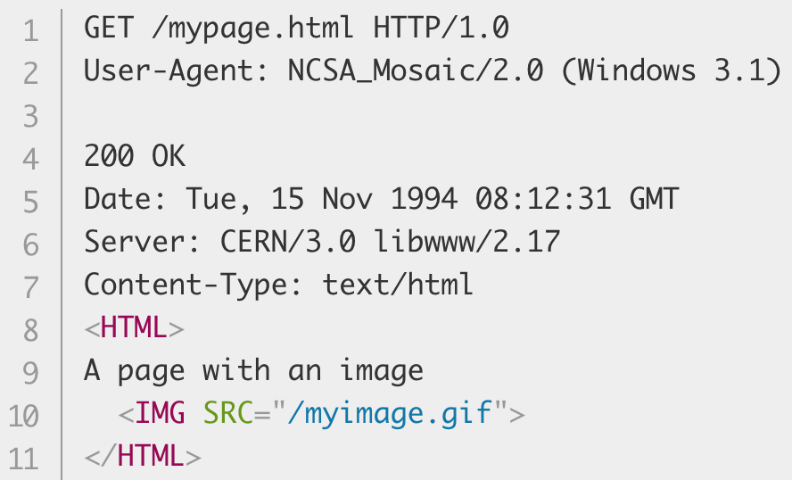
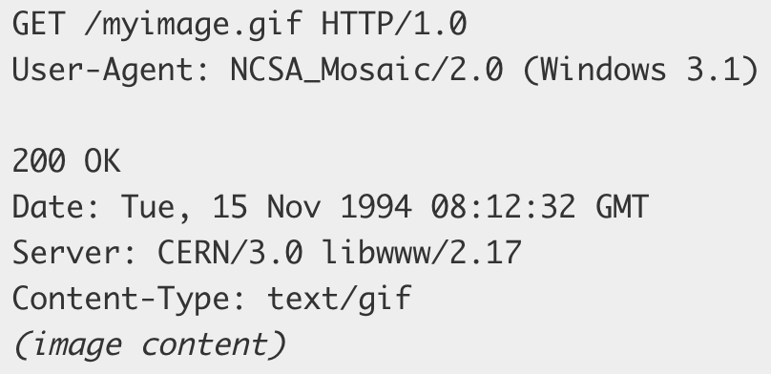
HTTP 1.0
HTTP version
Status Codes
GET HEAD POST
Headers
Content-Type header (any file types)

Slide 7
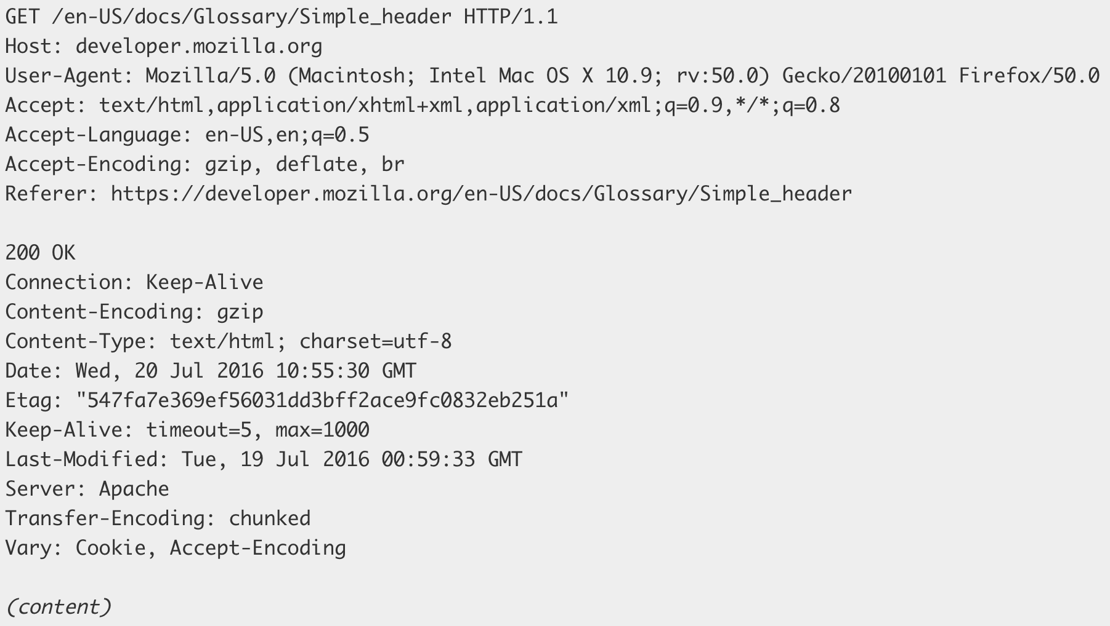
HTTP 1.1
connection can be reused
Pipelining
chunked transfers
compression/decompression
GET , HEAD , POST , PUT , DELETE
TRACE , OPTIONS
Long-lived connection Keep-Alive
Host header (multiple hosts on one IP)

Slide 8
HTTP 2.0
Server push
Binary optimization
Multiplexing
Most of features related to data transfer optimizations.

Slide 9
HTTP 3.0
Based on UDP

Slide 10
HTTPS - SSL
TLS
SSL
PKI
Asymmetric Cryptography vs Symmetric Cryptography

Slide 11
Cookie https://developer.mozilla.org/en-US/docs/Web/HTTP/Cookies
Set-Cookie: <cookie-name>=<cookie-value>
Set-Cookie: id=a3fWa; Expires=Wed, 21 Oct 2015 07:28:00 GMT; Secure; HttpOnly
Set-Cookie: key=value; SameSite=Strict
Set-Cookie: CSRF=e8b667; Secure; Domain=example.com
Cookie: yummy_cookie=choco; tasty_cookie=strawberry

Slide 12
HTTP Methods
OPTIONS
GET
HEAD
POST
PUT
PATCH
DELETE
TRACE
CONNECT

Slide 13
Status Codes
1xx: Informational
2xx: Success 200 201
3xx: Redirection 301 304
4xx: Client Error 401 403 404 405 418
5xx: Server Error 500 502 503 504

Slide 14
http.server https://docs.python.org/3/library/http.server.html
http.server.HTTPServer
http.server.ThreadingHTTPServer
http.server.BaseHTTPRequestHandler
def run(server_class=HTTPServer, handler_class=BaseHTTPRequestHandler):
server_address = ('', 8000)
httpd = server_class(server_address, handler_class)
httpd.serve_forever()

Slide 15
urllib
urllib.parse.urlparse
urllib.parse.parse_qs
urllib.parse.quote
urllib.parse.urlencode

Slide 16
requests https://2.python-requests.org//en/latest/index.html
>>> r = requests.get('https://api.github.com/user', auth=('user', 'pass’))
>>> r.status_code
200
>>> r.headers['content-type’]
'application/json; charset=utf8’
>>> r.encoding
'utf-8’
>>> r.text
u'{"type":"User"...}’
>>> r.json()
{u'private_gists': 419, u'total_private_repos': 77, ...}
import requests
resp = requests.get('http://www.mywebsite.com/user’)
resp = requests.post('http://www.mywebsite.com/user’)
resp = requests.put('http://www.mywebsite.com/user/put’)
resp = requests.delete('http://www.mywebsite.com/user/delete')

Slide 17
Beautiful Soup 4
https://www.dataquest.io/blog/web-scraping-tutorial-python/

Slide 18
We do what we most because we can
NETWORKS: Basics

