Slide 1
Object-Oriented Design

Slide 2
agenda
Object-oriented design process, inputs and outputs
Object-oriented concepts
Metaclass and abstract class in Python
Polymorphism in Python
Inheritance in Python
Object-oriented design principles
Composition over Inheritance

Slide 3
Object-oriented design is the discipline of defining the objects and their interactions to solve a problem that was identified and documented during object-oriented analysis.

Slide 4
Object-Oriented Analysis
Analysis
Design
Use cases and use case diagram
Conceptual model of the problem domain
System sequence diagram
User interface documentations
Relational data model
Class diagram

Slide 5
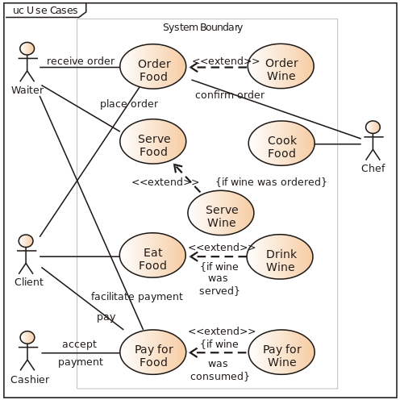
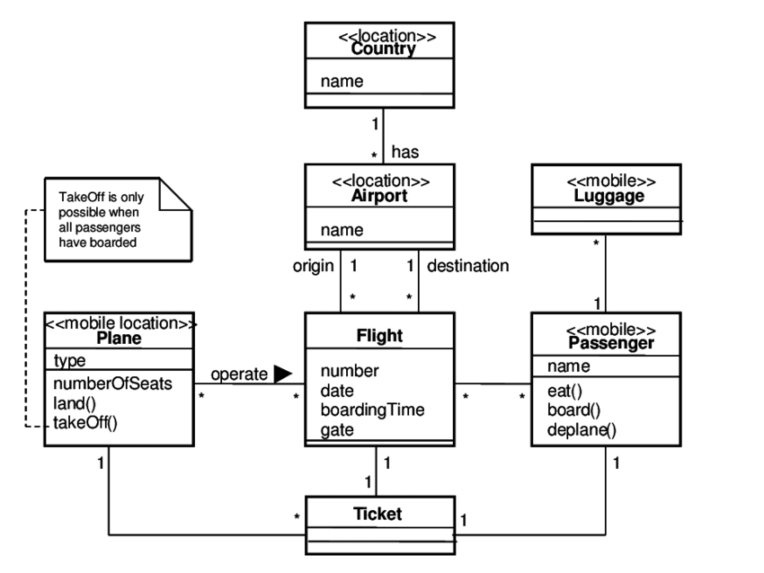
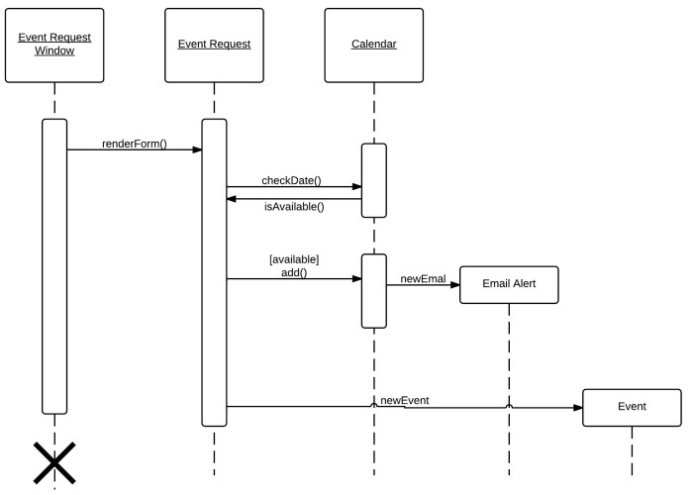
Unified Modeling Language (UML)
Class diagram
Use case diagram
System sequence diagram

Slide 6
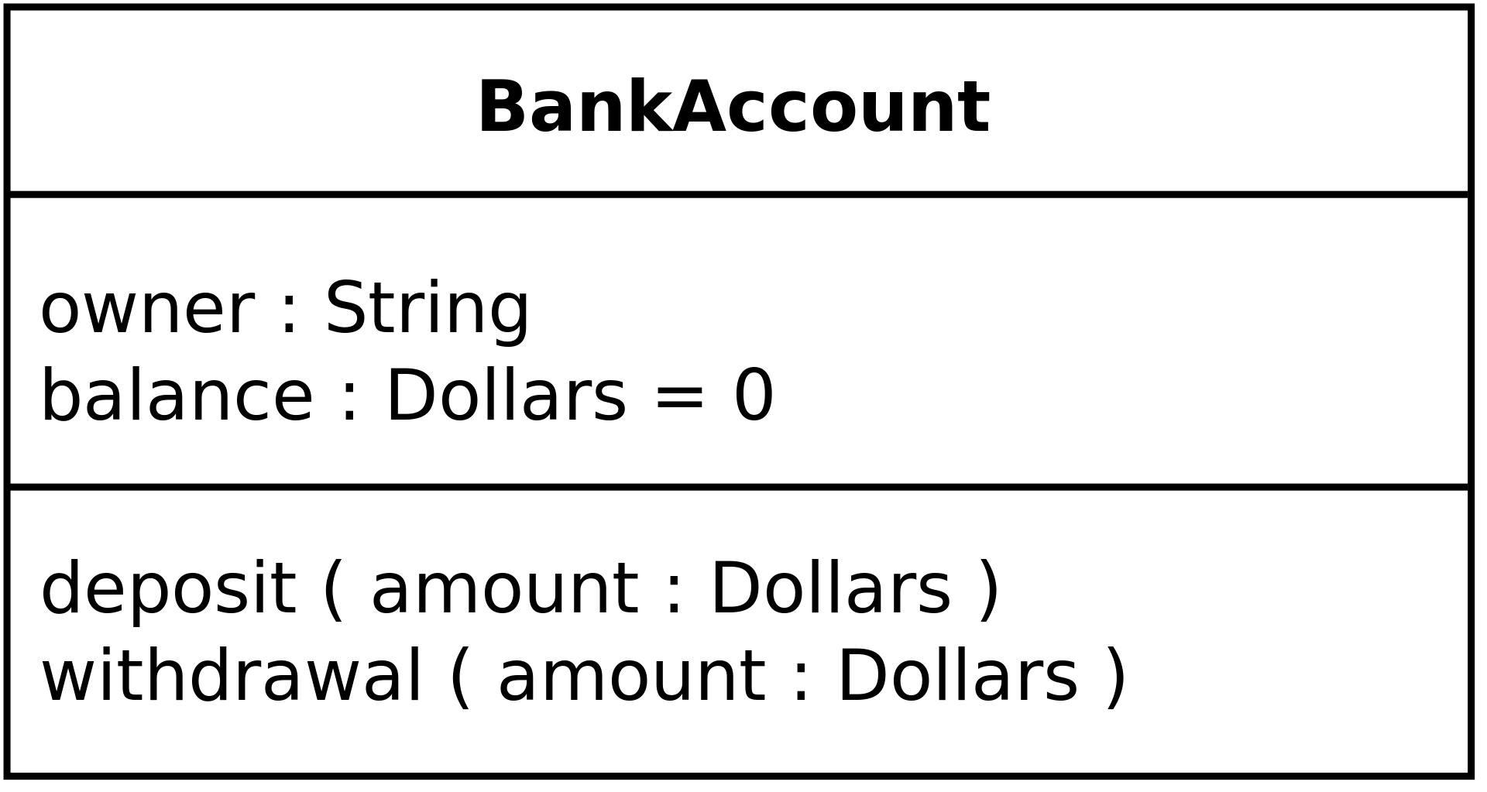
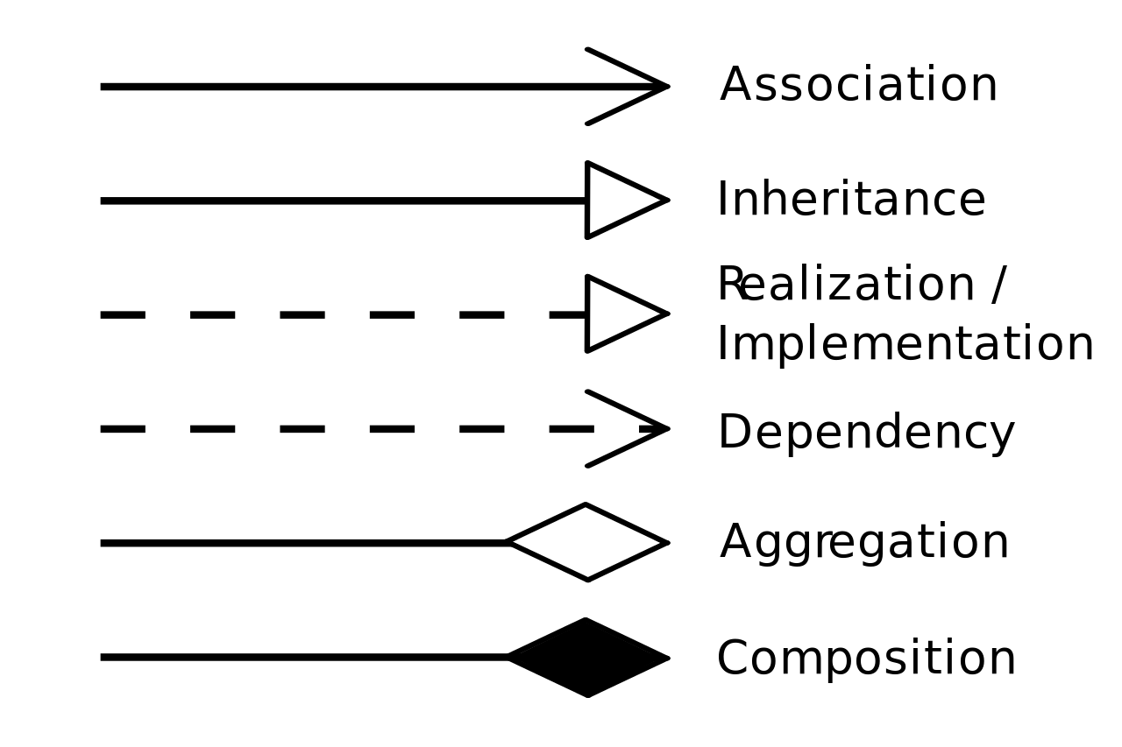
Class Diagram
Class name
Access modifiers:
+ public
- private
# protected
Class members are underlined, instance members are not.
Attributes
Methods

Slide 7
Object-Oriented Concepts
1
Object and Class
2
Abstraction
3
Encapsulation
4
Inheritance
5
Polymorphism

Slide 8
Metaclass and abstract class in Python
object is the base of every object
type is the class of every type, i.e. default metaclass of every class
Abstract classes exist to be inherited, but never instantiated
Creation of abstract class in Python:
Use module abc (abc.ABC, abc.abstractmethod)
Or use raise NotImplementedError to make a method abstract

Slide 9
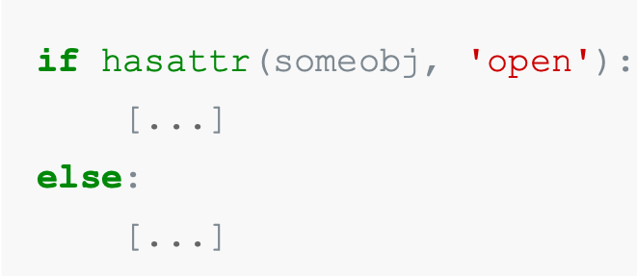
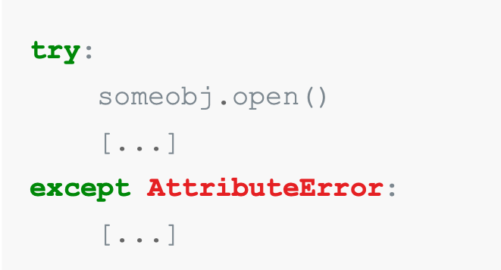
Polymorphism in Python
Ask the data itself to perform the operation
c = a + b actually uses c = a.__add__(b)
len() function calls __len__() method
Subtype polymorphism
“Duck typing”
“Easier to ask for forgiveness than permission” (EAFP)

Slide 10
Inheritance in Python
Use super() instead of hardcoded base class name
Design classes cooperatively:
the caller and callee need to have a matching argument signature
the method being called by super() needs to exist
every occurrence of the method needs to use super()

Slide 11
Design Principles
S
Single Responsibility Principle
O
Open Closed Principle
L
Liskov’s Substitution Principle
I
Interface Separation Principle
D
Dependency Inversion Principle

Slide 12
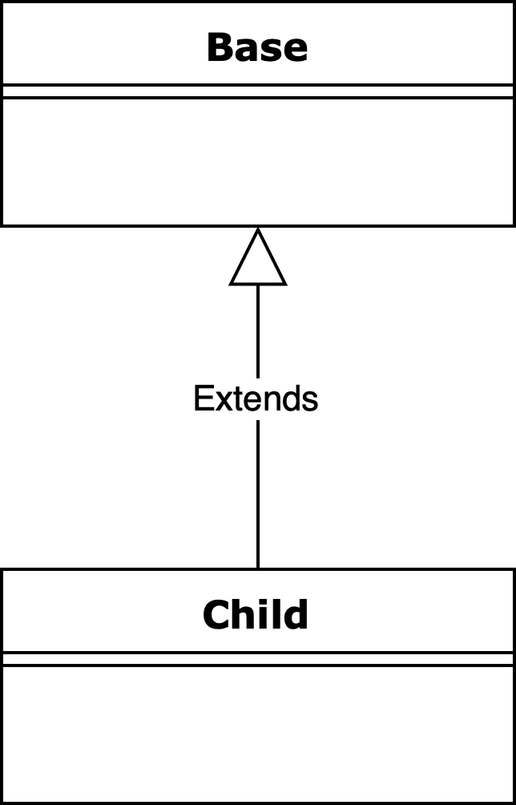
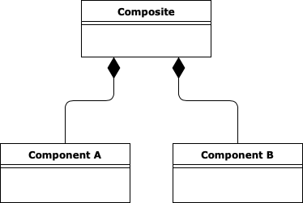
Inheritance and Composition
Inheritance
composition
Models “is a” relationship.
It is tightly coupled relationship.
Can lead to class explosion problem.
Derived classes inherit the interface and implementation of their base classes.
Models ”has a” relationship.
It is loosely coupled relationship.
Flexible and more suitable to change.

Slide 13
Let’s practice

Slide 14
Problem: design HR system
HR system must:
allow to calculate 3 types of employee salary (hourly, fixed and commission)
allow to track productivity (number of hours at work) for 3 types of employees: manager (has fixed salary), factory worker (hourly salary) and sales worker (commission salary)

Slide 15
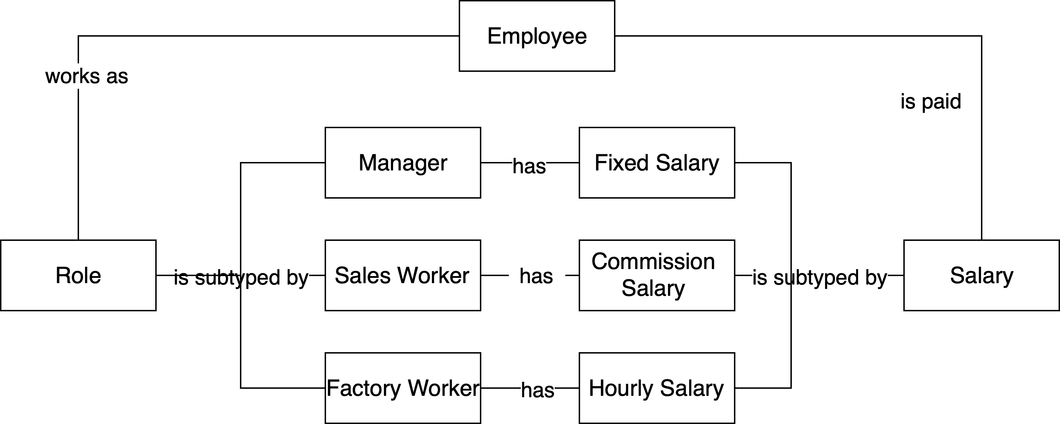
Conceptual Model

Slide 16
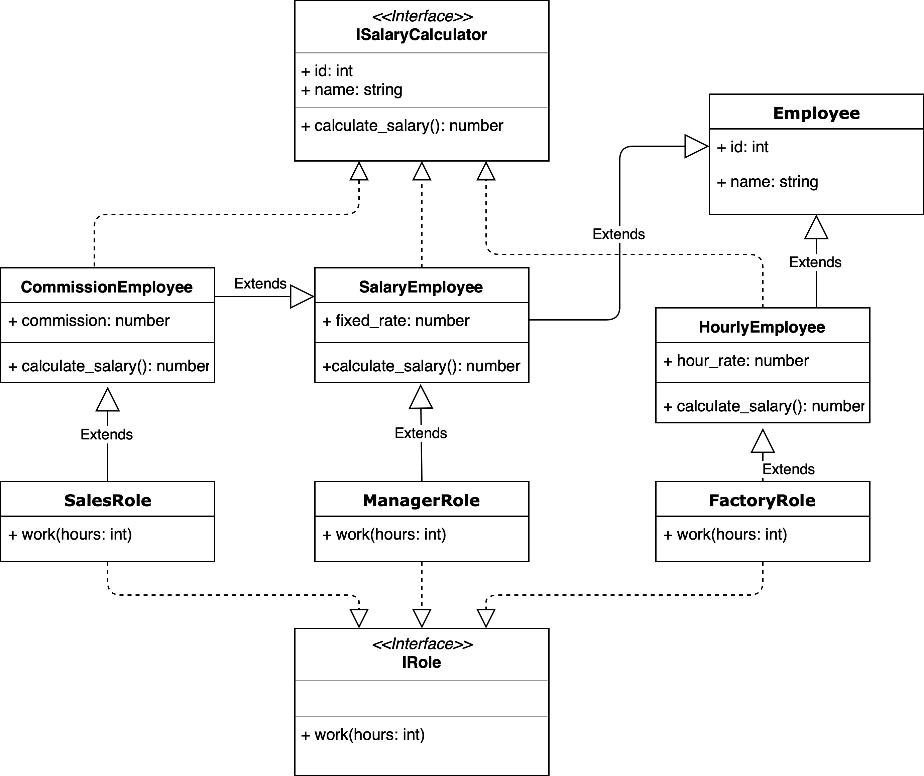
Inheritance solution

Slide 17
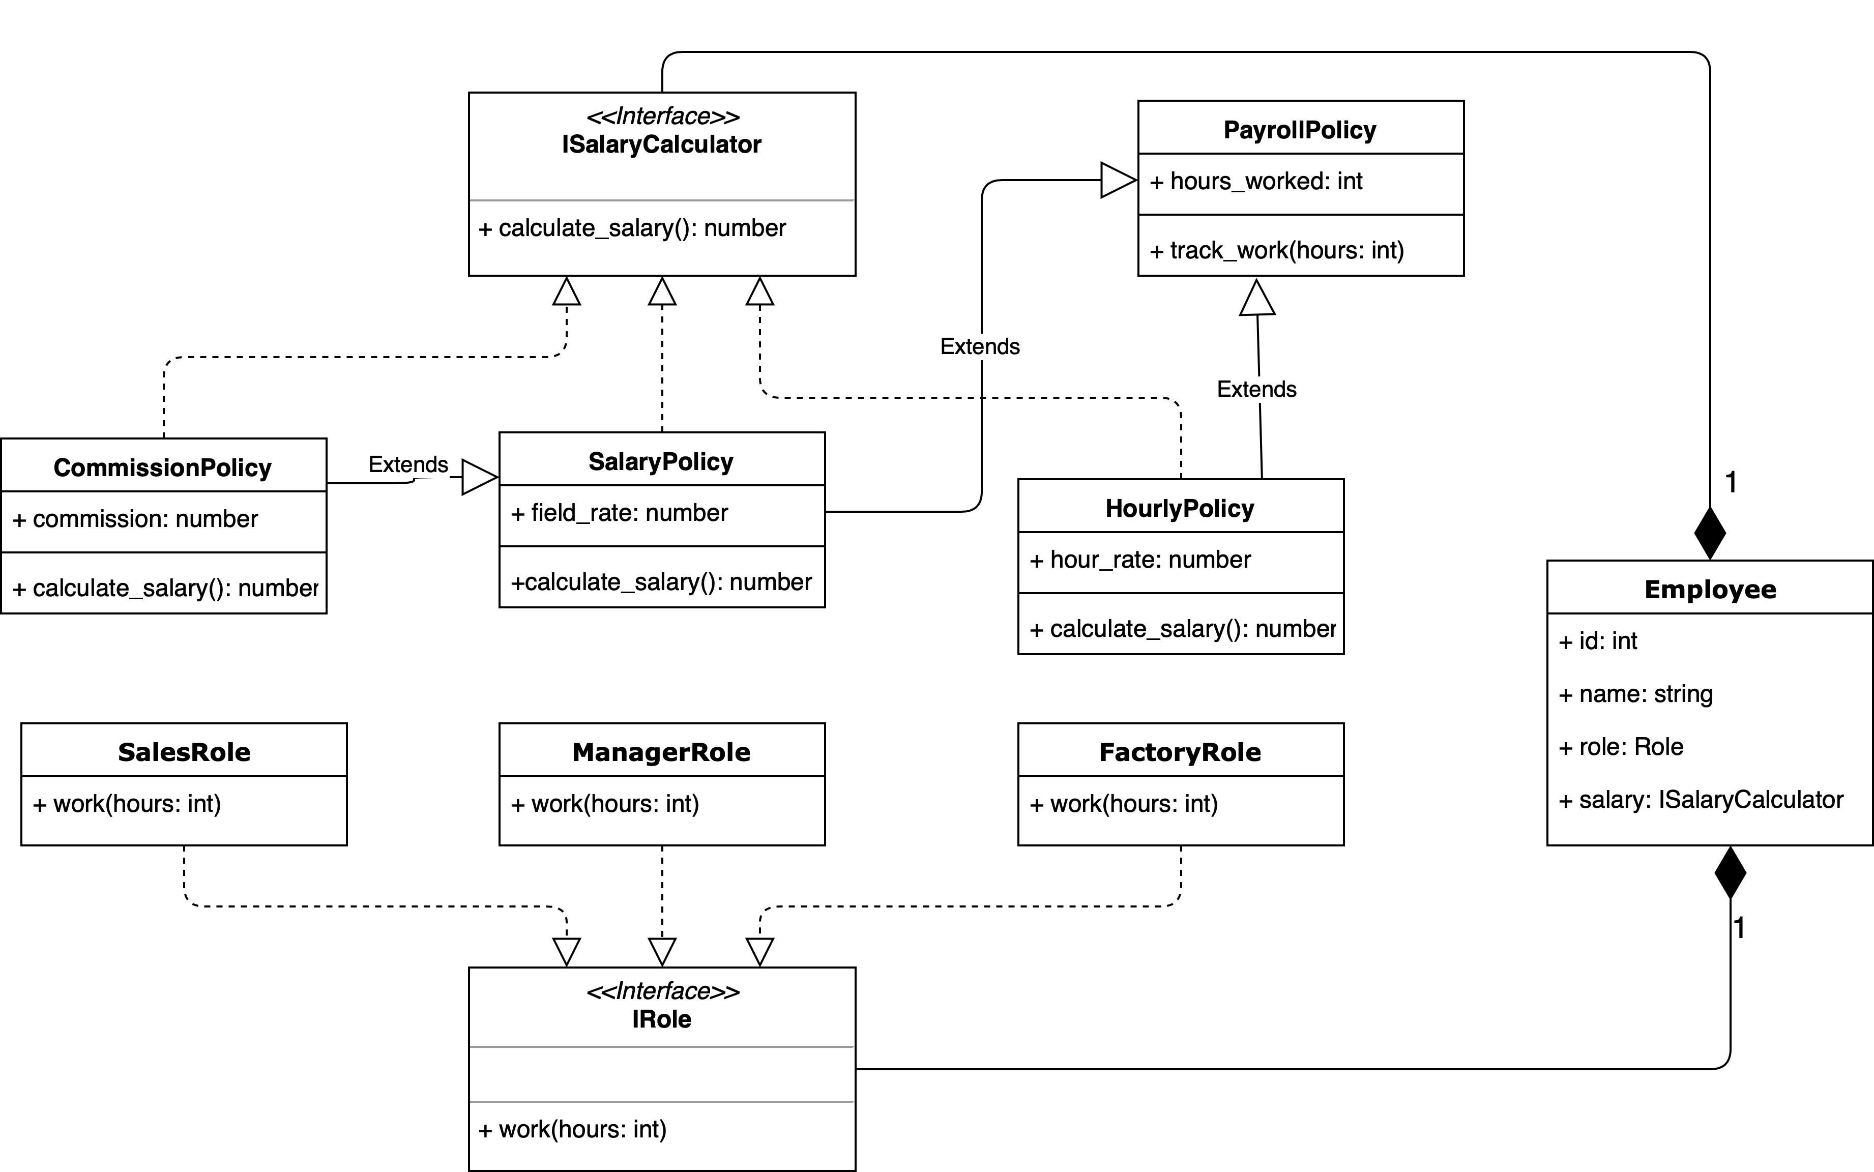
Composition solution

Slide 18
Homework

Slide 19
Homework
On the map there are a Factory, Port, Warehouse A and Warehouse B. Factory has a number of containers that have to be delivered to these warehouses. You have 2 Trucks and 1 Ship that can carry one container at a time (trucks start at the Factory, Ship starts at the Port).
Traveling takes a specific amount of hours (represented by an orange number). Time is needed to travel in one direction, you also spend the same amount of time to come back. Transport picks the first container from the location (first-in, first - out), bring it to the designation, then come back home.
Truck that drops off cargo at the Port doesn't need to wait for the ship (there is a small warehouse buffer there). Transport moves in parallel. First truck might be bringing container to a location A, while the second truck comes back from A, while ship travels back to the Port.
Task: write a program that takes a list of cargos from the command line (format ‘ABBAA’) and prints out the number of hours that it would take to get them delivered.
Analyze the problem
Design the solution
Code it

Slide 20
Homework
Factory
Port
Warehouse A
Input | Output
A | 5
AB | 5
BB | 5
ABB | 7
AABABBAB | ?
ABBBABAAABBB | ?
1
4
Trucks
Ship
5
Warehouse B

Slide 21
Object-Oriented Design
Thank you for attention!

