Slide 1
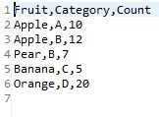
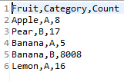

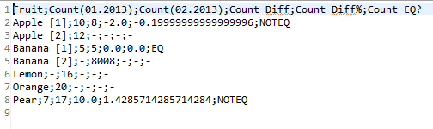
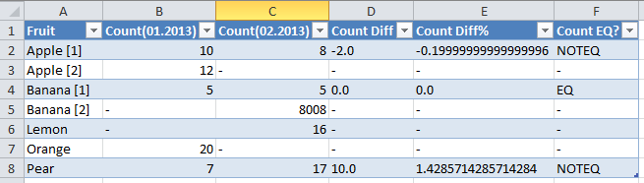
Input / Output Example
Output formatted in Excel(manually):

Slide 2
Input / Output Example
Output formatted in Excel(manually):

Slide 3
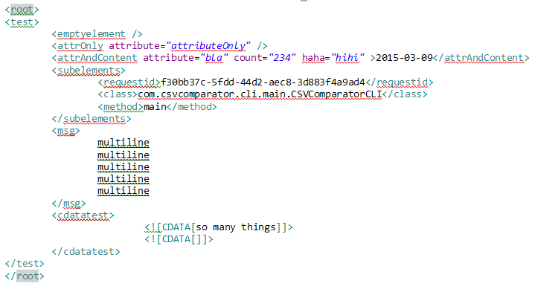


Compare .xml-Files
XML Input
Key,Value
xmlfolder.subfolder1.file1.xml.root.description,folder test
xmlfolder.subfolder1.file1.xml.root.folder,id=sub1
xmlfolder.subfolder2.file2.xml.root.description,Test folder structure
xmlfolder.subfolder2.file2.xml.root.folder,id=sub2
xmlfolder.topfile.xml.root.description,In parent folder
xmlfolder.topfile.xml.root.folder,id=parent
Key,Value
xmlfolder.subfolder1.file1.xml.root.description,folder test
xmlfolder.subfolder1.file1.xml.root.folder,id=sub1
xmlfolder.subfolder2.file2.xml.root.description,Test folder structure
xmlfolder.subfolder2.file2.xml.root.folder,id=sub2
xmlfolder.topfile.xml.root.description,In parent folder
xmlfolder.topfile.xml.root.folder,id=parent

