Slide 1
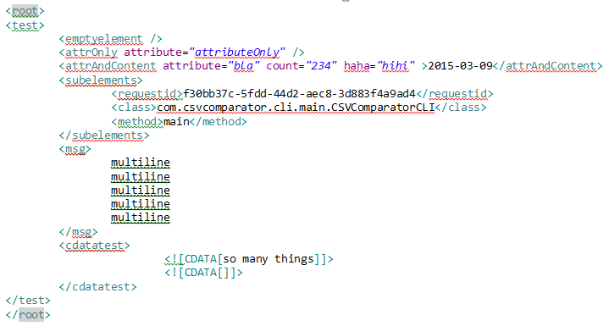

Transforms .xml-Files
Key,Value
smalltest.xml.root.test.attrAndContent,attribute=bla / count=234 / haha=hihi / text=2015-03-09
smalltest.xml.root.test.attrOnly,attribute=attributeOnly
smalltest.xml.root.test.cdatatest.cdata,so many things
smalltest.xml.root.test.cdatatest.cdata,
smalltest.xml.root.test.msg, multiline multiline multiline multiline multiline
smalltest.xml.root.test.subelements.class,com.csvcomparator.cli.main.CSVComparatorCLI
smalltest.xml.root.test.subelements.method,main
smalltest.xml.root.test.subelements.requestid,f30bb37c-5fdd-44d2-aec8-3d883f4a9ad4

Slide 2
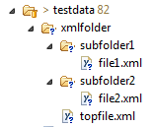
Transforms all .xml-Files in a folder
Key,Value
xmlfolder.subfolder1.file1.xml.root.description,folder test
xmlfolder.subfolder1.file1.xml.root.folder,id=sub1
xmlfolder.subfolder2.file2.xml.root.description,Test folder structure
xmlfolder.subfolder2.file2.xml.root.folder,id=sub2
xmlfolder.topfile.xml.root.description,In parent folder
xmlfolder.topfile.xml.root.folder,id=parent

Slide 3

Transform and Compare
XML Input
Key,Value
xmlfolder.subfolder1.file1.xml.root.description,folder test
xmlfolder.subfolder1.file1.xml.root.folder,id=sub1
xmlfolder.subfolder2.file2.xml.root.description,Test folder structure
xmlfolder.subfolder2.file2.xml.root.folder,id=sub2
xmlfolder.topfile.xml.root.description,In parent folder
xmlfolder.topfile.xml.root.folder,id=parent
Key,Value
xmlfolder.subfolder1.file1.xml.root.description,folder test
xmlfolder.subfolder1.file1.xml.root.folder,id=sub1
xmlfolder.subfolder2.file2.xml.root.description,Test folder structure
xmlfolder.subfolder2.file2.xml.root.folder,id=sub2
xmlfolder.topfile.xml.root.description,In parent folder
xmlfolder.topfile.xml.root.folder,id=parent

