Slide 1
Core Framework Features
An Overview

Slide 2
Purpose of CFW
The following were the goals in mind when the Core Framework(CFW) was created:
Providing a base User Management System (Users, Roles, Permissions)
Extendable Dashboard Feature to allow users to create custom displays
Extendable Configuration, Settings, API and Task Management
Extendable Query Language to process data as needed

Slide 3
USER MANAGEMENT

Slide 4
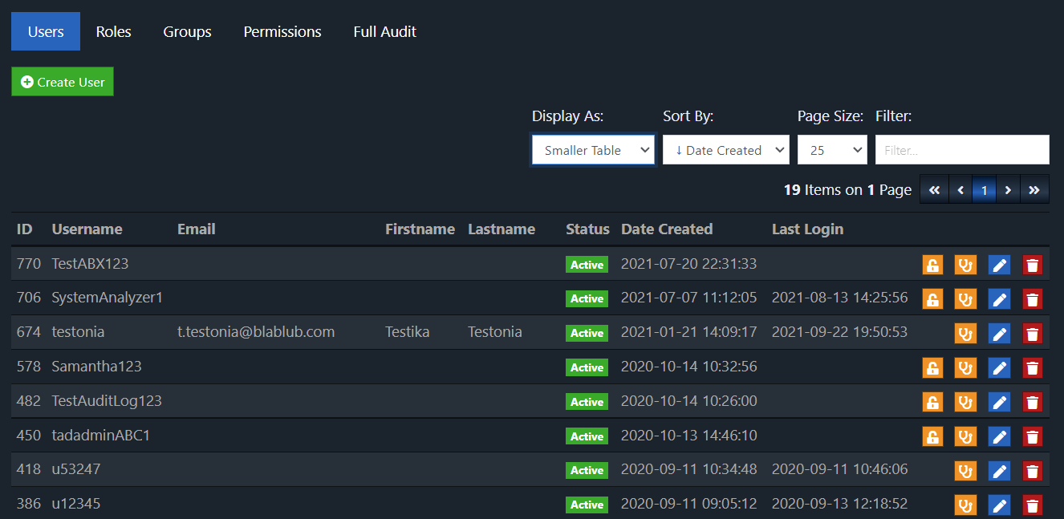
User Management

Slide 5
DASHBOARDING

Slide 6
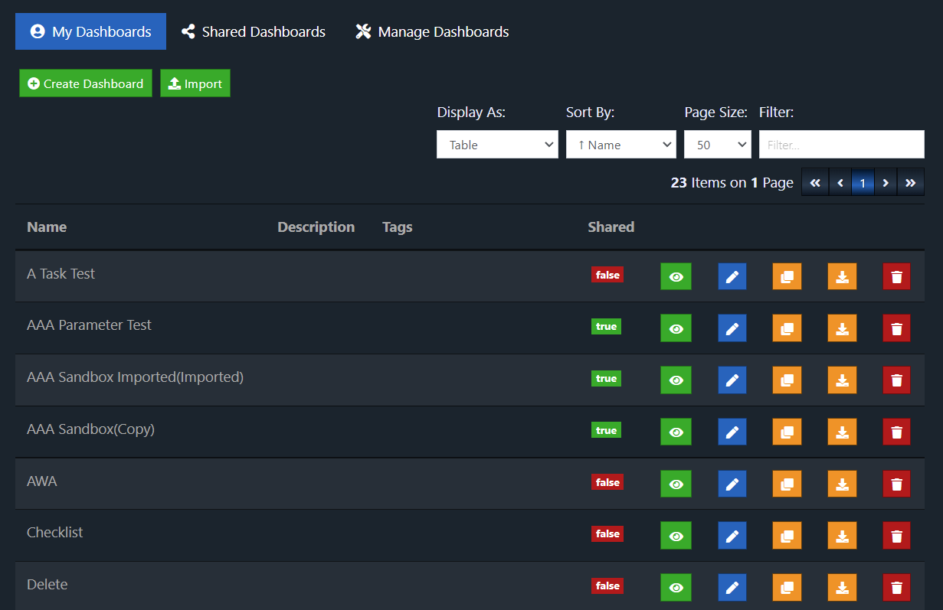
Dashboard List

Slide 7
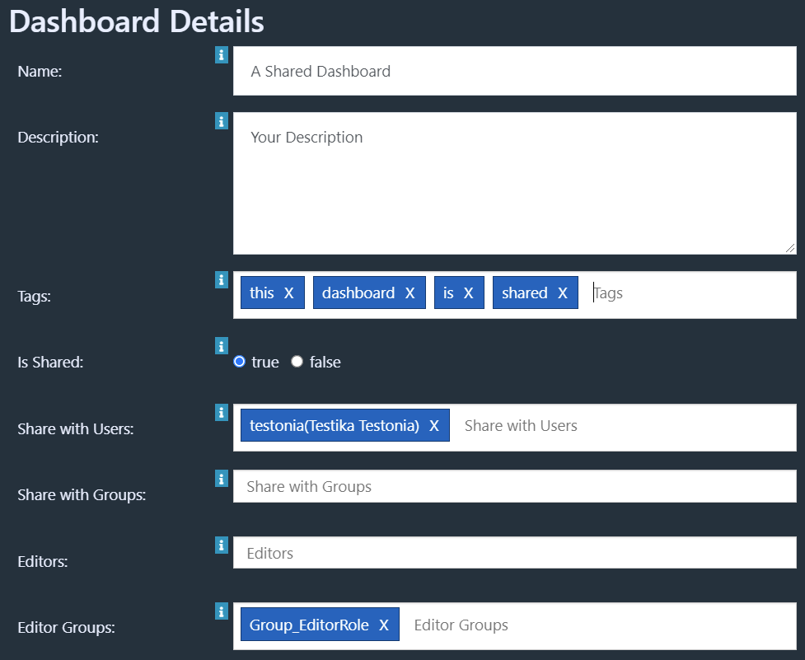
Dashboard Options
Dashboards can be shared with:
Specific users
Groups of users
All who can access the dashboard feature (if no user/group is specified)
Everyone(Public URL)
Editor permissions can be granted to users or groups

Slide 8
Available Dashboard Widgets
Text
Label
List
Checklist
CSV Table
Tags
Image
HTML Editor
Website
Youtube Video
Refresh Time
Parameters
Replica
Display Query Results
Force Refresh
Javascript
Databases:
MySQL
MSSQL
Oracle
Other Databases(JDBC Drivers)

Slide 9
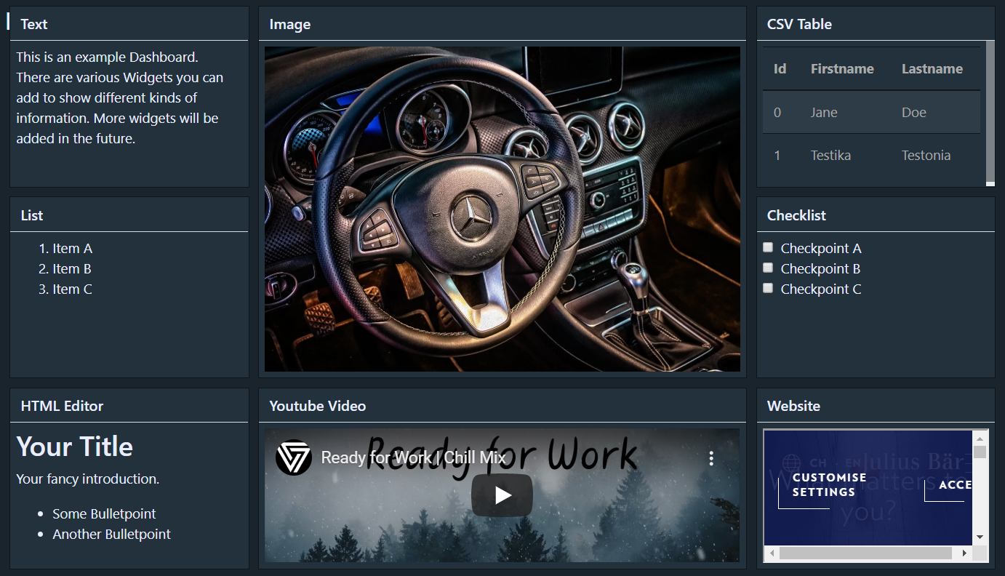
Overview of Standard Widgets

Slide 10
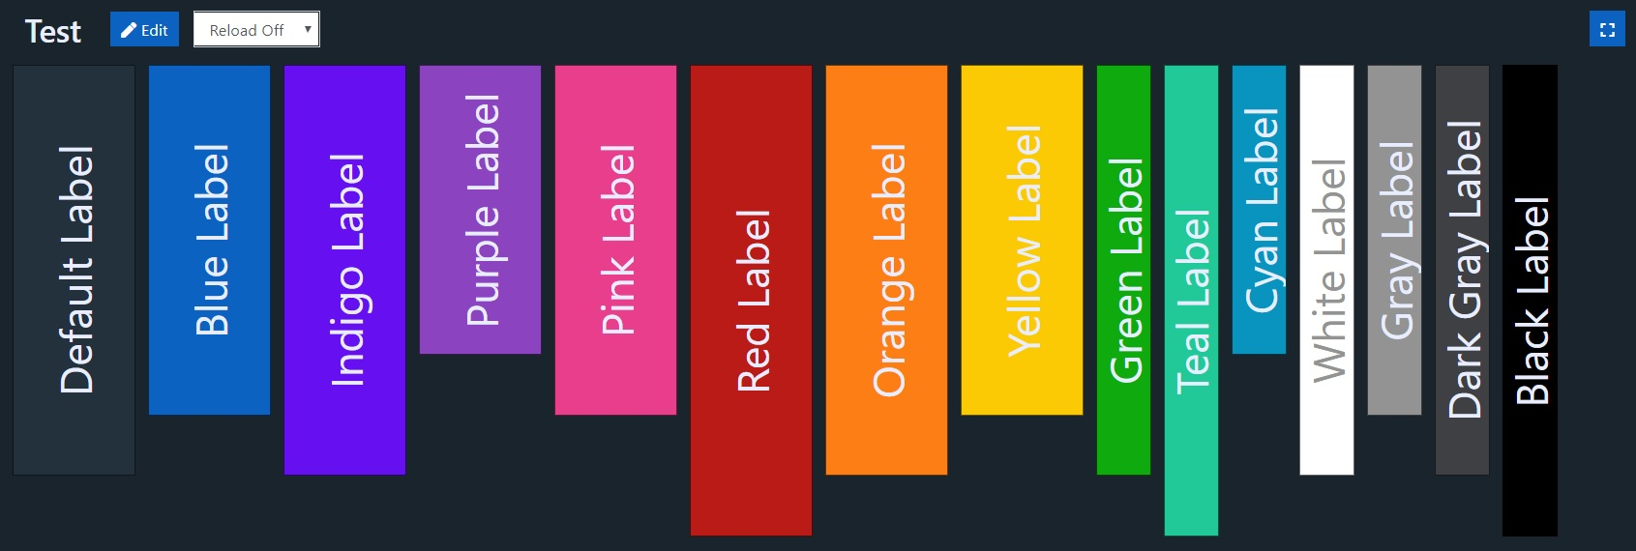
Dashboard Widgets – Colors
Widgets can be colored to highlight or create visual grouping.

Slide 11
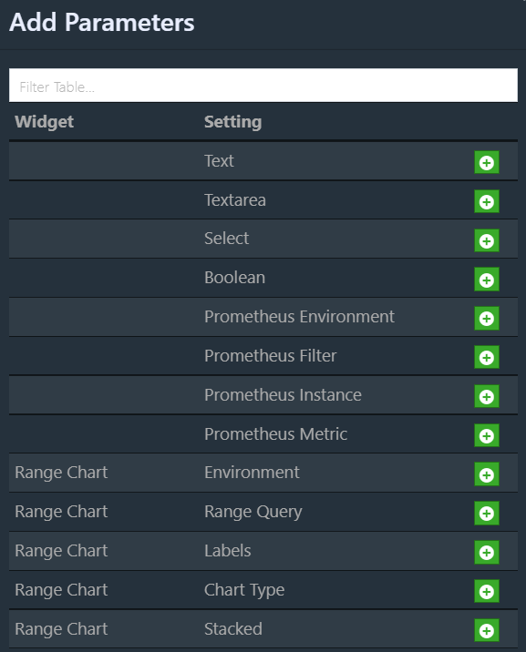
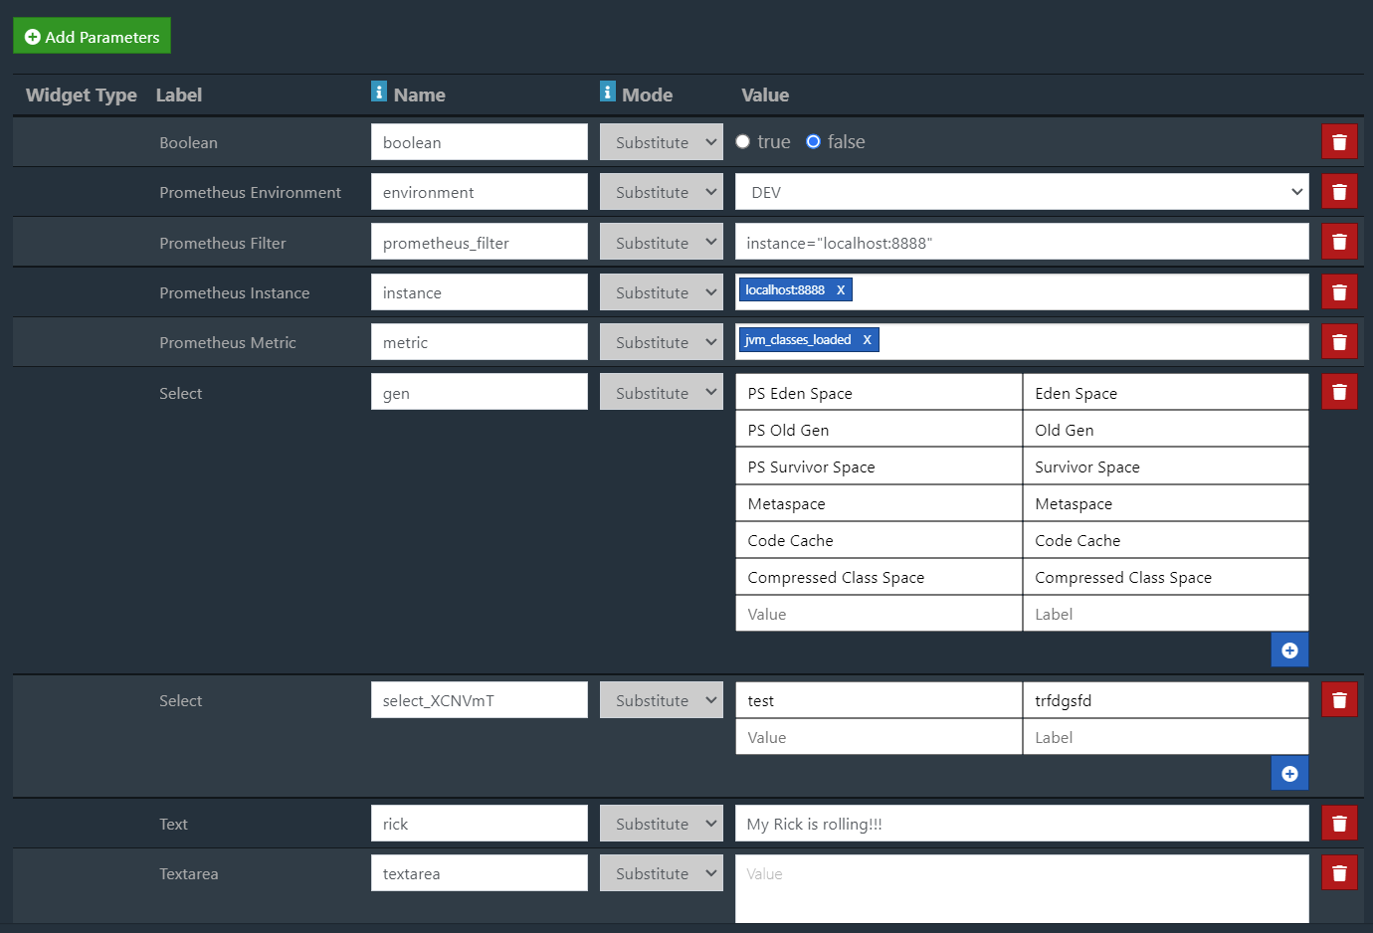
Dashboard Parameters
You can add custom parameters to the dashboard. Either global override the or replacing placeholders.

Slide 12
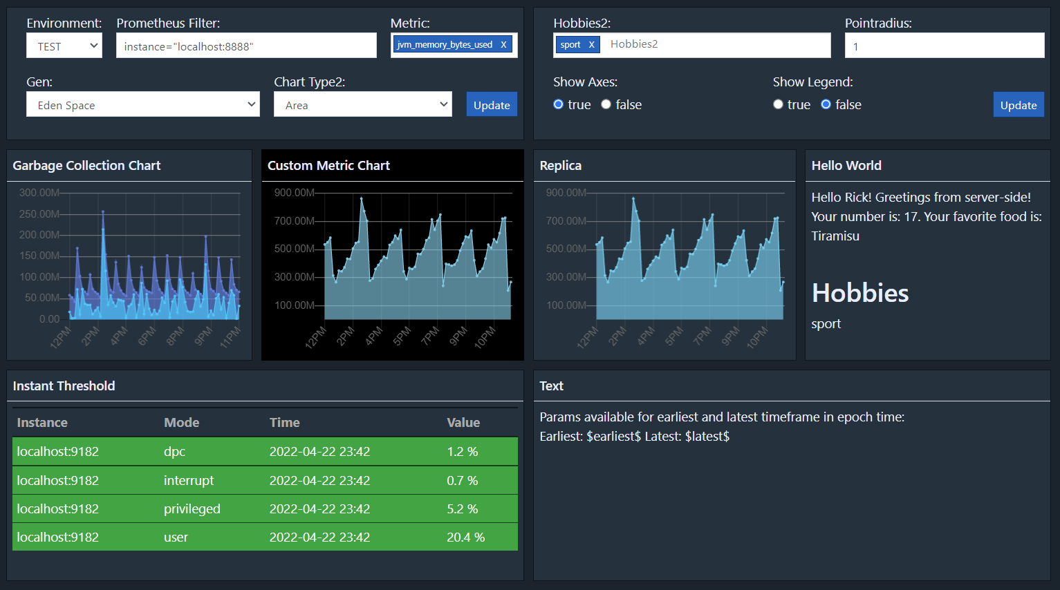
Dashboard Parameters Widget
Allow a user to adjust the defined parameters with one or multiple parameters widgets.

Slide 13
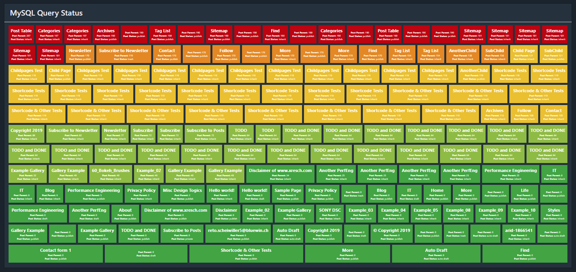
Example – MySQL Data
Fetch data from a database with a simple SQL Query. Check if the value of a specific column reaches a defined threshold and set the color appropriately:

Slide 14
QUERY FEATURE

Slide 15
Query Feature
The query feature gives you more flexibility on how you want to fetch and display your data . You can either use it to fetch data on the fly or display data on a dashboard. Features:
Various out of the box database sources (MySQL, MSSQL Oracle, any JDBC driver etc…)
Commands for filtering based on field values
Sorting of the data based on one or multiple field
Merging of data from multiple sources into one set of data
Deduplication by field values and keeping top <n> or last <n> records
Formatting of fields or records based on field values
Integrate the queries into dashboards using the Query Widget
Mass display of traffic lights

Slide 16
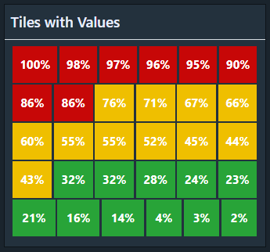
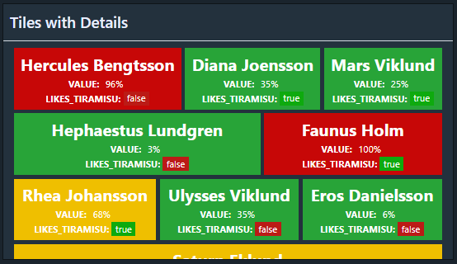
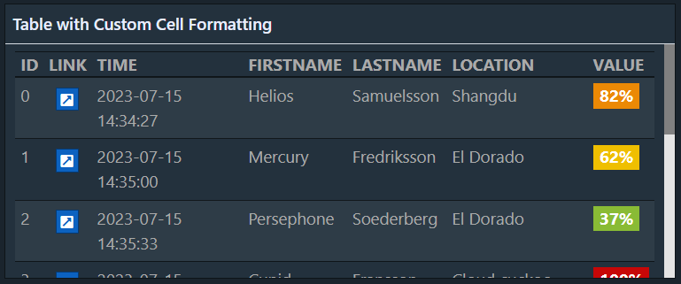
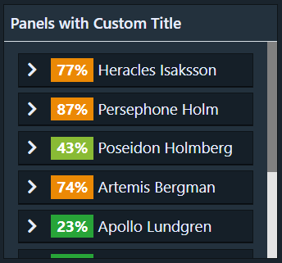
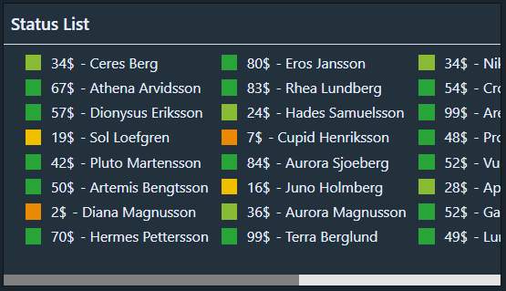
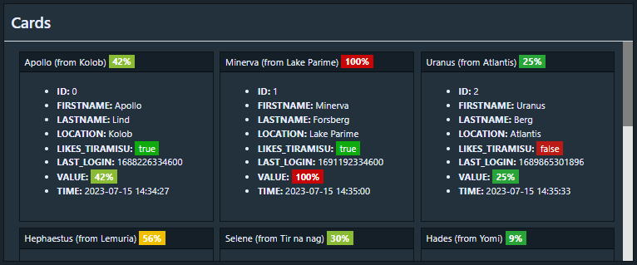

Query Results on Dashboard
Show any result of a query on a dashboard using any format you can create with the query language:

Slide 17
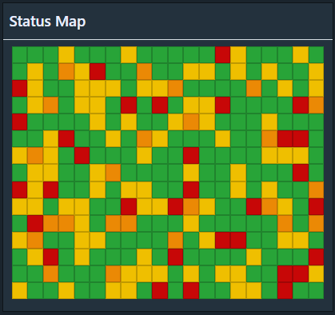
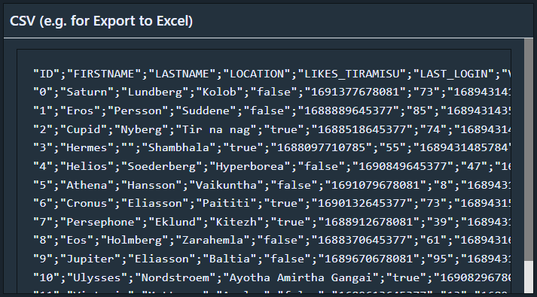
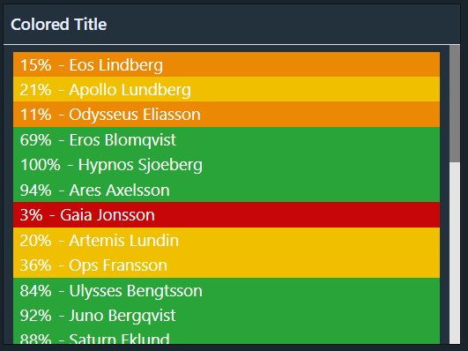
Query Results on Dashboard
Continued:

Slide 18
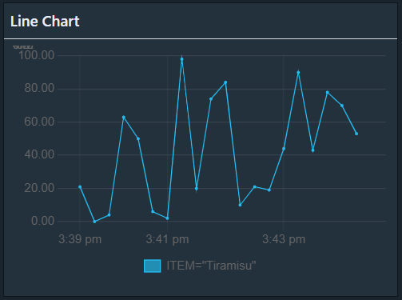
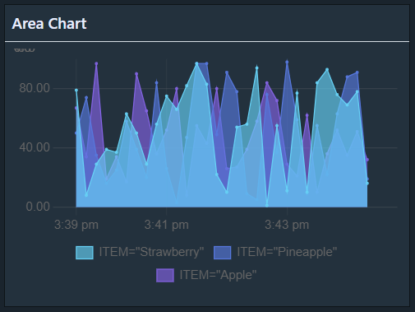
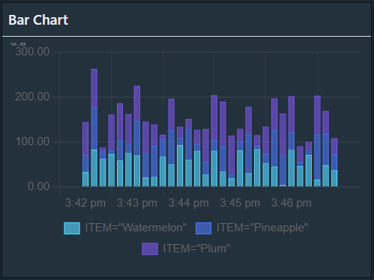
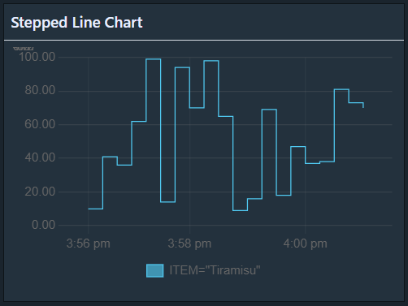
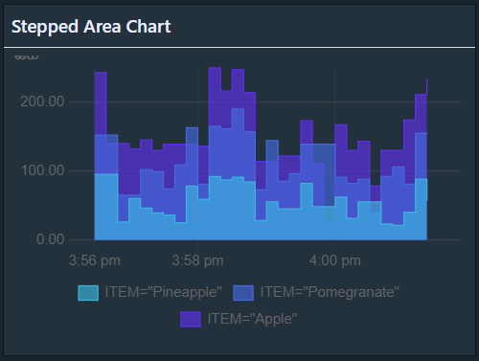
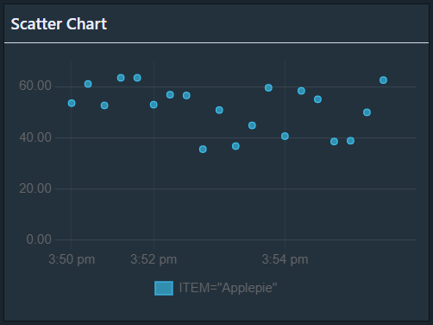
Query Results - Chart Display

Slide 19
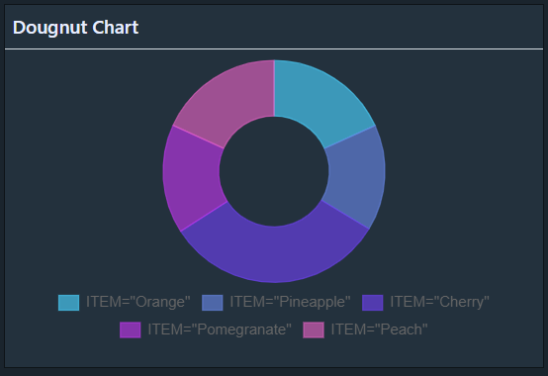
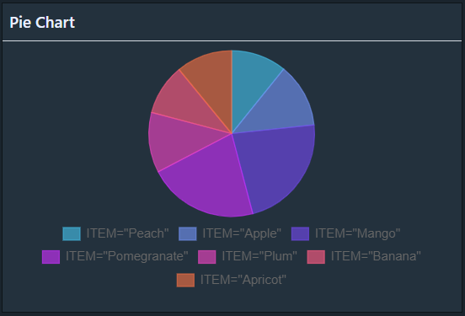
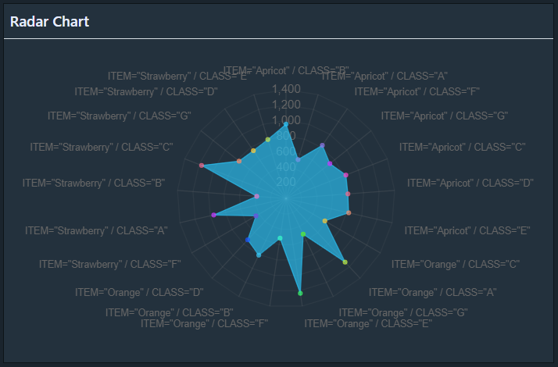
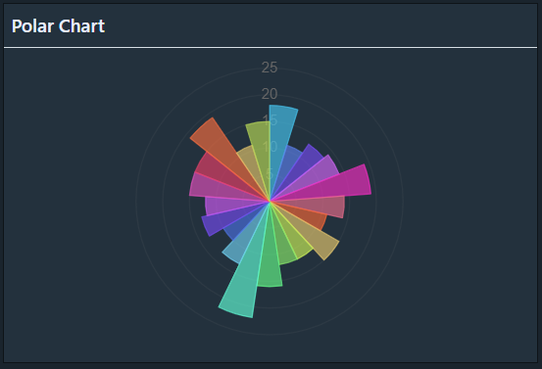
Query Results - Chart Display

Slide 20
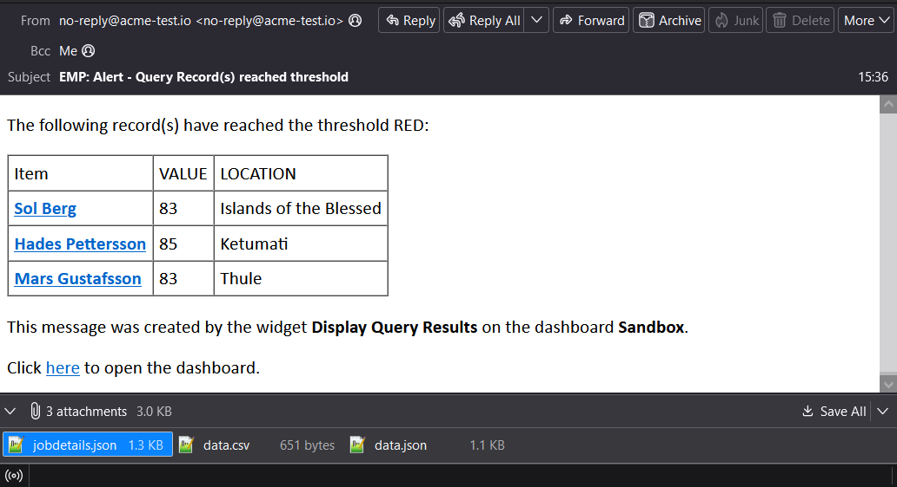
Query – Alerting
Use the query feature to get alerts by eMail or In-App Notifications:

Slide 21
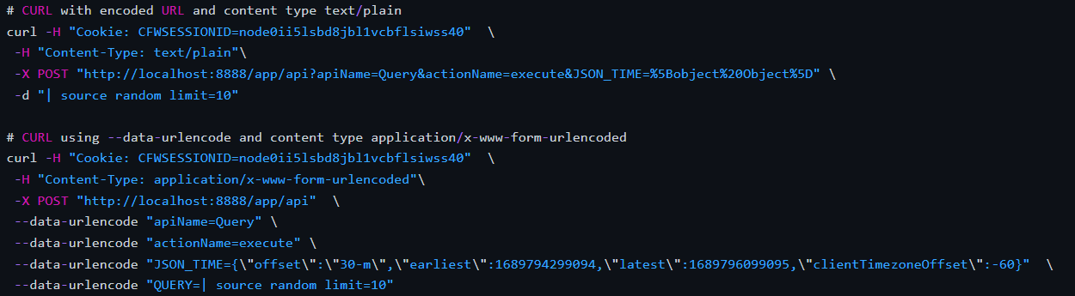
Query – API Endpoint
Use the available API endpoint to execute queries from another application to get the data for usage in other applications.
The user interface includes an overview of all API endpoints where you can generate example URLs and CURL commands to assist you in using the API:

Slide 22
QUERY EXAMPLES

Slide 23
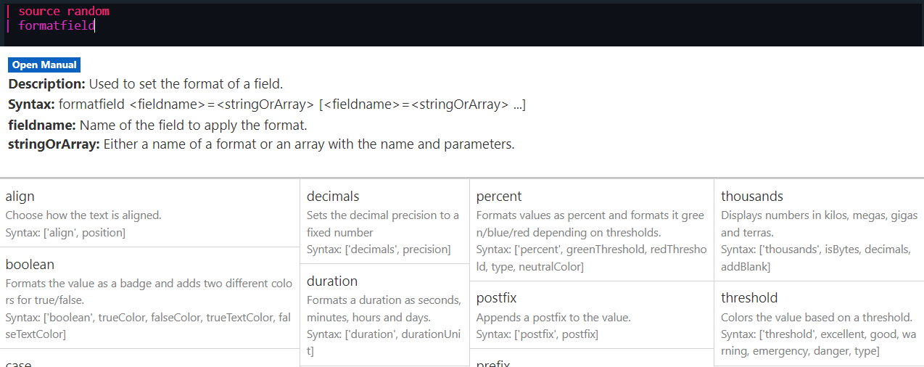
Query – Content Assist
Use Ctrl+Space to open the content assist to search for commands, functions, getting help on how to use them and autocomplete items.

Slide 24
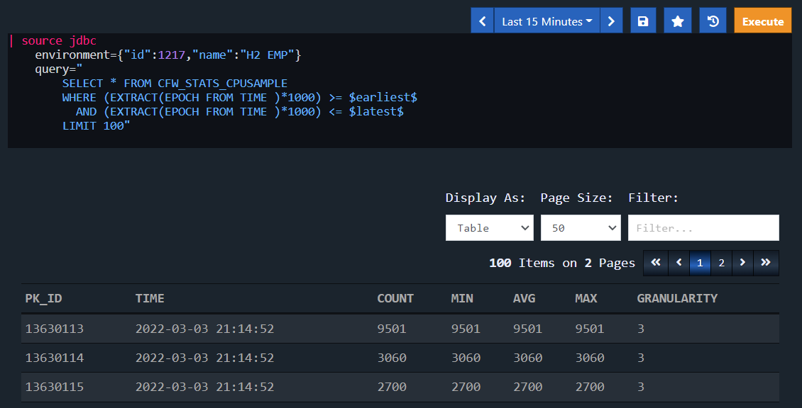
Query – Fetch Data From Database
Fetches data from a database and displays the data as table.

Slide 25
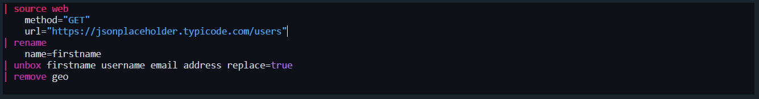
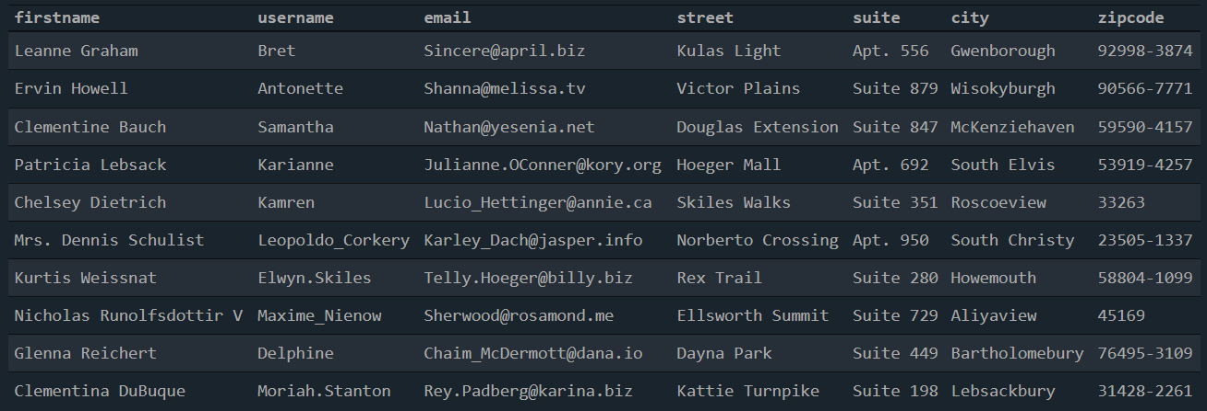
Query – Fetch JSON from Web APIs
Use the web source to fetch JSON data from a web API and choose the data you want to display using the unbox command:

Slide 26
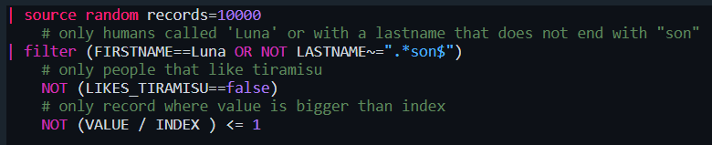
Query – Filter Data
Use the filter command to do any kind of filtering on any field, supports regular expressions:

Slide 27
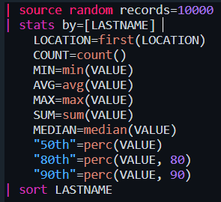
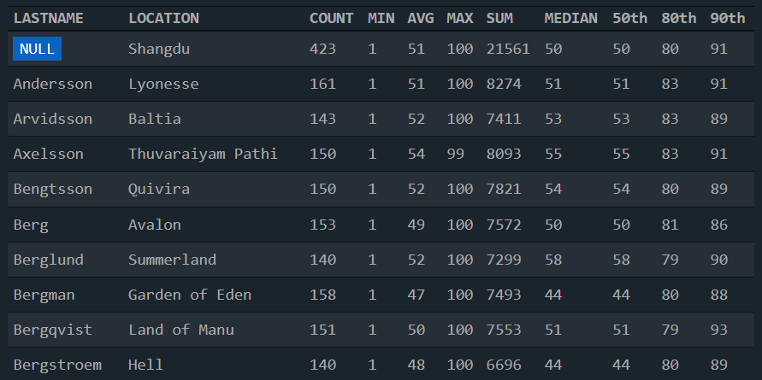
Query – Create Statistics
Create statistics fast and easy with the stats command:

Slide 28
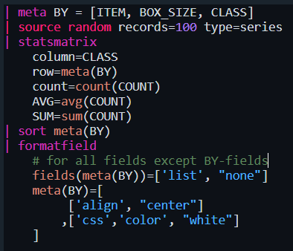
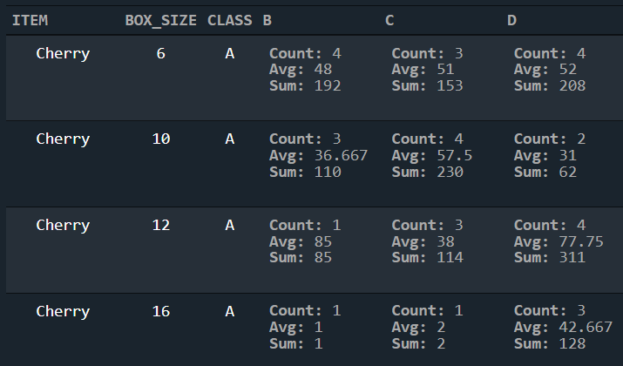
Query – Create Statistics Matrix
Create statistical matrix with the statsmatrix command:

Slide 29
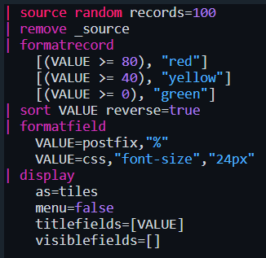
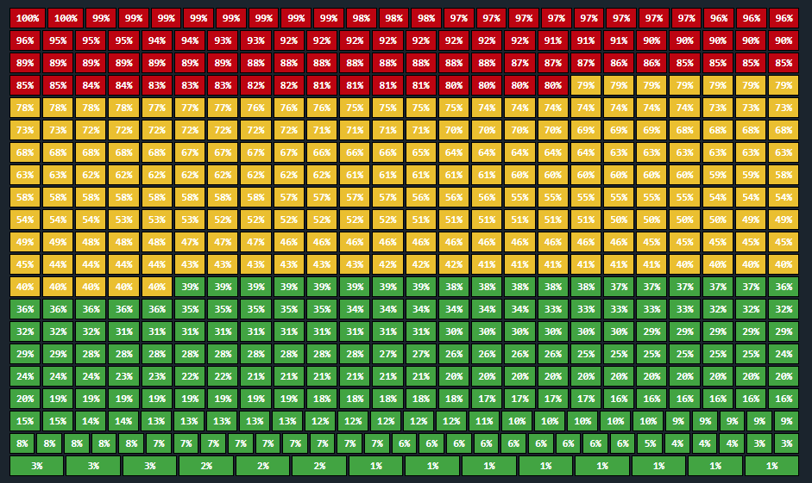
Query - Formatting
Show records as traffic lights based on field values.

Slide 30
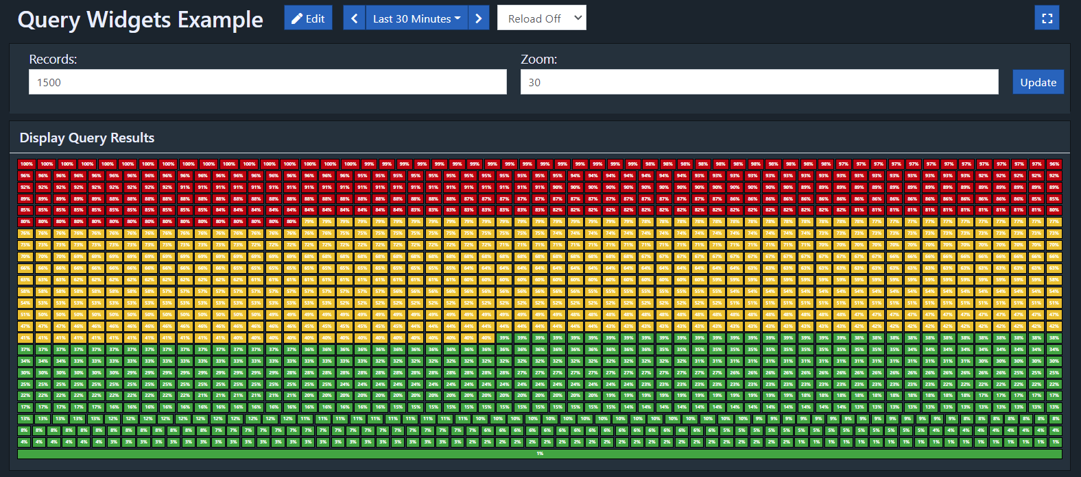
Query - Dashboard Widget with Parameters
Add queries to dashboards and use the dashboard parameter feature to customize your query.

Slide 31
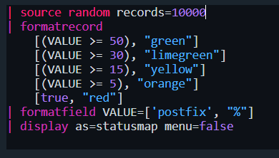
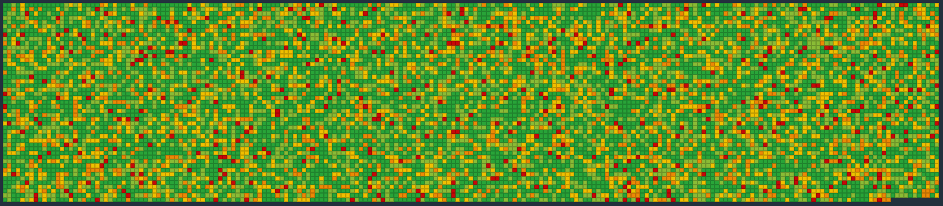
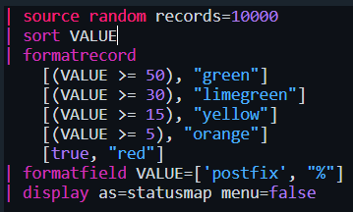
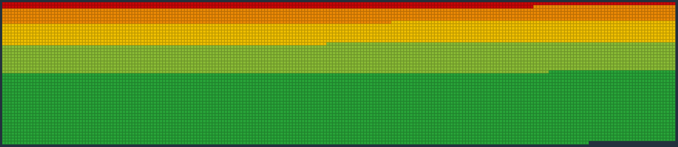
Query – Status Map for Mass Display
Use the query feature to mass display thousands of items, sort them with a simple command and get full visibility of the status of an entire system, add custom links for drilldown into detailed views(below 10’000 squares rendered in 2 sec):

Slide 32
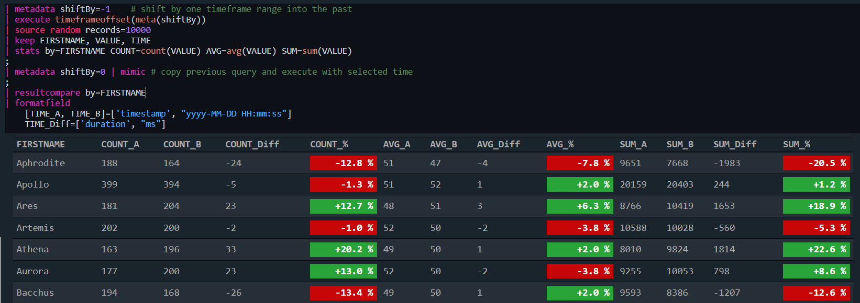
Query – Compare Data
Use the query language to compare similar data from two different sources or two different timeframes:

Slide 33
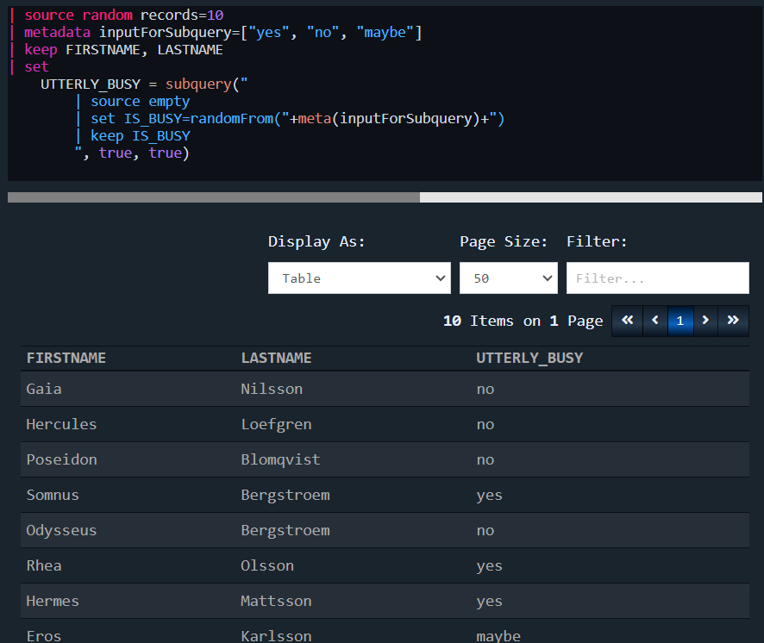
Query – Subquerying Data
The subquery function allows you to query additional data from another data source to enhance your data:

Slide 34
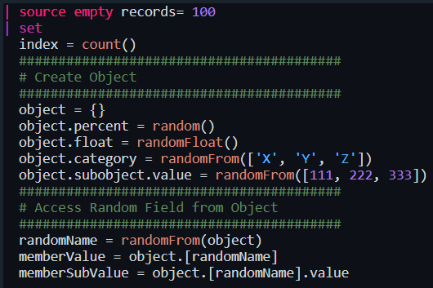
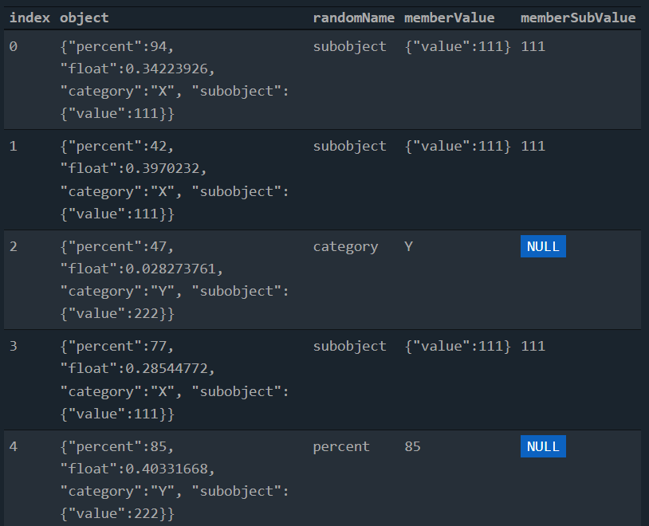
Query – Object and Array Support
The query language supports objects and arrays, creating, accessing and manipulation of the data included in them:

Slide 35


Query – Multi Chart and Chart Details
Use the multi chart options and details options to render multiple data series separately with a simple setup:

