Slide 1
Core Framework Features
An Overview

Slide 2
Purpose of CFW
The following were the goals in mind when the Core Framework(CFW) was created:
Providing a base User Management System (Users, Roles, Permissions)
Extendable Dashboard Feature to allow users to create custom displays
Extendable Configuration, Settings, API and Task Management
Extendable Query Language to process data as needed

Slide 3
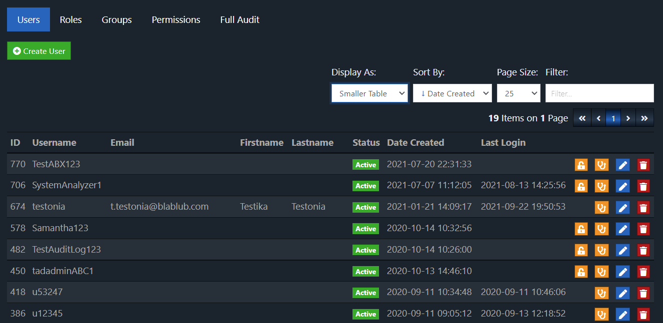
User Management

Slide 4
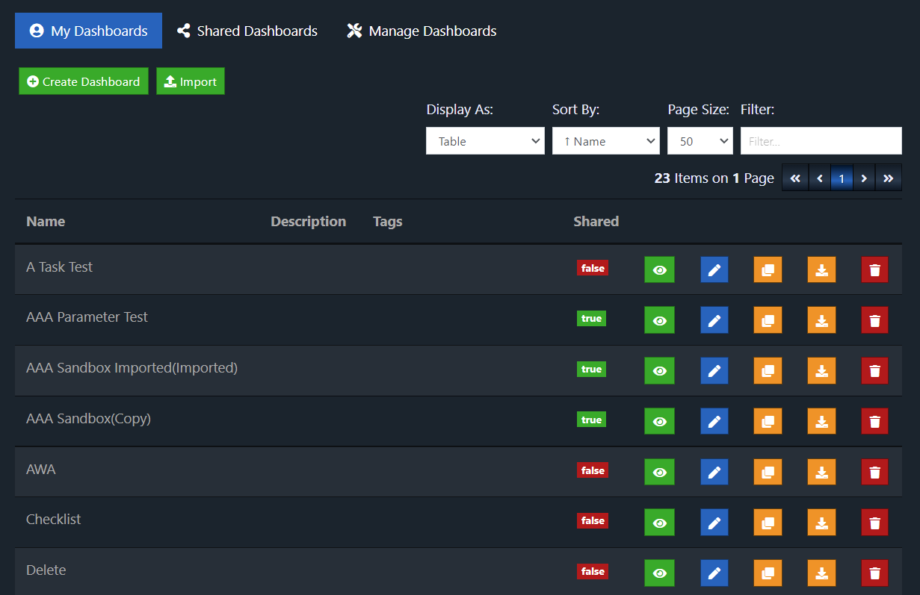
Dashboard List

Slide 5
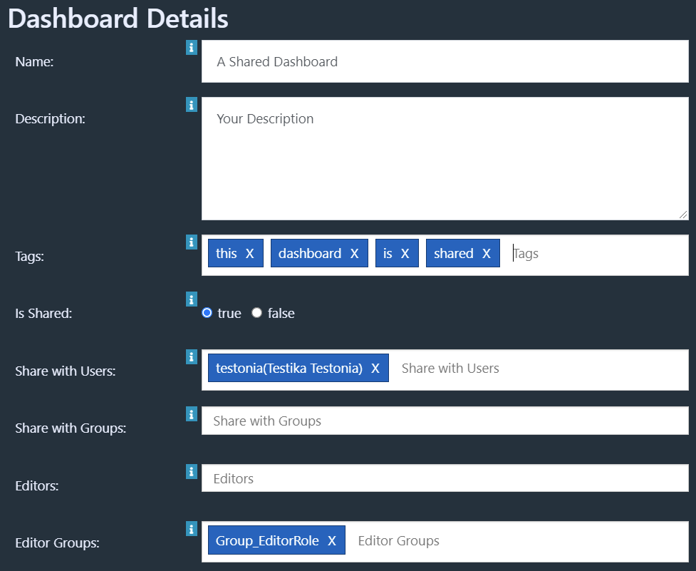
Dashboard Options
Dashboards can be shared with:
Specific users
Groups of users
All who can access the dashboard feature (if no user/group is specified)
Everyone(Public URL)
Editor permissions can be granted to users or groups

Slide 6
Available Dashboard Widgets
Text
Label
List
Checklist
CSV Table
Tags
Image
HTML Editor
Website
Youtube Video
Refresh Time
Parameters
Replica
Display Query Results
Force Refresh
Javascript
Databases:
MySQL
MSSQL
Oracle
Other Databases(JDBC Drivers)

Slide 7
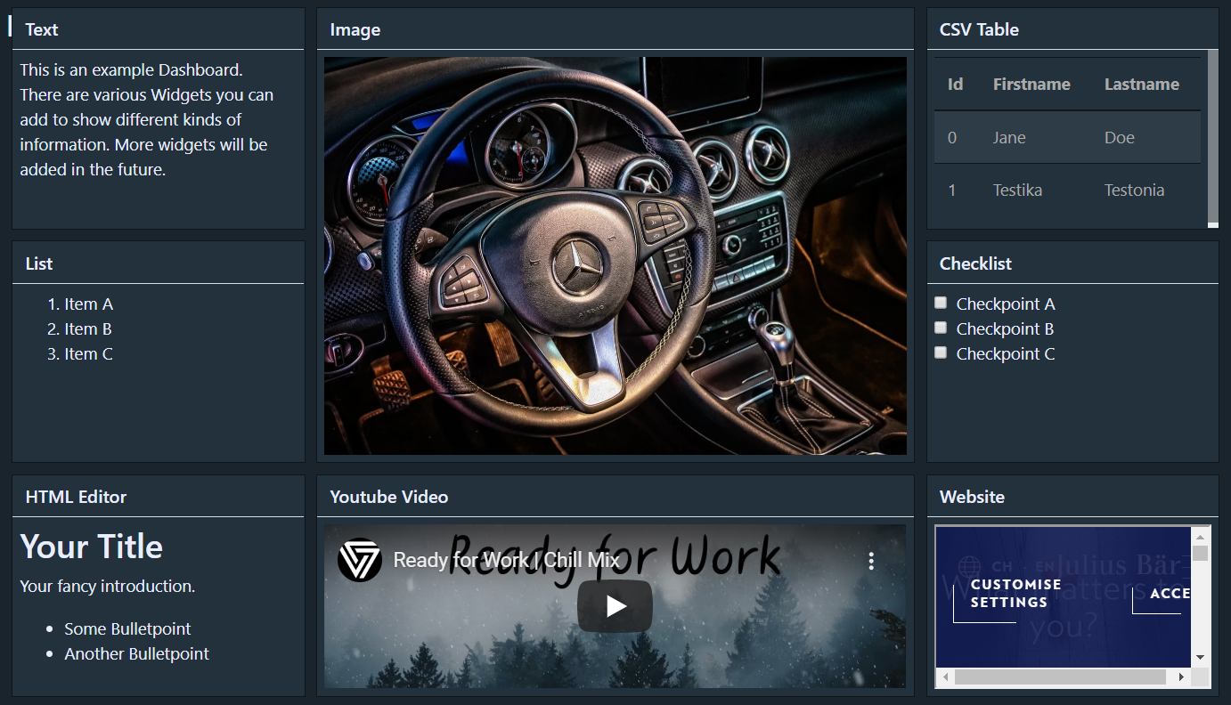
Overview of Standard Widgets

Slide 8
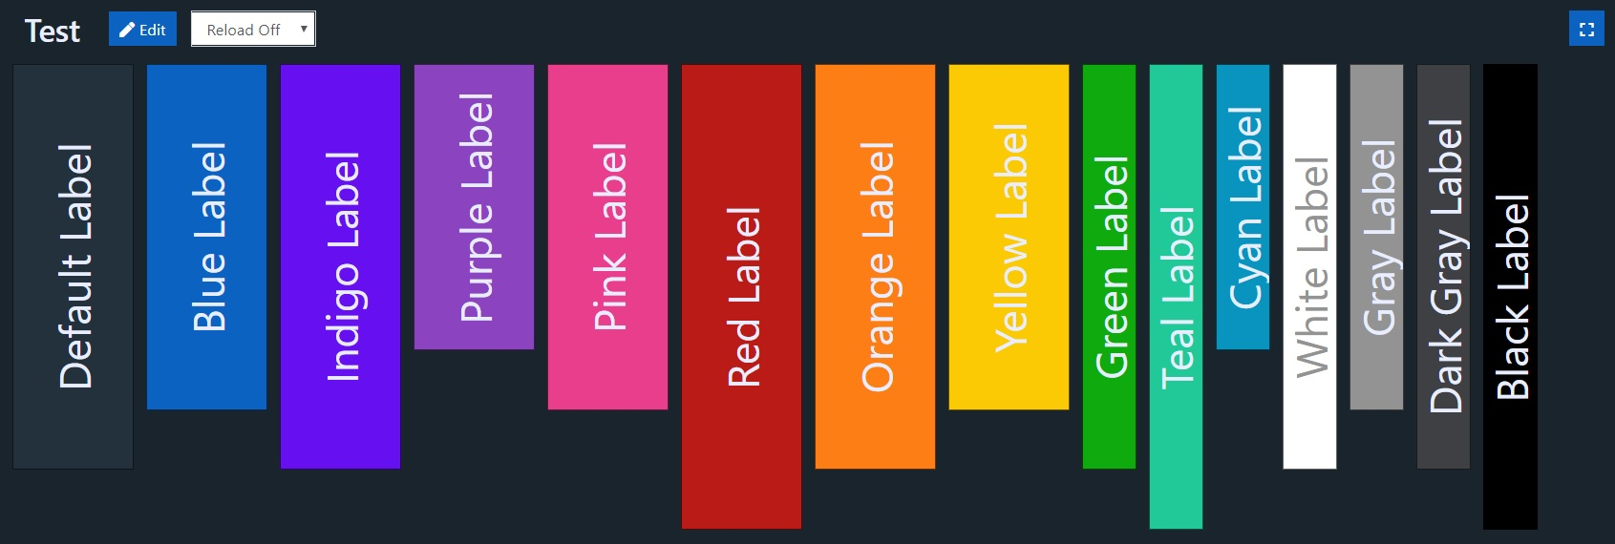
Dashboard Widgets – Colors
Widgets can be colored to highlight or create visual grouping.

Slide 9
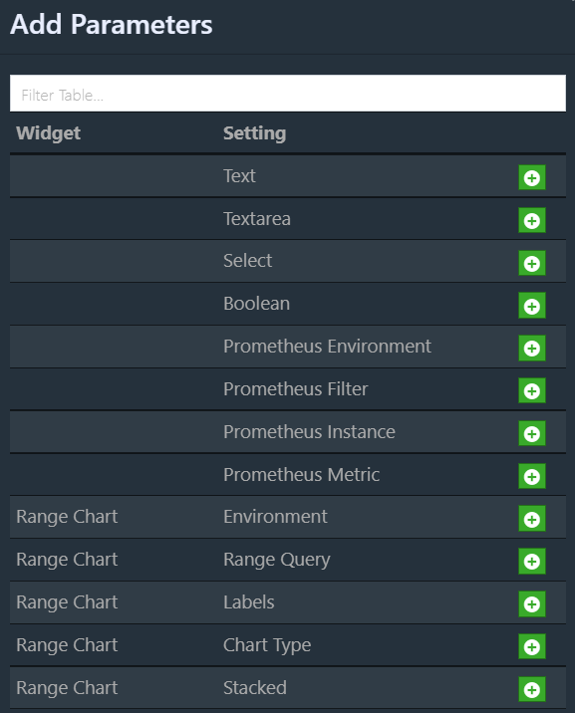
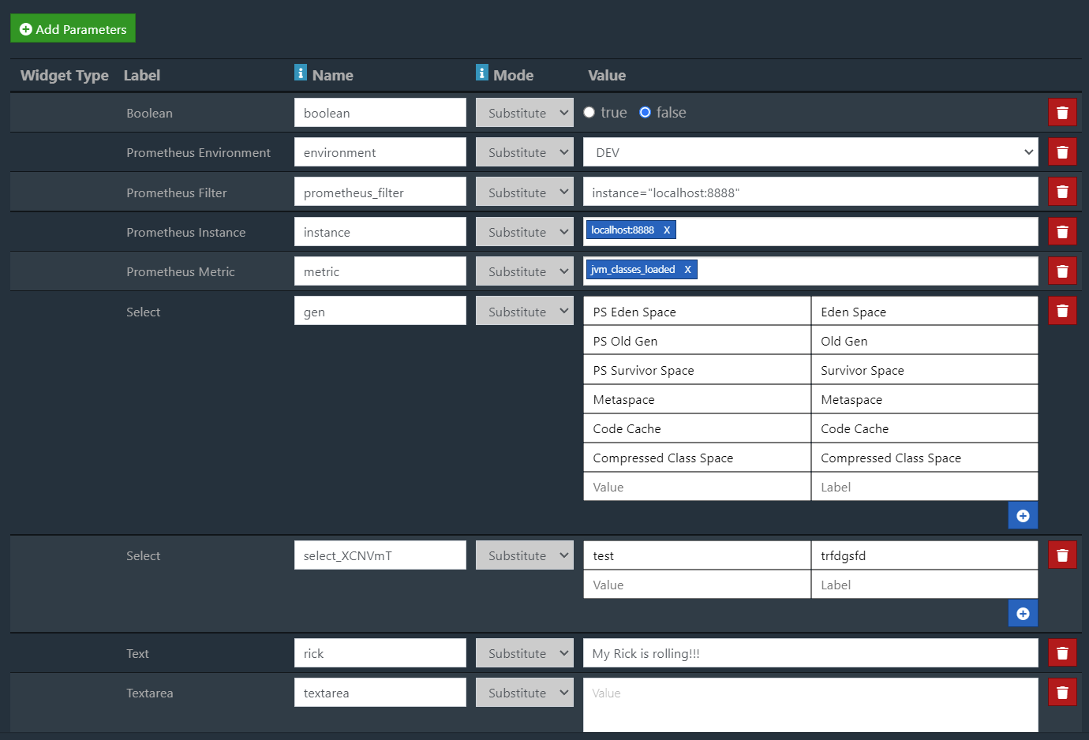
Dashboard Parameters
You can add custom parameters to the dashboard. Either global override the or replacing placeholders.

Slide 10
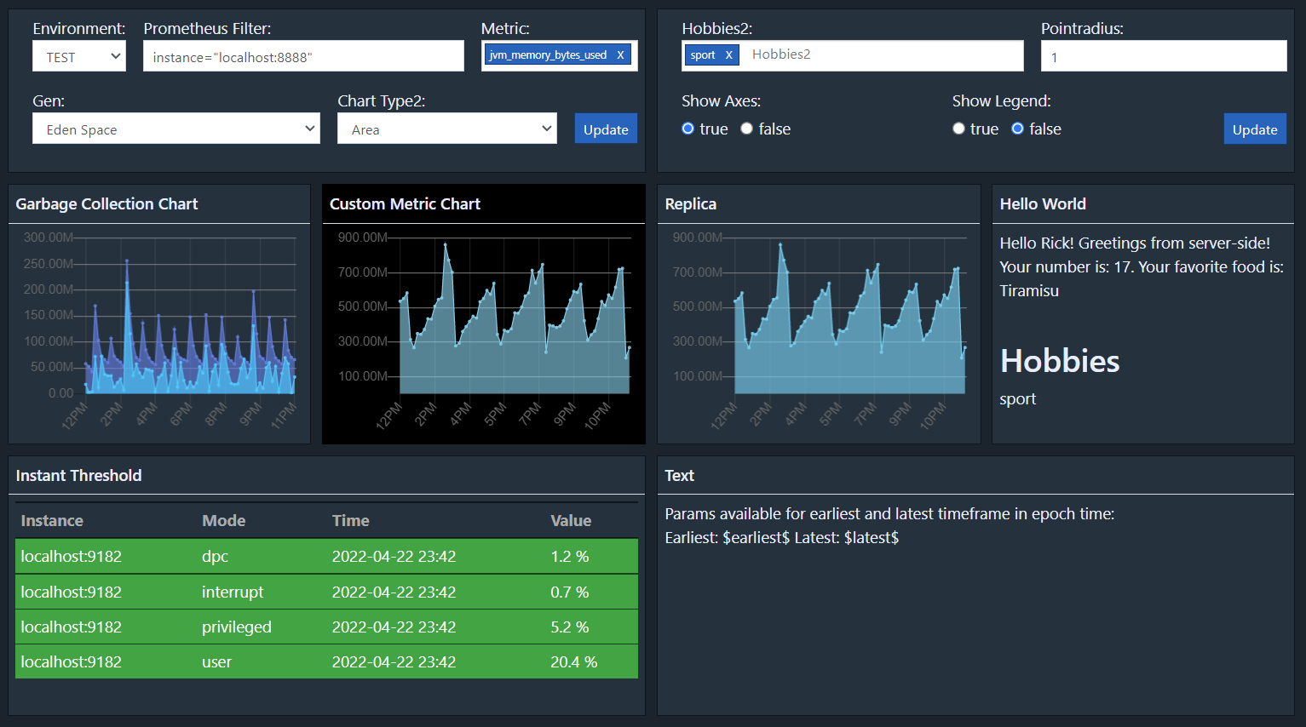
Dashboard Parameters Widget
Allow a user to adjust the defined parameters with one or multiple parameters widgets.

Slide 11
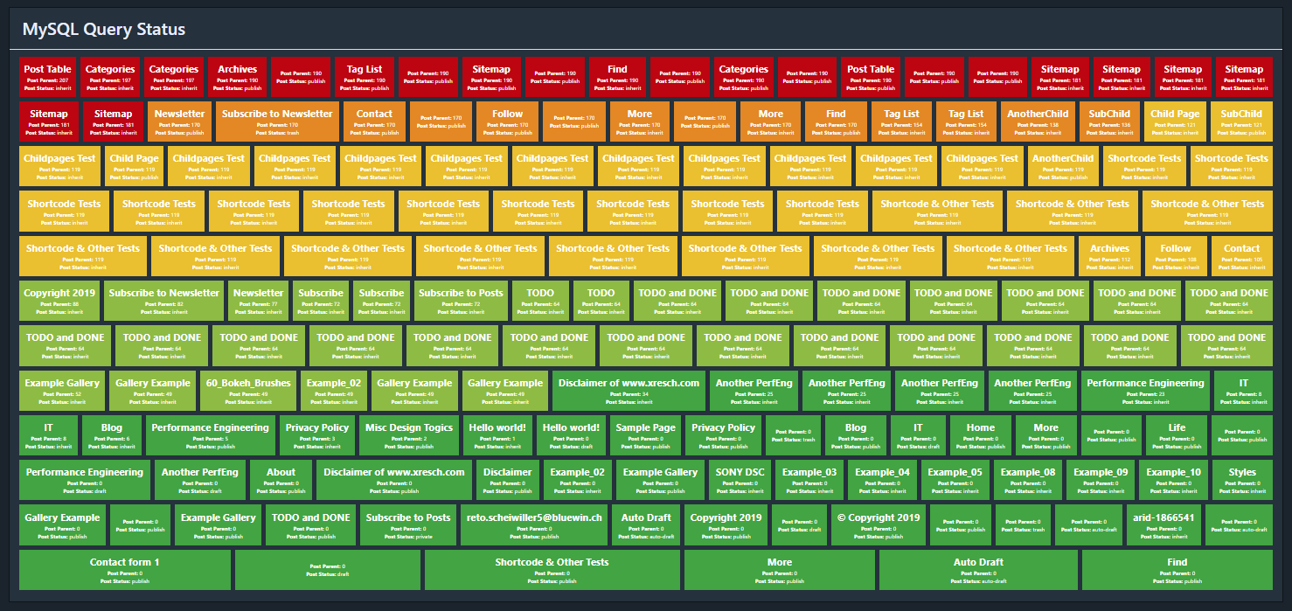
Example – MySQL Data
Fetch data from a database with a simple query. Check if the value of a specific column reaches a defined threshold and set the color appropriately:

Slide 12
Query Feature
The query feature gives you more flexibility on how you want to fetch and display your data . You can either use it to fetch data on the fly or display data on a dashboard. Features:
Various out of the box database sources (MySQL, MSSQL Oracle, any JDBC…)
Commands for filtering based on field values
Sorting of the data based on one or multiple field
Merging of data from multiple sources into one set of data
Deduplication by field values and keeping top <n> or last <n> records
Formatting of fields or records based on field values
Integrate the queries into dashboards using the Query Widget
Mass display of traffic lights

Slide 13
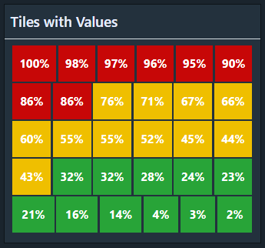
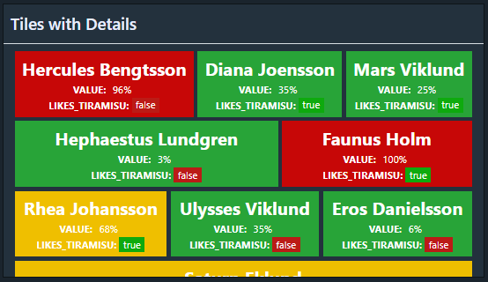
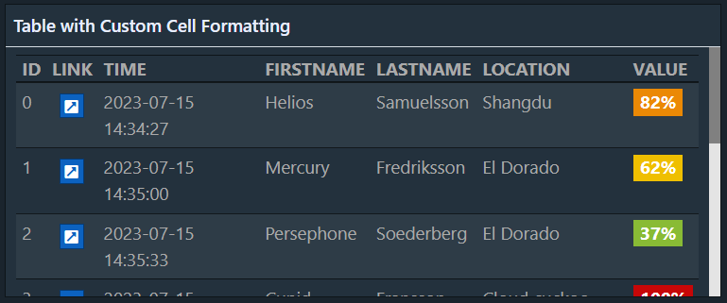
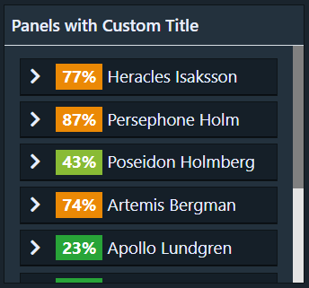
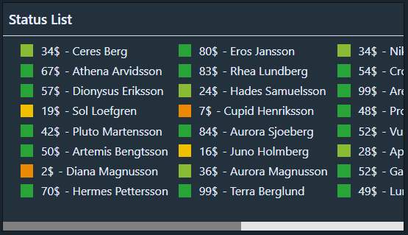
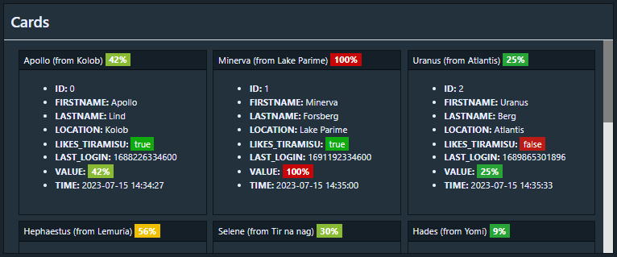

Query Widget Custom Display
With the Query Widget, you can create more customized displaying of your data:

Slide 14
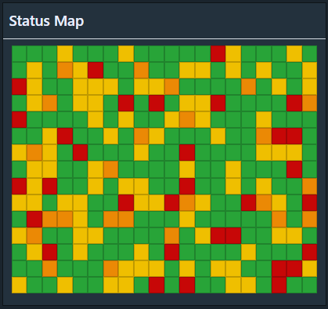
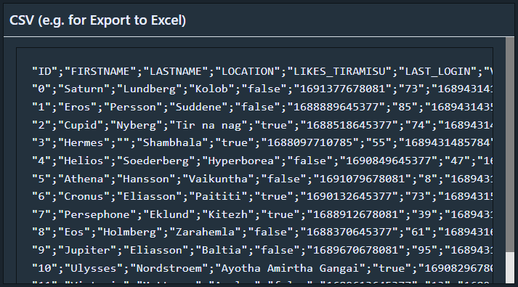
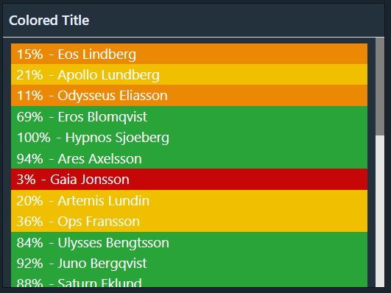
Query Widget Custom Display
Continued:

Slide 15
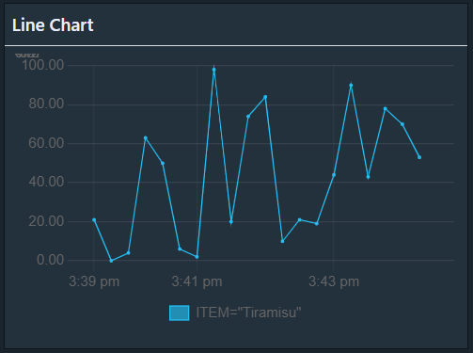
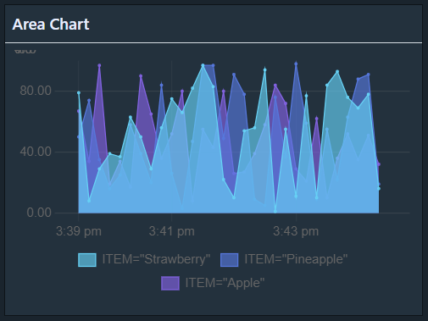
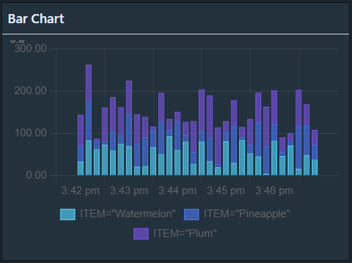
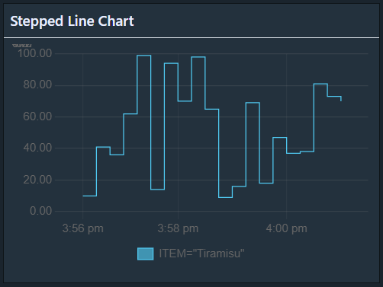
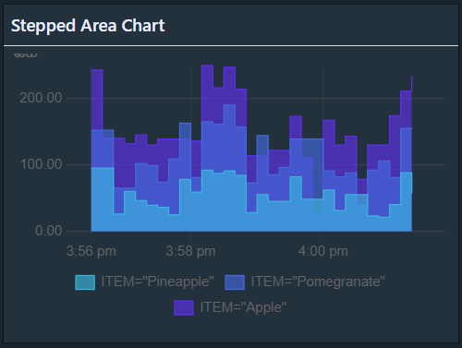
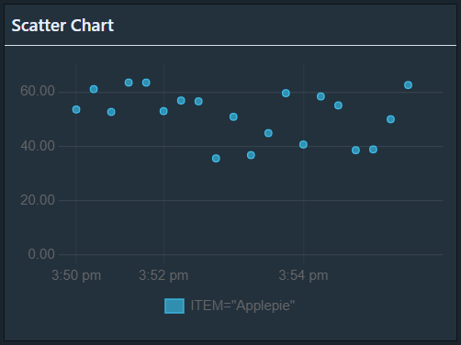
Query Widget Chart Display

Slide 16
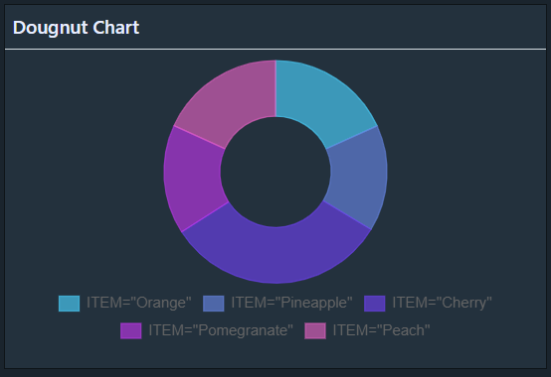
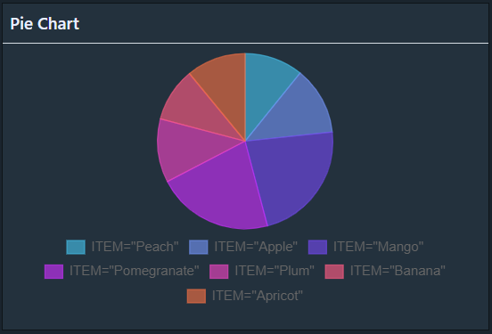
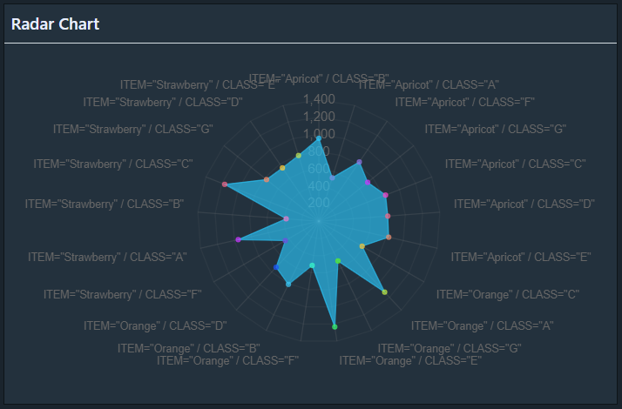
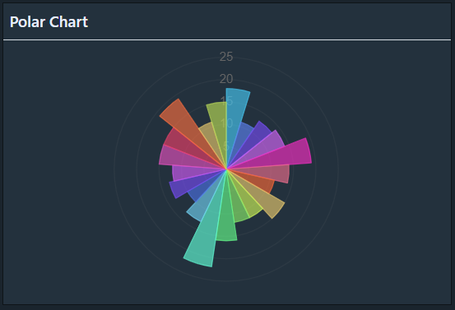
Query Widget Chart Display

Slide 17
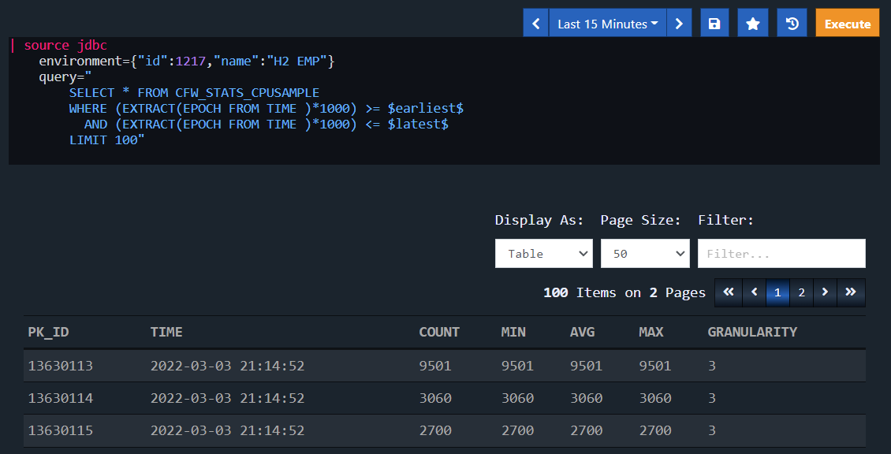
Query – Fetch Data From Database
Fetches data from a database and displays the data as table.

Slide 18
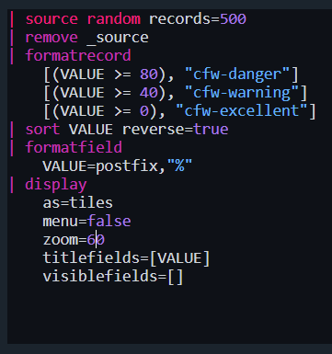
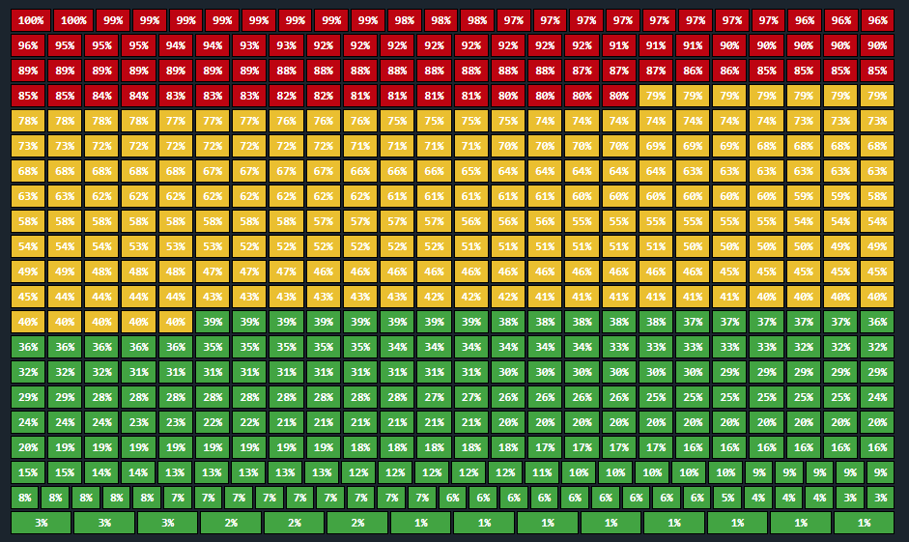
Example - Format
Show records as traffic lights based on field values.

Slide 19
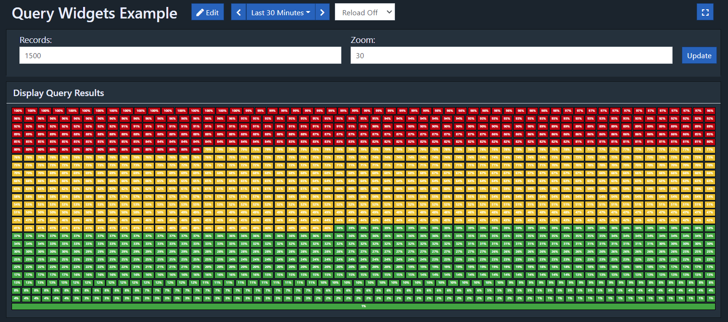
Example –Dashboard Widget with Parameters
Add queries to dashboards and use the dashboard parameter feature to customize your query.

