Slide 1
Engineered Monitoring Plattform (EMP)
An Overview

Slide 2
Purpose of EMP
The following were the goals in mind when EMP was created:
Dashboarding of status information (green, yellow red) for a lot of data.
Dashboarding of time based information (charts)
Dashboards can have customized parameters
eMail Alerting based on widget settings (if supported by widget)
Flexible Permission Management (Users/Roles/Permissions)
Extendable with custom widgets to tailor it to specific needs.

Slide 3
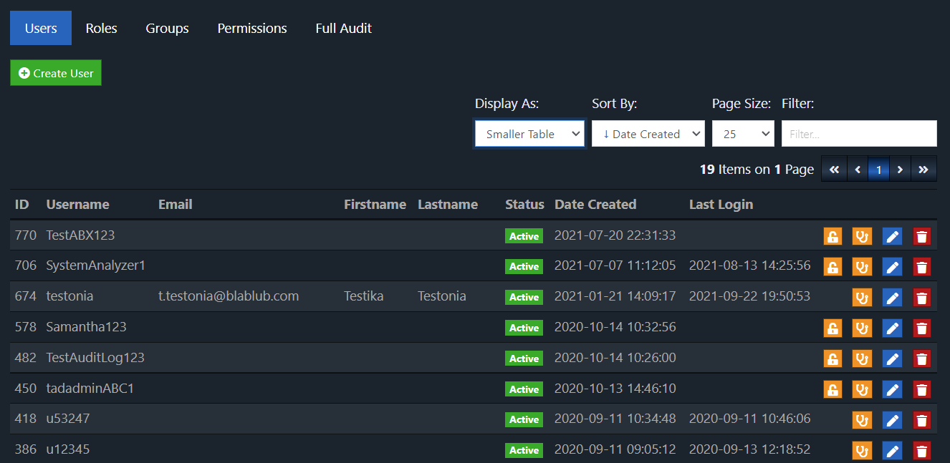
User Management

Slide 4
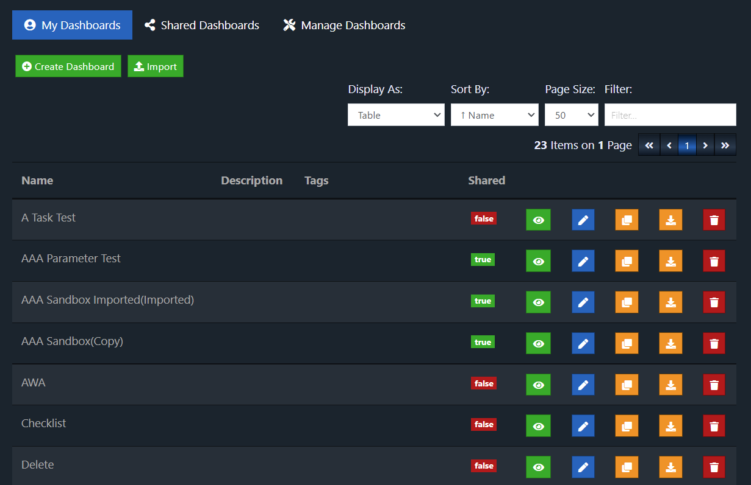
Dashboard List

Slide 5
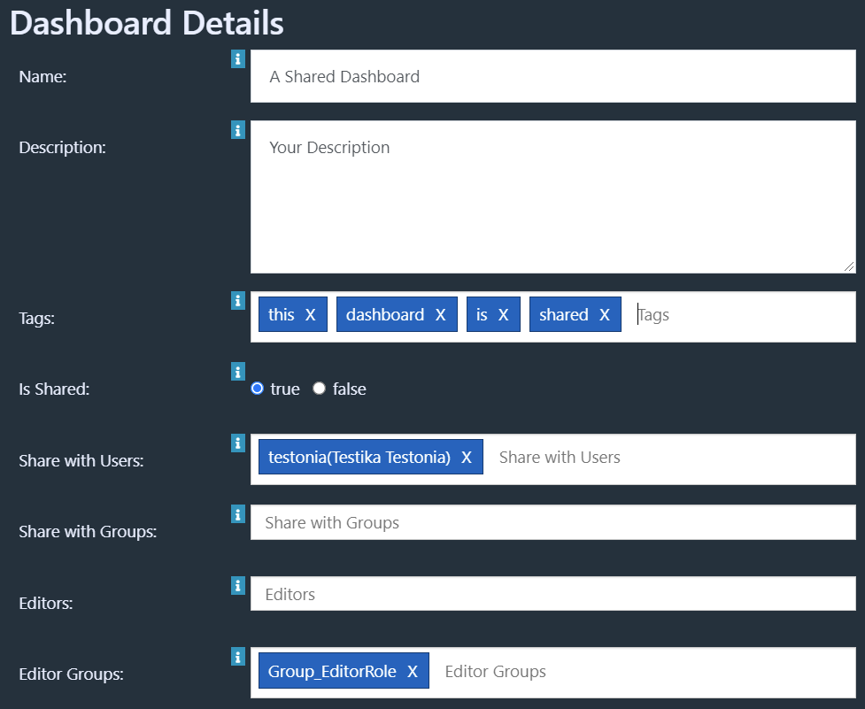
Dashboard Options
Dashboards can be shared with:
Specific users
Groups of users
All who can access the dashboard feature (if no user/group is specified)
Everyone(Public URL)
Editor permissions can be granted to users or groups

Slide 6
Available Widgets in Version 1.8
Standard Widgets
Monitoring Widgets
Text
Label
List
Checklist
CSV Table
Tags
Image
HTML Editor
Website
Youtube Video
Refresh Time
Parameters
Replica
Display Query Results
Dynatrace
MySQL
MSSQL
Oracle
Other Databases(JDBC Drivers)
InfluxDB
Prometheus
Exense Step
Silk Performance Manager(SPM)
Webex
CA Automic Workload Automation(AWA)

Slide 7
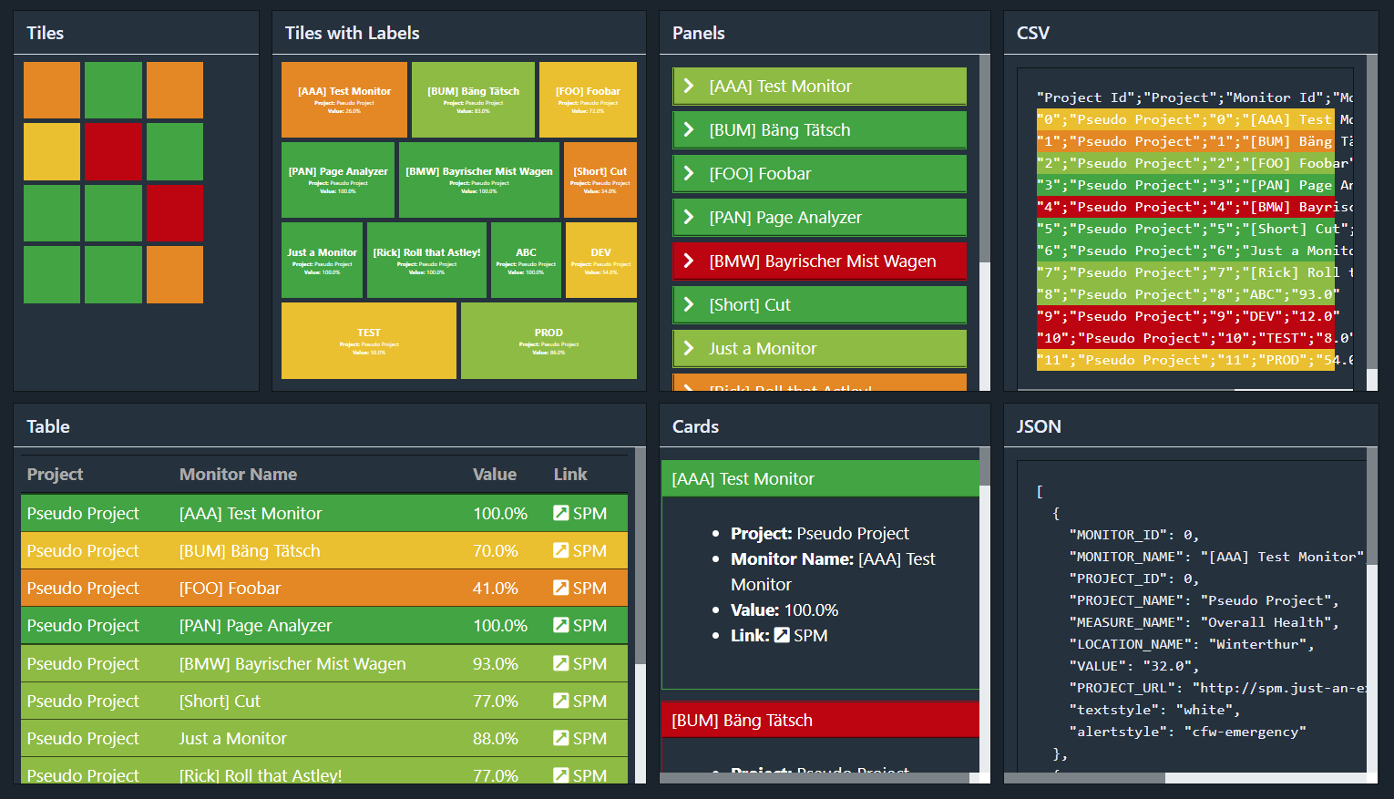
Monitoring Widgets – Displays
Many Monitoring widgets use a default approach to show data, and can be displayed as: Tiles, Table, Panels, Cards, Bar, Map, List, CSV, JSON,

Slide 8
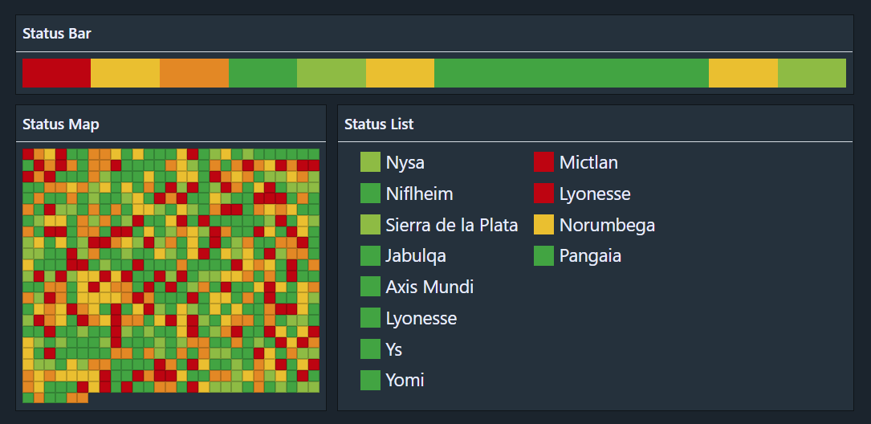
Monitoring Widgets – Displays
Examples for Status Bar, Map and List:

Slide 9
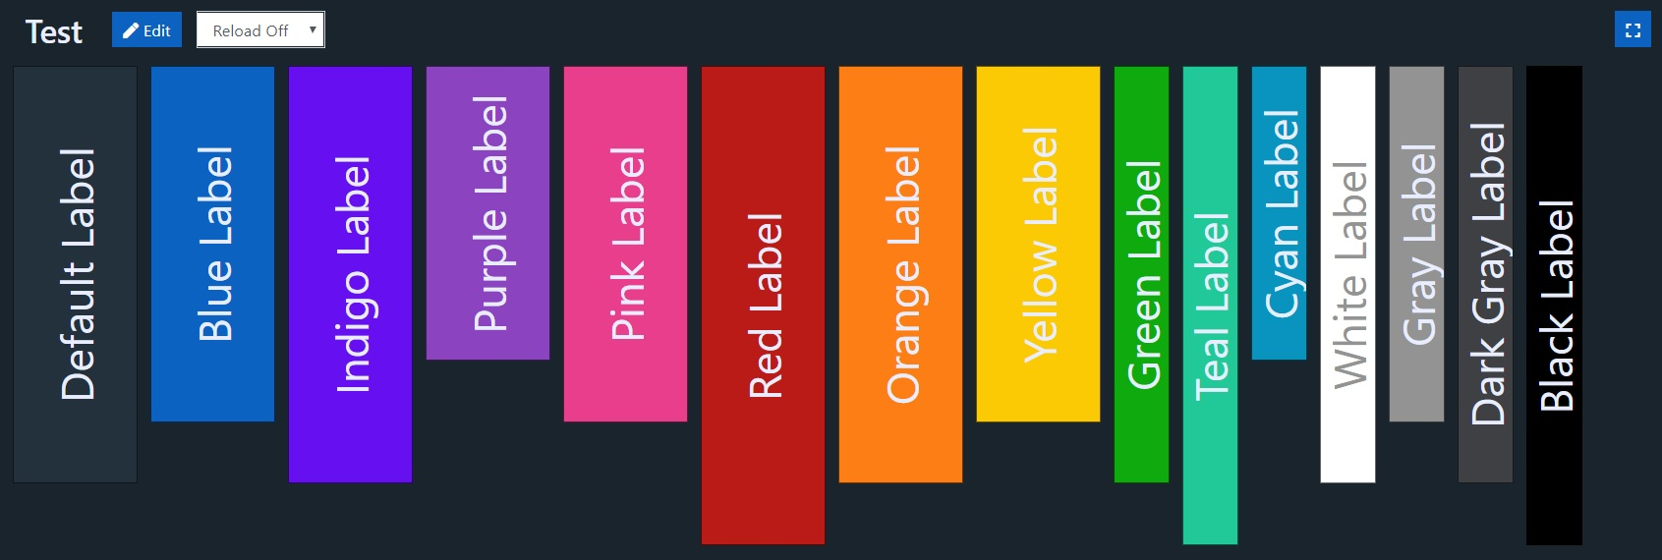
Dashboard Widgets – Colors
Widgets can be colored to highlight or create visual grouping.

Slide 10
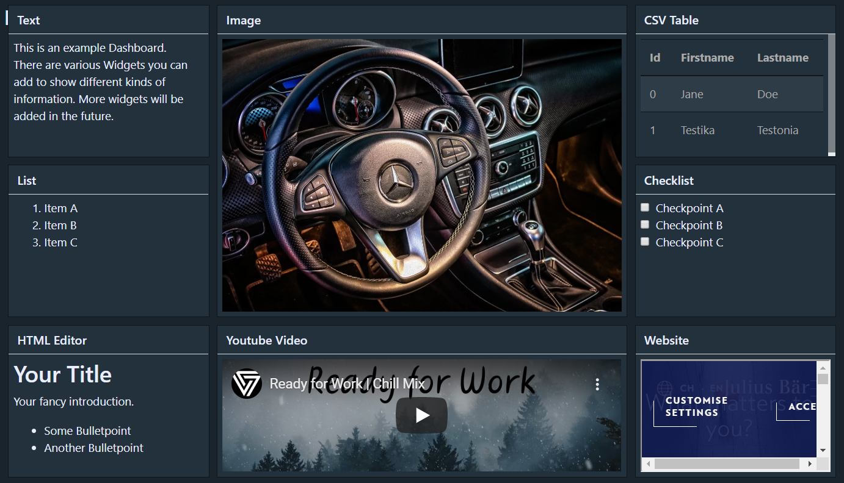
Overview of Standard Widgets

Slide 11
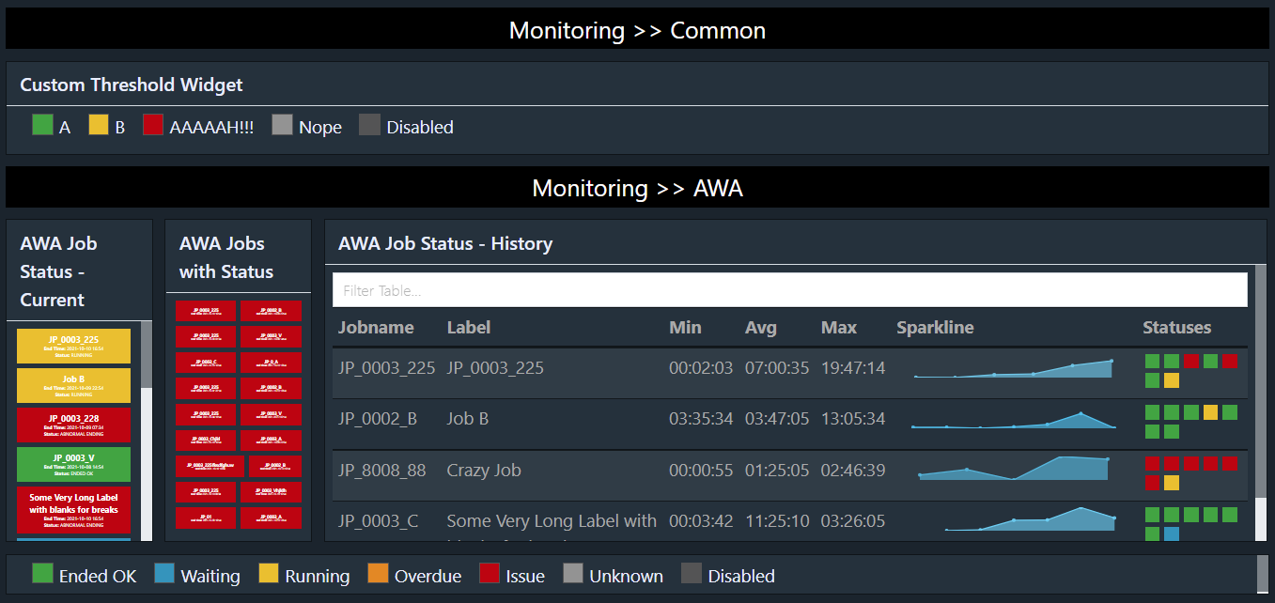
Monitoring Widgets – Common and AWA

Slide 12
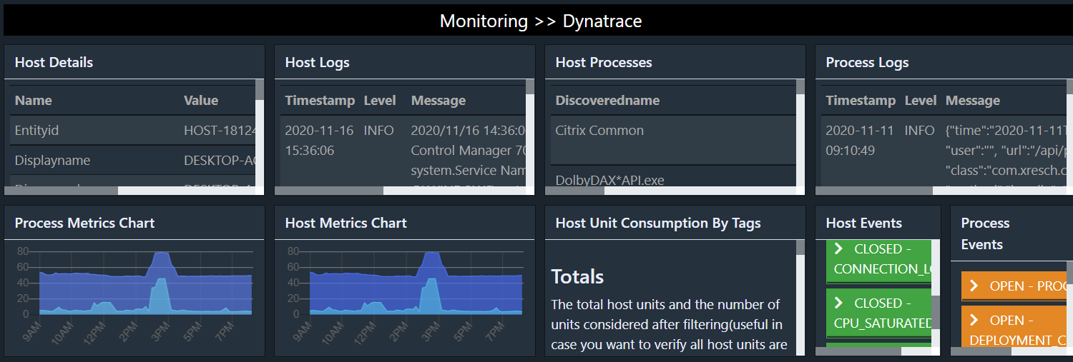
Monitoring Widgets – Dynatrace

Slide 13
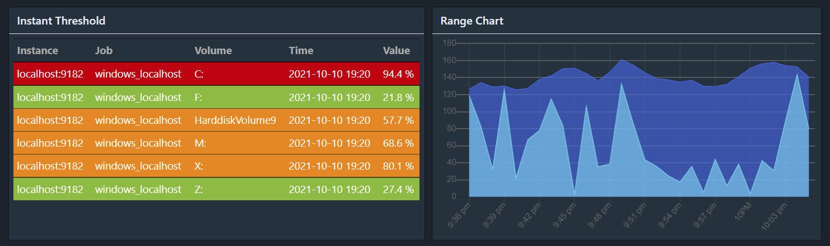
Monitoring Widgets – Prometheus

Slide 14
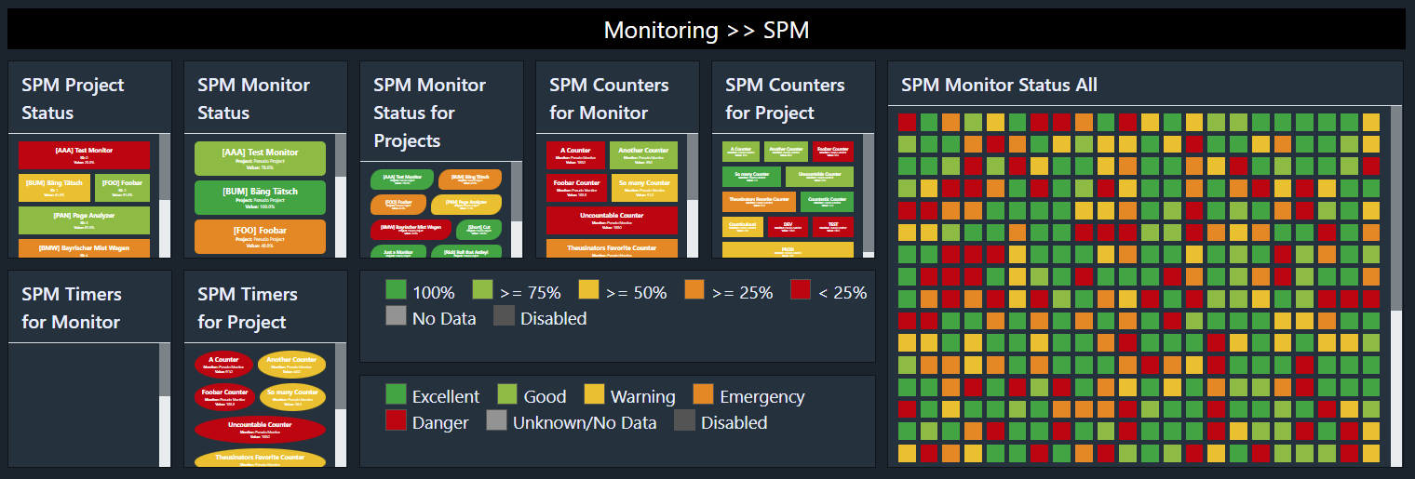
Monitoring Widgets – SPM

Slide 15
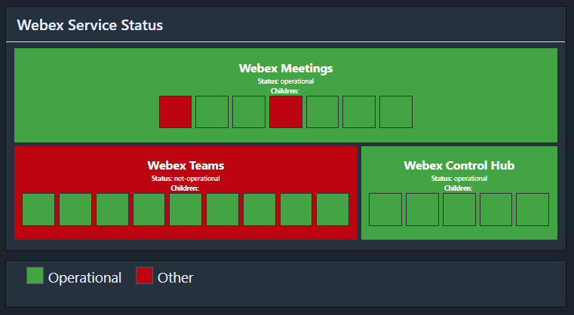
Monitoring Widgets – Webex Service

Slide 16
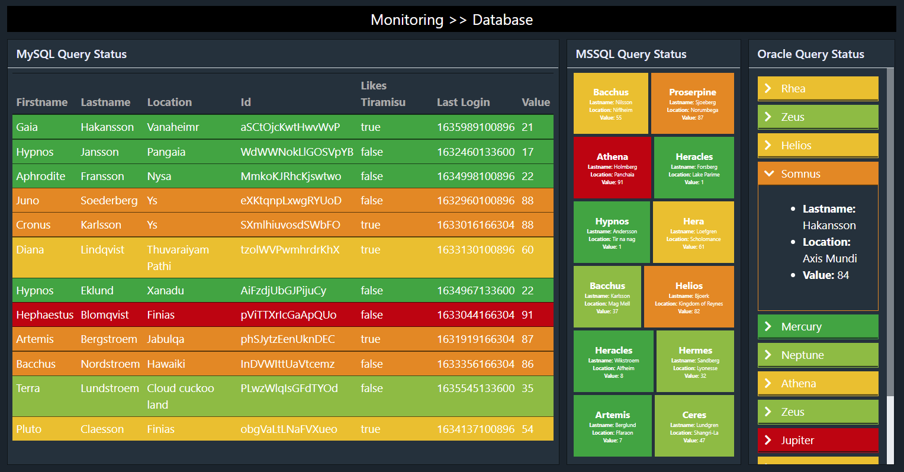
Monitoring Widgets – Database

Slide 17
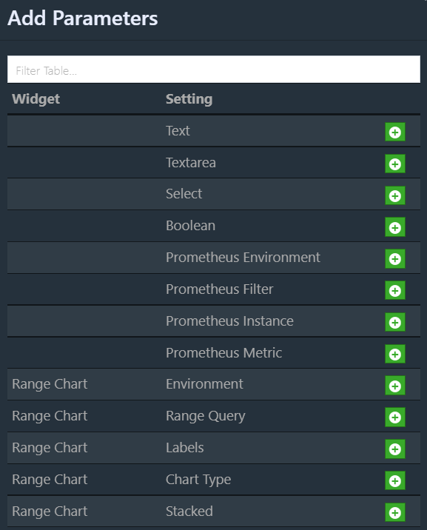
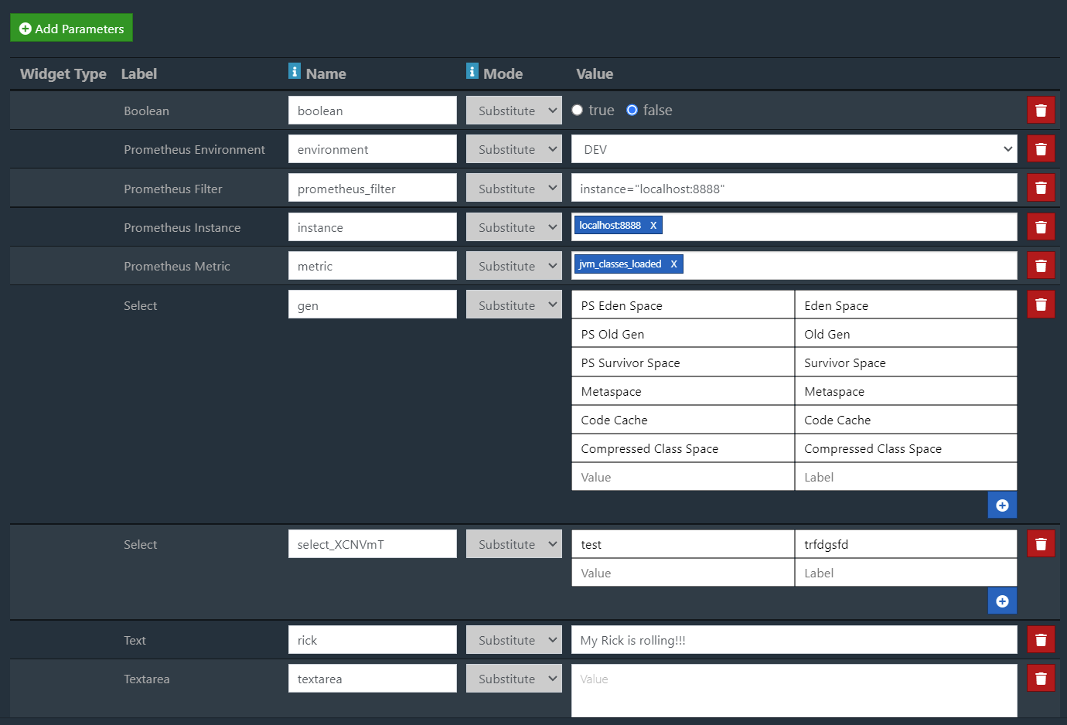
Dashboard Parameters
You can add custom parameters to the dashboard. Either global override the or replacing placeholders.

Slide 18
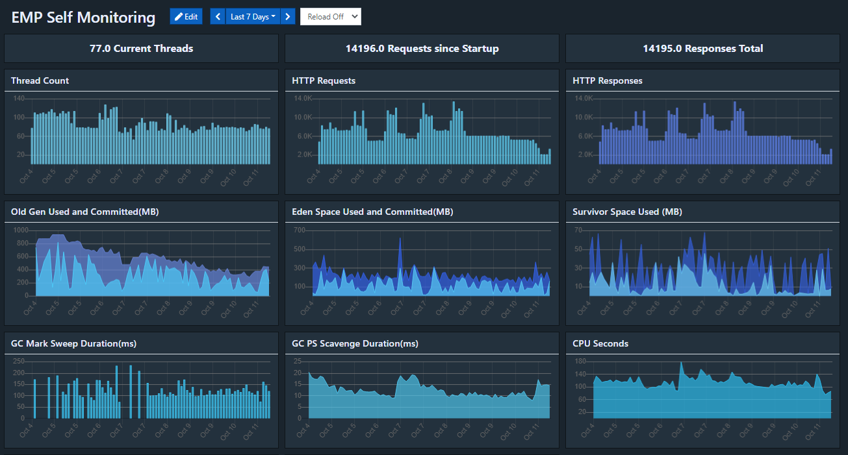
Example – Self Monitoring
EMP has a Prometheus endpoint(/metrics) and we can create a dashboard to
self-monitor the application(importable template available).

Slide 19
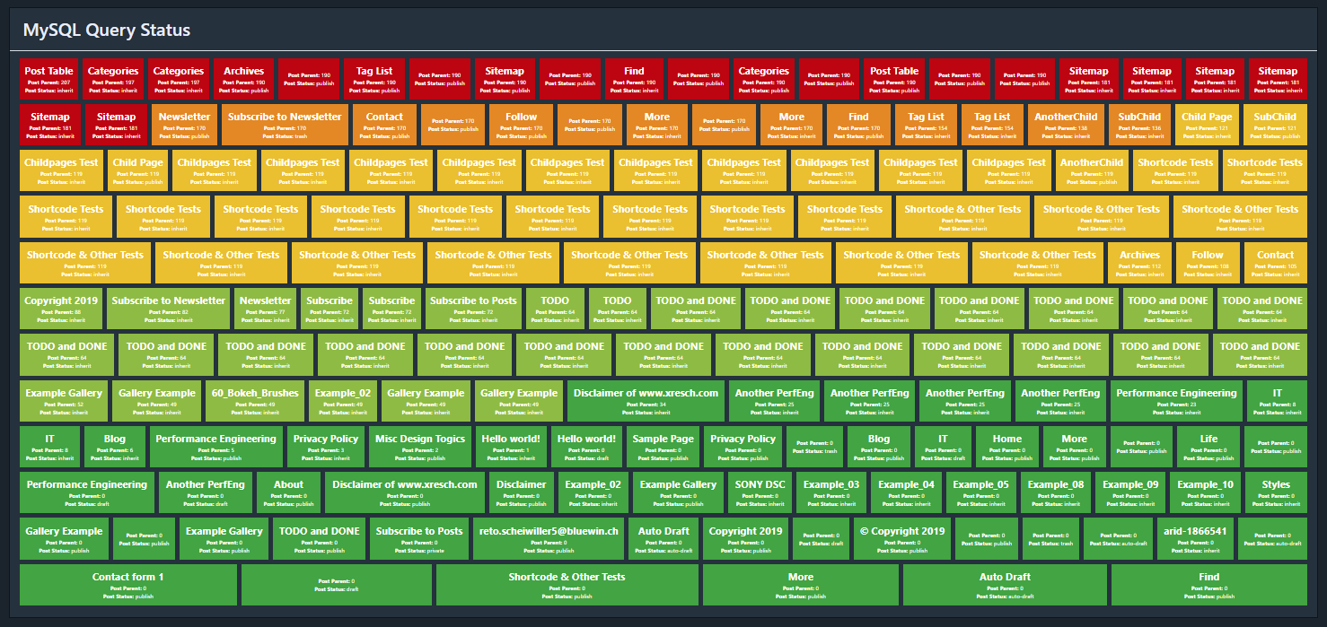
Example – Query MySQL
Query Records from a Database with a simple query. Check if the value of a specific column reaches a defined threshold and set the color appropriately:

Slide 20
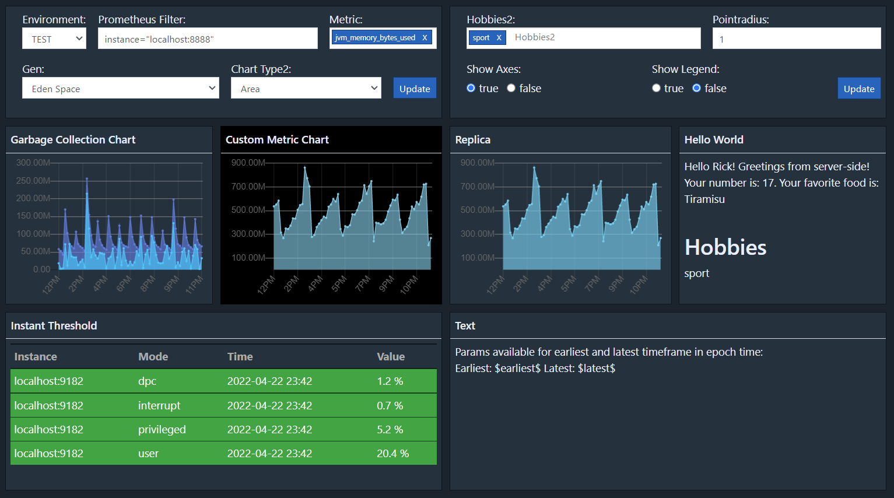
Dashboard Parameters Widget
Allow a user to adjust the defined parameters with one or multiple parameters widgets.

Slide 21
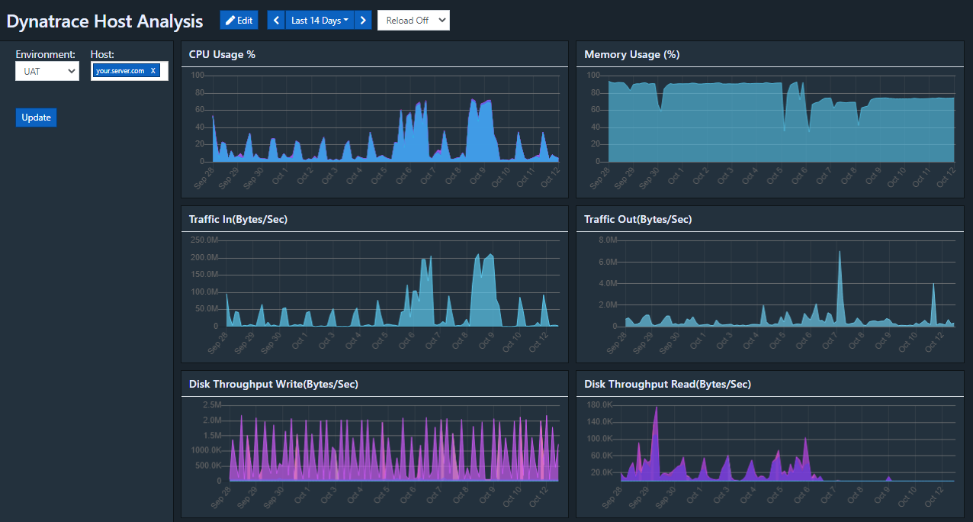
Example – Dynatrace Host Analysis
Parameterized dashboard to analyze host metrics from Dynatrace.
This is included as a template that can be imported:

Slide 22
Query Feature
The query feature gives you more flexibility on how you want to fetch and display the data in EMP. You can either use it to fetch data on the fly or display data on a dashboard. Features:
Various out of the box database sources (MySQL, MSSQL Oracle, any JDBC…)
Prometheus Source
Commands for filtering based on field values
Sorting of the data based on one or multiple field
Merging of data from multiple sources into one dataset
Deduplication by field values and keeping top <n> or last <n> records
Formatting of fields or records based on field values
Integrate the queries into dashboards using the Query Widget
Mass display of traffic lights

Slide 23
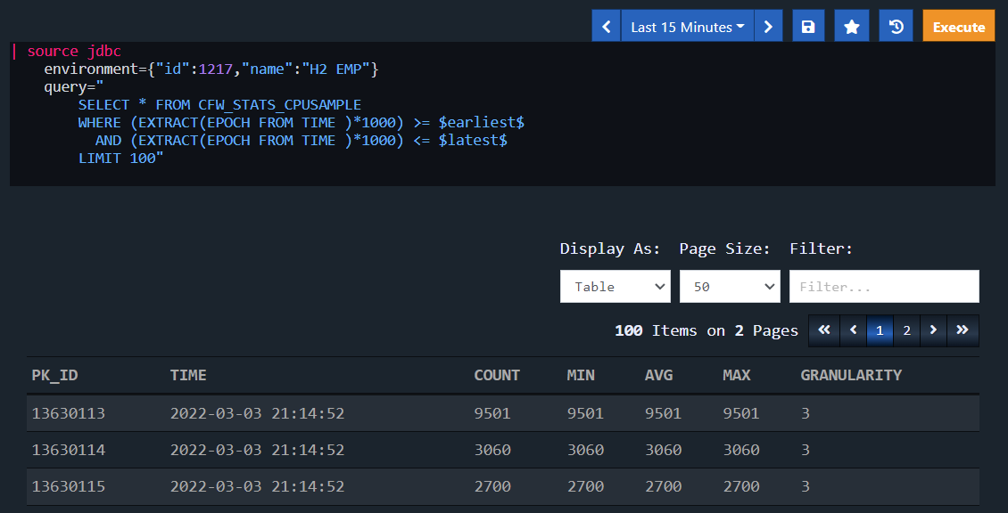
Example – Fetch Data From Database
Fetches data from a database and displays the data as table.

Slide 24
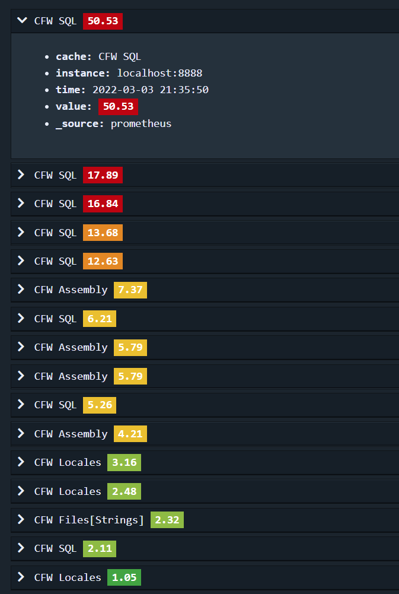
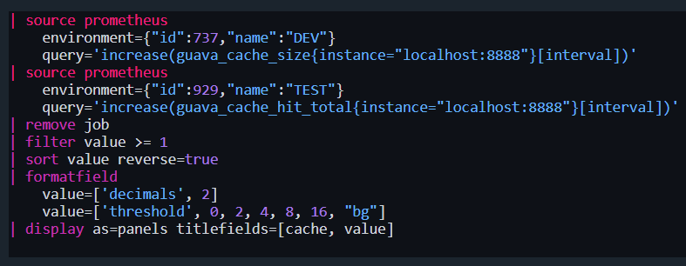
Example – Fetch from Prometheus
Fetch data with two different Prometheus queries from two different prometheus instances. Filter, sort and format by the field “value” and display the result as panels.

Slide 25
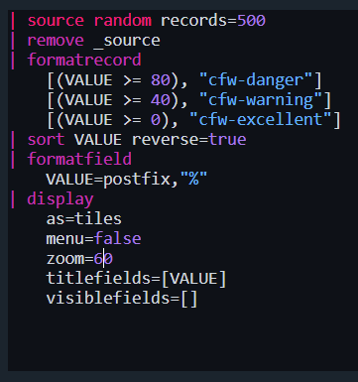
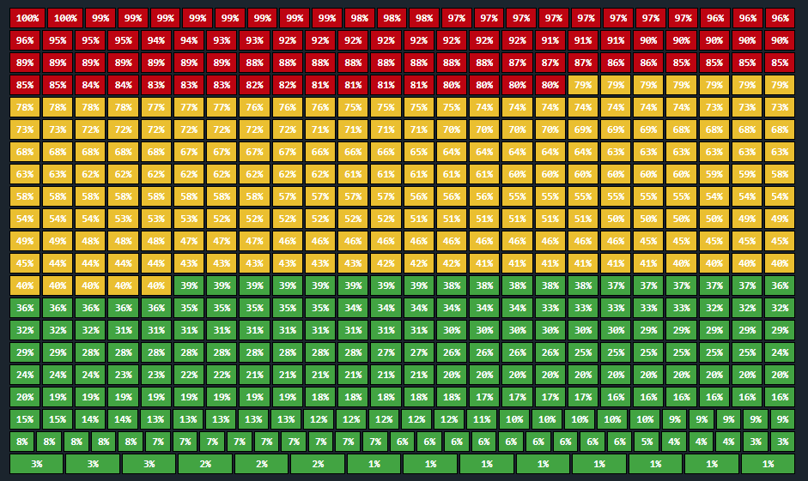
Example - Format
Show records as traffic lights based on field values.

Slide 26
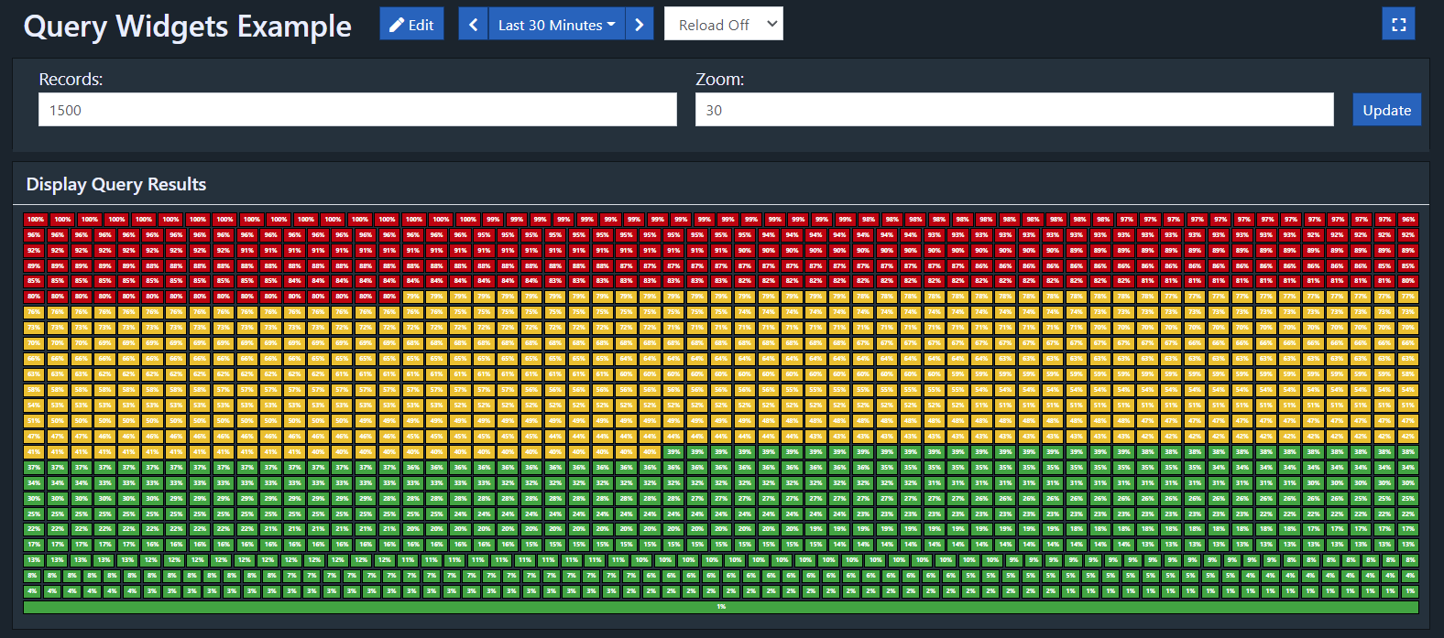
Example –Dashboard Widget with Parameters
Add queries to dashboards and use the dashboard parameter feature to customize your query.

