Slide 1
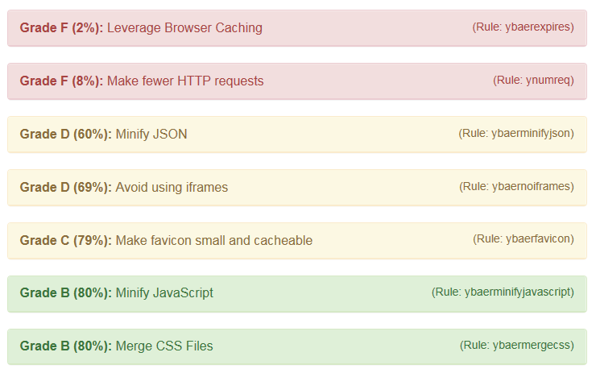
Page Analyzer Architecture
Browser
Java Webserver
NodeJS
1. Upload HAR to web server
3. Send Request
to YSlow
.har-File Upload
HAR Upload Servlet
Customized yslow.js
7. Return HTML including JSON results
6. Compute and return results as JSON
Custom.js
8. Render Page with Javascript based on the JSON Results
2. Store HAR File in a cache
Cache
5. Retrieve HAR File from cache
4. Retrieve HAR file from web server
HAR Download Servlet

