Slide 1
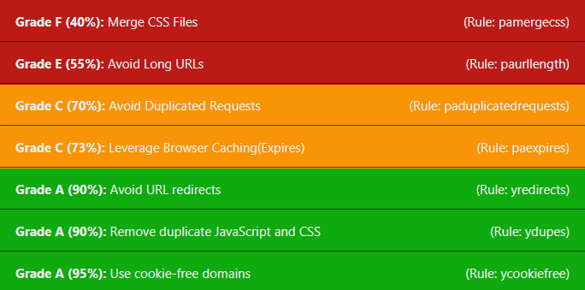
Page Analyzer Architecture
Browser
Java Webserver
NodeJS
1. Upload HAR to web server
3. Send Request
to YSlow
/harupload
HAR Upload Servlet
Customized yslow.js
6. Return HTML including JSON results
4. Compute and return results as JSON
Custom.js
7. Render Page with JavaScript based on the JSON Results
5. Store HAR File and result in DB
PhantomJS.exe
PhantomJS is used to create the .har-File when /analyzeurl is called. It will use netsniff.js for creating the HAR.
Database Server
H2 Database
netsniff.js

