Slide 1
HAℓF
Fei Yuan (Code)
Heiko Möller (Parameter)
Alex Dombos (Analysis)

Slide 2
Goals
Perform a simulation of a supernova explosion near the Solar system (at, say, 10 parsecs) using the VH1 hydrodynamics solver.
Explore the effects of the explosion (in particular, near the orbit of the Earth) and how they vary depending on the energy of the supernova (relative to the force of the Solar wind), proximity, and density.

Slide 3
Motivation

Slide 4
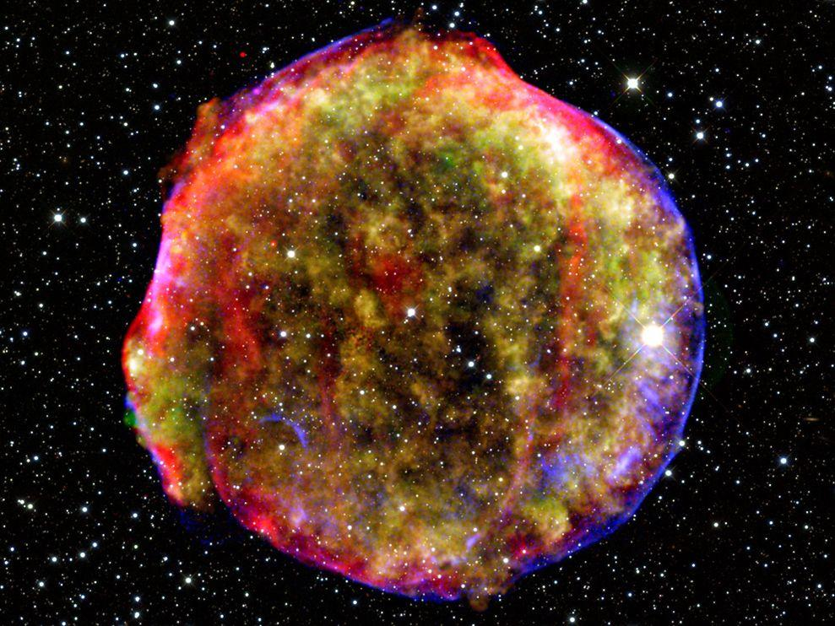
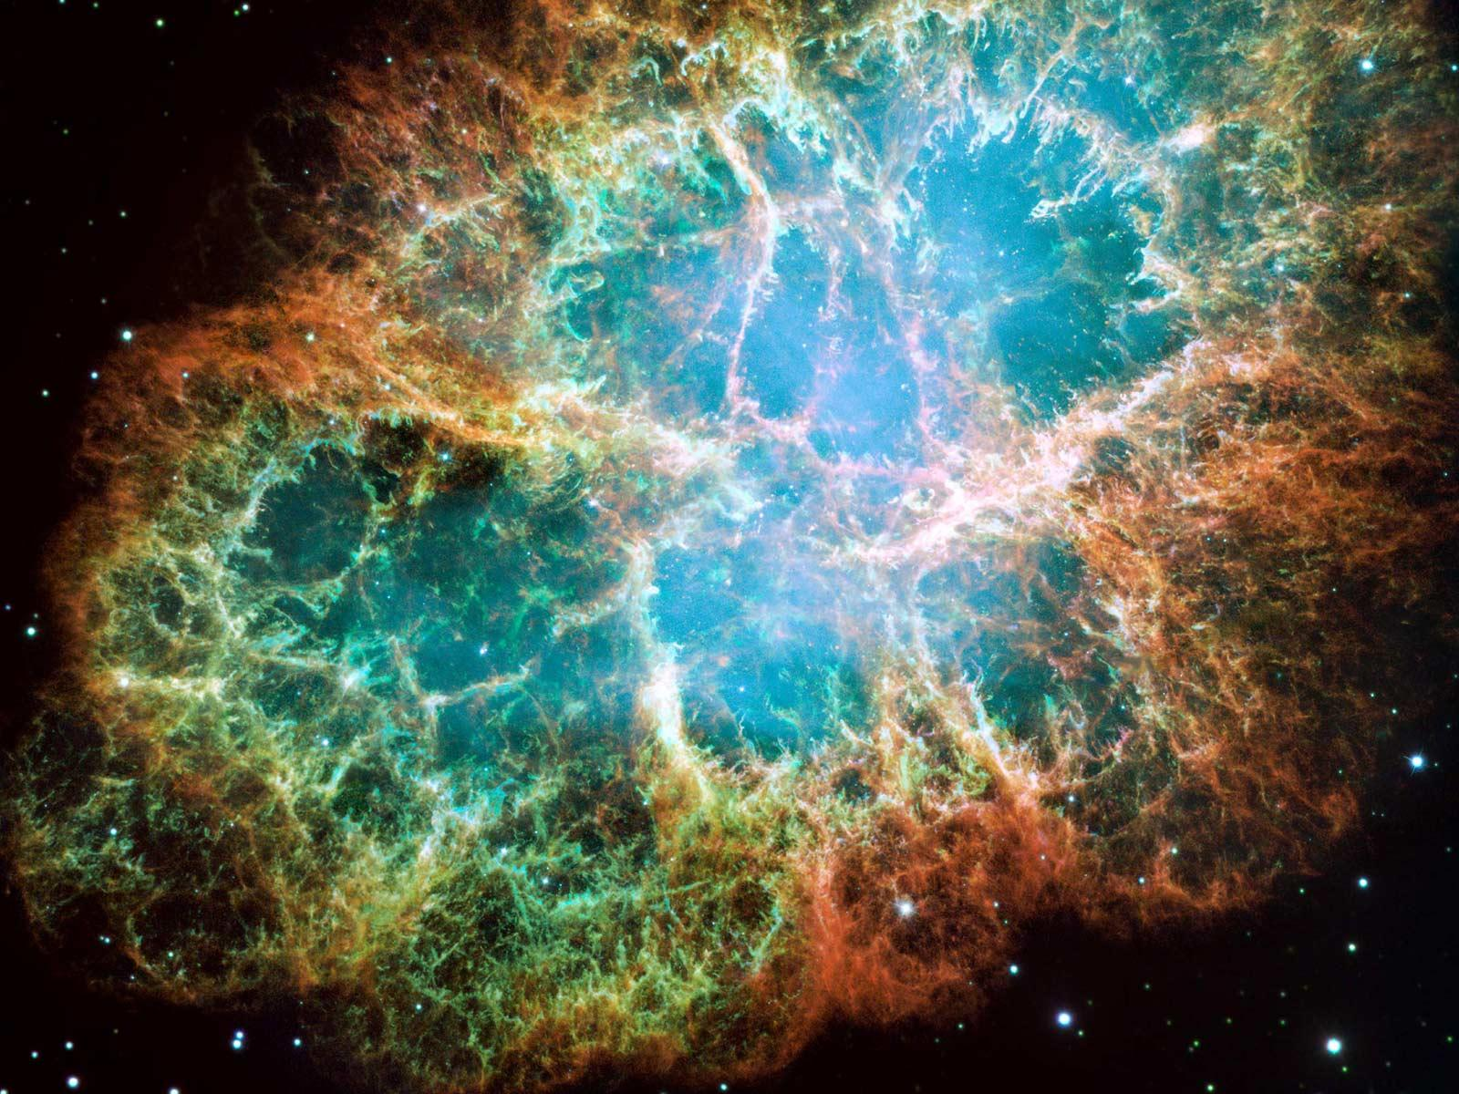

Supernovae
MW Disk: Side View
h ~ 100 pc

Slide 5
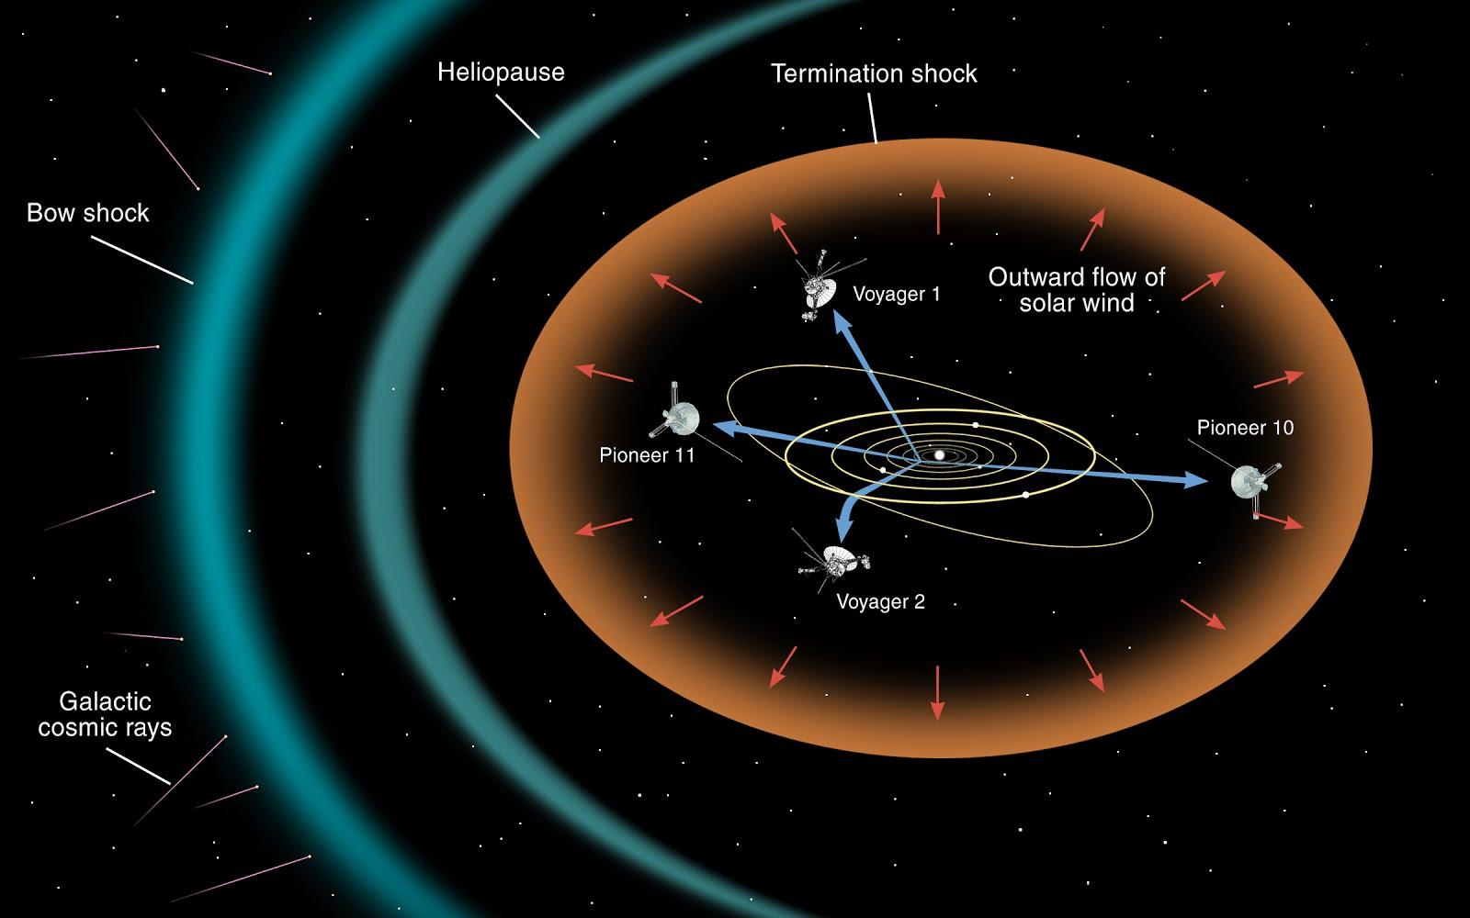
The Solar Wind

Slide 6
Resources and Tools

Slide 7
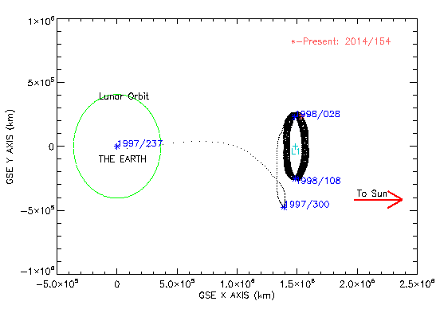
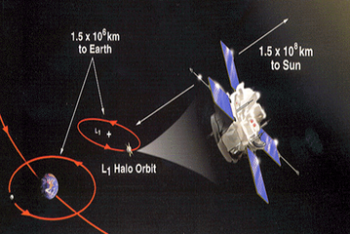
Advanced Composition Explorer (ACE)
L1 libration point
Launched: 1997
Runs out of fuel ≈ 2024

Slide 8
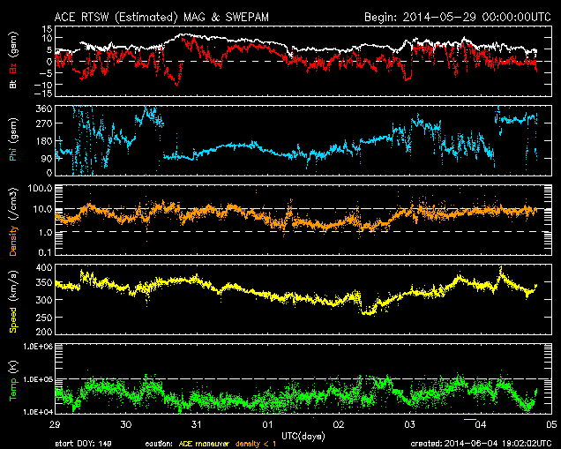
ACE Real Time Solar Wind
near-real-time 24/7 continuous coverage

Slide 9
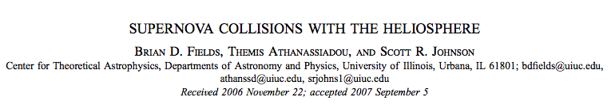
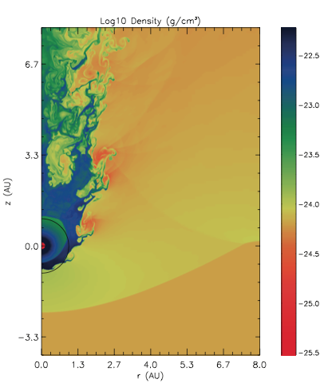
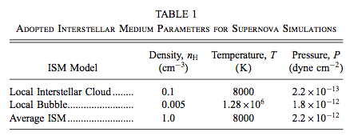
Previous Work and Simulations
Sun
Simulation: FLASH
Blast Properties: SN at 10 pc
Geometry: Cylindrical
1 AU =
Earth’s Orbit
Incoming Blast

Slide 10
Results

Slide 11
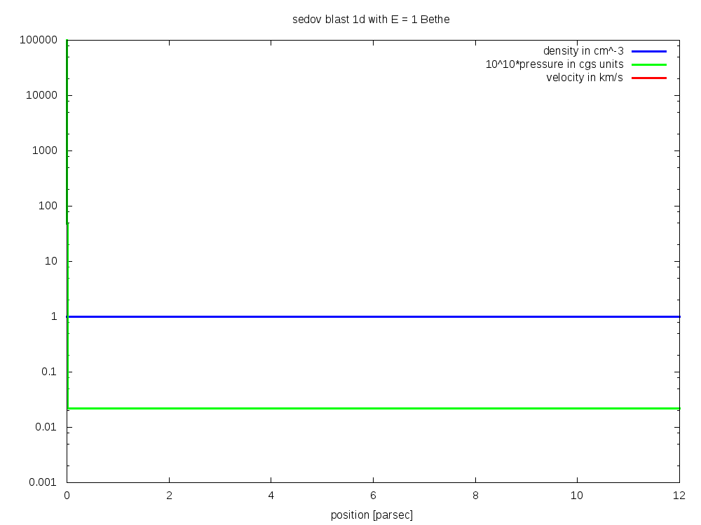

Sedov Blast in 1D
Simulate supernova explosion
E = 10⁵¹ erg
Extract blast properties at 10 parsecs from earth

Slide 12
Sedov Blast in 1D
Simulate supernova explosion
E = 10⁵¹ erg
Extract blast properties at 10 parsecs from earth

Slide 13
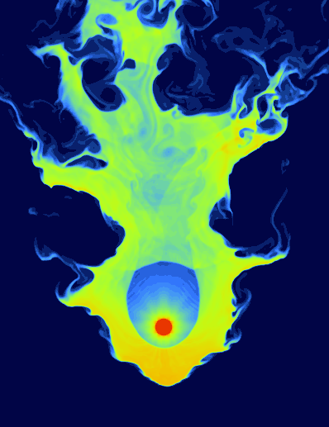
Simulate Solar Wind with Realistic Parameters in 2D
SNE:
~10⁵¹ erg
0.4 /cm³
varied:
950 km/s (shown here)
1900 km/s
5700 km/s
Solar wind:
6 /cm³
470 km/s

Slide 14
Conclusions

