Slide 1
Principles of Object-Oriented Design

Slide 2
The Object-Oriented ... Hype
What are object-oriented (OO) methods?
  OO methods provide a set of techniques for analysing, decomposing, and modularising software system architectures
  In general, OO methods are characterized by structuring the system architecture on the basis of its objects (and classes of objects) rather than the actions it performs
What is the rationale for using OO?
  In general, systems evolve and functionality changes, but objects and classes tend to remain stable over time
  Use it for large systems
  Use it for systems that change often

Slide 3
OO Design vs. OO Programming
Object-Oriented Design
  a method for decomposing software architectures
  based on the objects every system or subsystem manipulates
  relatively independent of the programming language used
Object-Oriented Programming
  construction of software systems as
    Structured collection of Abstract Data Types (ADT)
    Inheritance
    Polymorphism
  concerned with programming languages and implementation issues

Slide 4
Polymorphism
Behavior promised in the public interface of superclass objects
implemented by subclass objects
  in the specific way required for the subclass
Why Is this Important?
  Allow subclasses to be treated like instances of their superclasses
  Flexible architectures and designs
    high-level logic defined in terms of abstract interfaces
    relying on the specific implementation provided by subclasses
    subclasses can be added without changing high-level logic

Slide 5
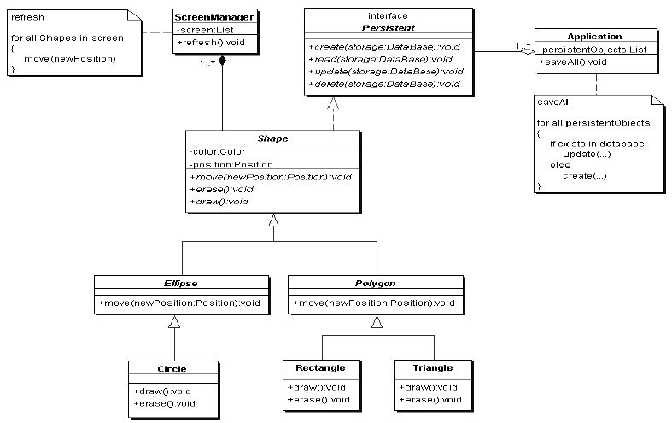
Polymorphism Example

Slide 6
Signs of Rotting Design
Rigidity
  code difficult to change (Continuity)
  management reluctance to change anything becomes policy
Fragility
  even small changes can cause cascading effects
  code breaks in unexpected places (Protection)
Immobility
  code is so tangled that it's impossible to reuse anything
  Composability
Viscosity
  much easier to hack than to preserve original design

Slide 7
Causes of Rotting Design
Changing Requirements
  is inevitable
  "All systems change during their life-cycles. This must be borne in mind when developing systems expected to last longer than the first version". (I. Jacobson, OOSE, 1992)
Dependency Management
  the issue of coupling and cohesion
  It can be controlled!
    create dependency firewalls
    see DIP example

Slide 8
Open-Closed Principle (OCP)
"Software Systems change during their life time"
  both better designs and poor designs have to face the changes;
  good designs are stable
Software entities should be open for extension,
but closed for modification
B. Meyer, 1988 / quoted by R. Martin, 1996
Be open for extension
  module's behavior can be extended
Be closed for modification
  source code for the module must not be changes
Modules should be written so they can be extended
without requiring them to be modified

Slide 9
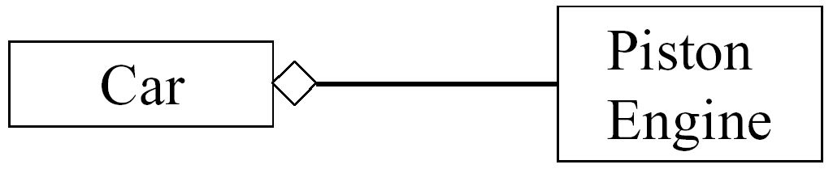
Open the door ...
How to make the Car run efficiently with a TurboEngine?
Only by changing the Car!
  ...in the given design

Slide 10
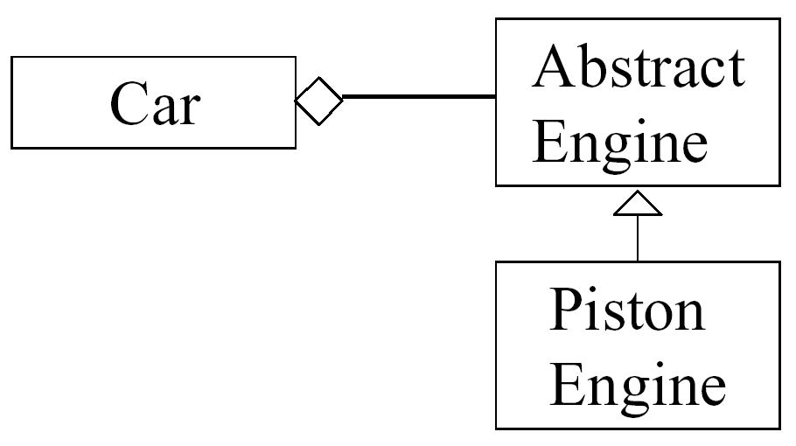
... But Keep It Closed!
A class must not depend on a concrete class!
It must depend on an abstract class ...
...using polymorphic dependencies (calls)

Slide 11
Strategic Closure
"No significant program can be 100% closed "
R.Martin, “The Open-Closed Principle,” 1996
  Closure not complete but strategic
Use abstraction to gain explicit closure
  provide class methods which can be dynamically invoked
    to determine general policy decisions
    e.g. draw Squares before Circles
  design using abstract ancestor classes
Use "Data-Driven" approach to achieve closure
  place volatile policy decisions in a separate location
    e.g. a file or a separate object
  minimizes future change locations

Slide 12
OCP Heuristics
Make all object-data private
No Global Variables!
Changes to public data are always at risk to “open” the module
  They may have a rippling effect requiring changes at many unexpected locations;
  Errors can be difficult to completely find and fix. Fixes may cause errors elsewhere.
Non-private members are modifiable
  Case 1: "I swear it will not change"
    may change the status of the class
  Case 2: the Time class
    may result in inconsistent times

Slide 13
OCP Heuristics (2)
RTTI is Ugly and Dangerous!
RTTI is ugly and dangerous
  If a module tries to dynamically cast a base class pointer to several derived classes, any time you extend the inheritance hierarchy, you need to change the module
  recognize them by type switch-es or if-else-if structures
Not all these situations violate OCP all the time
  when used only as a "filter"

Slide 14
Liskov Substitution Principle (LSP)
The key of OCP: Abstraction and Polymorphism
  Implemented by inheritance
  How do we measure the quality of inheritance?
Inheritance should ensure that any property proved about supertype objects also holds for subtype objects
        B. Liskov, 1987
Functions that use pointers or references to base classes
must be able to use objects of derived classes
without knowing it.
        R. Martin, 1996

Slide 15
Inheritance Appears Simple
class Bird { // has beak, wings,...
public: virtual void fly(); // Bird can fly
};
class Parrot : public Bird { // Parrot is a bird
public: virtual void mimic(); // Can Repeat words...
};
// ...
Parrot mypet;
mypet.mimic(); // my pet being a parrot can Mimic()
mypet.fly(); // my pet “is-a” bird, can fly

Slide 16
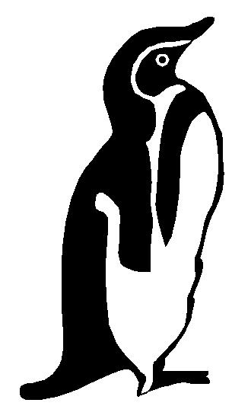
Penguins Fail to Fly!
class Penguin : public Bird {
public: void fly() {
error (“Penguins don’t fly!”); }
};
void PlayWithBird (Bird& abird) {
abird.fly(); // OK if Parrot.
// if bird happens to be Penguin...OOOPS!!
}
Does not model: “Penguins can’t fly”
It models “Penguins may fly, but if they try it is error”
Run-time error if attempt to fly → not desirable
Think about Substitutability - Fails LSP

Slide 17
Design by Contract
Advertised Behavior of an object:
  advertised Requirements (Preconditions)
  advertised Promises (Postconditions)
When redefining a method in a derivate class, you may only replace its precondition by a weaker one, and
its postcondition by a stronger one
        B. Meyer, 1988
Derived class services should require no more and promise no less
int Base::f(int x);
// REQUIRE: x is odd
// PROMISE: return even int
int Derived::f(int x);
// REQUIRE: x is int
// PROMISE: return 8

Slide 18
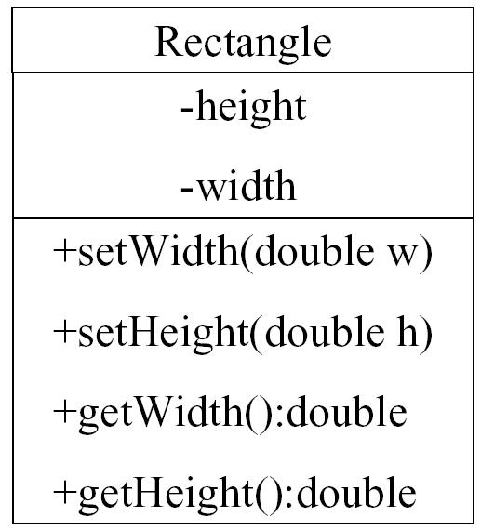
Square IS-A Rectangle?
Square
?
Should I inherit Square from Rectangle?

Slide 19
The Answer is ...
Override setHeight and setWidth
  duplicated code...
  static binding (in C++)
    void f(Rectangle& r) { r.setHeight(5); }
    change base class to set methods virtual
The real problem
  void g(Rectangle& r) {
  r.setWidth(5); r.setHeight(4);
  // How large is the area?
  }
  20! ... Are you sure? ;-)
IS-A relationship must refer to the behavior of the class!

Slide 20
LSP is about Semantics and Replacement
The meaning and purpose of every method and class must be clearly documented
  Lack of user understanding will induce de facto violations of LSP
Replaceability is crucial
  Whenever any class is referenced by any code in any system,
  any future or existing subclasses of that class must be 100% replaceable
  Because, sooner or later, someone will substitute a subclass;
    it’s almost inevitable.

Slide 21
LSP and Replaceability
Any code which can legally call another class’s methods
  must be able to substitute any subclass of that class without modification:
Client
Service Class
Service Class
Client
Unexpected
Subclass

Slide 22
LSP Related Heuristic (2)
It is illegal for a derived class, to override
a base-class method with a NOP method
NOP = a method that does nothing
Solution 1: Inverse Inheritance Relation
  if the initial base-class has only additional behavior
    e.g. Dog - DogNoWag
Solution 2: Extract Common Base-Class
  if both initial and derived classes have different behaviors
  for Penguins → Birds, FlyingBirds, Penguins
Classes with bad state
  e.g. stupid or paralyzed dogs...

Slide 23
Example of Rigidity and Immobility
enum OutputDevice {printer, disk};
void Copy(OutputDevice dev){
int c;
while((c = ReadKeyboard())!= EOF)
if(dev == printer)
WritePrinter(c);
else
WriteDisk(c);
}
Copy
Read
Keyboard
Write
Printer
Write
Disk
void Copy(){
int c;
while ((c = ReadKeyboard()) != EOF)
WritePrinter(c);
}

Slide 24
Dependency Inversion Principle
I. High-level modules should not depend on low-level modules.
Both should depend on abstractions.
II. Abstractions should not depend on details.
Details should depend on abstractions
R. Martin, 1996
OCP states the goal; DIP states the mechanism
A base class in an inheritance hierarchy should not know any of its subclasses
Modules with detailed implementations are not depended upon, but depend themselves upon abstractions

Slide 25
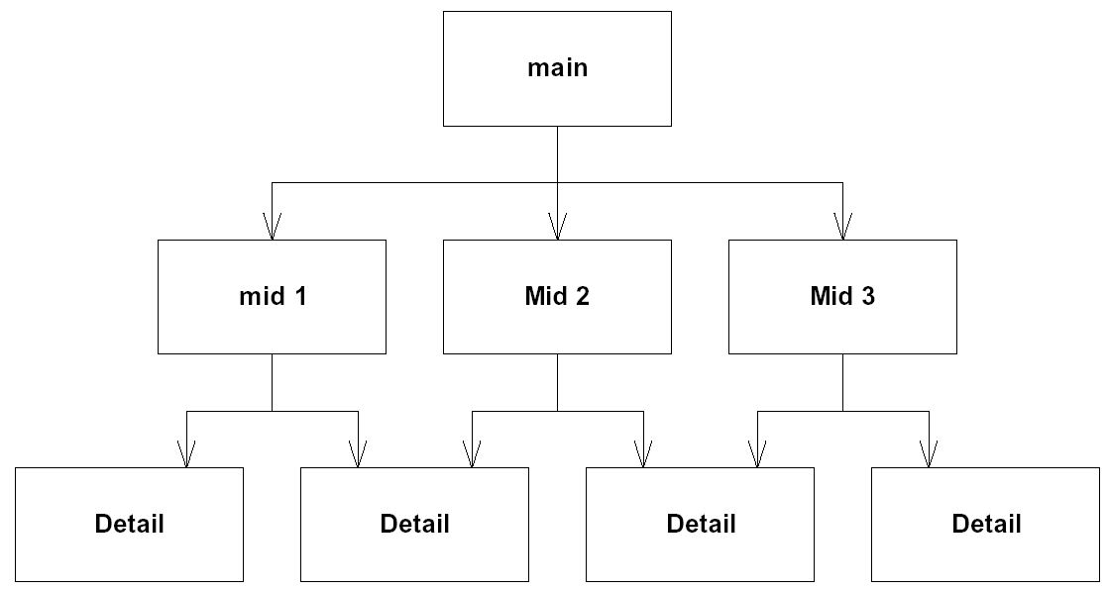
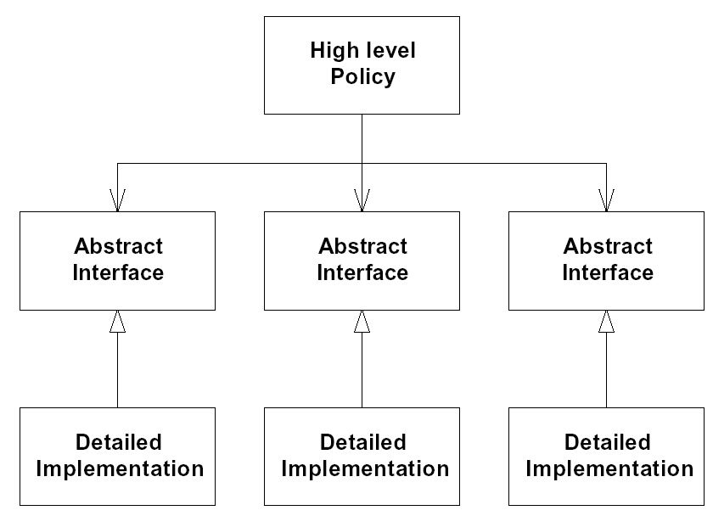
Procedural vs. OO Architecture
Procedural
Architecture
Object-Oriented
Architecture

Slide 26
DIP Applied on Example
Copy
class Reader {
public:
virtual int read()=0;
};
class Writer {
public:
virtual void write(int)=0;
};
void Copy(Reader& r, Writer& w){
int c;
while((c = r.read()) != EOF)
w.write(c);
}
Reader
Writer
Keyboard
Reader
Printer
Writer
Disk
Writer

Slide 27
DIP Related Heuristic
Design to an interface,
not an implementation!
Use inheritance to avoid direct bindings to classes:
Interface
(abstract class)
Client
Implementation
(concrete class)

Slide 28
Design to an Interface
Abstract classes/interfaces:
  tend to change much less frequently
  abstractions are ‘hinge points’ where it is easier to extend/modify
  shouldn’t have to modify classes/interfaces that represent the abstraction (OCP)
Exceptions
  Some classes are very unlikely to change;
    therefore little benefit to inserting abstraction layer
    Example: String class
  In cases like this can use concrete class directly
    as in Java or C++

Slide 29
DIP Related Heuristic
Avoid Transitive Dependencies
Avoid structures in which higher-level layers depend on lower-level abstractions:
  In example below, Policy layer is ultimately dependant on Utility layer.
Policy
Layer
Depends on
Mechanism
Layer
Depends on
Utility
Layer

Slide 30
Solution to Transitive Dependencies
Use inheritance and abstract ancestor classes to effectively eliminate transitive dependencies:
Policy
Layer
depends on
Mechanism
Interface
Mechanism
Layer
depends on
Utility
Interface
Utility
Layer

Slide 31
DIP - Related Heuristic
When in doubt, add a level of indirection
If you cannot find a satisfactory solution for the class you are designing, try delegating responsibility to one or more classes:
Problem
Holder
Problem
Solver

Slide 32
When in doubt ...
It is generally easier to remove or by-pass existing levels of indirection than it is to add them later:
Blue class’s indirect message calls to red class fail to meet some criteria (e.g. real-time constraints, etc.)
So, Blue class re-implements some or all of green class’s responsibilities for efficiency and calls red object directly
X

Slide 33
The Founding Principles
The three principles are closely related
Violating either LSP or DIP invariably results in violating OCP
  LSP violations are latent violations of OCP
It is important to keep in mind these principles to get most out of OO development...
... and go beyond buzzwords and hype ;)

