Slide 1
ACDNet

Slide 2
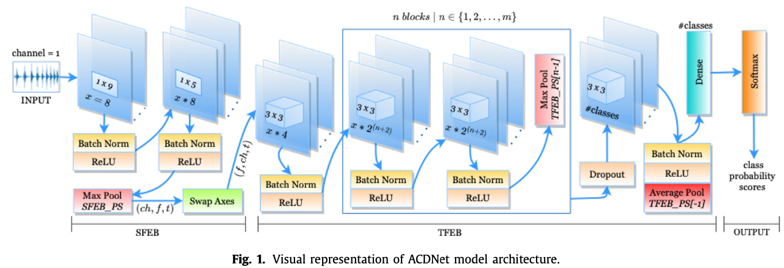
ACDNet Architecture

Slide 3

SFEB Maxpool Kernel Size Equation

Slide 4
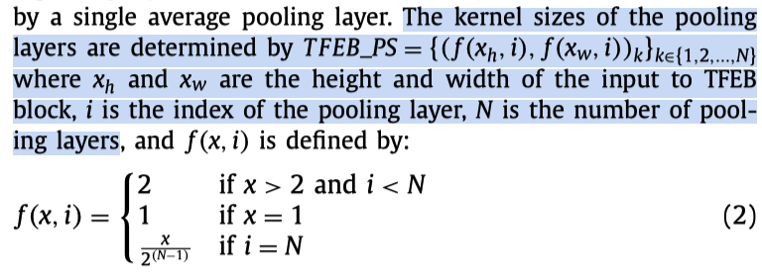
TFEB Pooling Layer Kernel Size Equation

Slide 5
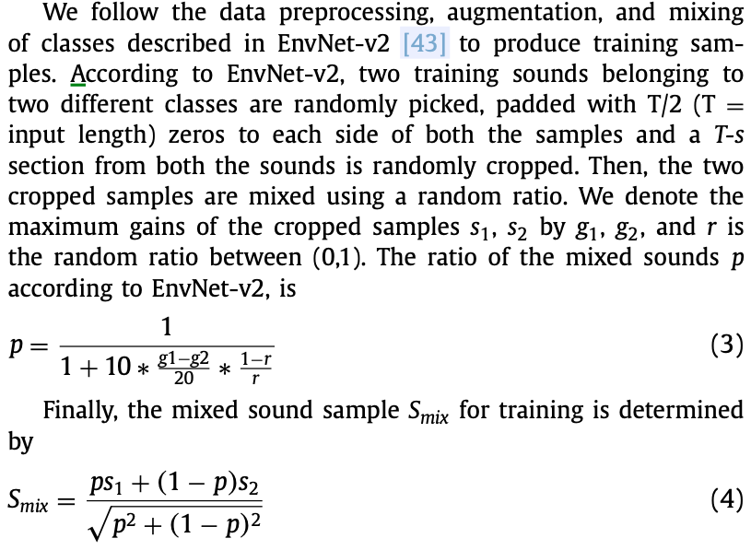
Training Audio Data Mix Equation

