Slide 1
2020.09.18會議報告

Slide 2
本周進度
Post Quantization:
Weight Quantization.
Activation Quantization.
Output Layer and Bias Bits Shift.

Slide 3
Quantization Flow
Saved Model
Create Model
Input Data
Int8 Weights and Out & Bias Shifts
Get Best Act Max

Slide 4
Shift Bits Verification
Shift Bits: [64, 64, 32, 32, 32, 32, 32,64]
分六組：
1. (64 ,64)
2. (64 ,32)
3. (32 ,32)
4. (32 ,32)
5. (32 ,32)
6. (32 ,32)
7. (32 ,64)
fc1_W_0 number of wts/bias: (520, 128) frac bits: 8
fc1_b_0 number of wts/bias: (128,) frac bits: 8
fc2_W_0 number of wts/bias: (128, 128) frac bits: 8
fc2_b_0 number of wts/bias: (128,) frac bits: 7
fc3_W_0 number of wts/bias: (128, 128) frac bits: 8
fc3_b_0 number of wts/bias: (128,) frac bits: 7
final_fc_0 number of wts/bias: (128, 128) frac bits: 7
Variable_0 number of wts/bias: (128,) frac bits: 8

Slide 5
Shift Bits Verification (Cont.)
consider the formula:
out = activation(in * w + b)
we use Qx.y format to represent the fractional part of each variable in the equation.
the N_{t} layer out is N_{(t+1)} input.
set fi_{t} is fraction bits of input
set fw is fraction bits of weights
set fo_{t} is fraction bits of output
set fi_{t+1} is fraction bits of layer_{t+1} input
the fractional bits of product of in_{t} * w is
fi_{t} + fw bits long, as the product of in_{t} * w is input of next layer, and original next layer’s input fractional bits is fi_{t+1} long, as a result, the out need to shift right
out_rshift = (fi_{t} + fw)-fi_{t+1}

Slide 6
Shift Bits Verification (Cont.)
Q6.1 (in)
Q6.1 (out)
(64, 64)
input
output
fc1_W_0 frac bits: 8
frac bits is 8 (Weight)
fc1_b_0 frac bits: 8
frac bits is 8 (Bias)
Output Shift:
While input * weights will have 9 frac bits.
(Q6.1 x Q0.8), but the output is originally Q6.1 , as a result, output need to shift right 8 bits to get to same representation.
Bias Shift:
So, while input * weights will have 9 dec bits.
(Q6.1 x Q0.8), from above fc1_b_0 has frac bits is 8 bits, as a result , bias need to shift left 1 bits to get to the same representation.

Slide 7
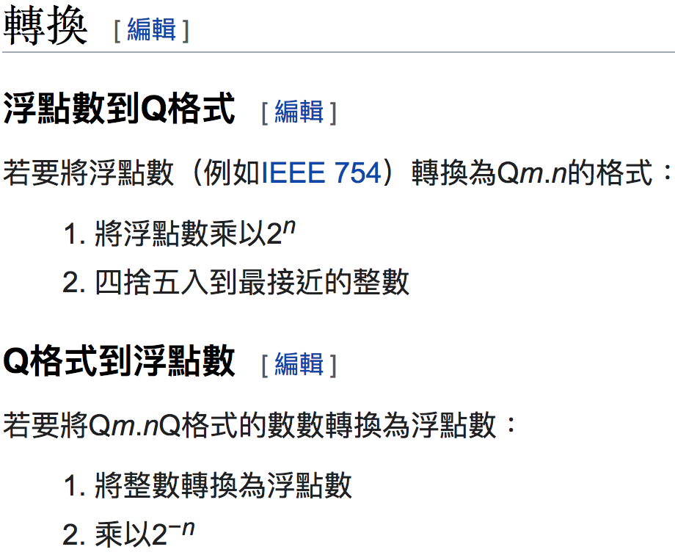
Q-Format Arithmetic

Slide 8
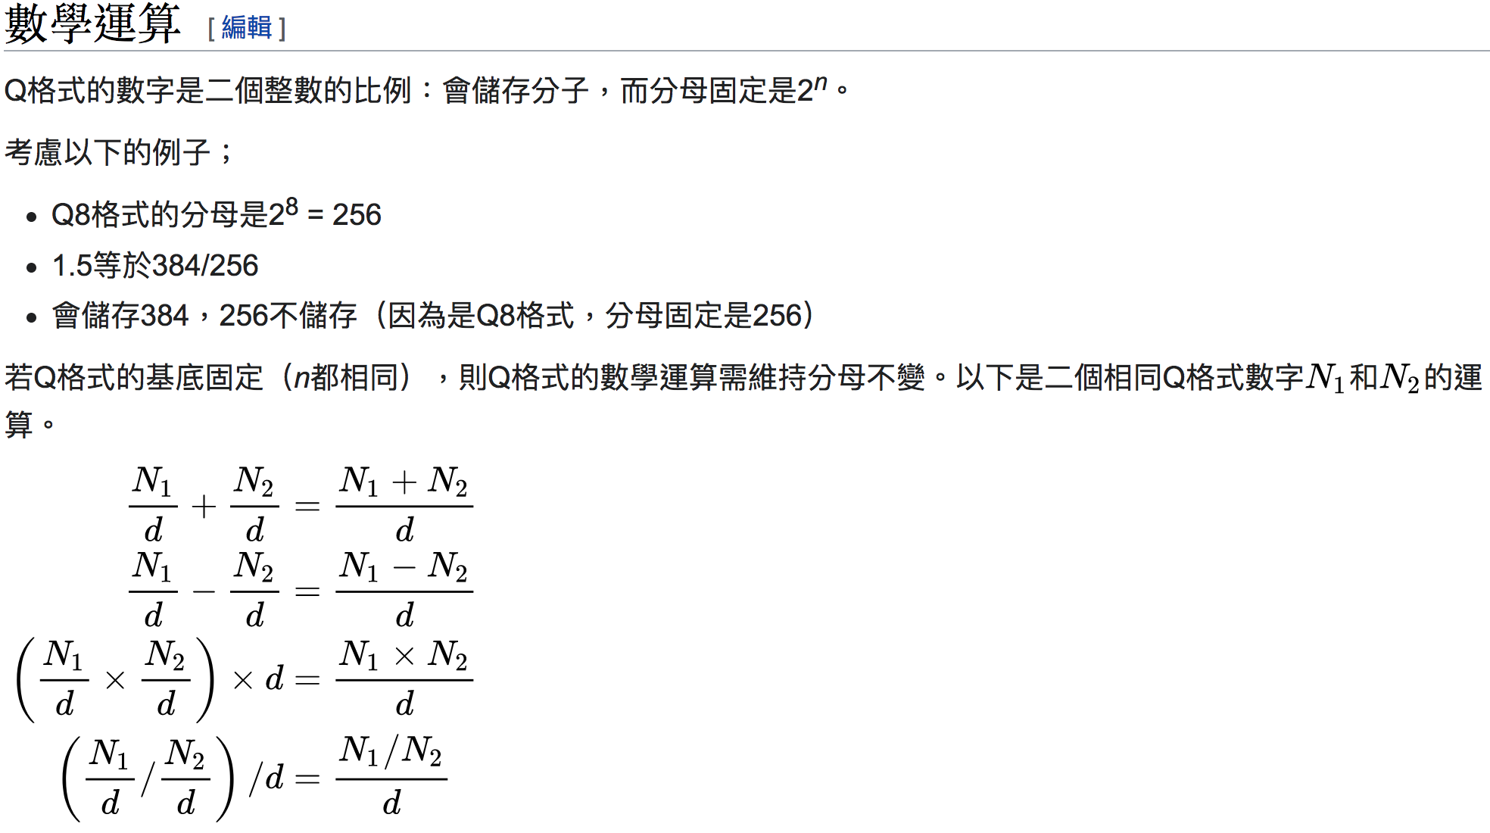
Q-Format Arithmetic

Slide 9
Quantization Notes
From Input to final output layer, all applying fake_quant_min_max_vars function to quantize the values.
Finally, write the weights and biases to .c file.

Slide 10
Quantization Notes
When using quanted weights and biases by calling ARM NN API, we need to pass each layers’ weight shift bits and bias shift bits to the api function.
This is because we need to align the input and output decimal and float format.
For example, from quantization sweeps we get the input to the first fully-connected layer in DNN model is of Q5.2 format or 2 bits after the decimal point (i.e. ranges from -32,31.75) and the expected output format for maximum accuracy is also Q5.2.

Slide 11
tf.fake_quant_with_min_max_vars note
Fake-quantize the inputs tensor of type float via global float scalars min and max to outputs tensor of same shape as inputs.
Attributes
[min; max] define the clamping range for the inputs data.
inputs values are quantized into the quantization range ( [0; 2^num_bits - 1] when narrow_range is false and [1; 2^num_bits - 1] when it is true) and then de-quantized and output as floats in [min; max] interval.
num_bits is the bitwidth of the quantization; between 2 and 16, inclusive.

Slide 12
tf.fake_quant_with_min_max_vars note Cont.
Before quantization, min and max values are adjusted with the following logic. It is suggested to have min <= 0 <= max. If 0 is not in the range of values, the behavior can be unexpected:
If 0 < min < max: min_adj = 0 and max_adj = max - min.
If min < max < 0: min_adj = min - max and max_adj = 0.
If min <= 0 <= max: scale = (max - min) / (2^num_bits - 1), min_adj = scale * round(min / scale) and max_adj = max + min_adj - min.

