Slide 1
BC-Learning+ProtoNet Thought 1
Rick Liao

Slide 2
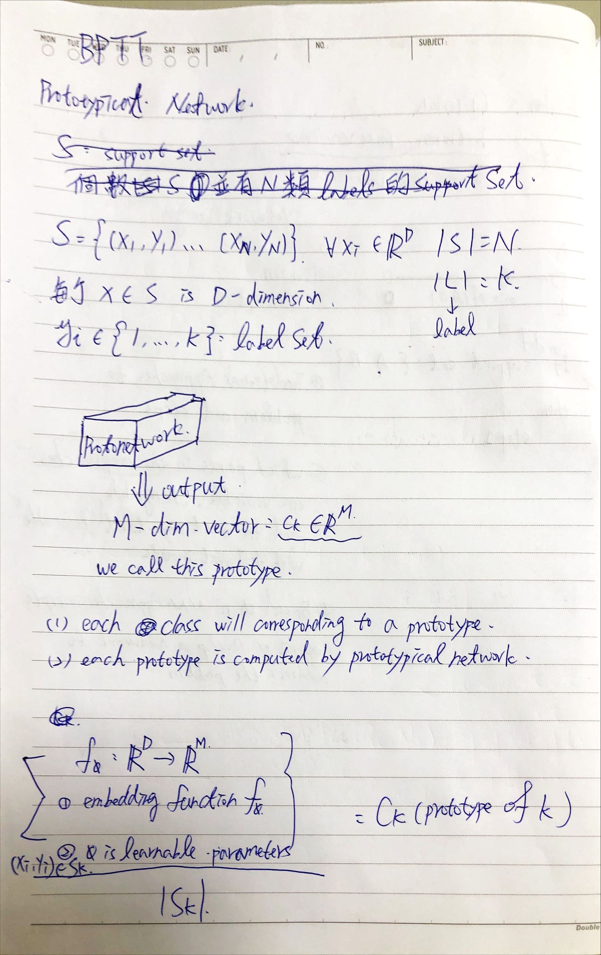
Draft Thoughts-step 1

Slide 3
Draft Thoughts-step1

Slide 4
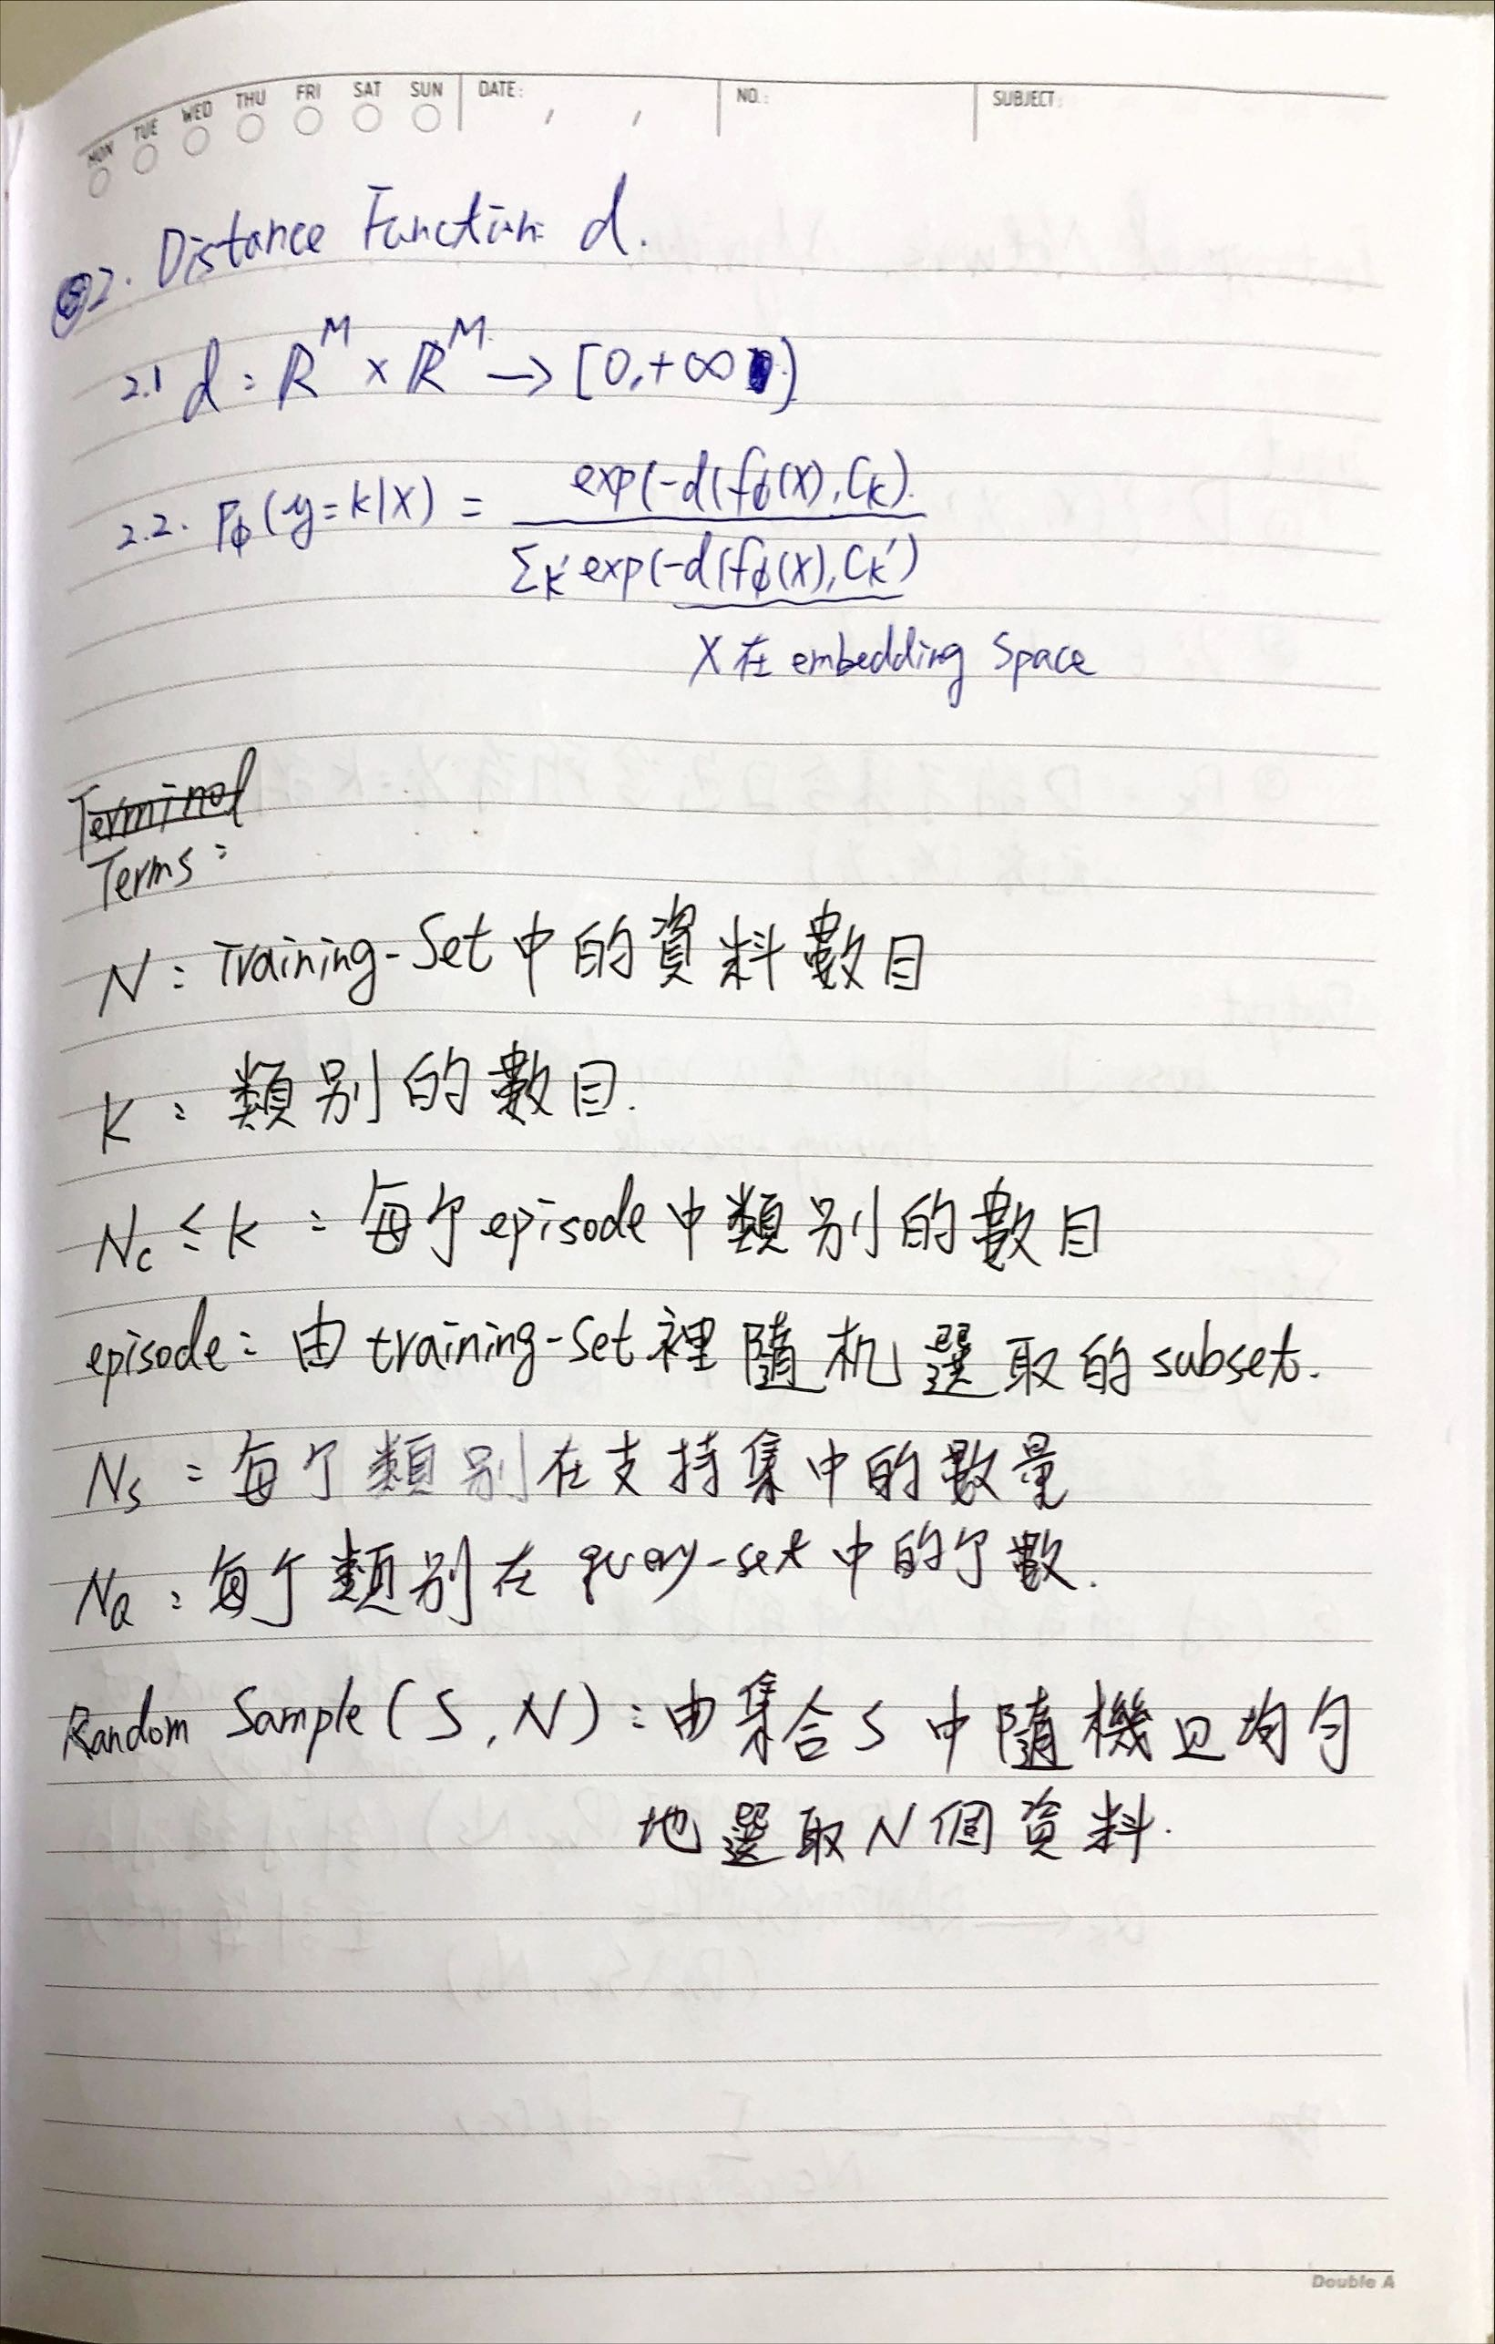
Draft Thoughts-step 2

Slide 5
Draft Thoughts-step 2

Slide 6
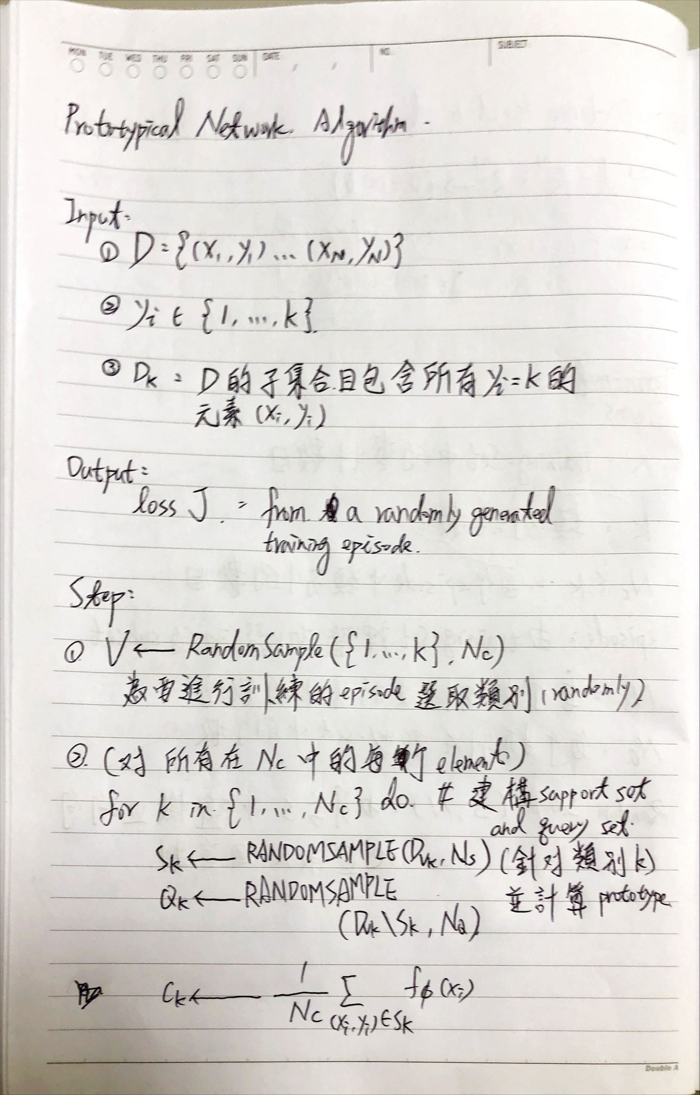
Draft Thoughts-step 3

Slide 7
Draft Thoughts-step 3

Slide 8
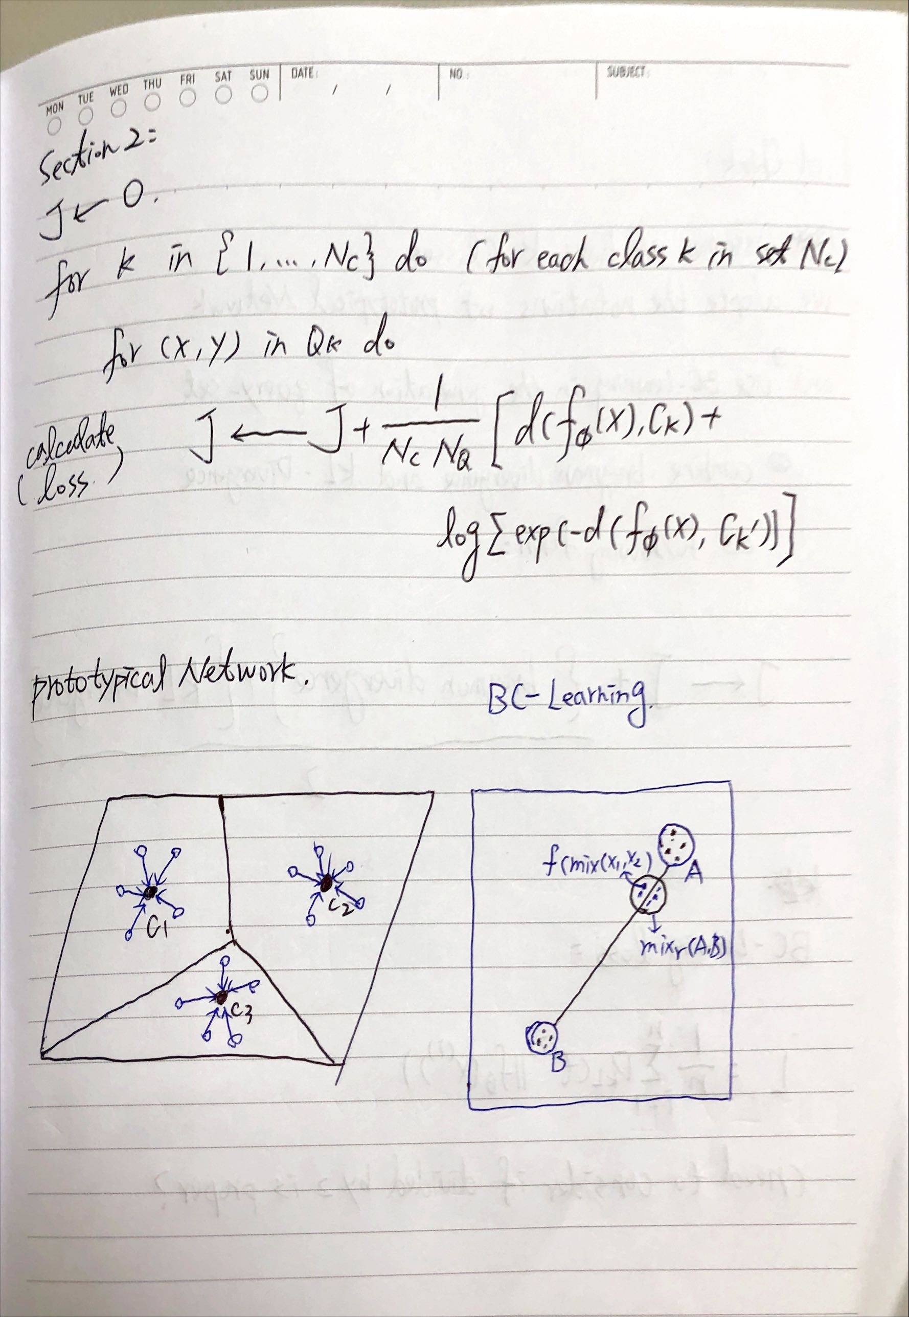
Draft Thoughts-step 4

Slide 9
Draft Thoughts-step 4

Slide 10
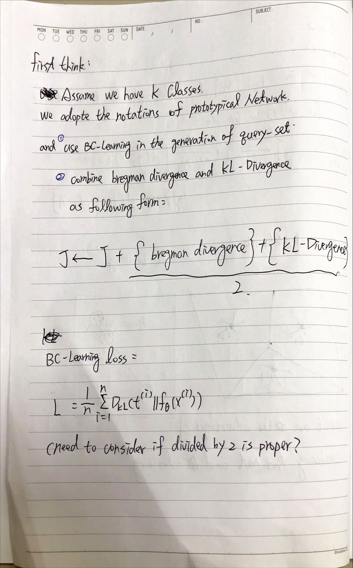
Draft Thoughts-step 5

Slide 11
Draft Thoughts-step 5

Slide 12
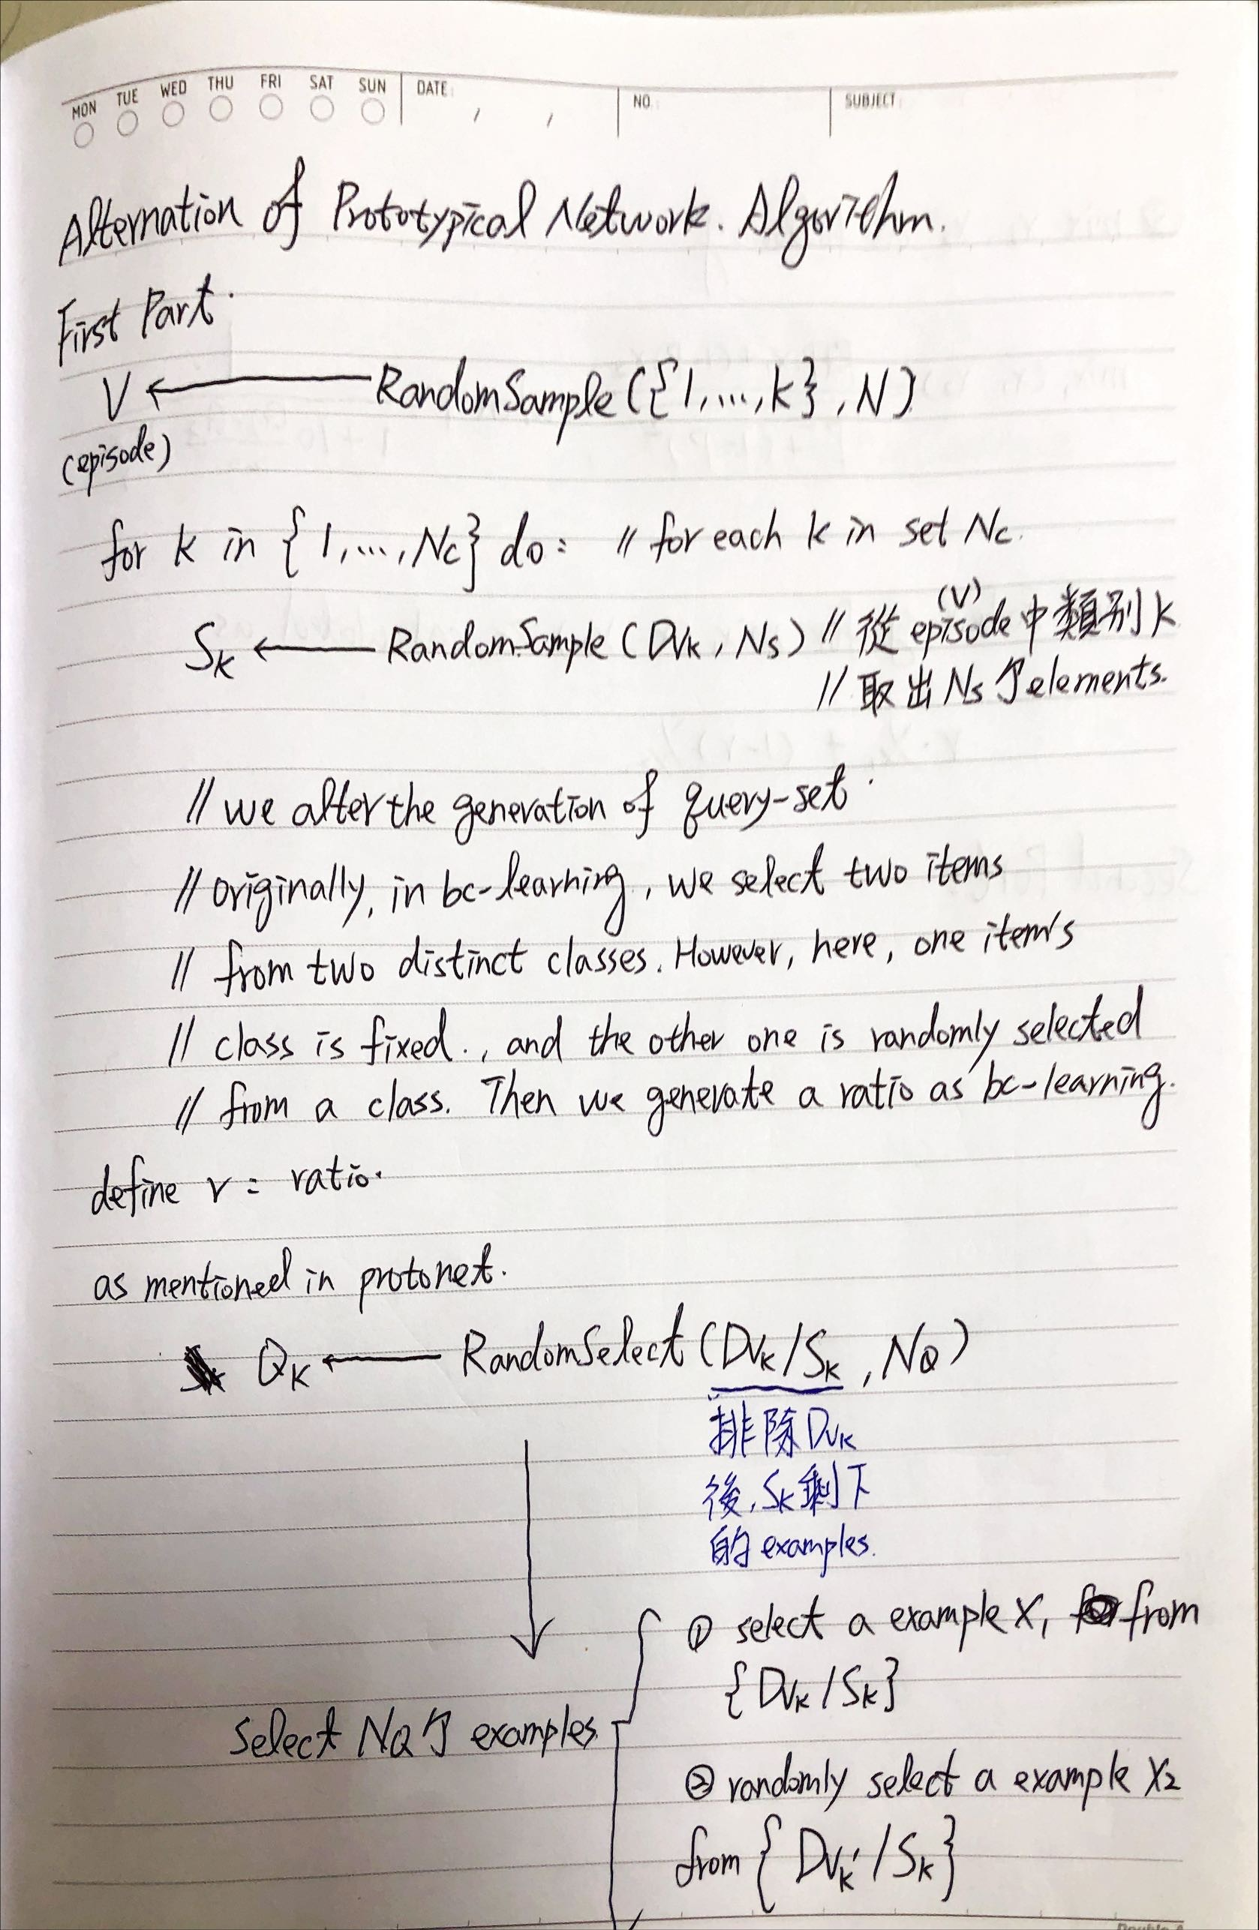
Draft Thoughts-step 6

Slide 13
Draft Thoughts-step 6

Slide 14
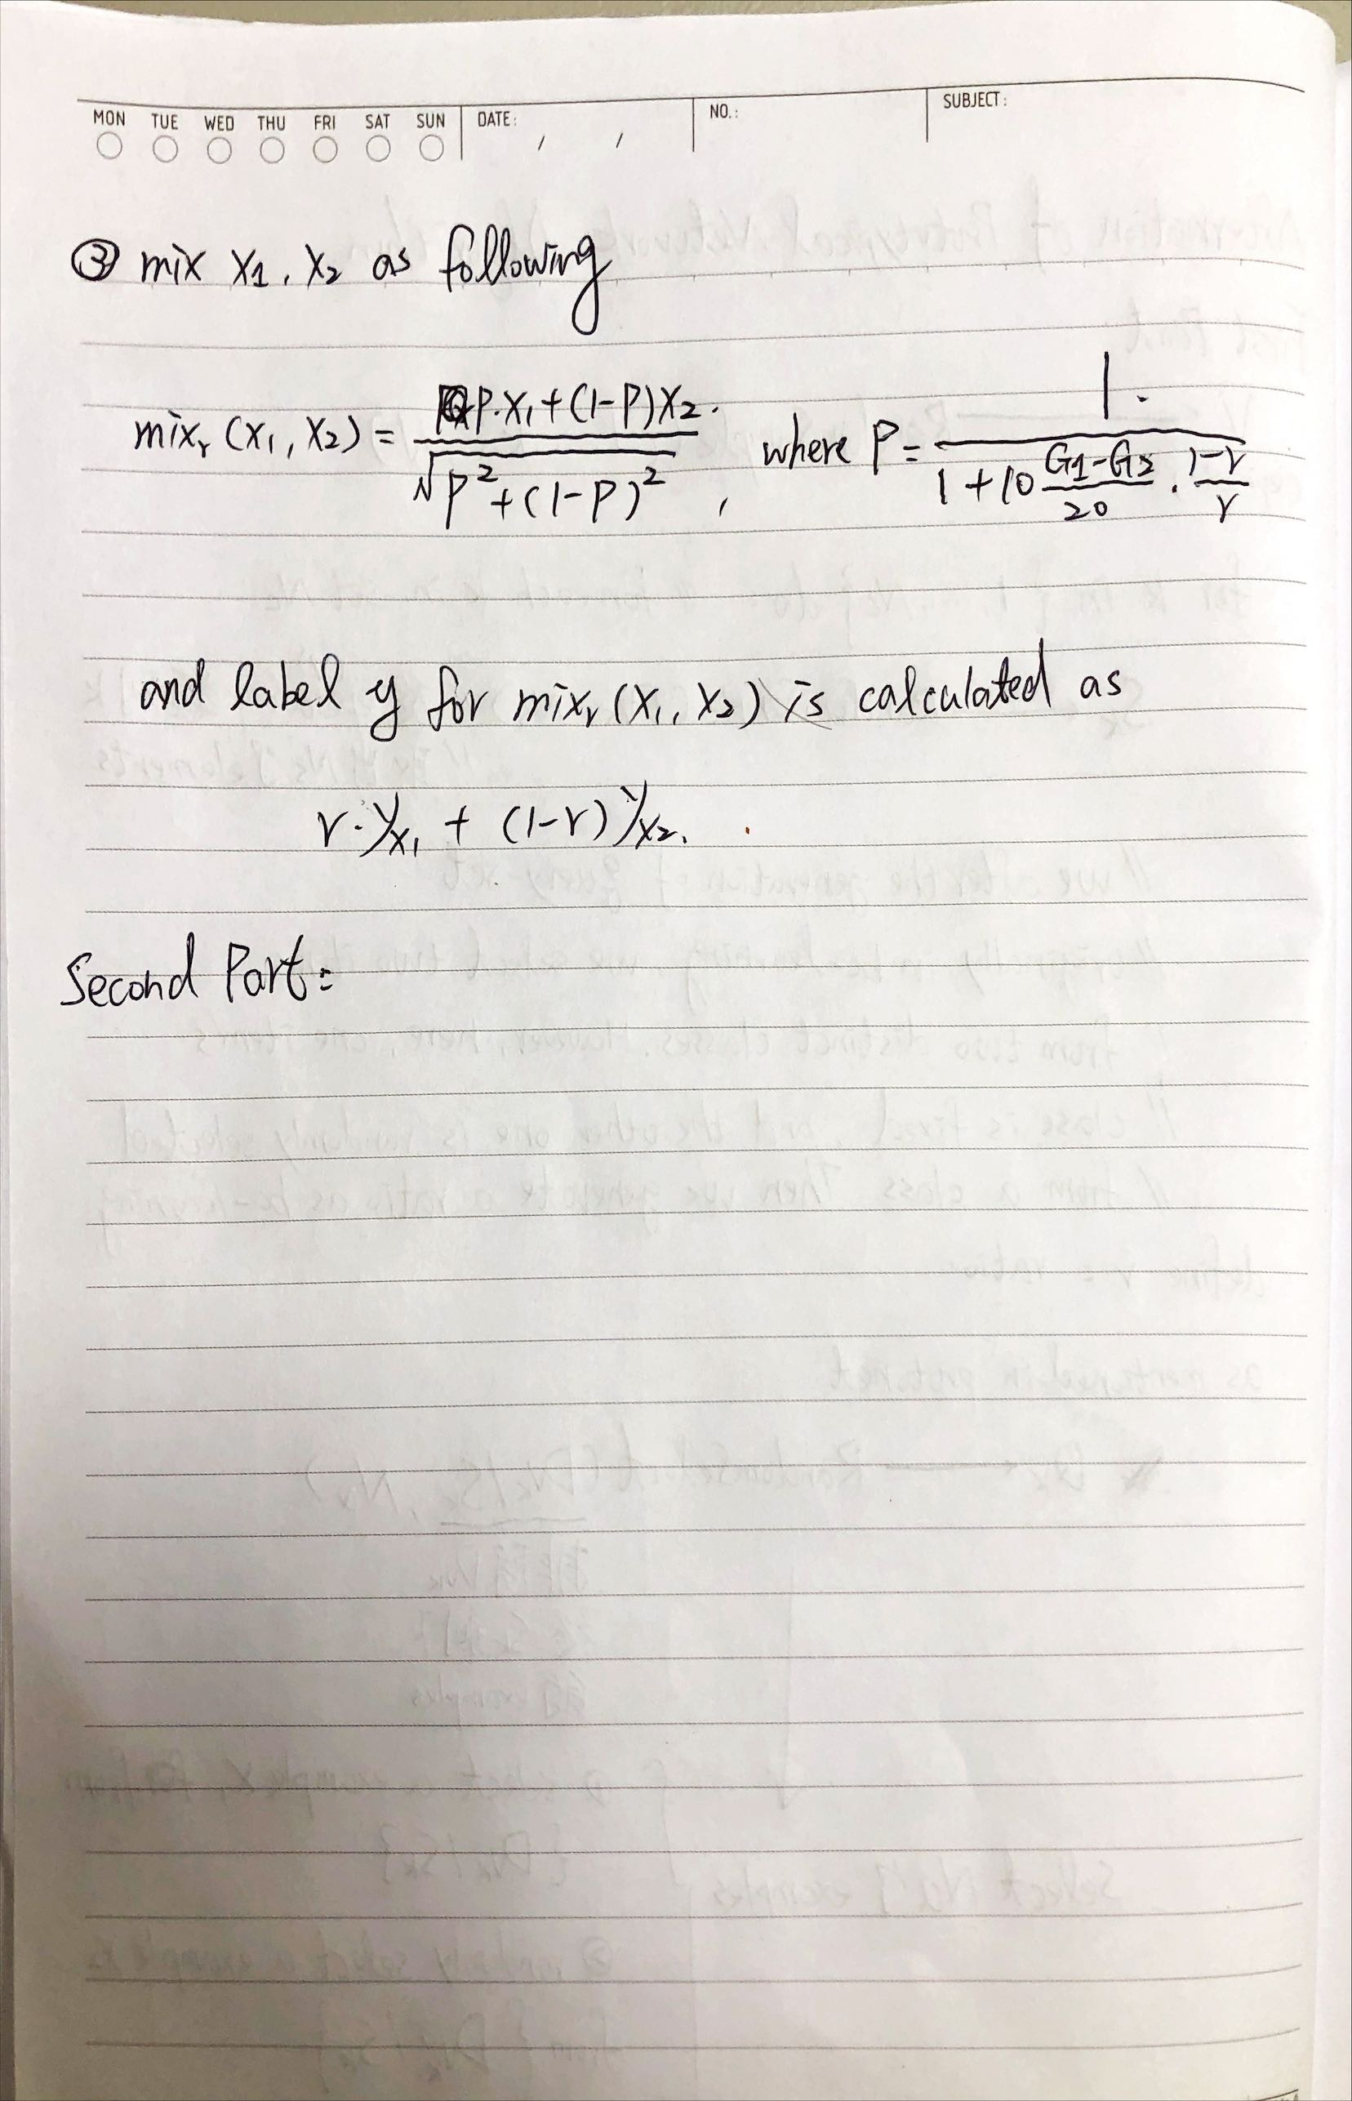
Draft Thoughts-step 7

Slide 15
Draft Thoughts-step 7

Slide 16
Draft Thoughts-step 2

