Slide 1
BC-Learning+ProtoNet Thought 1
Rick Liao

Slide 2
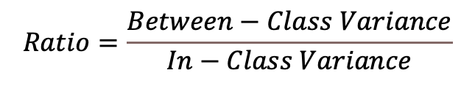
Fisher’s Criteria
$$Ratio=\frac{Between−Class Variance}{In−Class Variance}$$
Between-Class Variance
In-Class Variance

Slide 3
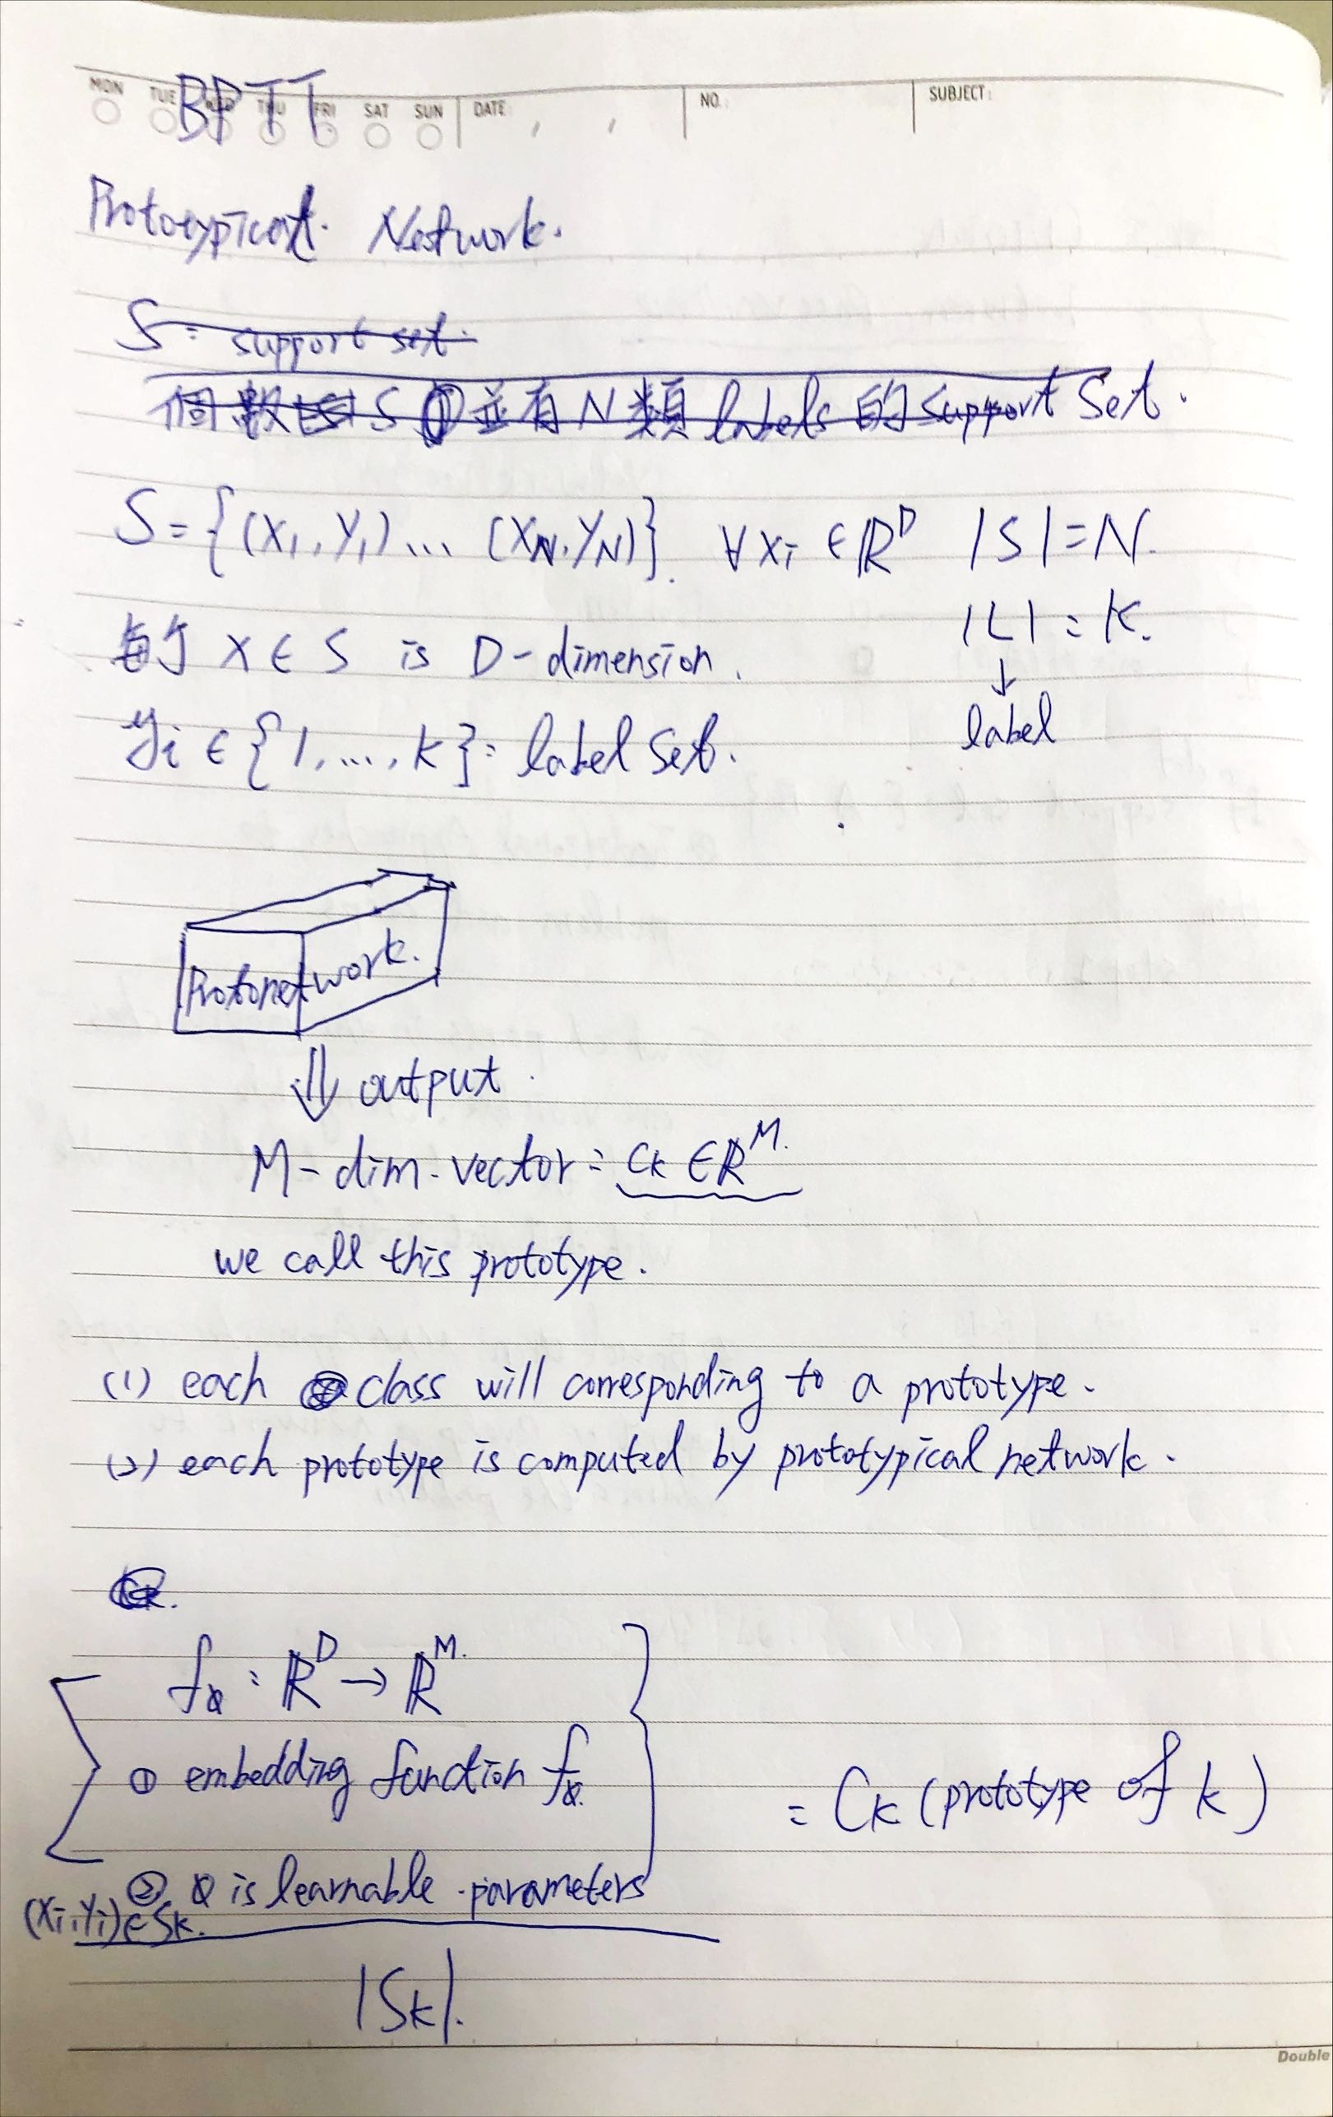
Draft Thoughts-step 1

Slide 4
ProtoNet: Terminology
N
N_{C} :

Slide 5
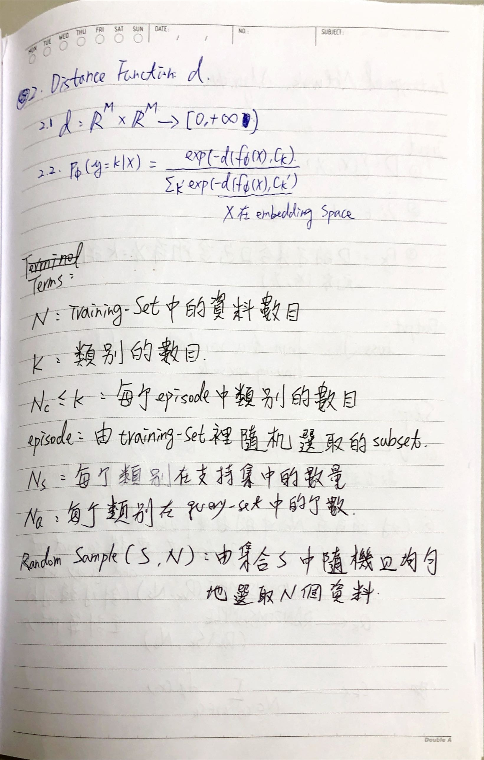
Draft Thoughts-step 2

Slide 6
Draft Thoughts-step 2

Slide 7
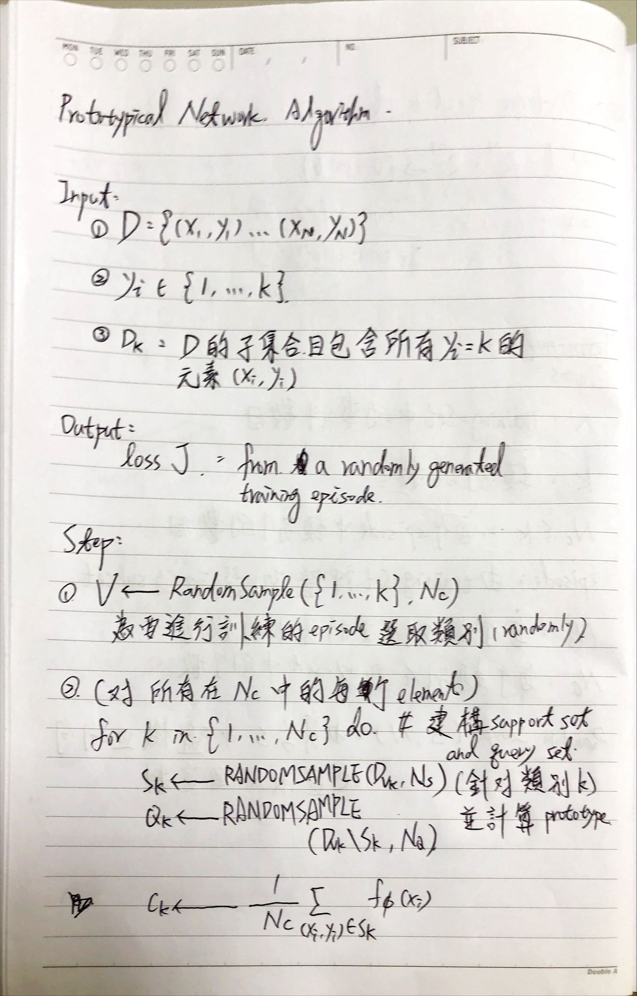
Draft Thoughts-step 3

Slide 8
Draft Thoughts-step 3

Slide 9
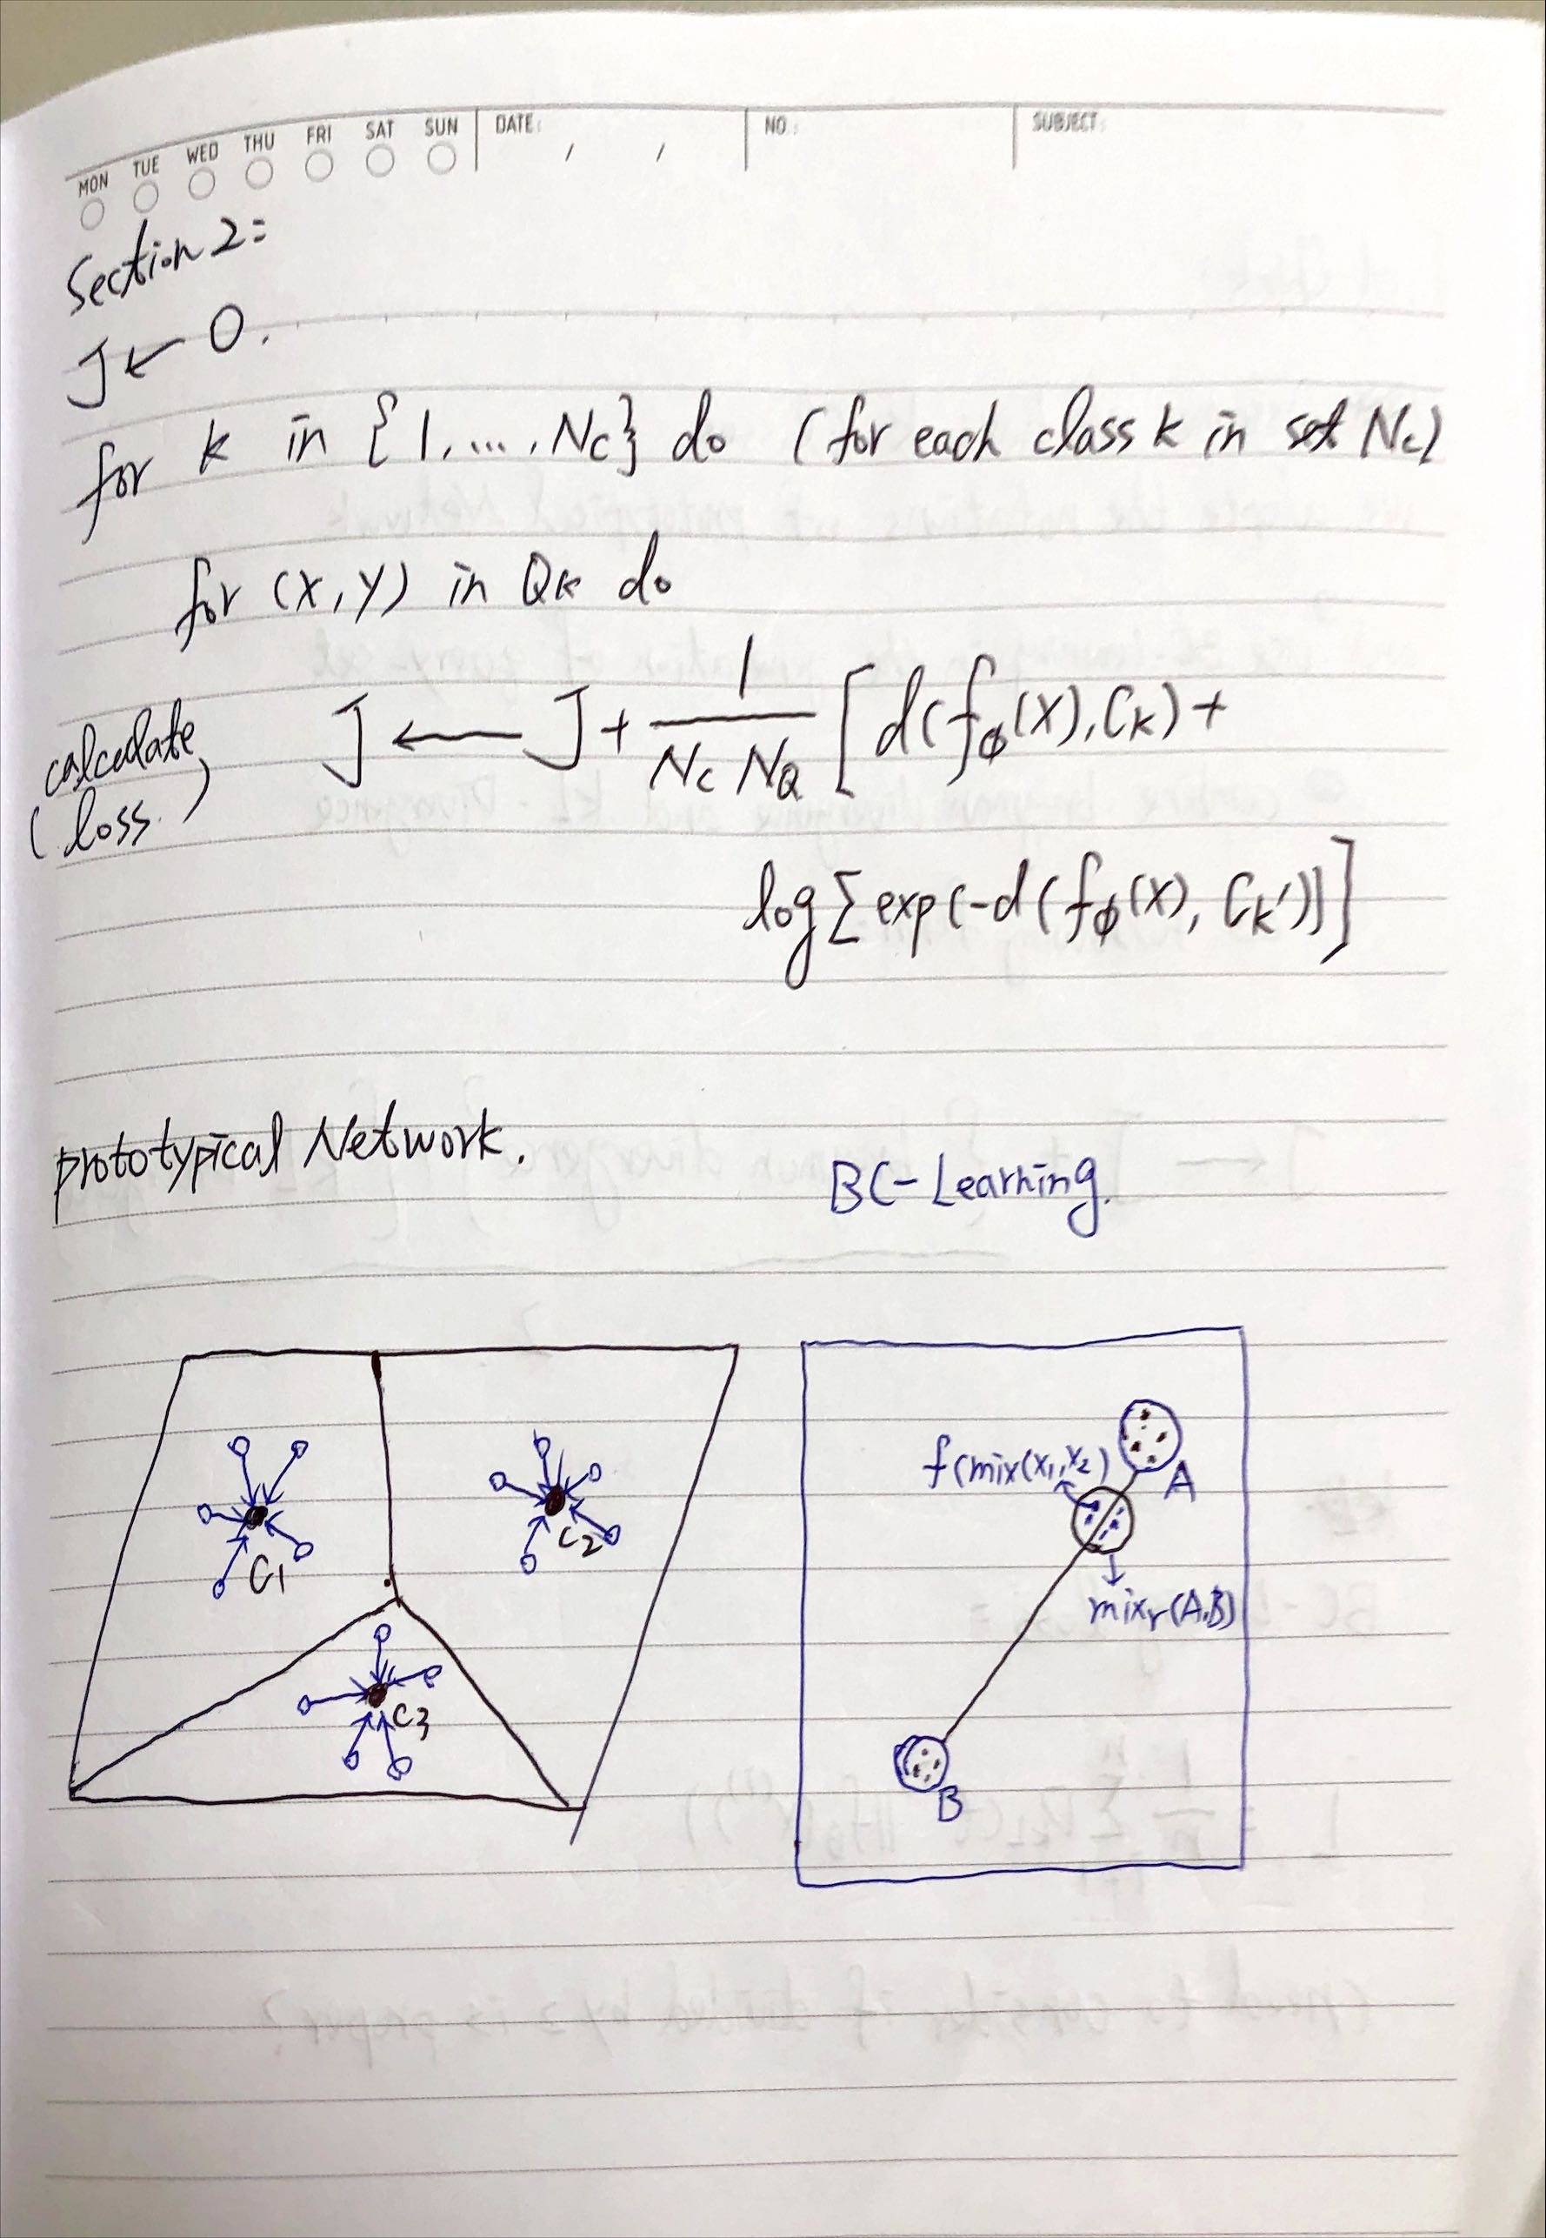
Draft Thoughts-step 4

Slide 10
Draft Thoughts-step 4

Slide 11
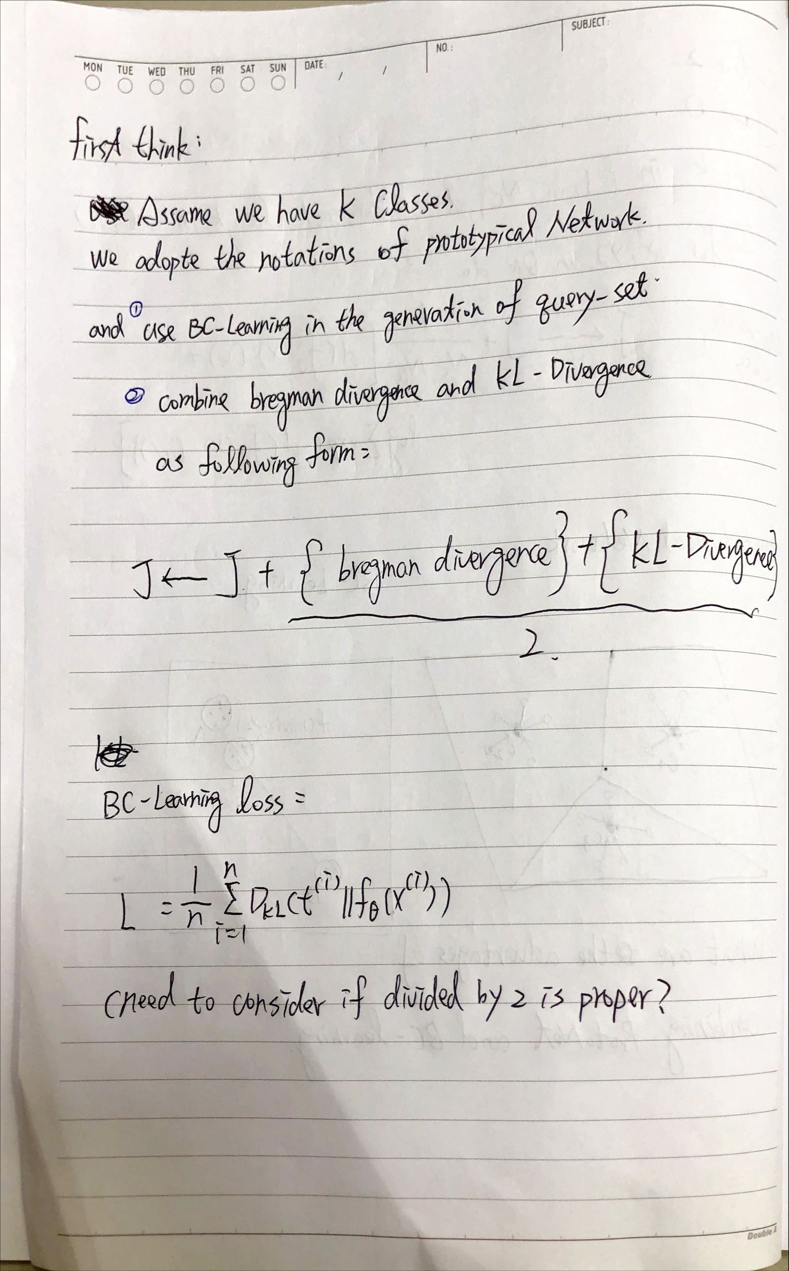
Draft Thoughts-step 5

Slide 12
BC-Learning + ProtoNet Thoughts
假設給予K個類別(Class)，在此我們採用ProtoNet原論文中的符號定義；則，

Slide 13
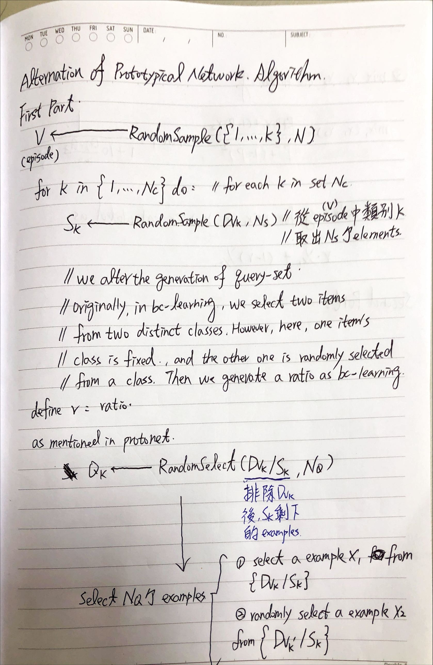
Draft Thoughts-step 6

Slide 14
Draft Thoughts-step 6

Slide 15
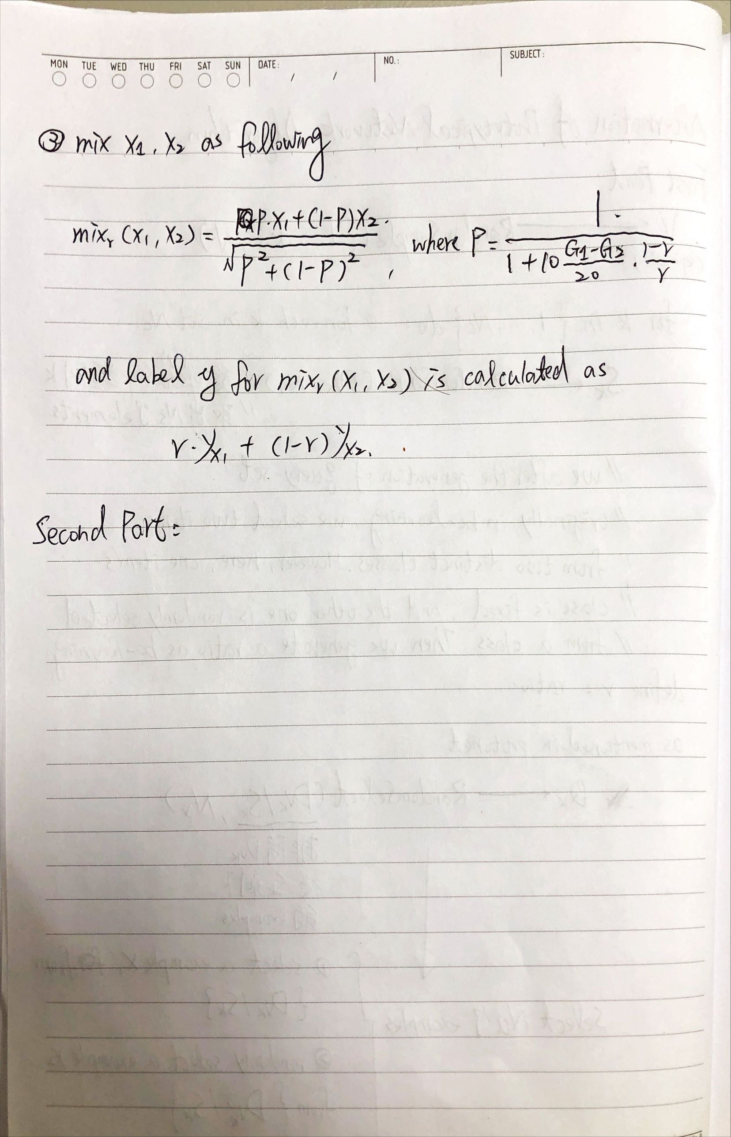
Draft Thoughts-step 7

Slide 16
Draft Thoughts-step 7

Slide 17
Draft Thoughts-step 2

