Slide 1
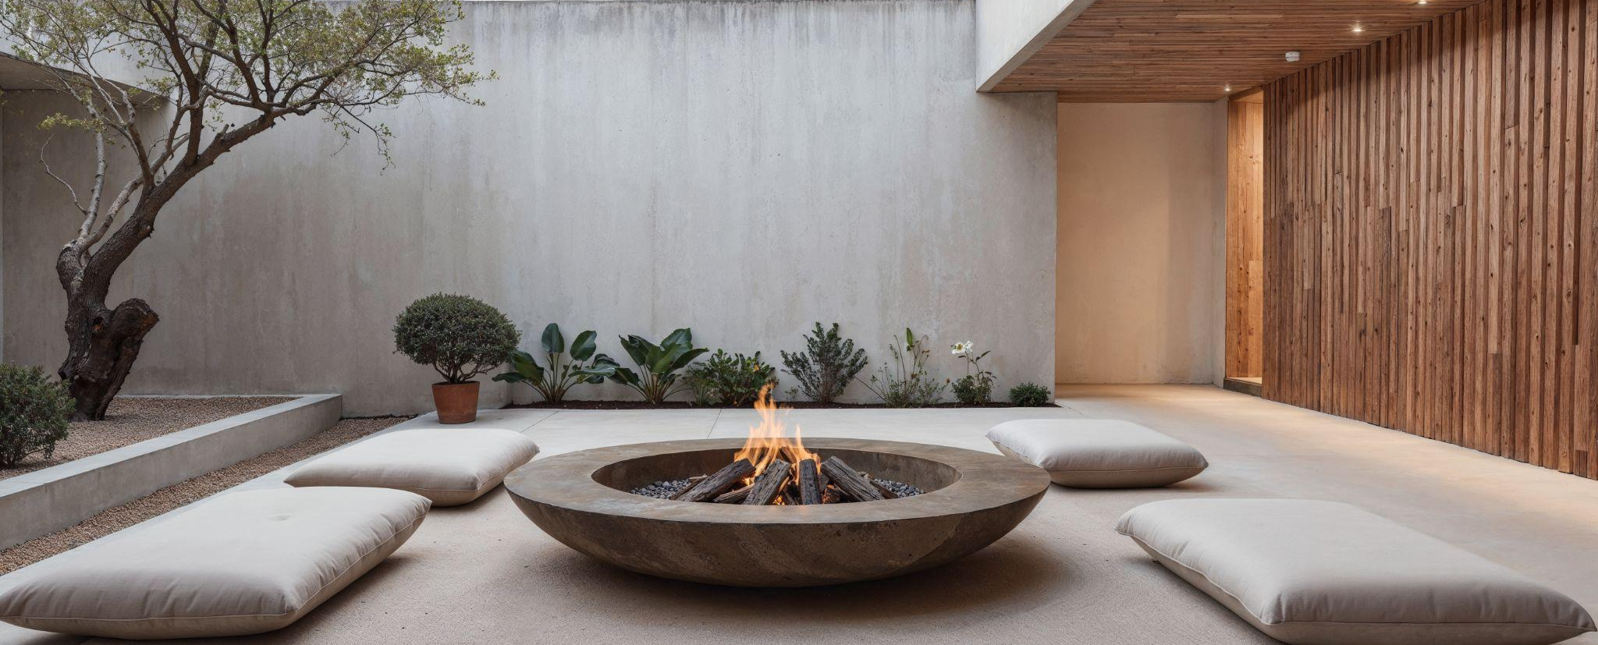
Architecture Design
Here is where your presentation begins

Slide 2

Contents of this template
Fonts
Colors
Thanks slide
Icons and infographics
To view this template correctly in PowerPoint, download and install the fonts we used
You can see on the link all the colors used in this presentation
You must keep it so that proper credits for our design are given
These can be used in the template, and their size and color can be edited
For more info: SLIDESGO | SLIDESGO AI TOOLS | BLOG | FAQs
You can edit the master slides easily. For more info, click here
You can visit our sister projects: FREEPIK AI TOOLS | FREEPIK LIBRARY RESOURCES
You can delete this slide when you’re done editing the presentation

Slide 3
Table of contents
01
02
03
04
05
06
07
Name of the section
Name of the section
Name of the section
Name of the section
Name of the section
Name of the section
Name of the section

Slide 4
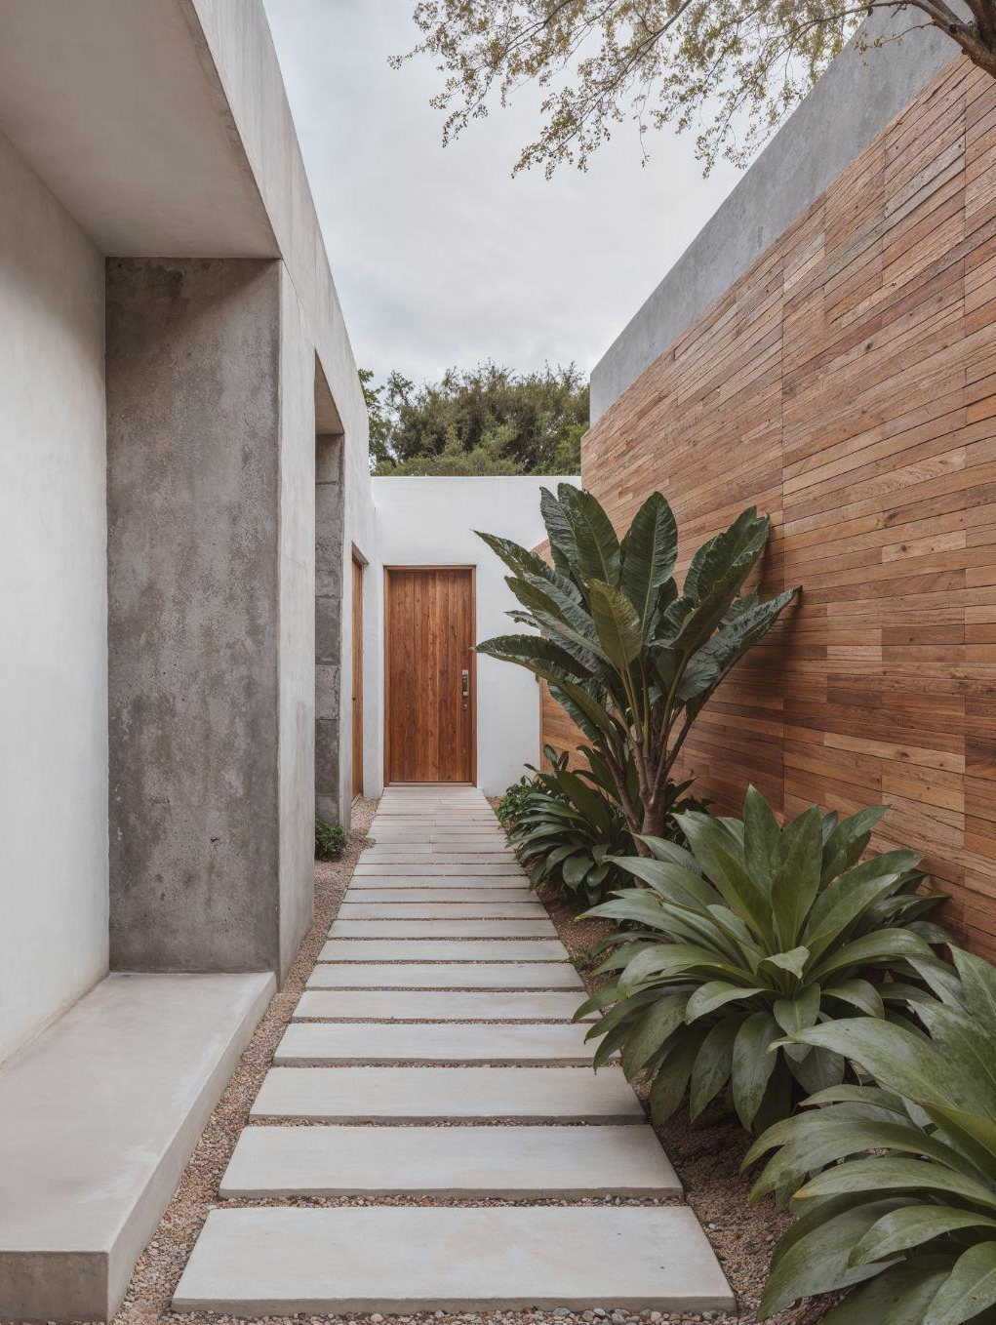
01
Name of the section

Slide 5
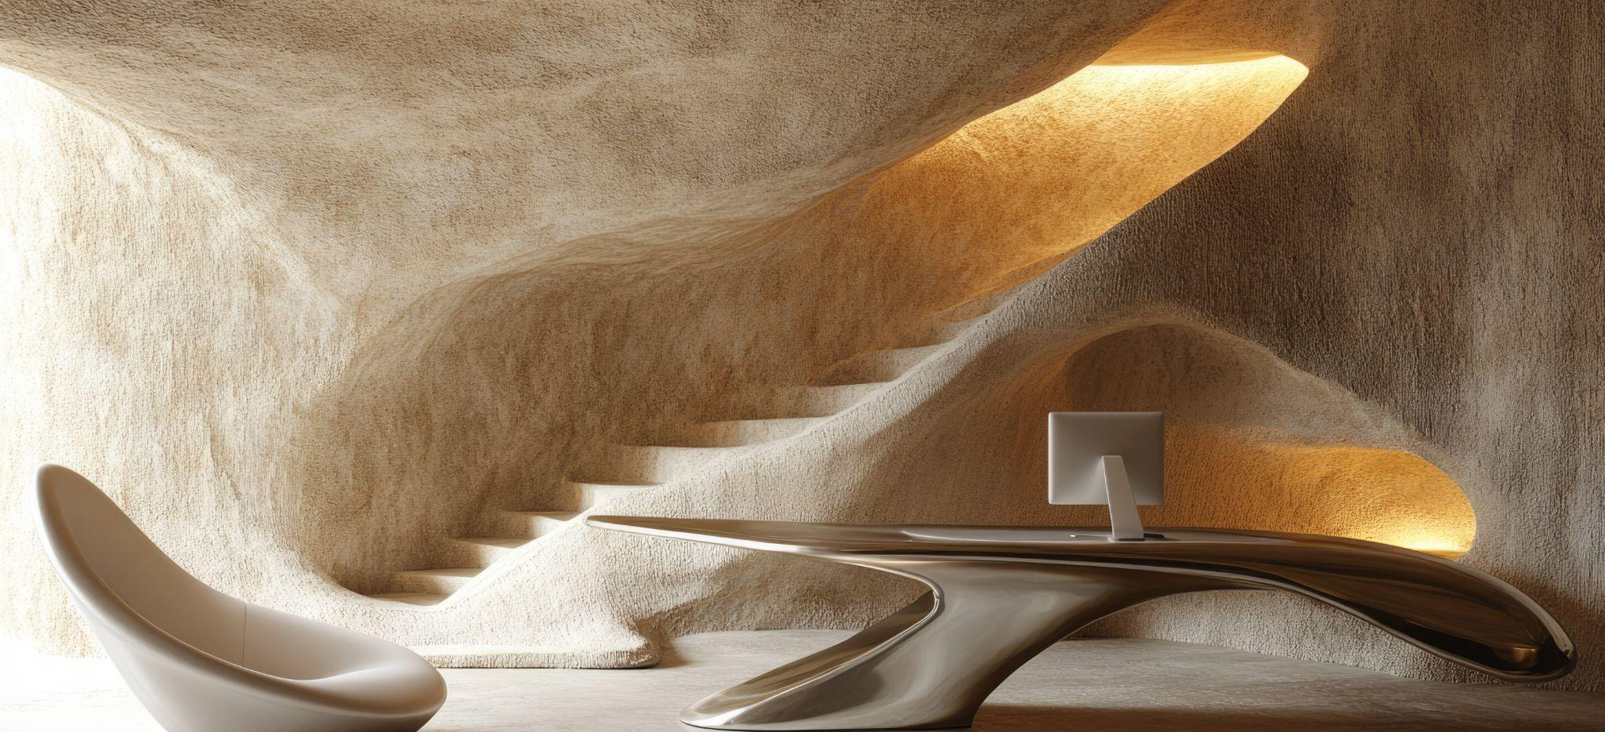
The slide title goes here!
Do you know what helps you make your point clear? Lists like this one:
They’re simple
You can organize your ideas clearly
You’ll never forget to buy milk!
You can replace the image. Just right-click on it and select “Replace image”

Slide 6
Let’s take a look
Mercury is the closest planet to the Sun and the smallest one in the entire Solar System. This planet’s name has nothing to do with the liquid metal, since Mercury was named after the Roman messenger god. Despite being closer to the Sun than Venus, its temperatures aren't as terribly hot as that planet’s. Its surface is quite similar to that of Earth’s Moon, which means there are a lot of craters and plains. Speaking of craters, many of them were named after artists or authors who made significant contributions to their respective fields. Mercury takes a little more than 58 days to complete its rotation, so try to imagine how long days must be there!

Slide 7
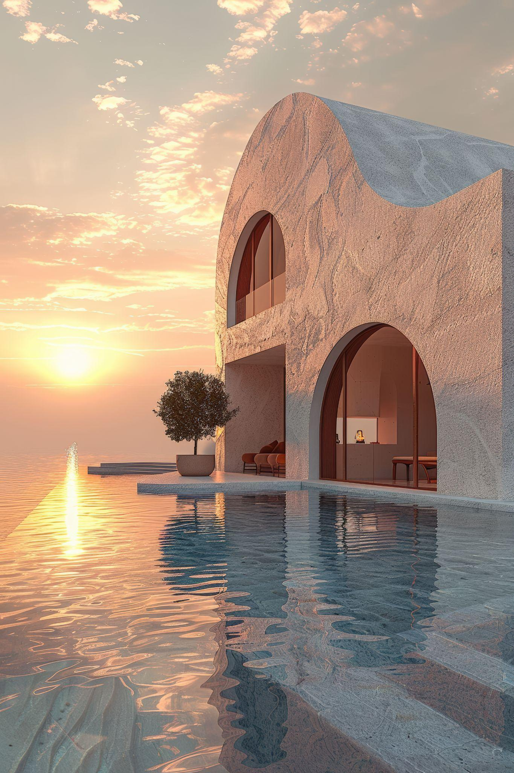
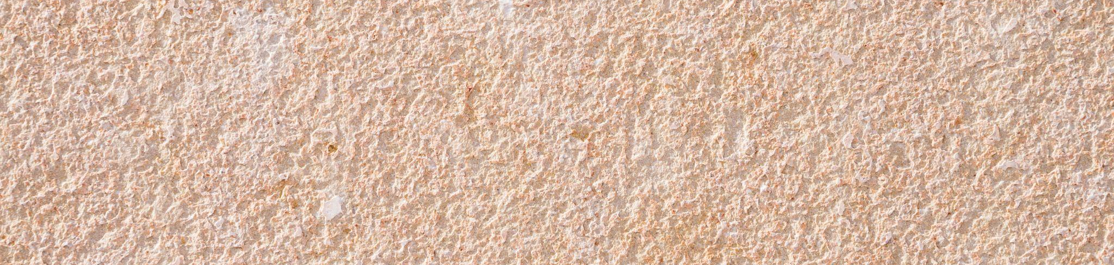
Two ideas
Let’s learn about Mercury
Mercury is the closest planet to the Sun and the smallest one in the Solar System. This planet’s name has nothing to do with the liquid metal
Let’s take a look at Venus
Venus has a beautiful name and is the second planet from the Sun. It’s hot and is the second-brightest natural object in the night sky

Slide 8
Six different ideas
All you need to know about Mercury
Here’s exactly why Venus is so unique
Discover even more about Mars
Mercury is the smallest planet in the Solar System
Venus is the second planet from the Sun
Despite being red, Mars is actually a cold place
Here’s why Jupiter is so massive
Saturn and its famous iconic rings
Let’s explore Neptune's mysteries
Jupiter is the biggest planet in the Solar System
Saturn is composed of hydrogen and helium
Neptune is the farthest planet from the Sun

Slide 9
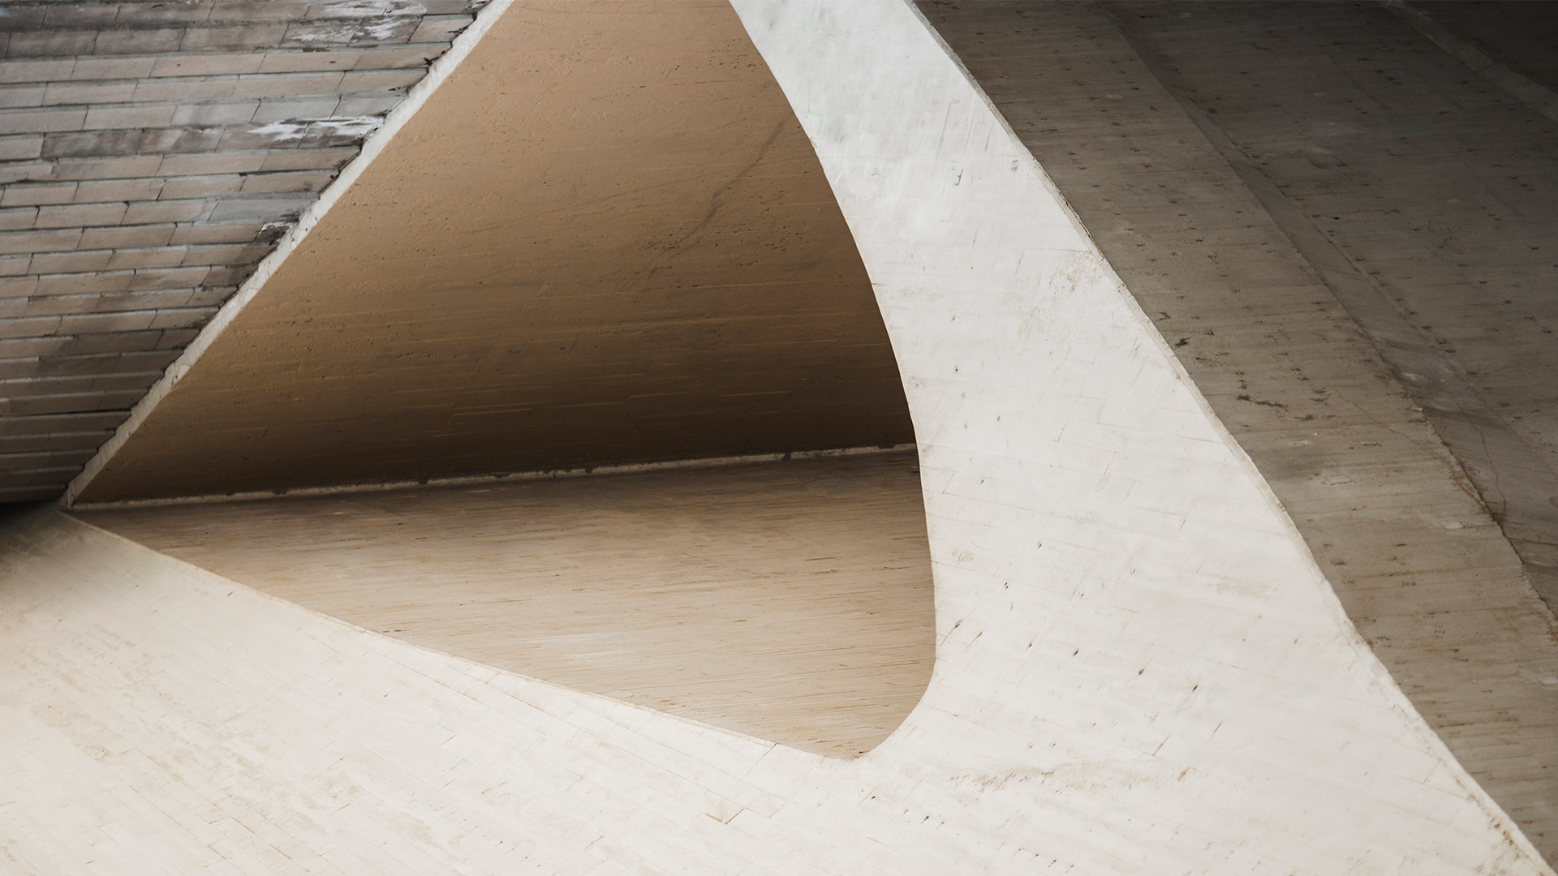
A picture is worth a thousand words

Slide 10
You can use an infographic
1
2
3
4
Step 1
Step 2
Step 3
Step 4
Jupiter is the biggest planet of them all
Saturn is composed of hydrogen and helium
Neptune is the farthest planet from the Sun
Earth is the third planet from the Sun

Slide 11
Thank you
Do you have any questions?
youremail@freepik.com
+00 000 000 000
yourwebsite.com
Please keep this slide for attribution

Slide 12
Instructions for use
If you have a free account, in order to use this template, you must credit Slidesgo by keeping the Thanks slide
As a Free user, you are allowed to:
Modify this template
Use it for both personal and commercial projects
You are not allowed to:
Sublicense, sell or rent any of Slidesgo Content
Distribute Slidesgo Content unless it has been expressly authorized by Slidesgo
Include Slidesgo Content in an online or offline database or file
Offer Slidesgo templates (or modified versions of Slidesgo templates) for download
Acquire the copyright of
Slidesgo Content
For more information about editing slides, please read our FAQs or visit our blog

Slide 13
Instructions for use (premium users)
As a Premium user, you can use this template without attributing Slidesgo or keeping the Thanks slide
You are allowed to:
Modify this template
Use it for both personal and commercial projects
Share this template in an
editable format
Hide or delete the “Thanks” slide and the mention to Slidesgo in the credits
You are not allowed to:
Sublicense, sell or rent any of Slidesgo Content
Distribute Slidesgo Content unless it has been expressly authorized by Slidesgo
Use any of the elements that are part in a separated way
Register any of the elements as a trademark or logo in an intellectual property registry
For more information about editing slides, please read our FAQs or visit our blog

Slide 14
Fonts
Colors
This presentation has been made using the following fonts:
All the colors used in this presentation
Click on the button of the link to the fonts
#191919
#ffffff
Viaoda Libre
Archivo
#2a2828
#8b8264
Ballet
To view this template correctly in PowerPoint, download and install the fonts we used

Slide 15
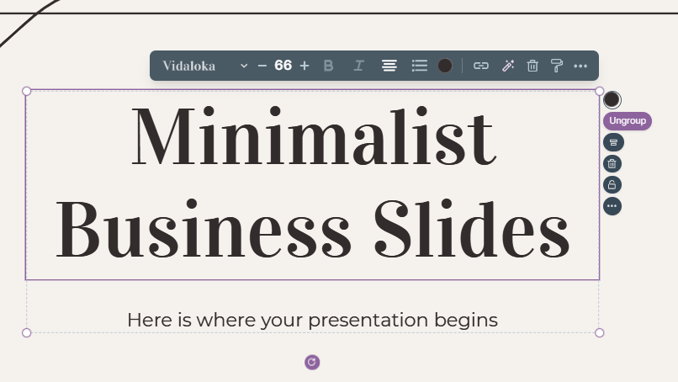
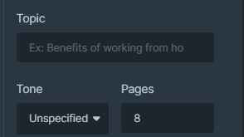
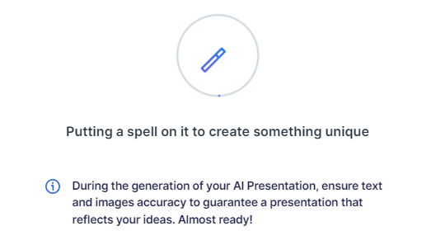
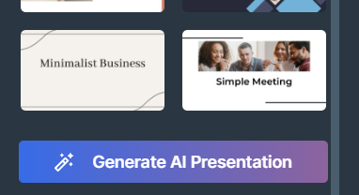
Presentation Maker
Slidesgo introduces its latest feature: the Presentation Maker. Enjoy two main functionalities - firstly, with a few clicks, create marvelous presentations with Artificial Intelligence that adapt to your needs. And it's completely free
Generate AI Presentation

Slide 16
Instructions for use
If you have a free account, in order to use this template, you must credit Slidesgo by keeping the Thanks slide
As a Free user, you are allowed to:
Modify this template
Use it for both personal and commercial projects
You are not allowed to:
Sublicense, sell or rent any of Slidesgo Content
Distribute Slidesgo Content unless it has been expressly authorized by Slidesgo
Include Slidesgo Content in an online or offline database or file
Offer Slidesgo templates (or modified versions of Slidesgo templates) for download
Acquire the copyright of
Slidesgo Content
For more information about editing slides, please read our FAQs or visit our blog

Slide 17
Use our editable graphic resources...
You can easily resize these resources without losing quality. To change the color, just ungroup the resource and click on the object you want to change. You can also look for more infographics on Slidesgo

Slide 20
 | Jan | Feb | Mar | Apr | Jun
Task 1
Task 2
Task 3
 | No | Yes | Yes | No | Yes
 | Yes | No | Yes | No | Yes
 | Yes | Yes | No | Yes | No
 | Jan | Feb | Mar | Apr | Jun
Task 1
Task 2
Task 3

Slide 22
6/10 | 8/10 | 7/10 | 4/10

Slide 23
...and our sets of editable icons
You can resize these icons without losing quality
You can change the stroke and fill color; just select the icon and click on the paint bucket/pen
In Google Slides, you can also use Flaticon’s extension, allowing you to customize and add even more icons

Slide 24
Educational icons
Medical icons

Slide 25
Business icons
Teamwork icons

Slide 26
Help & support icons
Avatar icons

Slide 27
Creative process icons
Performing arts icons

Slide 28
Nature icons

Slide 29
SEO & marketing icons

Slide 30


