Slide 1

Responsible-AI Reading Group
First Meeting 19/ 10/ 2023
Discussion of the 3rd chapter of the book “Fairness and Machine Leaning”
Solon Barocas, Moritz Hardt, Arvind Narayanan

Slide 2
Agenda
Part 1: Statistical Fairness Criteria
Part 2: Case Study
Discussion

Slide 3
Goal of classification
Leverage patterns in natural and social processes to conjecture about uncertain outcomes
An outcome may be uncertain because it lies in the future
Ex. predict whether a loan applicant will pay back a loan by looking at various characteristics (credit history, income)
An outcome has already occurred but we are unsure about it
Ex. Classify whether financial fraud has occurred by looking financial transactions

Slide 4
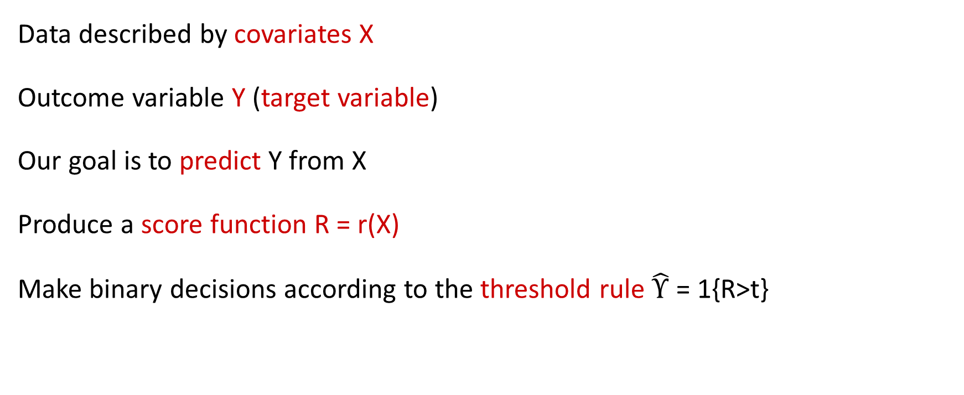
Formalizing classification
Data described by covariates X
Outcome variable Y (target variable)
Our goal is to predict Y from X
Produce a score function R = r(X)
Make binary decisions according to the threshold rule $\hat{Υ}$ = 1{R>t}

Slide 5
No fairness through unawarness
Removing (or not including) “sensitive attributes” is not a cure for fairness and can exacerbate them
Example
Consider a fictitious start-up that sets out to predict your income from your genome. Seems to be impossible, but DNA encodes information about ancestry, which in turn correlates with income in some countries such is the US
Gender can be predicted from retinal photographs with very high accuracy

Slide 6
Statistical Fairness Criteria
Introduce random variable A that encodes membership in a protected class
Equalize different statistical quantities involving group membership A
We will discuss three different criteria:
Equalizing acceptance rate (Independence)
Equalizing error rate (Separation)
Calibration (Sufficiency)

Slide 7


Equalizing acceptance rate (Independence)
For any two groups a, b require:
Generalization: Require R to be independent of A (Independence Criterion)
Variations, relaxations:
$P\left\{\hat{Y}=1 | A=a\right\}=P\{\hat{Y}=1|A=b\}$ acceptance rate
Demographic parity (statistical parity)
preserves the input ratio: the demographics of the individuals receiving a favorable outcome the same as demographics of the underlying population
$$\frac{P\left\{\hat{Y}=1 | A=a\right\}}{P\left\{\hat{Y}=1 | A=b\right\}}≥1−ε$$
$$P\left\{\hat{Y}=1 | A=a\right\}≥P\left\{\hat{Y}=1 | A=b\right\}−ε$$
Alternative definition: Require, $I\left(A;R\right)=0$ where $I\left(A;R\right)=H\left(A\right)+H\left(R\right)−H(A,R)$

Slide 8
Stress test on independence criterion
Make good/ informed decisions in one group, poor/ arbitrary decisions in other groups and then equalize positive rate
This can happen if we have less or poor data in one group
Example: a company hires carefully selected applicants from group A at a rate p > 0 and carelessly selected applicants from group B at the same rate p. Despite identical acceptance rates, it becomes more probable that unqualified applicants are chosen in one group over the other. Consequently, it might seem that group B underperformed compared to group A, establishing a negative track record for group B
We shouldn’t get too much true positives in one group with false positives in another

Slide 9
Equalizing error rates (Separation)
For any two groups a, b require:
$P\left\{\hat{Y}=1 | Y=1, A=a\right\}=P\left\{\hat{Y}=1 | Y=1, A=b\right\}$ (equal true positive rate)
$P\left\{\hat{Y}=1 | Y=0, A=a\right\}=P\left\{\hat{Y}=1 | Y=0, A=b\right\}$ (equal false positive rate)
Generalization: Require R to be independent of A given Y
Confusion Matrix
Actual
0
1
equal opportunity vs statistical parity: as with statistical parity, the members of the two groups have the same chance of getting the favorable outcome, but only when these members qualify
TP | FP
FN | TN
0
Predicted
1

Slide 10
Stress test on Separation criterion
An optimal predictor might not have equal error rates in all groups, especially when the probability of positive outcomes varies between groups.
Target variable sometimes reflect existing inequality and injustice

Slide 11
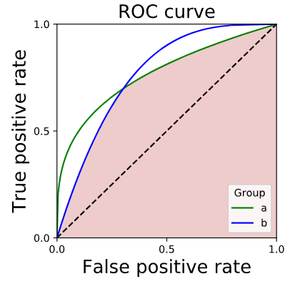
Group-specific ROC curves
Error rate parity, indicates that the ROC curve of the score, conditioned on the group, should lie under all curves
Group a
Group b

Slide 12

Calibration (Sufficiency)
A random variable R is sufficient for A if and only if for all groups a, b and all values r in the support of R, we have
$$P\left\{Y=1 | R=r,A=a\right\}=P\{Y=1|R=r,A=b\}$$
Generalization: Y independent of A conditional on R
Calibration
A score R is calibrated with respect to an outcome variable Y if for all score values r $∈$[0,1], we have:
$P\left\{Y=1 | R=r\right\}=r$
The set of all instances assigned a score value r has an r fraction of positive instances among them.
The score R satisfies calibration by group if it satisfies:
$P\left\{Y=1 | R=r,A=a\right\}=r, for all score values r and groups a$

Slide 13
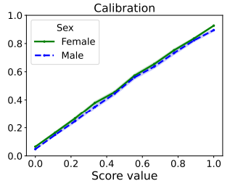
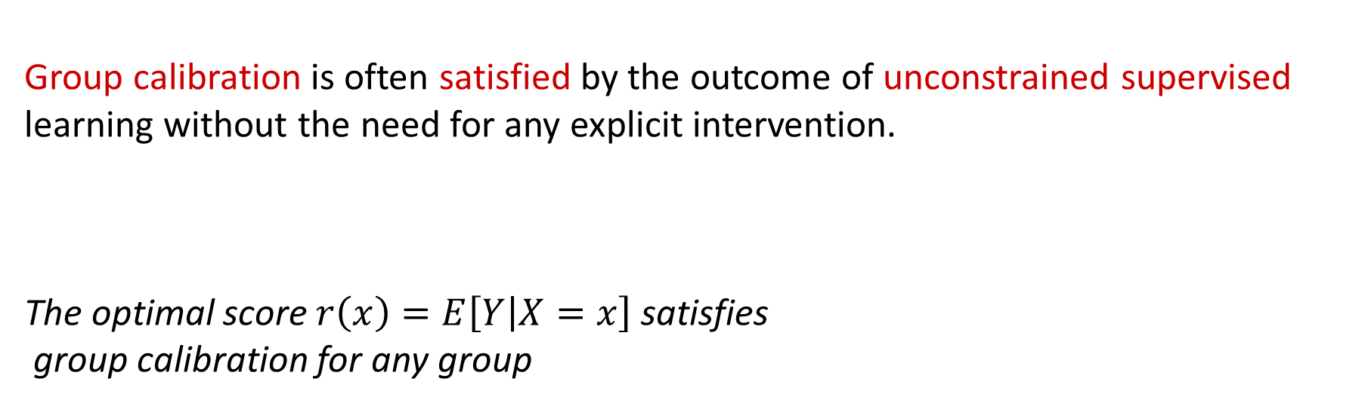
Calibration by group as a consequence of unconstrained learning
Group calibration is often satisfied by the outcome of unconstrained supervised learning without the need for any explicit intervention.
The optimal score $r\left(x\right)=E\left[Y | X=x\right]$ satisfies
group calibration for any group
Group calibration curves on Census ACS data
Lydia T Liu, Max Simchowitz, and Moritz Hardt. The implicit fairness criterion of unconstrained learning. In International Conference on Machine Learning, pages 4051–4060. PMLR, 2019.

Slide 14
How to satisfy a non-discrimination criterion
Pre-processing: feature space to be uncorrelated with the sensitive attribute
In-training: work the constraint into the optimization process that constructs a classifier from training data
Post-processing: adjust a learned classifier to be uncorrelated with the sensitive attribute

Slide 15
Relationships between criteria
Any of these criteria are mutually exclusive in general
Independence versus sufficiency
Independence versus separation
Separation versus sufficiency

Slide 16
Case Study: Credit Scoring
Credit Scores: Estimate the risk that a loan applicant will default on a loan
In the United States, three major credit-reporting for-profit agencies that generate risk scores based on their collected data
Credit agency regulation in the United States began with the Fair Credit Reporting Act of 1970
Regulation of credit agencies in the United States started with the Fair Credit Reporting Act, first passed in 1970, that aims to promote the accuracy, fairness, and privacy of consumer of information collected by the reporting agencies
The Equal Credit Opportunity Act, established in 1974, prohibits creditors from discriminating against applicants based on factors such as race, color, religion, national origin, sex, marital status, or age

Slide 17
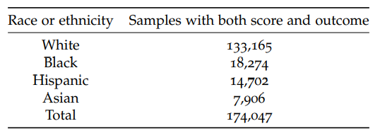
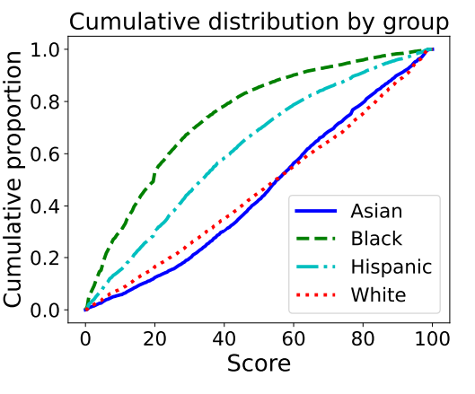
Case Study: Credit Scoring
Dataset comprises aggregate statistics from 2003, including credit scores, demographic information, and outcomes
Focus on score, race and outcome
The score used is based on TransUnion TransRisk score
Performance variable: based on the performance of new or existing accounts and measures whether individuals have been late 90 days or more on one or more of their accounts
Credit score distribution by ethnicity

Slide 18
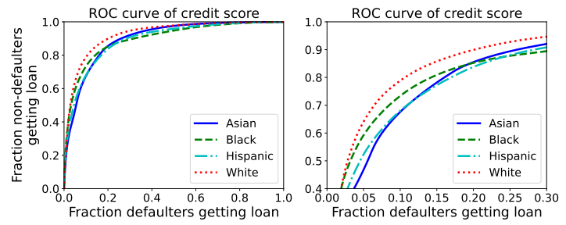
Case Study: Credit Scoring
ROC curve of credit score by group
“White ” group encloses a noticeably larger area under the curve than the “Black” group

Slide 19
Case Study: Credit Scoring
Four different classification strategies:
Maximum profit: Pick possibly group-dependent score thresholds in a way that maximizes profit
Single threshold: Pick a single uniform score threshold for all groups in a way that maximizes profit
Independence: Achieve an equal acceptance rate in all groups. Subject to this constraint, maximize profit
Separation: Achieve an equal true/false positive rate in all groups. Subject to this constraint, maximize profit

Slide 20
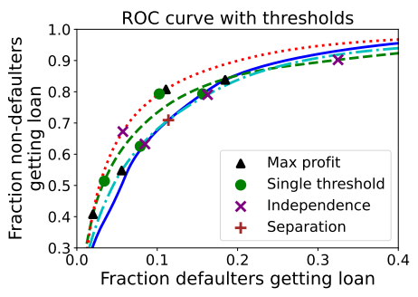
Case Study: Credit Scoring
Max Profit: TPR for Asian is twice of what it is for the Black group
Independence: equalizes acceptance rate but leads to different
Trade-offs
Separation: same trade-off in all groups
‘Single threshold’ achieves higher profit than ‘separation’ which
achieves higher profit than ‘independence’
ROC curves with optimal thresholds for different criteria
Moritz Hardt, Eric Price, and Nati Srebro. Equality of opportunity in supervised learning. In Advances in Neural Information Processing Systems, pages 3315–3323, 2016.

Slide 21
Discussion

