Slide 1
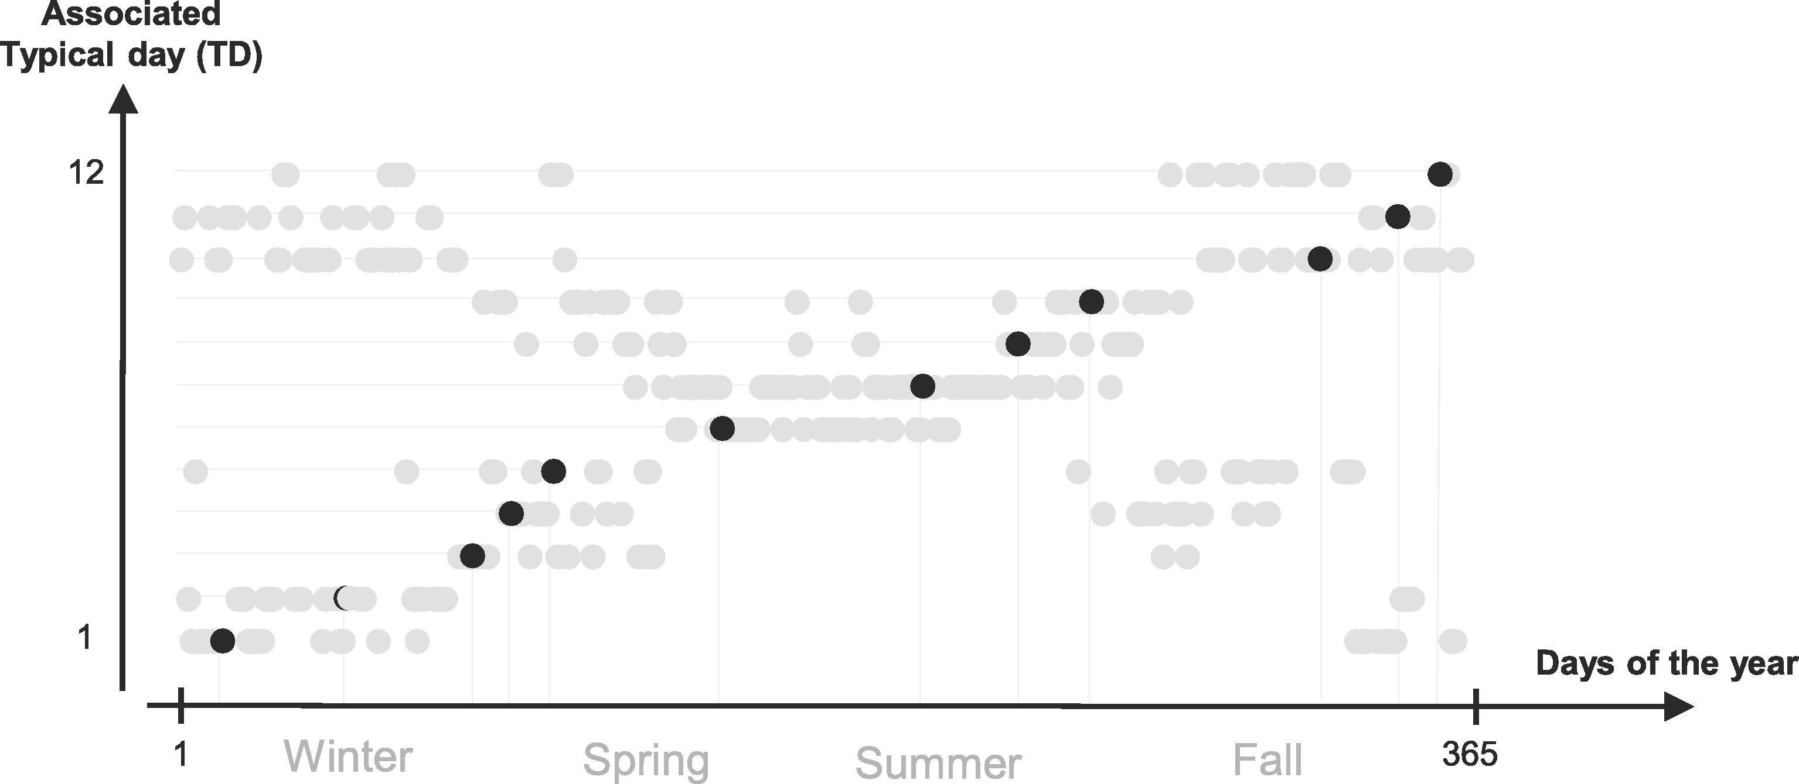
Associated
typical day (TD)
12
1
Day of the year
1
Winter
Spring
Summer
Fall
365

