Slide 1
La D è muta: introduzione a Django
Riccardo Magliocchetti
Torino Coding Society 28/09/15

Slide 2
whoami
Consultant
Free software developer
maintainer: django-admin-bootstrapped, uwsgitop
contributor: uwsgi, LibreOffice

Slide 3
Python

Slide 4
Highlights
OO but functional friendly
whitespace indentation
late binding type system, strong types
great standard library
implementations: cpython 2 and 3, pypy, jython
package manager: pip, https://pypi.python.org

Slide 5
>>> import this
The Zen of Python, by Tim Peters
Beautiful is better than ugly.
Explicit is better than implicit.
Simple is better than complex.
Complex is better than complicated.
Readability counts.
[...]

Slide 6
Quiz
>>> langs = [
csharp,
java,
javascript,
php,
python,
ruby
]
>>> langs = sorted(langs,
key=lambda l: l.year)

Slide 7
Answer
>>> [(l.name, l.year) for l in langs]
[
('python', 1991),
('java', 1995),
('javascript', 1995)
('php', 1995),
('ruby', 1995),
('csharp', 2000)
]

Slide 8
Django

Slide 9
Facts
Born in 2005 Lawrence, KS - USA
MTV architecture framework (==MVC)
Django Software Foundation
BSD license
Used in: Pinterest, Instagram, Bitbucket, Sentry

Slide 10
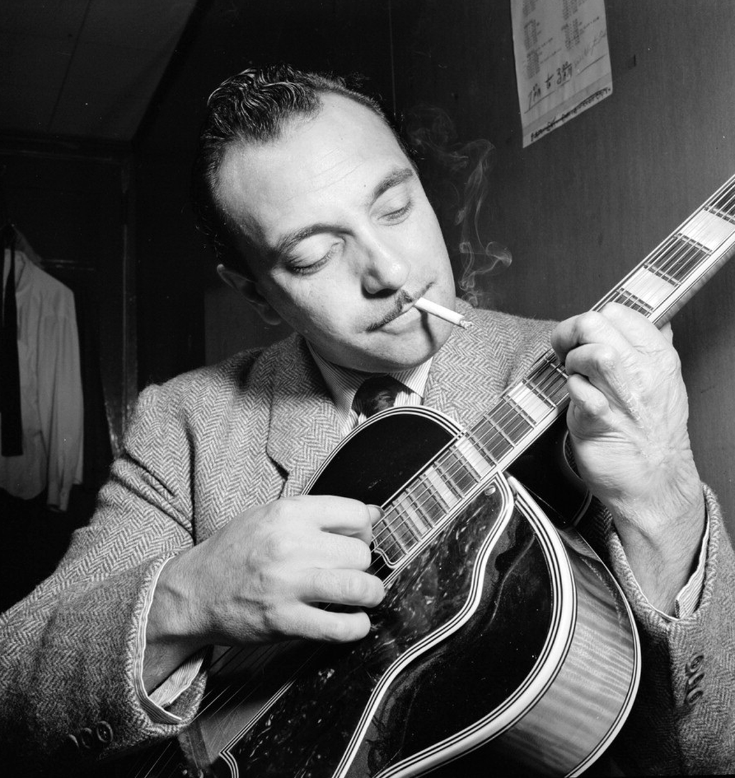
Trivia

Slide 11
Batteries included
core: ORM, urls, templates (pluggable), i18n, migrations
contrib apps: admin, auth, sessions, postgres (e.g. jsonb field)
tons of third party apps and libs

Slide 12
A (silly) Todo application

Slide 13
Environment setup
$ sudo apt-get install python python-virtualenv
$ virtualenv venv
$ . venv/bin/activate
(venv)$ pip install django

Slide 14
Project bootstrapping
$ django-admin startproject djangotcs
$ find
./djangotcs
./djangotcs/urls.py
./djangotcs/__init__.py
./djangotcs/wsgi.py
./djangotcs/settings.py
./manage.py
./db.sqlite3

Slide 15
Let's do something
$ manage.py startapp todo
$ mkdir -p todo/templates/todo
$ find todo/
todo/
todo/migrations
todo/migrations/__init__.py
todo/__init__.py
todo/templates
todo/templates/todo
todo/views.py
todo/models.py
todo/admin.py
todo/tests.py

Slide 16
todo/models.py
# -*- coding: utf-8 -*-
from django.db import models
class Todo(models.Model):
name = models.CharField(max_length=255)
def __unicode__(self):
return self.name
class TodoItem(models.Model):
text = models.TextField()
todo = models.ForeignKey(Todo)
def __unicode__(self):
return self.text

Slide 17
todo/forms.py
# -*- coding: utf-8 -*-
from django import forms
from .models import Todo, TodoItem
class TodoForm(forms.ModelForm):
class Meta:
model = Todo
fields = ('name',)
class TodoItemForm(forms.ModelForm):
class Meta:
model = TodoItem
fields = ('todo', 'text',)

Slide 18
todo/views.py
from django.shortcuts import render, redirect, get_object_or_404
from .models import Todo, TodoItem
from .forms import TodoForm, TodoItemForm
def index(request):
return render(request, "todo/index.html", {'todos': Todo.objects.all()})
def detail(request, todo_id):
todo = get_object_or_404(Todo, pk=todo_id)
return render(request, "todo/detail.html", {'todo': todo})
def new_todo(request):
if request.method == 'POST':
form = TodoForm(request.POST)
if form.is_valid():
todo = form.save()
return redirect('todo:index')
else:
form = TodoForm()
return render(request, "todo/new.html", {'form': form})

Slide 19
todo/templates/todo/new.html
{% extends 'todo/base.html' %}
{% block title %}
Add a new todo
{% endblock %}
{% block content %}
<form action="" method="POST">
{% csrf_token %}
{{ form.as_p }}
<input type="submit" value="Add">
</form>
{% endblock %}

Slide 20
todo/urls.py
# -*- coding: utf-8 -*-
from django.conf.urls import url
from . import views
urlpatterns = [
url(r'^$', views.index, name="index"),
url(r'^add$', views.new_todo, name="new_todo"),
url(r'^(?P<todo_id>\d+)$', views.detail, name="detail"),
url(r'^(?P<todo_id>\d+)/item/add$', views.add_item, name="add_item"),
url(r'^(?P<todo_id>\d+)/item/(?P<item_id>\d+)/remove$', views.remove_item, name="remove_item"),
]

Slide 21
todo/admin.py
# -*- coding: utf-8 -*-
from django.contrib import admin
from .models import Todo, TodoItem
class TodoItemInline(admin.StackedInline):
model = TodoItem
class TodoAdmin(admin.ModelAdmin):
inlines = [
TodoItemInline,
]
admin.site.register(Todo, TodoAdmin)

Slide 22
djangotcs/settings.py (excerpt)
INSTALLED_APPS = (
'django.contrib.admin',
'django.contrib.auth',
'django.contrib.contenttypes',
'django.contrib.sessions',
'django.contrib.messages',
'django.contrib.staticfiles',
'todo',
)
ROOT_URLCONF = 'djangotcs.urls'
DATABASES = {
'default': {
'ENGINE': 'django.db.backends.sqlite3',
'NAME': os.path.join(BASE_DIR, 'db.sqlite3'),
}
}

Slide 23
djangotcs/urls.py
# -*- coding: utf-8 -*-
from django.conf.urls import patterns, include, url
from django.contrib import admin
urlpatterns = patterns('',
url(r'^admin/', include(admin.site.urls)),
url(r'^todo/', include('todo.urls', namespace="todo")),
)

Slide 24
Migration time
$ ./manage.py makemigrations todo
Migrations for 'todo':
0001_initial.py:
- Create model Todo
- Create model TodoItem
$ ./manage.py migrate
Operations to perform:
Apply all migrations: admin, contenttypes, auth, sessions, todo
Running migrations:
Applying contenttypes.0001_initial... OK
Applying auth.0001_initial... OK
Applying admin.0001_initial... OK
Applying sessions.0001_initial... OK
Applying todo.0001_initial... OK

Slide 25
built-in http server with hot code reload
$ ./manage.py runserver
Performing system checks...
System check identified no issues (0 silenced).
September 16, 2015 - 22:00:50
Django version 1.8.4, using settings 'djangotcs.settings'
Starting development server at http://127.0.0.1:8000/
Quit the server with CONTROL-C.

Slide 26
A more serious stack
web server: nginx
application server container + lot more: uwsgi
database: postgres
data structure store / cache: redis

Slide 27
Modern Times

Slide 28
SPA
(too?) trivial to add rest interface to models https://django-rest-framework.org
react: server side jsx compiling (via nodejs) https://github.com/markfinger/python-react
angular: trivial conflict with angular default $interpolateProvider

Slide 29
What about the realtime web?
python 3.5 added async / await coroutines (or gevent)
django not async friendly (especially ORM)
tradeoff: offload realtime to another process with redis pub/sub
please remember: 99% non-blocking is still blocking

Slide 30
Age of microservices
do we need different kind of batteries?
easy deploy as important as dev productivity?

Slide 31
Resources

Slide 32
Python resources
Learn python the hard way
PythonAnywhere: try python in the cloud
ml python-it

Slide 33
Django resources
django girls tutorial
official tutorial
ml django-it

Slide 34
Todo demo app
Incomplete, pull requests welcome! :)
https://github.com/xrmx/tcs-djangodemopap

Slide 35
Happy Hacking :)
Riccardo Magliocchetti
riccardo@menodizero.it
@rmistaken
http://menodizero.it
https://github.com/xrmx

