Slide 1
Payment Gateways
Workflows, Triggers and Extensions
compiled by
graham brookins
brookins consulting
http://brookinsconsulting.com/

Slide 2
Term - Payment Gateway
Wikipedia defines the term 'Payment Gateway' as ...
  A Payment Gateway is an e-commerce service that authorizes payments for e-businesses and online retailers.
  It is the equivalent of a physical POS (Point-of-sale) terminal located in most retail outlets.
  Payment gateways encrypt sensitive information, such as credit card numbers, to ensure that information passes securely between the customer and the merchant.

Slide 3
Term - Workflow
Wikipedia defines the term 'Workflow' as ...
  Workflow at its simplest is the movement of documents and/or tasks through a work process.
  More specifically, workflow is the operational aspect of a work procedure:
  how tasks are structured,
  who performs them,
  what their relative order is,
  how they are synchronized,
  how information flows to support the tasks and how tasks are being tracked.

Slide 4
Overview
Describe the terms and relevance including payment gateways, workflows, events, triggers and extensions
Describe eZ authorize
Review the installation of a payment gateway
The Installation of a payment gateway, eZ authorize
Demonstrate a payment gatway workflow using eZ publish
Show examples of payment gateway extensions
Stay tuned ...
  Solutions
  Conclusions
  Questions
  References
  Tutorials

Slide 5
Introduction
Business logic as workflows
Workflows allows you to insert custom code into processes in eZ publish
Payment gateway workflows are an instance of workflows found in automated payment transaction authorization, just one of many commerce workflows.
Payment gateway are used for things like
  commerce (in-store, online shops, services)
  financial transaction automation
  social networking
  online banking

Slide 6
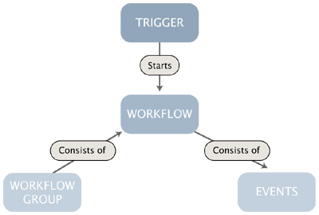
Payment Gateways - Workflow Diagram

Slide 7
Payment Gateways - Workflows
The system comes with an integrated workflow mechanism
The workflow system makes it possible
to perform different tasks with or without user interaction
The workflow implementation is based on the following components:
  Events
  Workflows
  Workflow groups
  Triggers

Slide 8
Payment Gateways == Workflow Events
A 'payment gateway' workflow is initiated by a trigger
A trigger is associated with a function of a module
A trigger will start the assigned workflow either
  before or after that the module’s function has completed
A trigger is capable of initiating only a single workflow *

Slide 9
Payment Gateways - Workflow Events
Custom workflow events can be programmed in PHP
A workflow is a named collection of events (ordered sequence of actions)
eZ publish comes with a growing collection of events that cover the needs of typical everyday tasks
An event carries out a specific task
The built-in multiplexer event makes it possible to start several workflows from within a workflow *

Slide 10
Payment Gateways - Facts on Triggers
The general idea about workflows and triggers is to attach separate written code at a specific place.
The workflow is the code (advice) that will be attached to the specific place.
The triggers are hardcoded places (joinpoints) where the code can be applied.
The trigger page (setup, trigger) contains five triggers, of which three apply to the shop module.

Slide 11
Payment Gateways - Trigger Placement
Currently, the (shop) workflows can be placed:
  Before or after a product is added to basket,
  Before or after basket is updated,
  Before a confirm order,
  Before a check out, and
  After a check out.

Slide 12
Payment Gateways - Available Generic Triggers
The following payment gateway workflow triggers are available from the eZ publish admin -> setup -> triggers.
  Module Function Connection type
  content publish before
  content publish after
  content read before*
  content read after*

Slide 13
Payment Gateways - Available Commerce Triggers
  Module Function Connection type
  shop confirmorder before
  shop checkout before
  shop checkout after
  shop addtobasket before
  shop addtobasket after
  shop updatebasket before
  shop updatebasket after
  * By default disabled, must be enabled in workflow.ini

Slide 14

Payment Gateways - Triggers
The process between a product checkout and the order overview is presented in the following figure
The Payment Gateway Workflow should be inserted before the checkout.
After the confirm order page will the payment gateway workflow be activated

Slide 15
Payment Gateways - Workflow Events Process Example
After the confirm order page, and before the checkout, the browser of the client will be redirected to the payment information entry view.
  After the client payment has been aproved the user is redirected to review the "order overview" page.
  The ordered products are not directly visible in the administration interface. The payment gateway service will contact the eZ publish shop first.
  This service will notify the shop of the payment.
  Hereafter the shop will test the authentication of the notification.
  The following figure illustrates the communication between the client browser, webserver which hosts the shop, and the payment gateway payment service.

Slide 16
Payment Gateways - Workflow Events Process Example
The callback of the payment gateway service to the shop requires the webserver to be available via the internet.
To check whether the callback is valid, the shop will query the payment service.
Therefore the webserver must be able to complete requests to the payment gateway service.

Slide 17
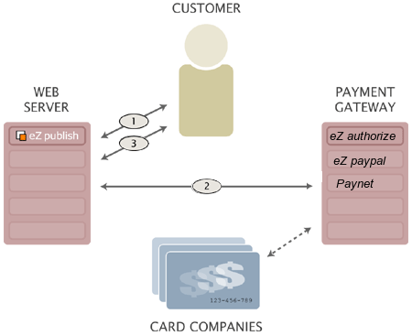
Payment Gateways - Workflow Example Interaction Diagram

Slide 18
Payment Gateways - Workflow Events Process
The numbers at the arrows define the sequence of the interactions
  1. The customer does a checkout from the products he or she wants to order.
  After the customer has filled in its address information, the customer is redirected to the Payment Workflow.
  The customer has to fill in his credit card information on the payment information page in the site.
  2. The customer has to fill in his credit card information on the payment information page in the site.
  If the credit card seems to be valid, the customer is redirected to the next step in the checkout workflow or process.

Slide 19
Payment Gateways - Workflow Events Process
  3. The customer gets a summary of the order when the transaction was successful.
  Otherwise the customer is offered to checkout again.
  Authorize.net will send a notification about the, successful or failed, payment to eZ publish.
  This notification is also known as a callback.
  eZ Publish relies on the callback to approve or decline orders.

Slide 20
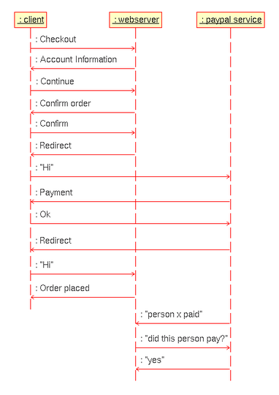
Payment Gateways - Workflow Example Diagram

Slide 21
Payment Gateways - Existing Solutions
Existing eZ publish (Payment Gateway) Workflow Extensions
  eZ Authorize (Authorize.net)
    http://ez.no/community/contribs/workflow/ez_authorize
  eZ Paypal (Paypal.com)
    http://zev.ez.no/svn/extensions/ezpaypal/
  Simple Payment Methods (Other/Invoice)
    http://ez.no/community/contribs/workflow/simple_paymentmethods
  Protx (Protx)
    http://ez.no/community/contribs/workflow/protx_payment_gateway
  Worldpay (Worldpay)
    http://ez.no/community/contribs/workflow/worldpay_payment_gateway_pubsvn
  Paynet (Paynet.no)
    http://ez.no/products/add_ons/paynet_gateway

Slide 22
eZ authorize - Audience
North American based and focused
We look forward towards helping existing and new eZ publish commerce applications.
Ideal: Bringing eZ publish stores online both quickly and efficiently.
Need: Customers need seamless payment solutions for their eZ publish store.
Problem: Keep customer on one domain through entire checkout workflow including payment process (workflow).
Symptom: Prevent paypal and other similar payment gateway solution which require 'site redirects'.
Solution: eZ Authorize provides a complete secure solution for users of Authorize.net payment gateway.
Benefit: Development cost savings for community by providing providing a free (as in freedom) solution in response to real customer needs of most commerce customers.

Slide 23
eZ authorize - Features
About
  Improved new way of implementing a payment gateway workflow
  eZ Authorize is a true eZ publish payment gateway extension that provides transparent, secure credit card payment processing using the Authorize.net service
Features
  No redirect, eZ authorize does not redirect user away from eZ publish store to perform payment information entry and processing.
  eZ authorize is unique in this way out of all current public contributed eZ publish payment gateway workflow extensions
  Supports providing user choice of payment gateway during checkout.
  Address and CV2 code verification
  Credit card payment authorization

Slide 24
eZ authorize - Concepts and basics
eZ authorize is an eZ publish payment gateway extension.
The eZ authorize no-redirect solution (coupled to eZ Publish) prompts customers during the checkout process for their payment information without redirecting users to another 3rd party website.
eZ authorize offers muti-gateway implimentation to support user choice between multiple payment gateways.
eZ authorize is secure in that it observes strict variable usage as well as requireing communication with the payment gateway service use ssl encryption to protect the private information transmited and returned representing the authorization transaction.

Slide 25
eZ authorize - How to install a payment gateway (mini-howto)
Download contribution
Unpack to “extension” folder
Set file ownership and permission
Activate 'eZ authorize' extension
Customize extension settings (as needed, desired or required)
Select 'Setup' -> 'Workflows'
Create 'Payment Gateways' Wokflow Group
Select 'Payment Gateways'
Create workflow 'All Gateways'
  Add event to workflow 'All Gateways' of type 'Event / Payment Gateway'
  Select Type 'All'
  Save Workflow

Slide 26
eZ authorize - How to install a payment gateway (mini-howto)
Create workflow 'Authorize.net'
  Add event to workflow 'All Gateways' of type 'Payment Gateway'
  Select Type 'All' or 'Authorize.net' *
  Save Workflow
Select 'Setup' -> 'Triggers'
  Select 'shop checkout before' to 'Authorize.net" workflow
  or
  Select 'shop checkout before' to 'Authorize.net" workflow
Test eZ publish workflow configuration
* The workflow selection 'Authorize.net' will not prompt
  the multi-payment workflow (payment providers) user choice

Slide 27

eZ authorize - Activate Extension
Activating the Payment Gateway
1. Open up your preferred site.ini override file in an editor. Typically the override file will be located at settings/override/site.ini.append.php.
2. Insert the text: ActiveExtensions[]=ezauthorize under [ExtensionSettings].

Slide 28
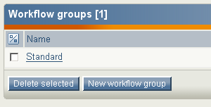
eZ authorize – Select workflows
3. Now open your site's eZ publish admin. Click on the "Setup" link on the top menu.
  In the side menu, at the very bottom, click "Workflows"
  You will be presented with the "Workflow groups" screen.
Workflow groups are primarily a way to keep your workflows organized. Now make a new "Workflow group" to keep all your site's payment gateway workflows
  together in one
  "workflow groups".
  Click the "New workflow
  group" button.

Slide 29
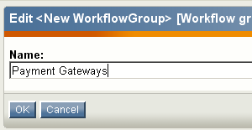
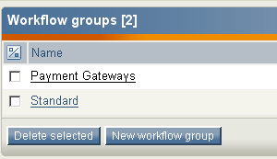
eZ authorize - Create workflow group
4. You will now be presented with the "New Workflow group" screen. Enter a name for the group like "Payment Gateways" should be fine, then click the "OK" button.
5. This will create the new workflow group "Payment Gateways" and take you back to the "Workflow groups" screen.
We want to start adding workflows to the workflow group, click on the button "New workflow group" you just created (Payment Gateways in this example).

Slide 30
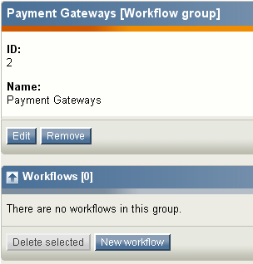
eZ authorize - Select workflow group
6. Now you will be inside your workflow group.
Here we can add new
workflows by clicking the
"New workflow" button.

Slide 31
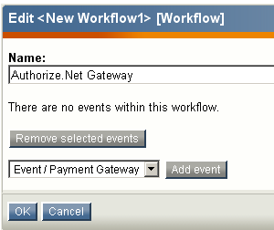
eZ authorize - Add new workflow event
7. Name the workflow
'Authorize.net'.
In the select dropdown, select
'Event / Payment Gateway'.
Then click the 'Add event'.

Slide 32
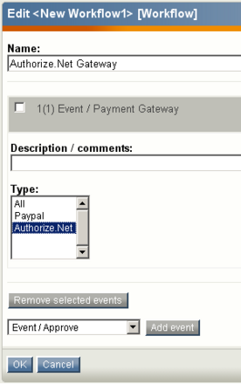
eZ authorize - Select workflow event type
8. On the next screen you
  will see a multi-select
  box with a list of the
  payment gateways you
  already have installed.
  Select 'Authorize.net'
  Click the "OK" button.

Slide 33
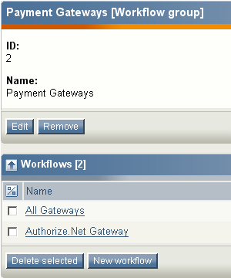
eZ authorize - Alternate workflow options
9. If you want to see how you can let a customer select from multiple payment gateways.
Repeat steps 5-8,
only in step 7 name the workflow something like 'All Gateways', and in step 8 select 'All' from the multi-select box.
If you do this, you will now see two workflows in the 'Payment Gateway' "Workflow groups" screen.

Slide 34
eZ authorize - Triggers
10. So we have now added one or two payment gateway workflow events.
  In the next step, we will be telling the eZ publish system
  when we want this payment gateway event to happen.
  Click the "Triggers" link in the left hand menu.
11. Payment gateway events always happen in the "shop" module, during the "checkout" function when the connection type is "before".
  So click the select box under the workflow heading next to those listings.

Slide 35
eZ authorize – Using Triggers
You will then be presented with the two workflows you have just created (along any other workflows that may already be in your application).
Select the Authorize.Net workflow if you would like your customers to be forced to pay via Authorize.Net, or if you would like to give them a choice of paying by any payment gateway you have installed, select the "All Gateways" workflow.
For the purposes of this tutorial, I'll be selecting the "All Gateways" workflow just so we can see what the payment gateway select screen should look like. When you have done this, make sure you click "Apply Changes".

Slide 36
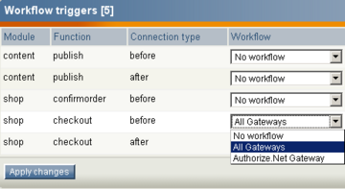
eZ authorize - Trigger Selection
You have now taken all the steps you need to install a payment gateway.
For this particular module, make sure you edit the ezauthorize.ini.append.php file in the extension/ezauthorize/settings directory to add your merchant specific information.

Slide 37
eZ authorize - Commerce checkout workflow
1. On the user side, add a product to the shopping cart and click the "Checkout" button.
2. Fill in information in the account information form, then click the "Continue" button.
3. On the next screen, review your order, then click the "Confirm" button.

Slide 38
eZ authorize - Commerce checkout workflow
4.1 If you set the trigger "shop.checkout.before" to "All Gateways" workflow (selected) for it's payment gateway, you should be presented with the "Select payment method" screen.
For this example choose the Authorize.Net option ratio and click "Select". This will start start the payment gateway workflow.
4.2 If however you set the trigger "shop.checkout.before" to "Authorize.net Gateway" workflow (selected) for your payment gateway, you will be presented with the "Payment Information" screen directly.

Slide 39
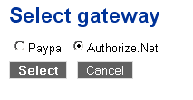
eZ authorize - Payment Gateway User Choice
4.2 If however you set the trigger "shop.checkout.before" to "Authorize.Net Gateway" workflow (selected)
  for your payment gateway,
  you will be presented with
  the "Payment Information"
  screen directly.

Slide 40
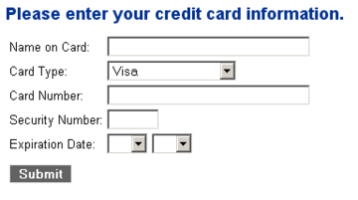
eZ authorize - Payment Information Submission
5. After clicking "Confirm" if you just have the "Authorize.net Gateway" selected in your workflow, you will be presented with the eZ Authorize "Payment Information" / credit card form.

Slide 41
Payment Gateways - Review
Describe the terms and relevance including payment gateways, workflows, events, triggers and extensions
Describe eZ authorize
Review the installation of a payment gateway
The Installation of a payment gateway, eZ authorize
Demonstrate a payment gatway workflow using eZ publish
Show examples of payment gateway extensions
Stay tuned ...
  Solutions
  Conclusions
  Questions
  References
  Tutorials
  Special Thanks

Slide 42
Payment Gateways - Conclusions
We hope this simple tutorial is helpful in teaching you how to install the eZ Authorize (Payment Gateway Extension), a little more about how payment gateways, workflows, triggers work in general and configuring them.
eZ publish makes implementing payment gateway solutions simple
eZ publish provides strong support for multiple payment gateways
eZ publish provides strong tools for building powerful commerce solutions
eZ publish community has provided a growing set of powerful payment gateway contributions
eZ publish echosystem (community) provides rich opportunities to create unique commerce solutions and contribution
eZ authorize is free software, meaning free as in freedom!

Slide 43
Payment Gateways - Questions, Ideas, Requests
What
How
Why
When
Brain Stormming - Suggestions on unique ideas involving
  Further needed payment gatway implimentations
  Workflow multiplexer events to start several workflows from within a workflow
  Social Networking application of micro payment commerce workflows
  Extending eZ authorize
  Extending eZ paypal
  Payment Gateway for Google Checkout
  Commerce integration with eBay, Google Local, Yahoo, Amazon
  eZ publish Commerce Solutions for North America

Slide 44
Brookins Consulting - Special Thanks
Dylan McDiarmid
Kristian Hole
Bob Sims
Paul Borgermans
Frederik Holljen
Matt Sweetman
Paul Holman
eZ systems
GNU
Internet

Slide 45
Payment Gateways - Would you like to know more?
Documentation
  http://ez.no/doc/extensions/paynet_terminal/1_x/installation
  http://ez.no/doc/extensions/paynet_terminal/1_x/concepts_and_basics
  http://ez.no/products/ez_publish/documentation/building_an_ez_publish_shop
  http://ez.no/products/ez_publish/documentation/building_an_ez_publish_shop/extending_the_shop_with_a_paypal_payment_service
  http://brookinsconsulting.com/solutions/ez_authorize/ez_authorize_tutorial
Contribution on ez.no
  http://ez.no/community/contribs/workflow/ez_authorize
  http://ez.no/community/contribs/workflow/ezcurlgateway
Support
  http://ez.no/community/forum/developer/ez_authorize
  http://ez.no/community/forum/developer/ezcurlgateway

Slide 46
Brookins Consulting - About
Contributing eZ systems partner in the North America / USA.
Brookins Consulting has been developing eZ publish business solutions, installation, training and consulting services since 2001.
Brookins Consulting has been building sites using eZ publish since the release of version 1.0 in 2001.
Brookins Consulting has developed stores, custom applications, intranets, and extranets all using eZ publish.
Brookins Consulting has extensive eZ publish expertise.
With a long standing history of eZ publish community contributions, forum support, documentation and development Brookins Consulting continues support and extend existing solutions integral to customer needs and business concerns.

Slide 47


Brookins Consulting - Contact
Brookins Consulting
eZ publish 'Bronze' Partner
http://brookinsconsulting.com
Phone: + 1 817 812 2782
Email: info [at] brookinsconsulting [dot] com
Contact: https://brookinsconsulting.com/content/view/full/58

Slide 48
Presentation - Document License
Copyright © 2006 Brookins Consulting
All text is available under the terms of the GNU Free Documentation License.
The text contained in this presentation is licensed to the public under the GNU Free Documentation License (GFDL). The full text of this license is at http://gnu.org/copyleft/fdl.html
The English text of the GFDL is the only legally binding document; what follows is our interpretation of the GFDL: the rights and obligations of users and contributors.
Permission is granted to copy, distribute and/or modify this document under the terms of the GNU Free Documentation License, Version 1.2 or any later version published by the Free Software Foundation; with no Invariant Sections, with no Front-Cover Texts, and with no Back-Cover Texts.
Sources
  Wikipedia – Terms 'Payment Gateway' and 'Workflow'
  eZ systems – 'eZ publish documentation' (3.5/3.6)
  Brookins Consulting - 'eZ Authorize payment gateway installation and setup tutorial'

