Slide 1
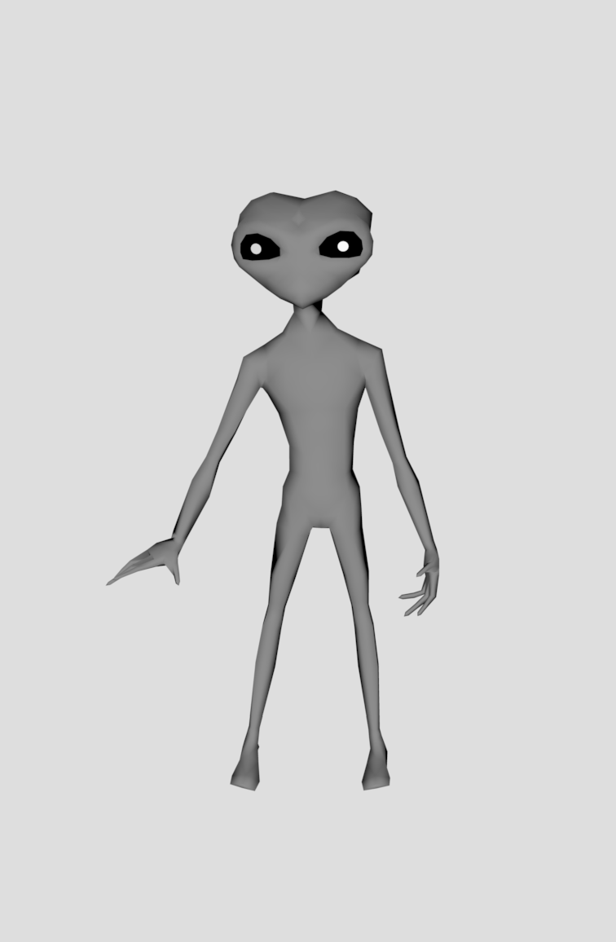
OKAY! OKAY! I’ll talk! Our boss is over at Tech Tower with a bomb. He’s going to set it off destroying all of the campus.

Slide 2
But you’ll never make it there in time! The boss set a timer for 15 minutes. Better run!

