Slide 1
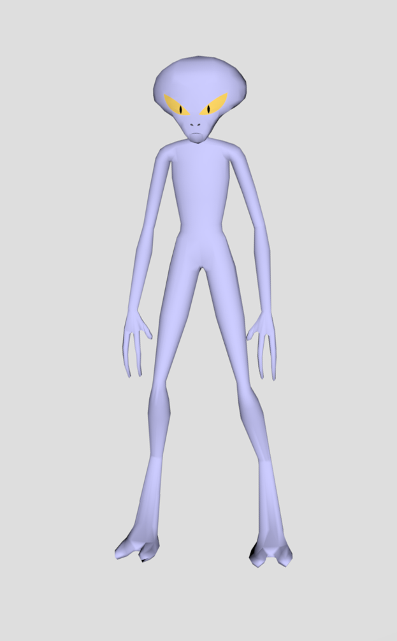
I think you have the wrong person. I didn’t do anything wrong, I just heard that some other aliens were planning something big.

Slide 2
I heard they have a bomb somewhere nearby. I think it was somewhere on the east side of campus. You’d better hurry before it goes off.

