Slide 1
Your Nearest ATM app
Using Ruby
Rose Hernnadez

Slide 2
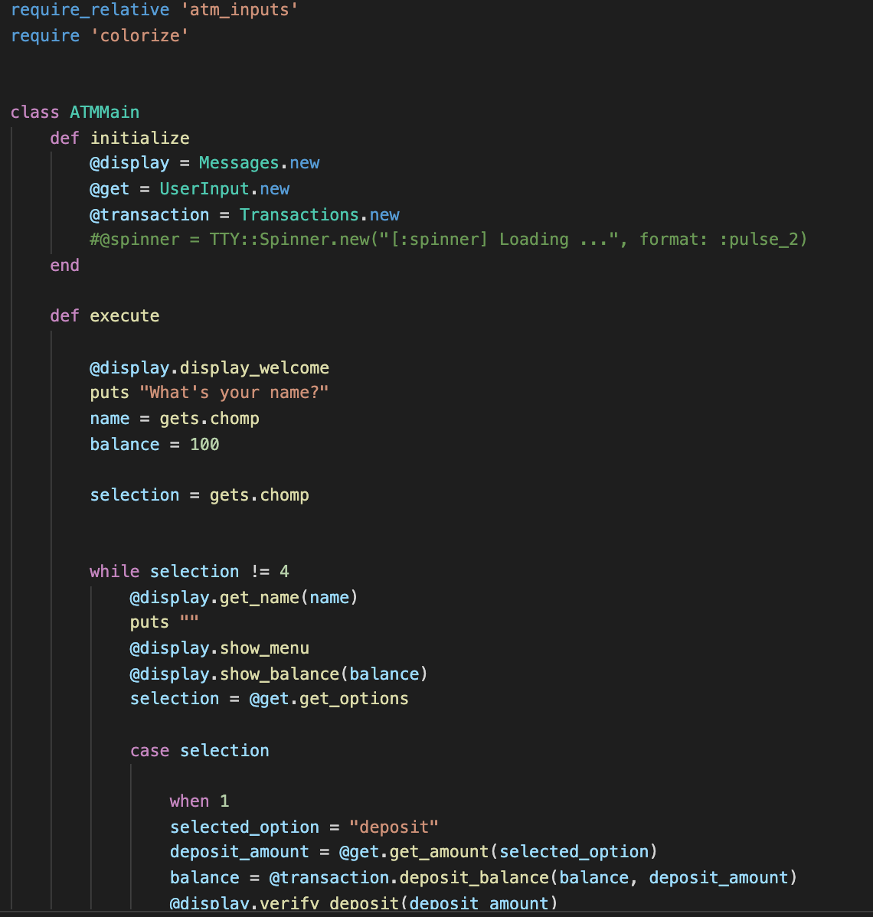
Your nearest ATM' is a simple program that will let you deposit, withdraw or let you know your balance.
This program will show the user a menu list and the user can select from it.
By pressing enter the program will initialize.

Slide 3
