Slide 1
COMP 531
Parallax Scrolling in Web Development
Ran Xu
20 April 2017
Instructor:
Scott E Pollack

Slide 2
What
Pros & Cons
How
Questions

Slide 3
What is Parallax Scrolling
y? What are their traits?
Parallax scrolling is a web site trend where the background content (i.e. an image) is moved at a different speed than the foreground content while scrolling.
Let’s see an example of difference between a website with and without parallax scrolling.

Slide 4
What is Parallax Scrolling
y? What are their traits?
Demo with Parallax Scrolling
demo without Parallax Scrolling
Notes:
I think the easiest example to explain’ is when you’re driving down the street. You’ve got the mountains in the background, you’ve got the trees in the foreground. And as you look out your window, the trees seem to be moving a lot faster than the mountains in the background. And that perceived difference in speed’ gives the landscape its depth. So a website with parallax scrolling helps create an illusion of depth

Slide 5
What
Pros & Cons
How
Questions

Slide 6
Pros
y? What are their traits?
Wow viewers with page depth and animation
Provoke curiosity to attract visitors to scroll through the entire page
Take a story-telling approach to guide visitors through the site
Notes:
has the advantages of :
With all of these benefits, there are also several downsides to having a parallax site.

Slide 7
Cons
y? What are their traits?
SEO takes a hit, because websites with a single page allow only one set of meta information, one effective h1 tag, and one URL
A ton of images and other information on one page cause slow load times
Not compatible with all mobile devices
Notes:
Most of these problems stem from the fact that the majority of parallax websites only have a single long page
Search engine optimization
Search engine optimization (SEO) is the process of affecting the visibility of a website or a web page in a web search engine's unpaid results. In general, the earlier (or higher ranked on the search results page), and more frequently a site appears in the search results list, the more visitors it will receive from the search engine's users;

Slide 8
What
Pros & Cons
How
Questions

Slide 9
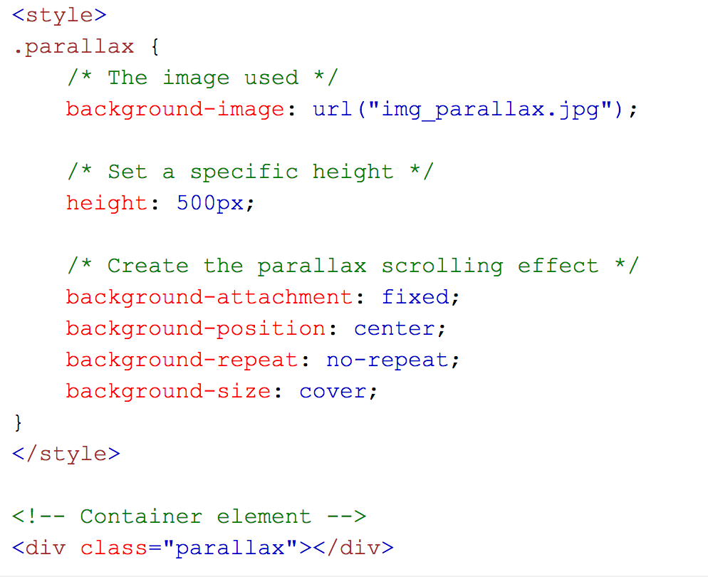
How to Create
y? What are their traits?
Notes:
So how to create a parallax scrolling effect?
It’s rather simple. Inside html, use a container element’ and add a background image to the container’ with a specific height. Then use the background-attachment: fixed to create the actual parallax effect. The other background properties’ are used to center and scale the image perfectly
So hope this easy little tool could help to build our website with more fun.

Slide 10
What
Pros & Cons
How
Questions

Slide 11
y? What are their traits?
Questions?

