Slide 1

Problem description and pipeline
Application example:
Photo OCR
Machine Learning

Slide 2
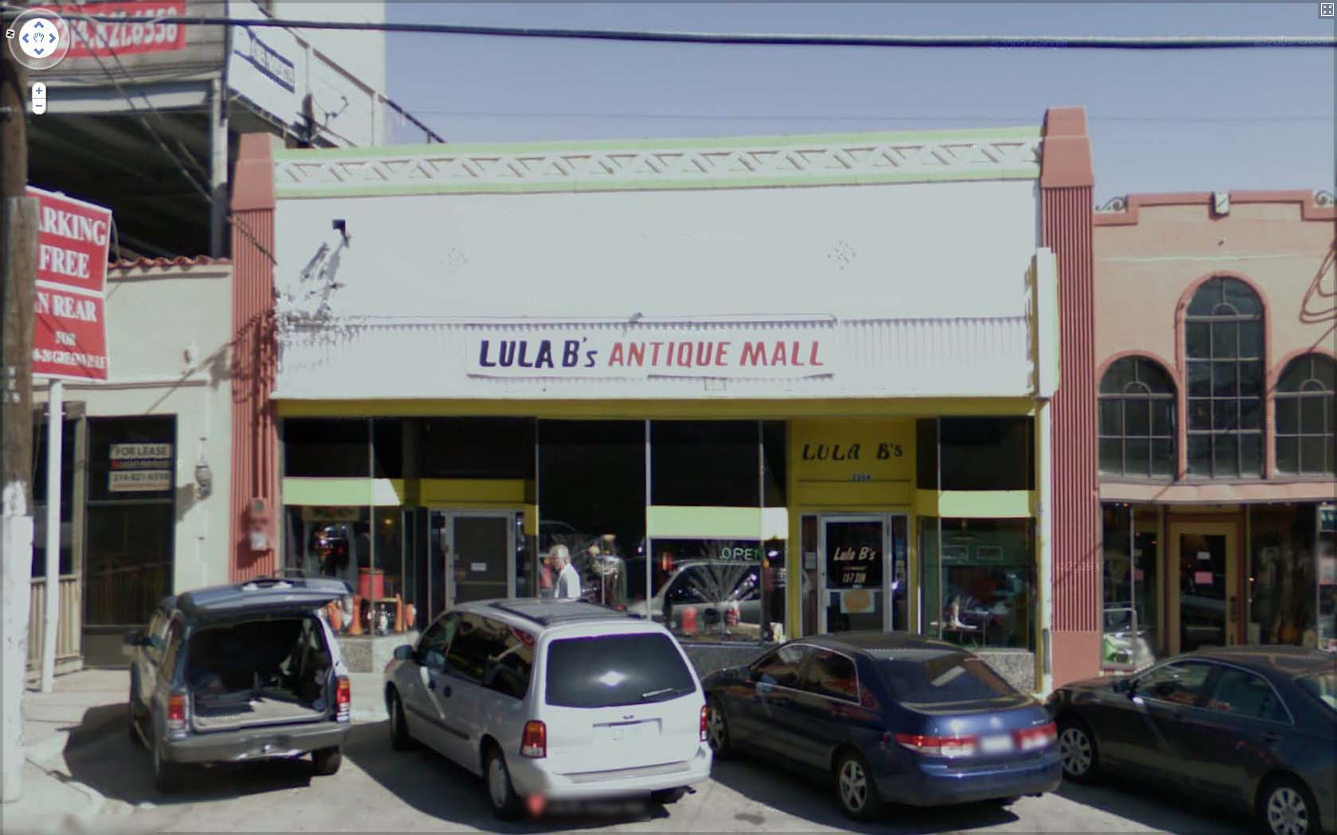
The Photo OCR problem
LULA B’s ANTIQUE MALL
LULA B’s
OPEN
LULA B’s

Slide 3
Photo OCR pipeline
1. Text detection
2. Character segmentation
3. Character classification
A
N
T

Slide 4
Photo OCR pipeline
Image
Text detection
Character segmentation
Character recognition

Slide 5
Sliding windows
Application example:
Photo OCR
Machine Learning

Slide 6
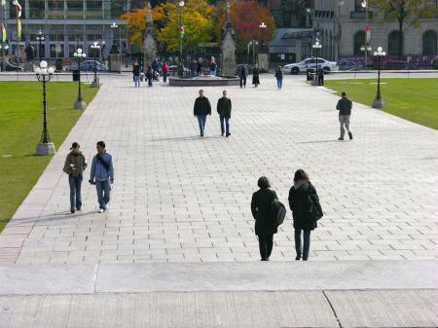
Text detection
Pedestrian detection

Slide 7


























Supervised learning for pedestrian detection
pixels in 82x36 image patches
Positive examples
Negative examples

Slide 8
Sliding window detection

Slide 9
Sliding window detection

Slide 10
Sliding window detection

Slide 11
Sliding window detection

Slide 12
Text detection

Slide 13
Text detection
Positive examples
Negative examples

Slide 14
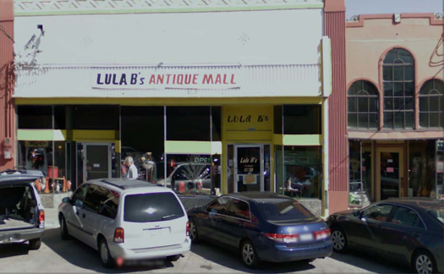


Text detection
[David Wu]
Notes:
Expansion
Rectangles around operator

Slide 15
1D Sliding window for character segmentation
Positive examples
Negative examples
Notes:
Change it to segmentation examples instead:

Slide 16
Photo OCR pipeline
1. Text detection
2. Character segmentation
3. Character classification
A
N
T

Slide 17
Getting lots of data: Artificial data synthesis
Application example:
Photo OCR
Machine Learning

Slide 18
Character recognition
A
N
T
I
Q
A
Notes:
Sort it, spell antique

Slide 19

Artificial data synthesis for photo OCR
Abcdefg
Abcdefg
Abcdefg
Abcdefg
Abcdefg
Real data
[Adam Coates and Tao Wang]

Slide 20
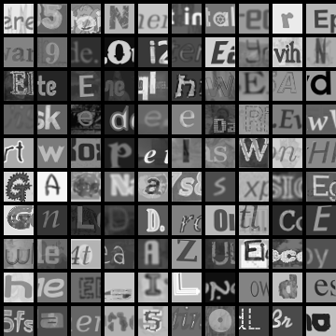
Artificial data synthesis for photo OCR
Real data
Synthetic data
[Adam Coates and Tao Wang]

Slide 21
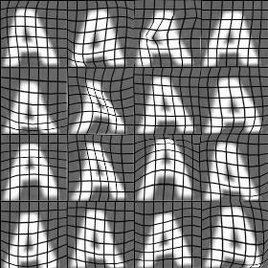

Synthesizing data by introducing distortions
[Adam Coates and Tao Wang]

Slide 22


Synthesizing data by introducing distortions: Speech recognition
Original audio:
Audio on bad cellphone connection
Noisy background: Crowd
Noisy background: Machinery
[www.pdsounds.org]

Slide 23
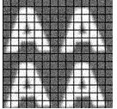


Synthesizing data by introducing distortions
Distortion introduced should be representation of the type of noise/distortions in the test set.
Audio:
Background noise,
bad cellphone connection
Usually does not help to add purely random/meaningless noise to your data.
intensity (brightness) of pixel
random noise
[Adam Coates and Tao Wang]
Notes:
2x2, add noise

Slide 24
Discussion on getting more data
Make sure you have a low bias classifier before expending the effort. (Plot learning curves). E.g. keep increasing the number of features/number of hidden units in neural network until you have a low bias classifier.
“How much work would it be to get 10x as much data as we currently have?”
Artificial data synthesis
Collect/label it yourself
“Crowd source” (E.g. Amazon Mechanical Turk)

Slide 25
Discussion on getting more data
Make sure you have a low bias classifier before expending the effort. (Plot learning curves). E.g. keep increasing the number of features/number of hidden units in neural network until you have a low bias classifier.
“How much work would it be to get 10x as much data as we currently have?”
Artificial data synthesis
Collect/label it yourself
“Crowd source” (E.g. Amazon Mechanical Turk)

Slide 26
Ceiling analysis: What part of the pipeline to work on next
Application example:
Photo OCR
Machine Learning

Slide 27
Estimating the errors due to each component (ceiling analysis)
Image
Text detection
Character segmentation
Character recognition
What part of the pipeline should you spend the most time trying to improve?
Component | Accuracy
Overall system | 72%
Text detection | 89%
Character segmentation | 90%
Character recognition | 100%

Slide 28
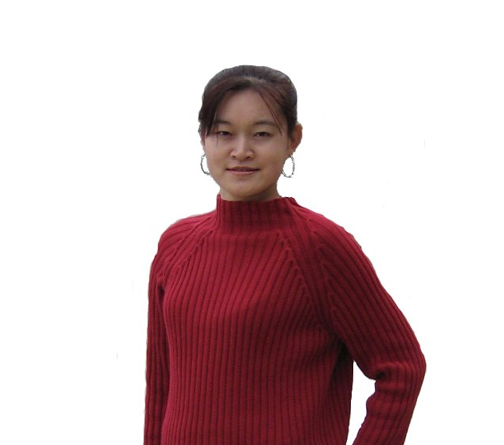
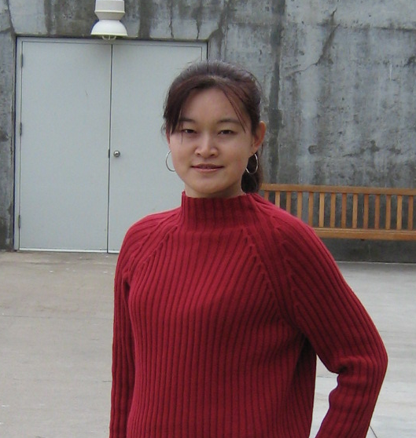
Another ceiling analysis example
Face recognition from images
(Artificial example)
Camera
image
Preprocess
(remove background)
Eyes segmentation
Face detection
Nose segmentation
Logistic regression
Label
Mouth segmentation

Slide 29
Another ceiling analysis example
Camera
image
Preprocess
(remove background)
Eyes segmentation
Logistic regression
Label
Face detection
Nose segmentation
Component | Accuracy
Overall system | 85%
Preprocess (remove background) | 85.1%
Face detection | 91%
Eyes segmentation | 95%
Nose segmentation | 96%
Mouth segmentation | 97%
Logistic regression | 100%
Mouth segmentation

