Slide 1
新規暗号の提案 -cubing暗号-
集中開発コース
X-II 暗号化通信ゼミ
石川琉聖

Slide 2
自己紹介. json
{
“名前” : { “漢字” : “石川 琉聖”,
“名前” : { “かな” : “いしかわ りゅうせい” } ,
“所属” : “立命館大学 情報理工学部 一回生” ,
“エディタ” : “Visual Studio Code” ,
“趣味” : [ “競技プログラミング”, “サイクリング”, “アニメ鑑賞” ] ,
“アカウント” : { “Twitter” : @ryusei_ishika ,
“アカウント” : { “Qiita” : xryuseix ,
“アカウント” : { “AtCoder” : xryuseix ,
“アカウント” : { “Github” : xryuseix } ,
“稼働率” : 0.1
}

Slide 3
本日のプログラム
EDIT IN GOOGLE SLIDES
Click on the button under the presentation preview that says "Use as Google Slides Theme".
You will get a copy of this document on your Google Drive and will be able to edit, add or delete slides.
You have to be signed in to your Google account.
EDIT IN POWERPOINT®
Click on the button under the presentation preview that says "Download as PowerPoint template". You will get a .pptx file that you can edit in PowerPoint.
Remember to download and install the fonts used in this presentation (you’ll find the links to the font files needed in the Presentation design slide)
More info on how to use this template at www.slidescarnival.com/help-use-presentation-template
This template is free to use under Creative Commons Attribution license. You can keep the Credits slide or mention SlidesCarnival and other resources used in a slide footer.

Slide 4
暗号とは
1
What is cryptograph

Slide 5
暗号とは
White
Is the color of milk and fresh snow, the color produced by the combination of all the colors of the visible spectrum.
Black
Is the color of coal, ebony, and of outer space. It is the darkest color, the result of the absence of or complete absorption of light.

Slide 6
現在使われている暗号の例
White
Is the color of milk and fresh snow, the color produced by the combination of all the colors of the visible spectrum.
Black
Is the color of coal, ebony, and of outer space. It is the darkest color, the result of the absence of or complete absorption of light.

Slide 7
cubing暗号の提案
2
proposal for cubing-cipher

Slide 8
cubing暗号の暗号化手順
White
Is the color of milk and fresh snow, the color produced by the combination of all the colors of the visible spectrum.
Black
Is the color of coal, ebony, and of outer space. It is the darkest color, the result of the absence of or complete absorption of light.

Slide 9
cubing暗号の利用メリット
White
Is the color of milk and fresh snow, the color produced by the combination of all the colors of the visible spectrum.
Black
Is the color of coal, ebony, and of outer space. It is the darkest color, the result of the absence of or complete absorption of light.

Slide 10
cubing暗号の解読
White
Is the color of milk and fresh snow, the color produced by the combination of all the colors of the visible spectrum.
Black
Is the color of coal, ebony, and of outer space. It is the darkest color, the result of the absence of or complete absorption of light.

Slide 11
cubingモードの提案
3
proposal for cubing-mode

Slide 12
暗号利用モードとは
White
Is the color of milk and fresh snow, the color produced by the combination of all the colors of the visible spectrum.
Black
Is the color of coal, ebony, and of outer space. It is the darkest color, the result of the absence of or complete absorption of light.

Slide 13
cubingモードの利用手順
White
Is the color of milk and fresh snow, the color produced by the combination of all the colors of the visible spectrum.
Black
Is the color of coal, ebony, and of outer space. It is the darkest color, the result of the absence of or complete absorption of light.

Slide 14
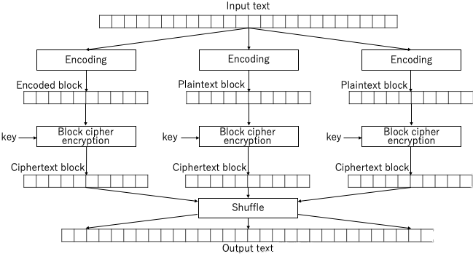

Slide 15
cubingモードの解読
White
Is the color of milk and fresh snow, the color produced by the combination of all the colors of the visible spectrum.
Black
Is the color of coal, ebony, and of outer space. It is the darkest color, the result of the absence of or complete absorption of light.

Slide 16
暗号化デモンストレーション
4
Encryption demonstration

Slide 17
暗号化デモンストレーション
White
Is the color of milk and fresh snow, the color produced by the combination of all the colors of the visible spectrum.
Black
Is the color of coal, ebony, and of outer space. It is the darkest color, the result of the absence of or complete absorption of light.

Slide 18
質疑応答

