Slide 1
Survival Analysis
Problem Formulation
Non-parametric methods
Semi-parametric methods
  Cox Proportional Hazards model
  Learning over censored data

Slide 2

Previous Literatures
Conventional Cox Propositional Hazards (CPH) model that estimates the risk/rate function h(x) by a linear function . The Cox regression is performed to tune by optimizing the Cox Partial Likelihood
However, in real applications, data always exhibits a nonlinear statistics that violates the linear proportional hazards condition
Nonlinear Survival Models were then explored to mitigate this issue
  Faraggi-Simon method was the first of such kind to replace the linear model with neural network. While Faraggi-Simon network has not been shown to outperform the linear CPH
  DeepSurv - The first attempt applying modern deep neural network to the CPH model with advancement in network architecture and training procedures. It demonstrated superiority over the linear CPH on multiple survival datasets.
  Cox Regression – Extended the DeepSurv to accommodate modern stochastic optimization that can lower the computational cost for training
  Deep Recurrent Survival Analysis – Modeled the CPH as a recurrent neural network
  Survival Tree & Random Survival Forest – The Survival Tree used Log-rank Test as the splitting criterion. The Random Survival Forest ensembles multiple Survival Trees in a “bagging” fashion
  Other Tree-based Survival method – using a specialized K-Means guided by the KL divergence as the tree splitting criterion (Node splitting via clustering: primarily targeting on categorical variables)
David Faraggi and Richard Simon. A neural network model for survival data. (Statistics in medicine ‘1995)
Katzman et al. DeepSurv: personalized treatment recommender system using a Cox proportional hazards deep neural network. (BMC Medical Research Methodology ‘2018)
Kvanmme et al. Time-to-Event Prediction with Neural Networks and Cox Regression. (Journal of Machine Learning Research, JMLR ‘2019)
Ren et al. Deep Recurrent Survival Analysis (Conference on Artificial Intelligence, AAAI ‘2019)
Ishwaran et al. Random Survival Forests. (The Annals of Applied Statistics ‘2008)
Wang et al. Functional Bid Landscape Forecasting for Display Advertising. (Joint European Conference on Machine Learning and Knowledge Discovery in Databases, ECML PKDD ‘2016)

Slide 3
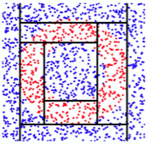
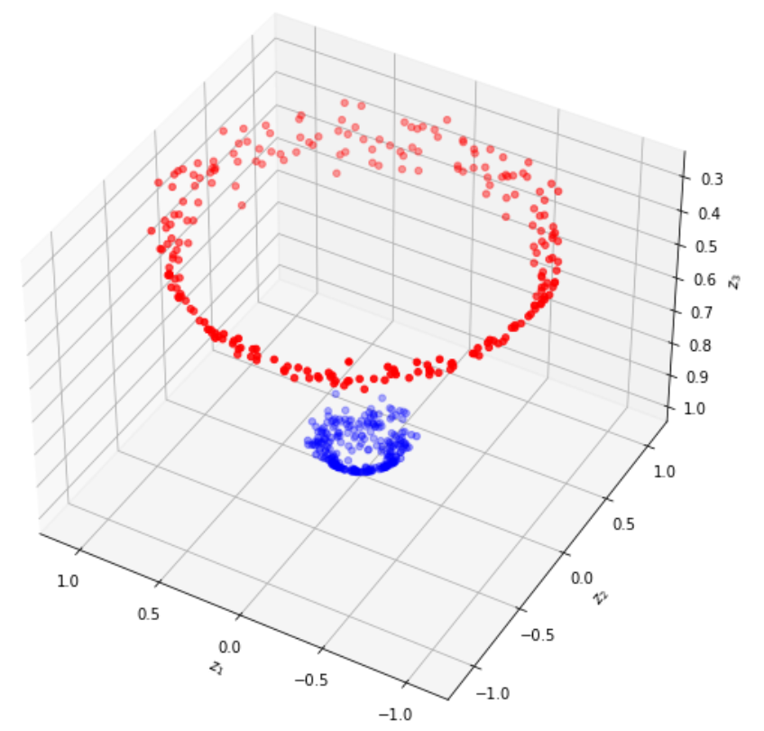
Tree-based Algorithm for Survival Analysis
Tree-based survival analysis is advantageous in terms of interpretability and versatility
  It enables the interpretation of intricately structured data by partitioning data into locally homogeneous sub-regions
  It can handle both discrete and continuous variables and targets
  It can handle complex (e.g., nonlinear) interactions and dependencies between features and target variables – not constrained by the proportionality assumption (That’s not true for axis-parallel split rule !)
However, existing tree-based algorithms for survival analysis have a few drawbacks
  They were grown in a greedy fashion – achieving local optimality at each splitting, but not guaranteed to converge to global optimality (as it is not optimized for that)
  The feature space was partitioned using axis-parallel splits – a single attribute or feature is split at each node. It is problematic when the true decision boundaries are not aligned with the feature axes (e.g., when feature interactions play a significant role)
  In other words, the decision to align a data point to its target variable is primarily based on the values of individual features independently, without considering their interactions
  A simple example of such scenario can be found on a toy circle dataset
    A decision tree (depth=10) with axis-parallel split rule easily fails, as the axis-parallel alignment can only occur by assuming a linear relationship between features and target variables (That’s why its decision boundaries are delineated by lines that are perpendicular to the feature axes)
    In contrast, the true decision boundaries of such circle dataset can be easily approximated by performing a nonlinear (e.g., polynomial, rbf) classification

Slide 4
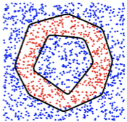
Proposed Tree-based Algorithm
To address the challenges in previous tree-based methods, we proposed a new tree-based algorithm by leveraging the oblique split – more that one attribute is involved in the split rule
Oblique splits are hyperplane splits defined by a linear combination of the feature variables (This enables the optimization for orientation and location of the boundaries)
Mathematically, its split rule is given by:
As a result, the oblique split can capture more complex relationship between features
In the meanwhile, such piece-wise constant functions (because of local homogeneity in trees) can be theoretically approximated by a locally constant networks (i.e., ReLU networks – neural network with ReLU activation only)
Previous works demonstrated how to build an Oblique Decision Trees from Derivatives of ReLU networks (Such Oblique Tree can be optimized in an end-to-end fashion which better approximates the global optimality for a given task)
To this end, we proposed a Survival Neural Oblique Tree based on ReLU Networks
  Different from conventional greedy trees, such oblique tree can be optimized to search for global optimality for a given task while retaining the local homogeneity for interpretability
  Incoporating the semi-parametric CPH model, the optimization of such Neural Oblique Tree can be achieved by maximizing Cox Partial Likelihood (as done by the DeepSurv and Cox regression)
  Non-axis-parallel oblique split made it better capture the complex relationship between variables
Lee et al. Oblique Decision Trees from Derivatives of ReLU Networks (International conference on Learning Representation ICLR ‘2020)

Slide 5
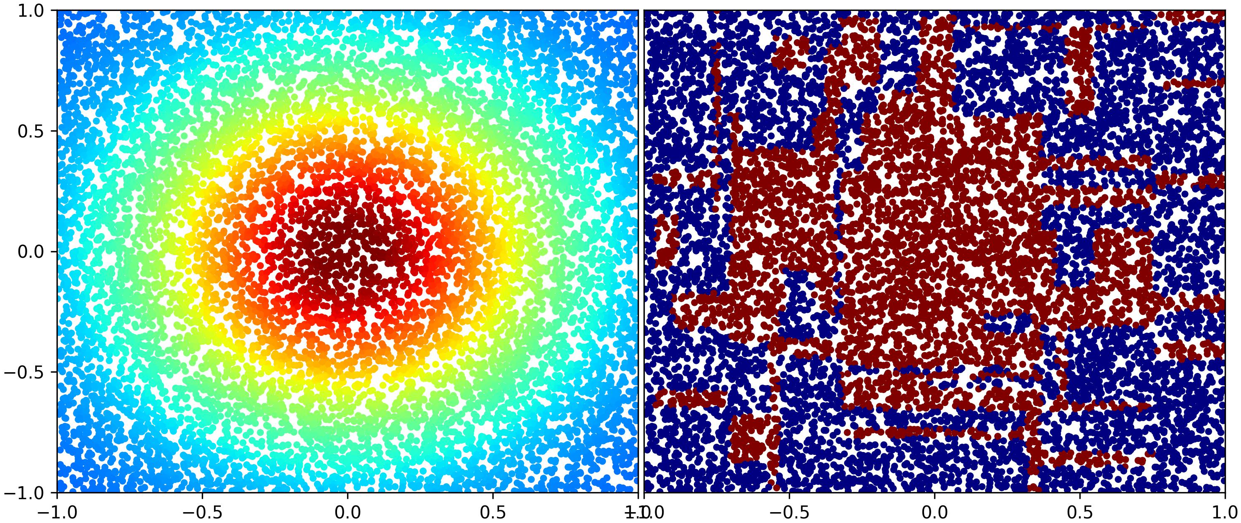
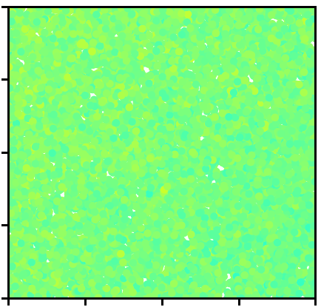
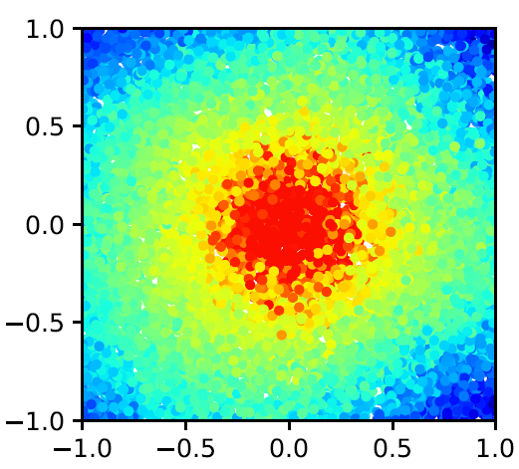
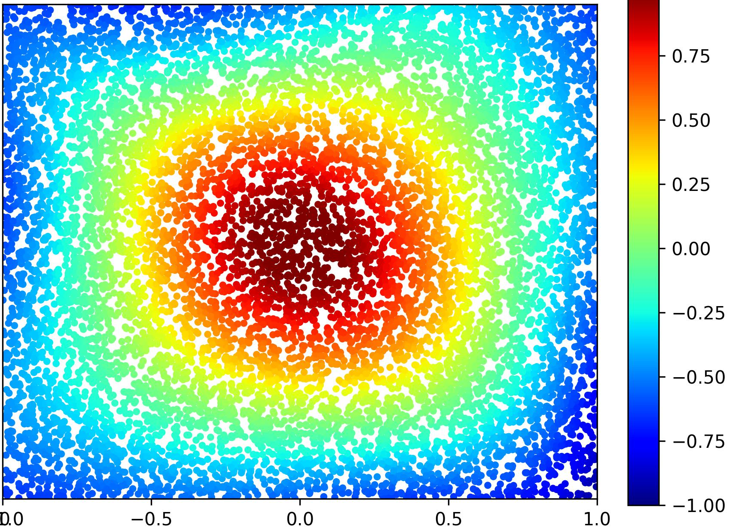
Preliminary results on the simulated Gaussian Rate Function
The approximation of rate function in Cox Propositional Hazards Model

