Slide 1
Restaurant in Toronto -An opportunity
Created by: Ankur Arora

Slide 2
Predicting the Best neighbourhood for Opening restaurant
Toronto is a promising market for investors/business owners to start their business. It is advantageous for business owners to accurately predict where they should open the restaurant and what are the driving factor for opening of restaurant.
Obviously, anyone who is planning to set the restaurant in Toronto wil be interested in this data for competitive advantage over others who are planning for the same.

Slide 3
Data Sourcing and Cleaning
City of Toronto Neighbourhood Profiles for providing an overview of the neighbourhoods in Toronto:
Wikilink for fetching the postal codes
Geospatial Data for coordinates
City of Toronto Neighbourhood Shapes for mapping: GeoJSON File
Foursquare API to collect information:
Venues in the Neighbourhood
Venue Details like Rating, Tips etc.
Data downloaded or scraped from multiple sources were combined into one table

Slide 4
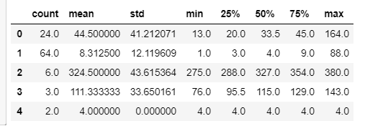
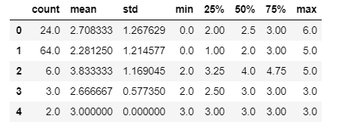
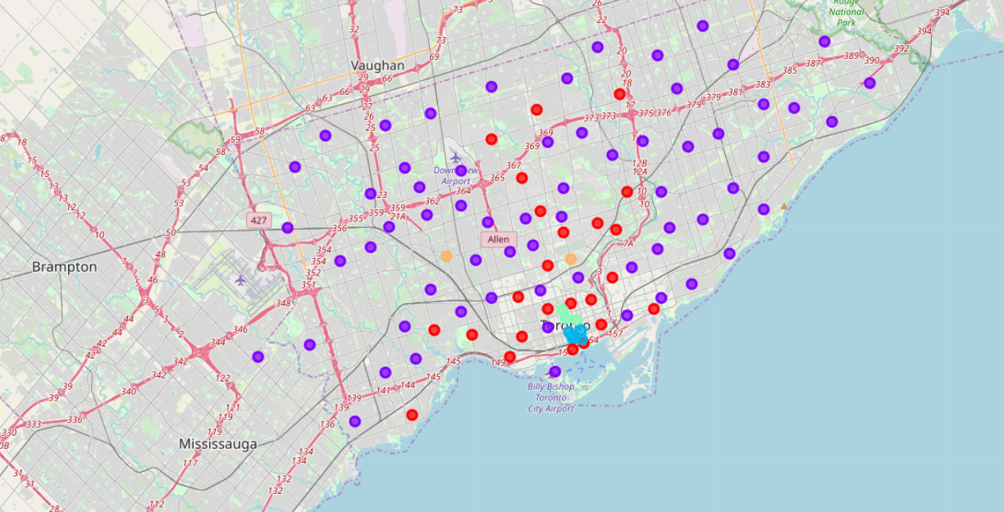
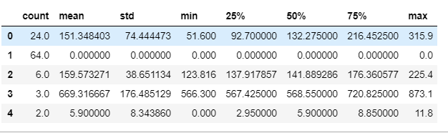
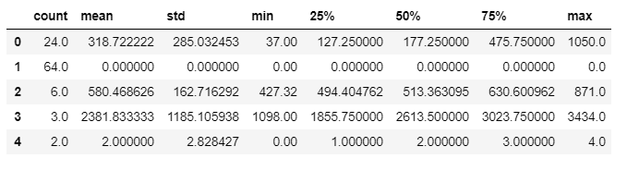
Data Charts for Prediction
No. of venues
Top Venue Restaurants
MAP Showing Clusters
Average Rating
Average Tips

Slide 5
conclusion
Cluster 2 have the highest top venue restaurant, with mean of 3.8. This means that in top 10 venues for each neighbourhood in Cluster 2, there are roughly 4 restaurants that get into that top 10 venues list. Cluster 4 is slightly behind. In cluster 0,1and 3, on average 2.5 restaurant that made it to top 10 venue list.
From this table we can conclude that Cluster 3 and 4 have less Restaurant in its neighbourhoods compared to other Cluster. Cluster 0 has max restaurants and Cluster 1 and 2 have similar number of restaurants in its neighbourhood, and almost close to Cluster 0.
Cluster 2 has highest number of venues and Restaurants.
Cluster 3 has highest number of tips followed by Cluster 1 and then 2. This shows tips are there in other clusters too, but quality/services is not that good in terms that people pay tips.
Based on the characteristics mentioned above, it's obvious that business owner should choose Cluster 2 to build their first restaurant.

