Slide 1
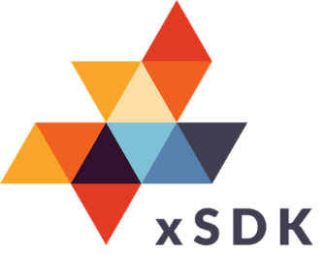


xSDK Version 1.0.0: November 2023
https://xsdk.info
https://xsdk.info
xSDK functionality, Nov 2023
Tested on key machines at ALCF, NERSC, OLCF, also Linux
Multiphysics Application C
Each xSDK member package uses or can be used with one or more xSDK packages, and the connecting interface is regularly tested for regressions.
Application A
Application B
SLEPc
hypre
AMReX
Omega_h
deal.II
HiOp
ArborX
HDF5
Alquimia
PETSc
SUNDIALS
PUMI
PHIST
Ginkgo
MAGMA
BLAS
PFLOTRAN
libEnsemble
ExaGO
SLATE
SuperLU
Trilinos
MFEM
preCICE
More external software
STRUMPACK
DTK
TASMANIAN
PLASMA
ButterflyPACK
heFFTe
November 2023
26 math libraries
2 domain components
17 mandatory xSDK community policies
Spack xSDK installer
Impact: Improved code quality, usability, access, sustainability
Foundation for work on performance portability, deeper levels of package interoperability
Domain components
Reacting flow, etc.
Reusable.
Libraries
Solvers, etc.
Interoperable.
Frameworks & tools
Doc generators.
Test, build framework.
SW engineering
Productivity tools.
Models, processes.
Extreme-Scale Scientific Software Development Kit (xSDK)

