Slide 1



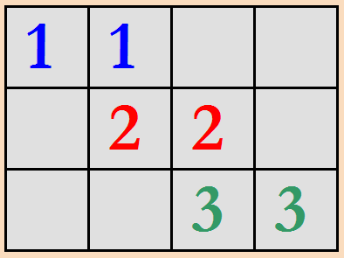

DEU_TEAM NUMBER MATCHING GAME Project_CME1251 / 2

Slide 2

OUR TEAM
Alaa Eldin Elreis
2019510007
Sefa Çelik
2020510978
Romina Dehghani Mohammadi
2020510096

Slide 3
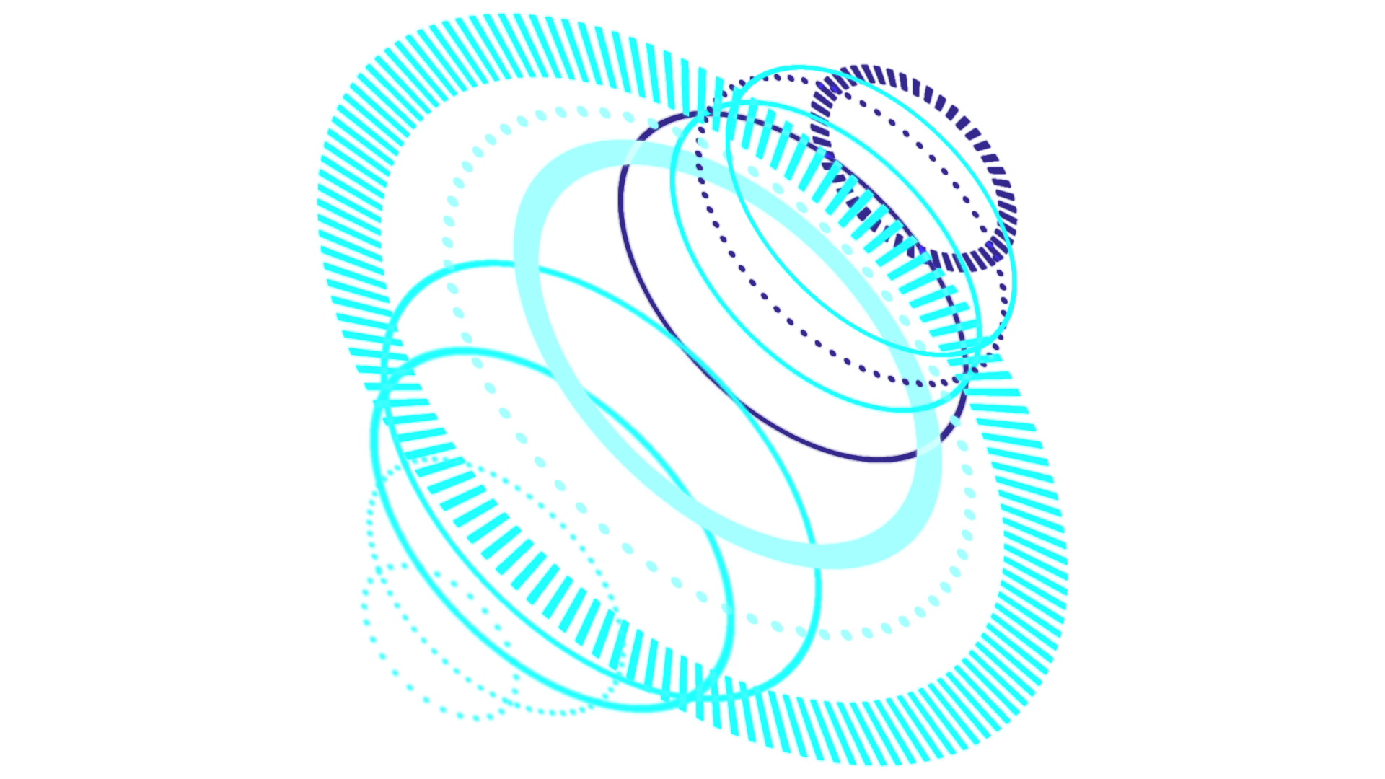
TABLE OF CONTENTS
PROGRESS SUMMARY
01
02
ALGORITHMS AND SOLUTION STRATEGIES
03
SCREENSHOTS
04
Conclusıon & REFERENCES

Slide 4

INTRODUCTION
Our team has created a one-player number matching game , where the player will try to get the highest score possible by matching numbers side by side.

Slide 5




Requirements
Requirements
1-C# language
2- Visual studio
3- Discord

Slide 6

TASK SHARING
Alaa Eldin Elreis
Romina Dehghani Mohammadi
Sefa Çelik
Printing the table and then showing thirty numbers in it randomly
Moving the cursor inside the table using the arrow keys.
Moving the numbers using the keys (WASD) and matching them and then disappear them and give the player ten points.

Slide 7

Scheduling
THIRD WEEK :
SECOND WEEK:
FIRST WEEK:
Moving single number left or right (A/D keys). Matching.
Creating the necessary variables, structures. Screen. Cursor movement.
FORTH WEEK
Initial board with the randomly generated numbers. Moving single number up or down (W/S keys).
Remaining parts of the application and testing..

Slide 8

COMPLETED TASKS
All tasks done except matching numbers where there are some errors

Slide 9
PROBLEMS ENCOUNTERED
Matching objects disappear and there are errors in the reflection of the score

Slide 10
ALGORITHMS & SOLUTION STRATEGIES
We first used arrays and then (for loop) , (while loop) and if conditionals.

Slide 11
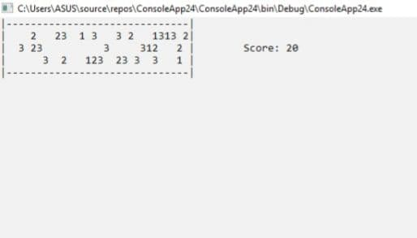

Slide 12
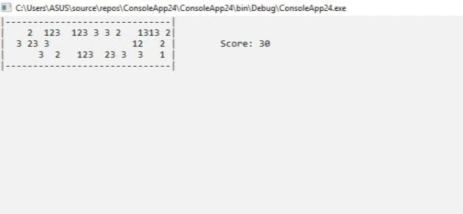

Slide 13
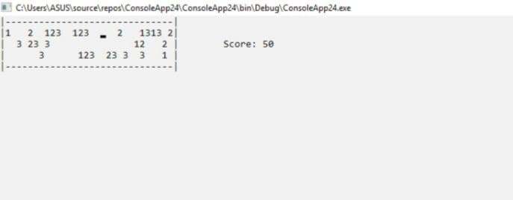

Slide 14
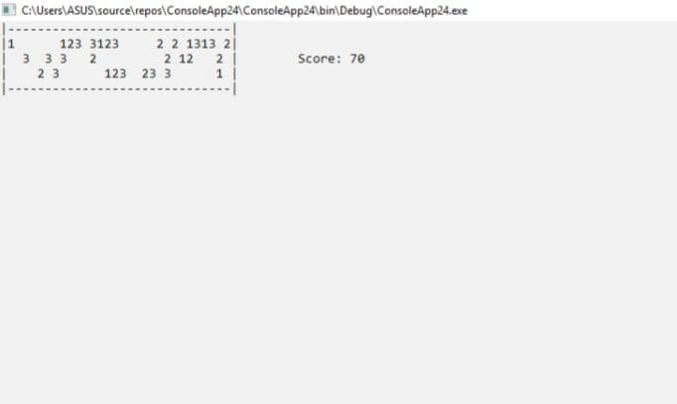

Slide 15
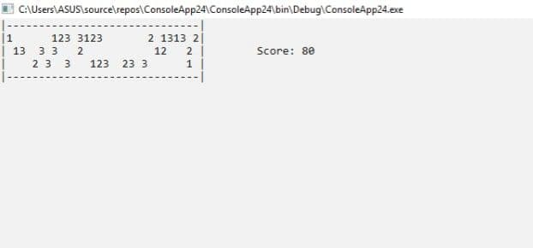

Slide 16
conclusıon
We have benefited from this project. And we learned and used a lot of new things that we didn't use before, such as arrays, moving the cursor, etc.
In addition to teamwork, we have gained new experiences due to working as a team.
On top of that, we're getting more and more understanding of how (while, for) loops and other functions work

Slide 17
REFERENCES
https://www.w3schools.com/cs/index.php
https://youtu.be/YiE0oetGMAg

Slide 18
THANS FOR LISTENING

