Slide 1

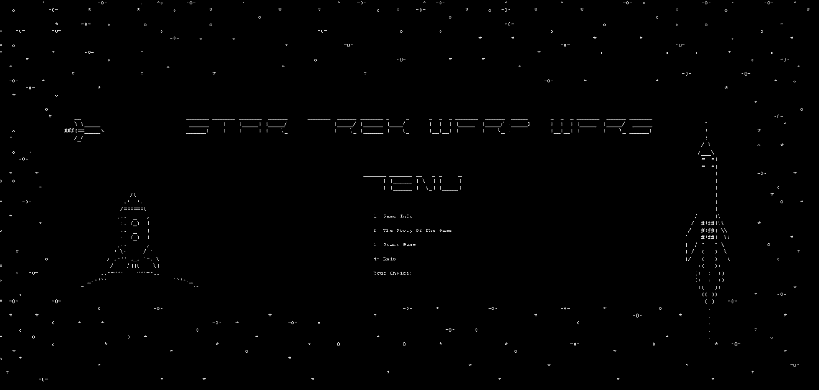

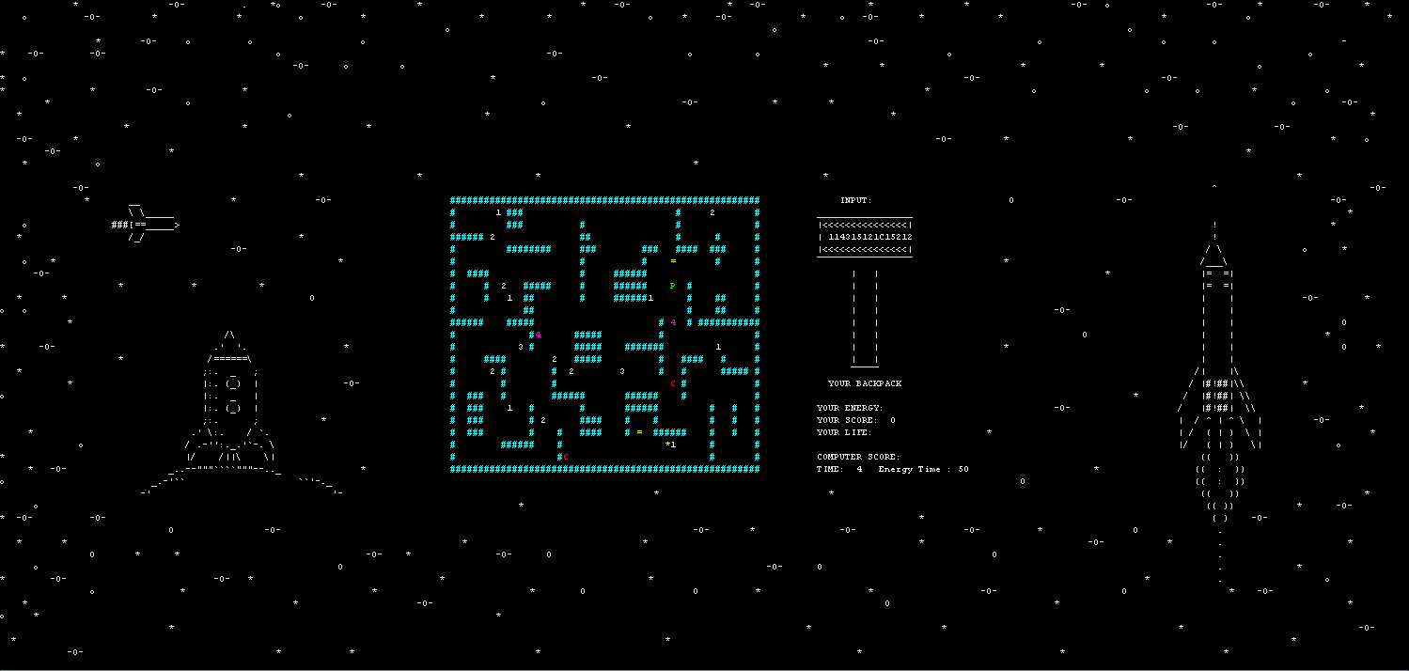

STAR TREK WARP WARS
Prepared By:
Sefa Çelik
Güney Söğüt
Hasan Balıkçı
Deniz Katayıfçı
4.20.2022 – Buca/İzmir

Slide 2

OUTLINE OF PRESENTATION
General Explanation Of Game
Progress Summary
Completed Tasks
Additional Improvements
Problems Encountered
Algorithms And Solution Strategies
Conclusion
Questions
References

Slide 3
GENERAL EXPLANATION OF OUR GAME
Single Player - Strategy
Collect treasure and destroy computer robots.

Slide 4


Progress Summary
TASK
Design of classes
Menu and screen
Player movements
Backpack
timing
Input Queue
Computer movements
Trap, warp device
Additional Improvements
Treasures
PERSON
Güney Söğüt
Hasan Balıkçı
Sefa Çelik
Deniz Katayıfçı

Slide 5

Completed Tasks
All tasks have been completed

Slide 6
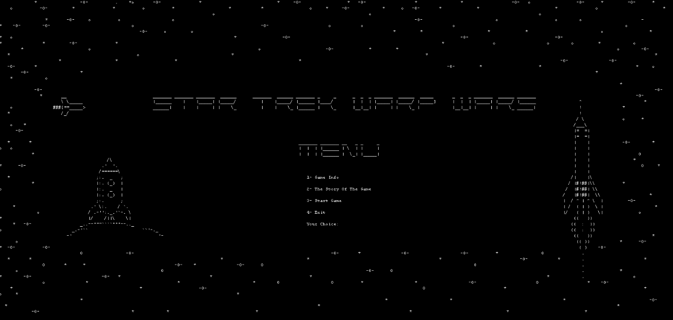
Additional Improvements
Menu design(Game Info, Story of Game, Start Game, Exit)
A stable game background
Colored maze design
A game story

Slide 7
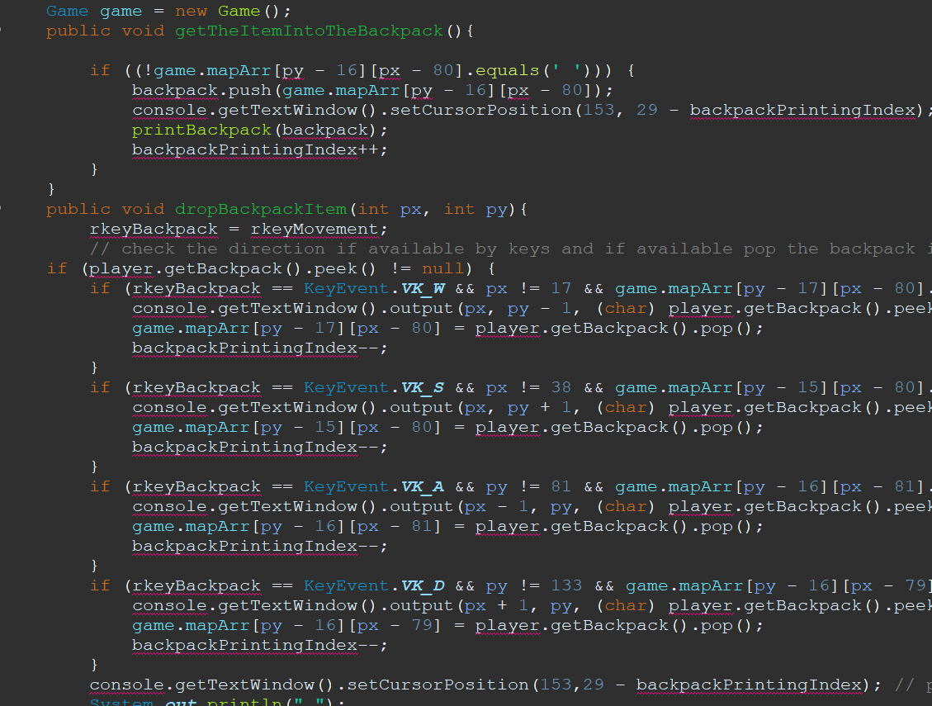

PROBLEMS ENCOUNTERED
Working on different screen sizes
Timing
Working with object oriented
Computer move

Slide 8
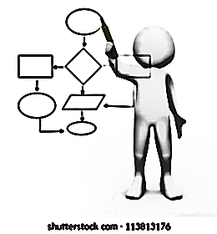
ALGORITHMS AND SOLUTION STRATEGIES
Player
Timing
Computers
Treasures

Slide 9
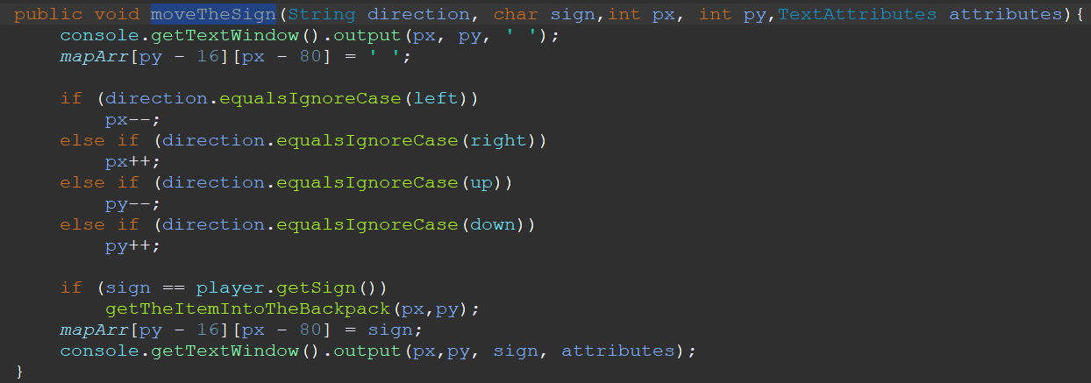
ALGORITHMS AND SOLUTION STRATEGIES - 1

Slide 10
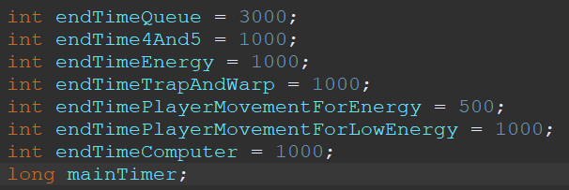
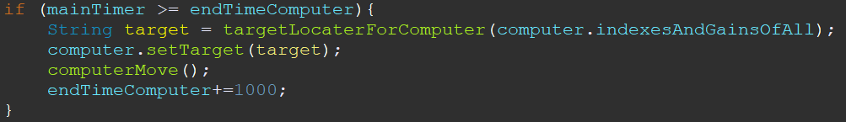
ALGORITHMS AND SOLUTION STRATEGIES - 1

Slide 11
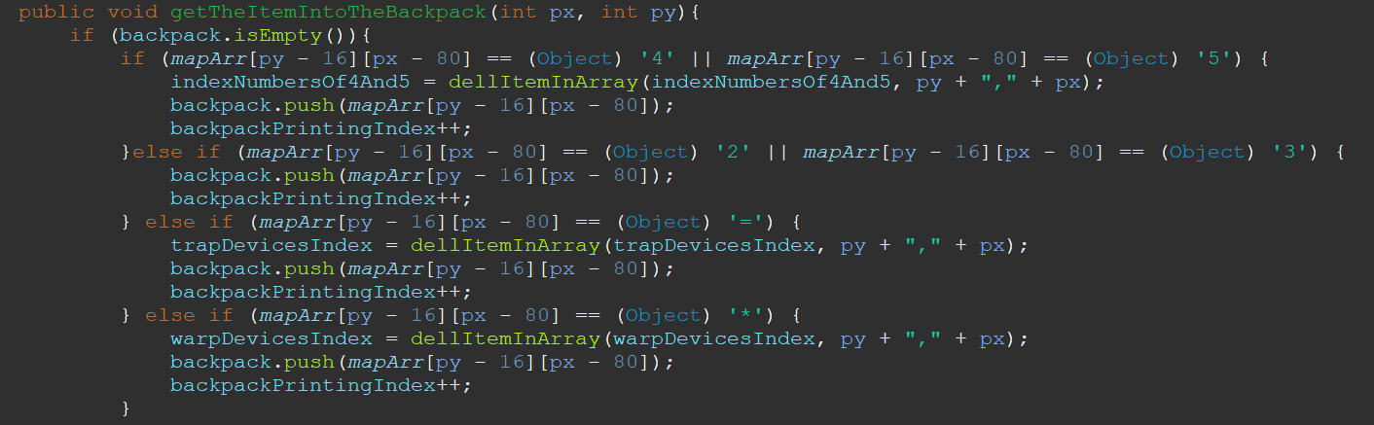
ALGORITHMS AND SOLUTION STRATEGIES - 1

Slide 12
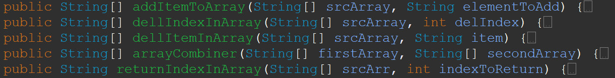
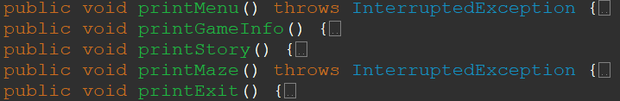

ALGORITHMS AND SOLUTION STRATEGIES - 2
1. Array Functions
2. Additional Functions
3. Computer Move

Slide 13
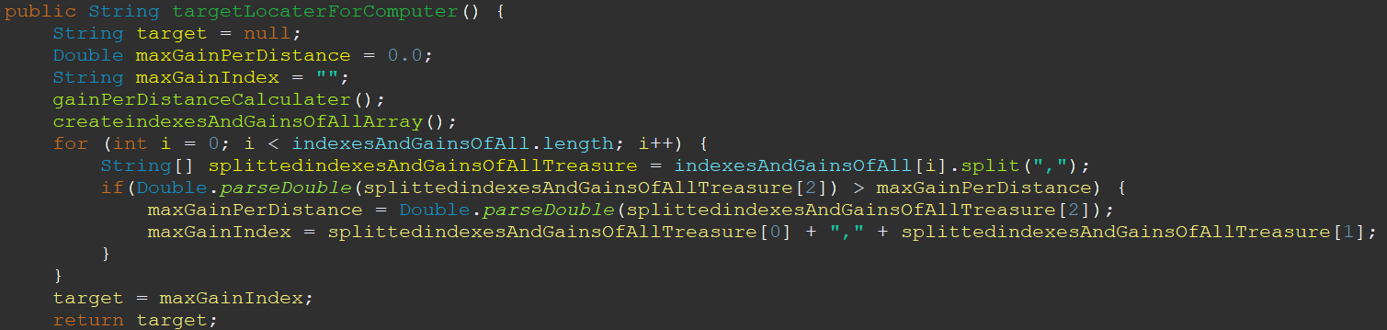
ALGORITHMS AND SOLUTION STRATEGIES - 2

Slide 14
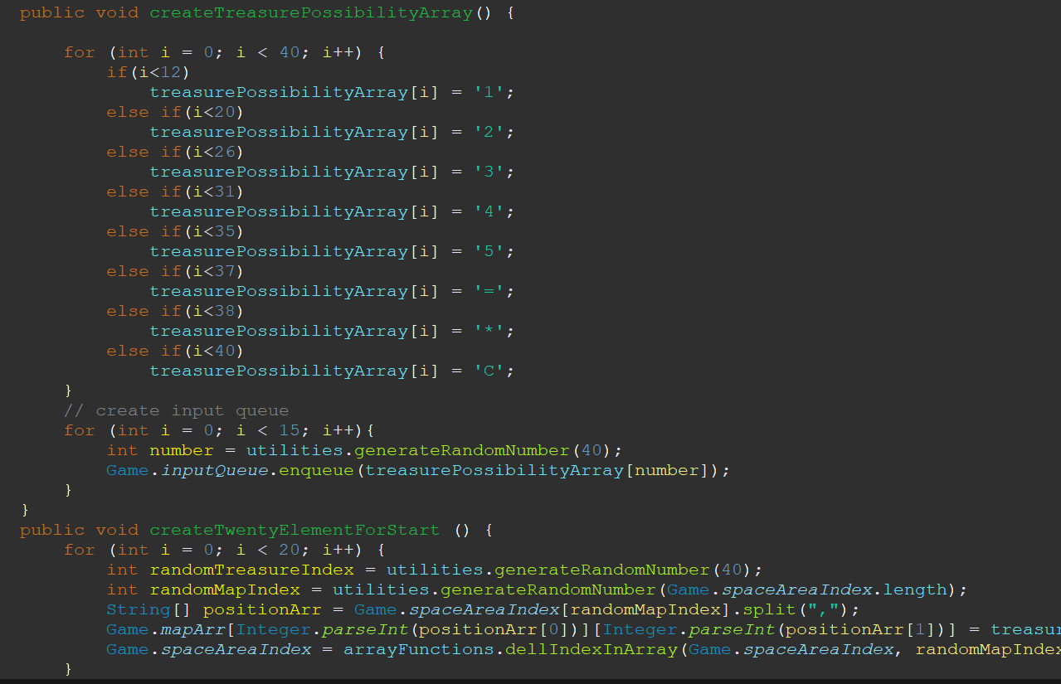
ALGORITHMS AND SOLUTION STRATEGIES - 3

Slide 15
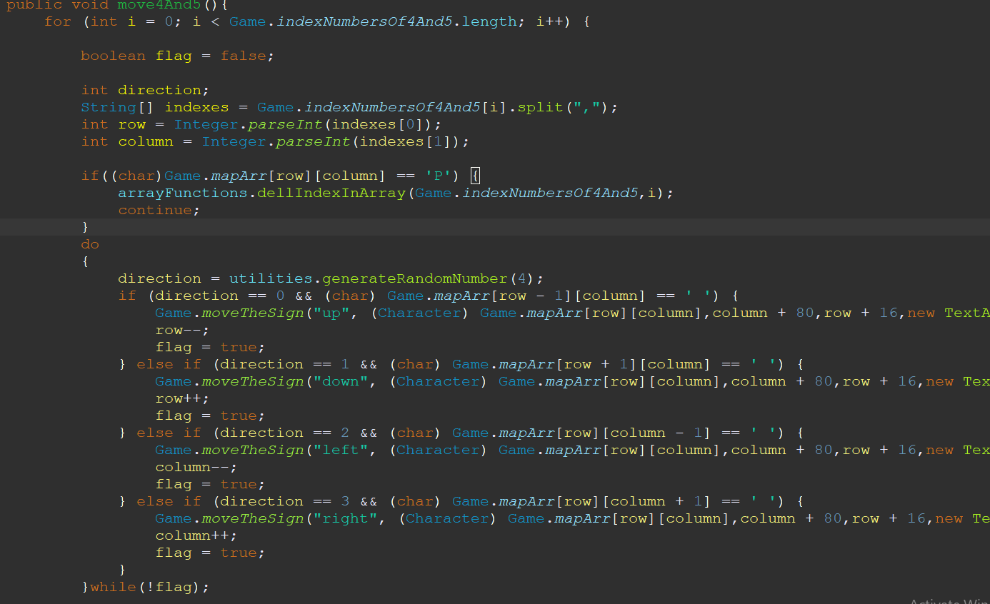
ALGORITHMS AND SOLUTION STRATEGIES - 3

Slide 16

conclusıon
First of all, the “Star Trek Warp Wars” project is accomplished perfectly without any unfinished part.

Slide 17

QUESTIONS?

Slide 18

REFERENCES
Y. Daniel Liang, "Introduction to Java Programming", tenth edition. ISBN: 0133761312
Bruce Eckel, "Thinking in Java", 4th ed, 2007.
Java mother site : https://www.oracle.com/technetwork/java/index.html.
Ken Arnold, James Gosling and David Holmes, "The Java Programming Language", 4th ed, 2005.
Oracle Java Sstem documentation : https://docs.oracle.com/javase/7/docs/api/java/lang/System.html

