Slide 1
The Discrete Fourier Transform and the Short-time Fourier Transform
Xavier Serra
Music Technology Group
Universitat Pompeu Fabra, Barcelona
Notes:
Welcome again to the course on Audio Signal Processing for Music Applications!!
In this lecture I start with our most fundamental topic, the Discrete Fourier Transform. If you can follow and understand this topic you should have no problem in following the whole course.
I divided this topic in two lectures, this is the first one.

Slide 2
Discrete Fourier Transform
Notes:
This is it!!! This is the most important equation to be shown in the whole course. So, pay attention!!
...
This equation can be decomposed into two parts: the complex exponential and the dot product.

Slide 3
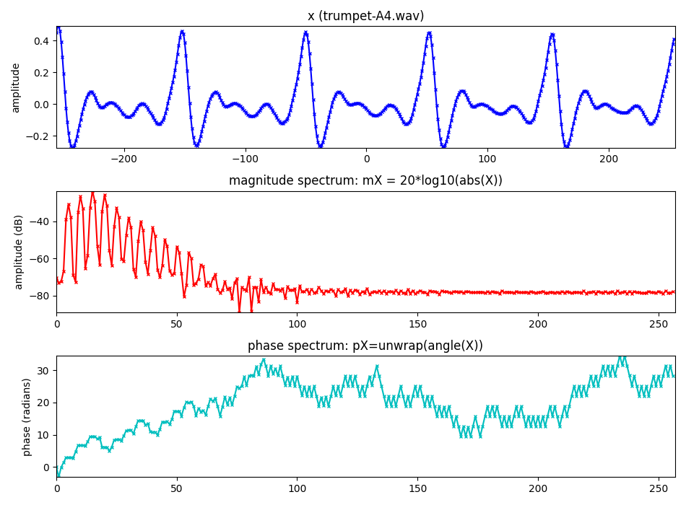
Notes:
Here we show an input signal, x[n], and the output of the DFT, X[k], the spectrum. it is a real sound, a fragment of an oboe sound.
...

Slide 4
DFT: complex exponentials
Notes:
As we said, in the DFT equation the input signal x[n] is multiplied by a series of complex exponentials, complex sinewaves.
These sinewaves are the basis functions of the DFT, the components that we will identify and measure in the input signal.
...
A signal of size N=4 will be projected into 4 sinewaves of size 4.

Slide 5
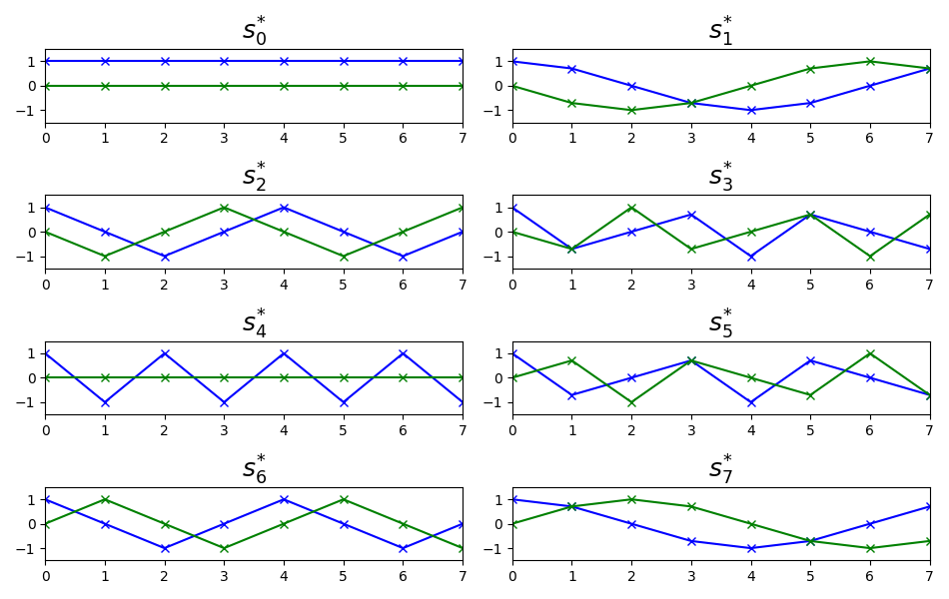
DFT: complex exponentials
Notes:
If the signal has a size N=8 we will need 8 complex sinewaves, like these ones.
...

Slide 6
DFT: scalar product
Example:
Notes:
The DFT equation can also be expressed by this equation, which emphasizes the scalar product operation of the input signal x[n] by the N complex sinewaves.
...

Slide 7
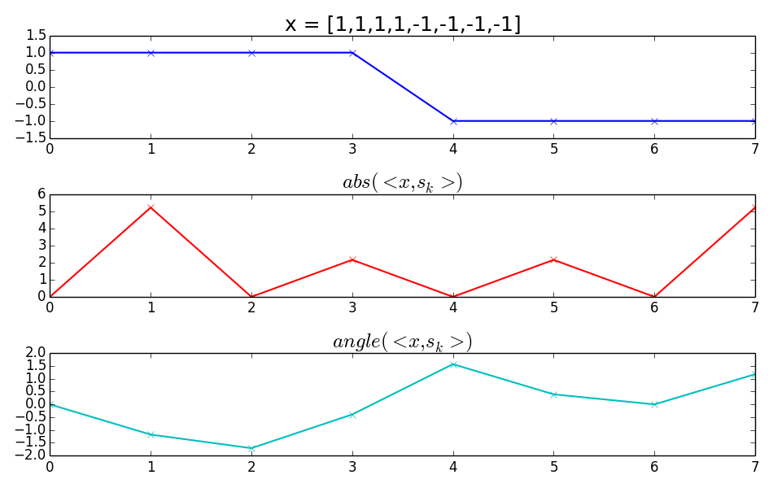
DFT: scalar product
Notes:
This is an example of the scalar product operation, of the DFT of a simple sequence.
...
This is the DFT operation.

Slide 8
DFT of real sinusoids
Notes:
Let's go a step further and compute the DFT of a real sinusoid, not of a complex one, thus closer to the reality of sounds. A bit more messy!!
...
and let's see a plot of it.

Slide 9
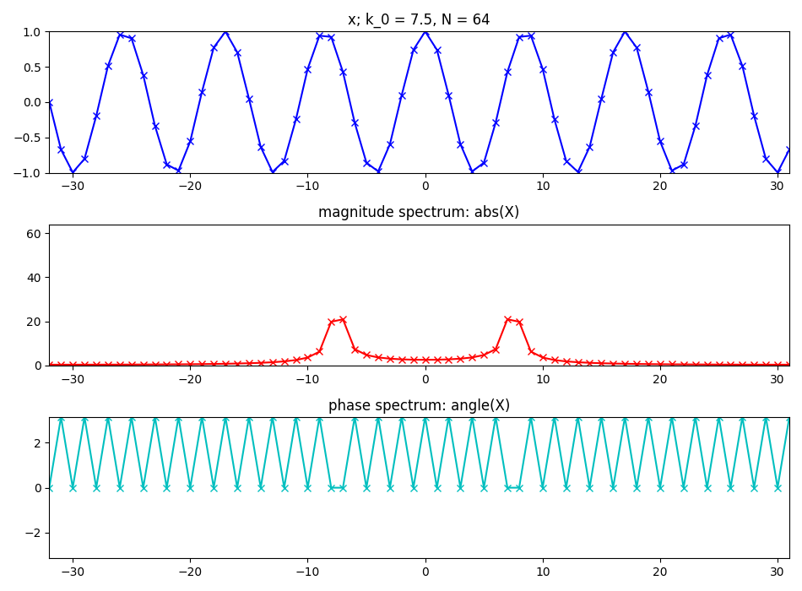
Notes:
This shows what is the output of calculating the DFT of a real sinewave.
...
Still we do not find sinusoids like this in our daily life, but we are gettig quite close. Some sounds are not that different to this.

Slide 10
Inverse DFT
Example:
Notes:
One of the great properties of the DFT is that is invertible, which means that we can get back the original signal from its spectrum.
...

Slide 11
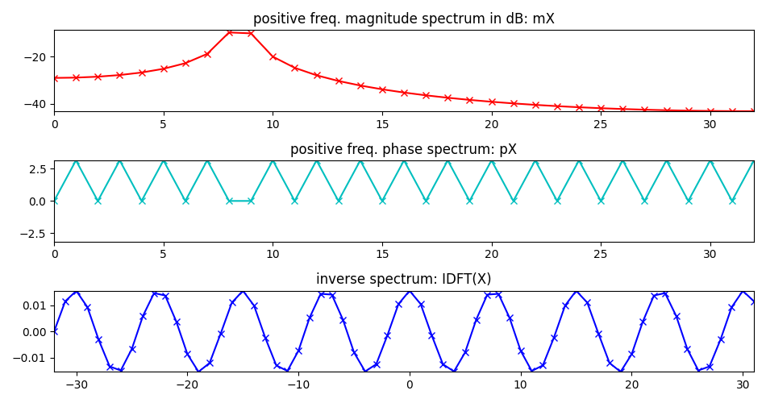
Inverse DFT for real signals
Notes:
For real signals we do not need to have the complete spectrum in order to recover the original signal.
It is enough to have half of the spectrum, tipically we use the positive side.
...
We will come back to these concept in the next lectures.

Slide 12
Short-time Fourier Transform
w: analysis window
l: frame number
H: hop-size
Notes:
This is the Short-time Fourier transform equation, basically a modified version of the DFT, with few but important differences.
...
To emphasize the idea of zero-phase windowing we specify the time index n to go from -N/2 to N/2-1.

Slide 13

Notes:
The windowing process is a way to step through a sound.
If we use the analogy of image and video we could relate a spectrum with a photograph, a static image, and the STFT with a video, a time varying image.
...

Slide 14
Transform of a windowed sinewave
Notes:
To better understand the effect of windowing a sound, lets put an example of what happends when we window a real sinusoid and then compute its spectrum.
...

Slide 15
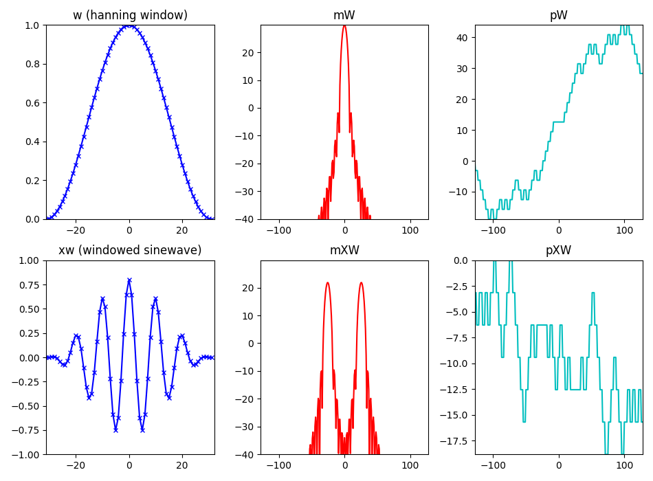
Notes:
With these plots we can understand the windowing process better.
...
From this discussion we can realize the importance of the analysis window in the spectrum of a sinusoid and thus of any sound.
It is clear that we have to spend some time explaining the windows.

Slide 16
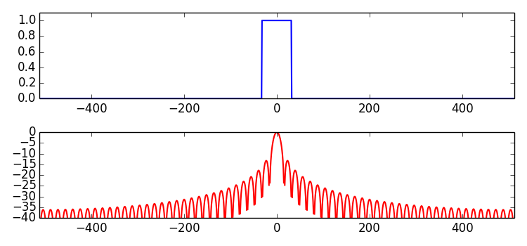
Rectangular window
main-lobe width: 2 bins
side-lobe level: -13.3 dB
Notes:
We start by showing, again, the rectangular window.
...

Slide 17
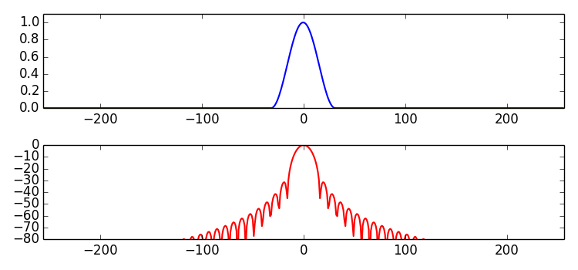
Hanning window
main-lobe width: 4 bins
side-lobe level: -31.5 dB
Notes:
Maybe the most popular window is the hanning window, which is a raised cosine.
...

Slide 18
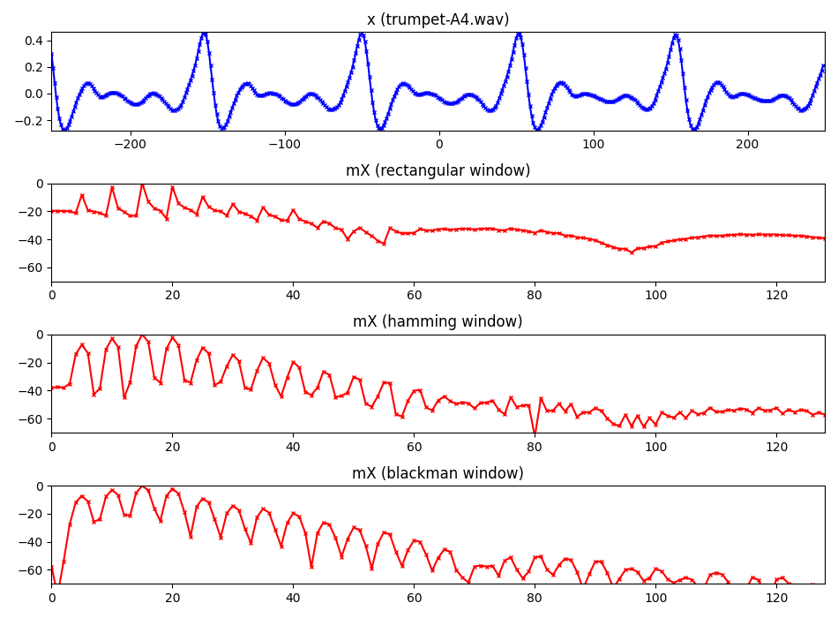
Notes:
This is an example of applying different windows to the same sound fragment.
...

Slide 19
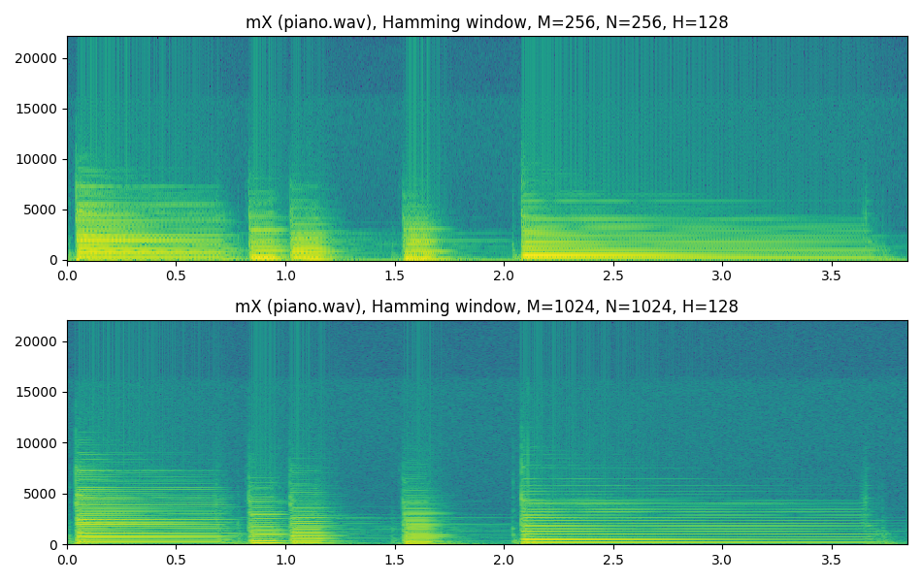
Time-frequency compromise
Notes:
Now we can put all these concepts together to analyze a real and complex signal, like a piano phrase.
Choosing all parameters in the STFT has a number of effects in the output, the most important one is what we call the time-frequency compromise.
...

Slide 20
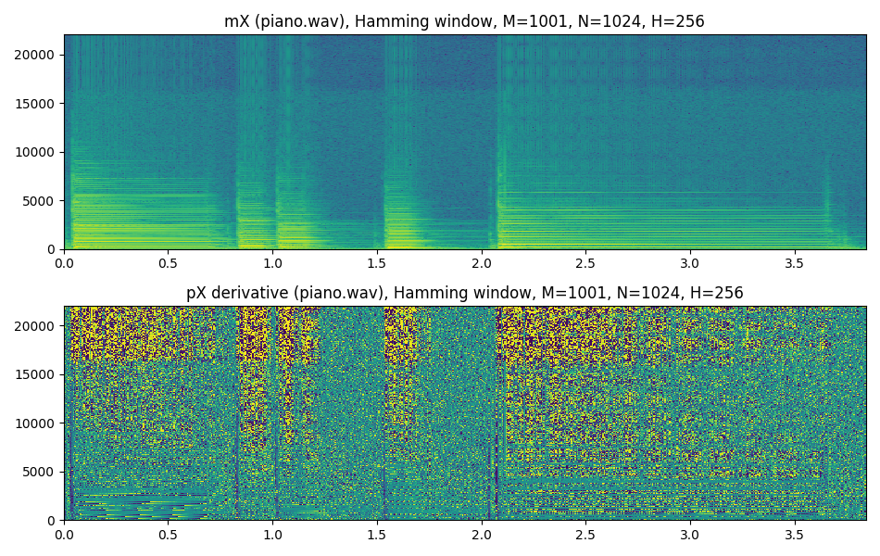
Amplitude and phase spectrogram
Notes:
Typically we only show the amplitude, or magnitude, spectrogram, but the phase has also valuable information about the sound.
....

Slide 21
Inverse STFT
each output frame is:
and the output sound is:
Notes:
Like the DFT, the STFT has the inverse transform. If we do the things right we can recover the original sound from the amplitude and phase spectrogram.
...

Slide 22
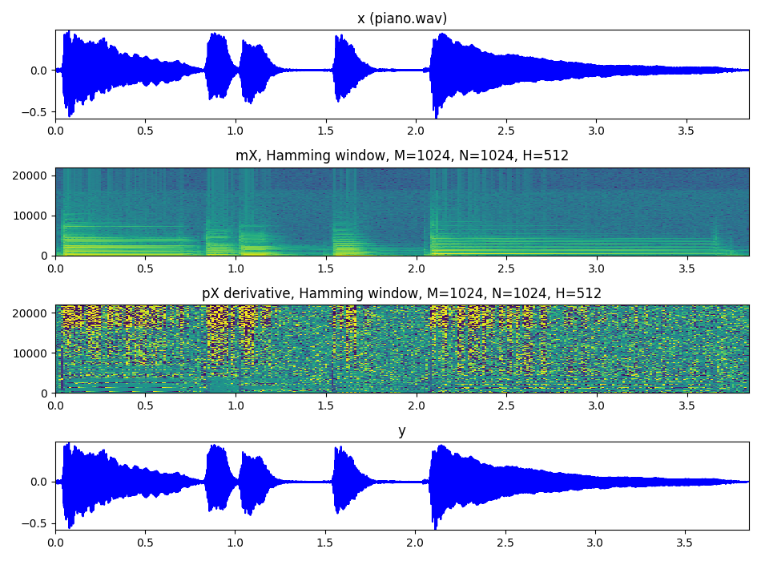
Notes:
Let's show and example.
From a complete sound, which varies in time, we can get a spectrogram, and then recover it.
...

Slide 23
References and credits
More information in:https://en.wikipedia.org/wiki/Discrete_Fourier_transform
https://en.wikipedia.org/wiki/STFThttps://en.wikipedia.org/wiki/Window_function
References by Julius O. Smith:https://ccrma.stanford.edu/~jos/mdft/https://ccrma.stanford.edu/~jos/sasp/
Slides and code released using the CC Attribution-Noncommercial-Share Alike license or the Affero GPL license.
Notes:
There is a lot of signal processing literature on windows.
...

