Slide 1
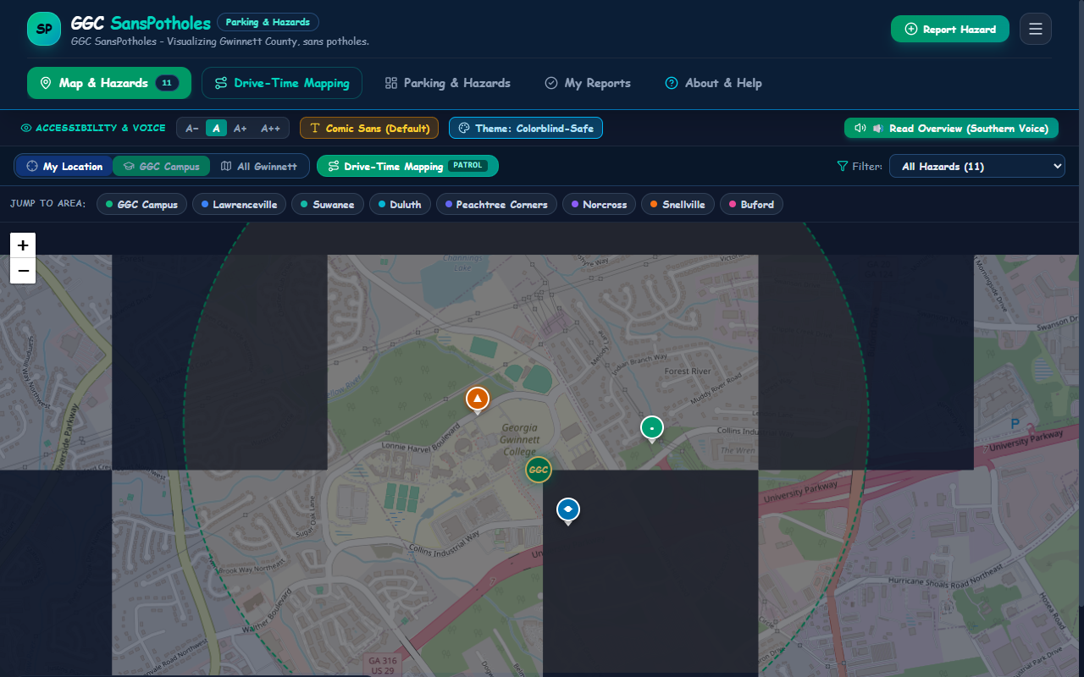
OFFICIAL PRESS RELEASE • CIVIC TECH
GGC SansPotholes: Visualizing Gwinnett, Sans Potholes
Georgia Gwinnett College senior capstone team debuts accessible, sensor-driven roadway hazard patrol.
🔴 🟡 🟢 ggc-sanspotholes.app • Live Active Interface
CIVIC INNOVATION
What GGC SansPotholes Does
Hands-free sensor patrol for commuter safety
Eliminates Distracted Driving: Mount phone & start patrol—silently monitors road vibrations and logs shock spikes.
Physical Telemetry: Uses device accelerometer (DeviceMotionEvent) measuring real G-forces (e.g. 7.80G to 8.80G).
Reverse Geocoded Mapping: Traces GPS route breadcrumbs and auto-resolves nearest street addresses.
MUNICIPAL READINESS
Turnkey Public Works Dockets
Automated civic dispatch to city engineers
End-of-Drive Readout: Immediate summary of trip mileage, duration, and detected shock incident ledger.
1-Click Batch Promotion: Converts sensor detections into confirmed public road hazard dockets.
Certified PDF Work Orders: Exports single-page municipal dockets featuring verified canvas map screenshots.
📸 ACTIVE SCREENCAPTURE: Live Physical GPS Centering & Predominant Drive-Time Nav
GGC SansPotholes • Official Civic Press Release • Senior Capstone ITEC 4860
Slide 1 of 3
Notes:
FOR IMMEDIATE RELEASE:
Today, Georgia Gwinnett College students unveil GGC SansPotholes, an accessible civic tech mobile utility engineered to protect student vehicles, eliminate distracted driving, and automate municipal work orders.
As showcased on the live screencapture on the left, the app combines real physical mobile accelerometer telemetry, live GPS path breadcrumbs, and instant reverse-geocoding. Commuters simply mount their smartphone and drive; the app silently monitors roadway vibrations, filters axle bounce, and logs genuine shock spikes.
Upon reaching campus or home, drivers receive an instant Drive Summary and can dispatch certified, geocoded PDF work order dockets with embedded map screenshots directly to municipal repair crews.

Slide 2
ARCHITECTURE & AESTHETIC TRANSFORMATION
Evolution: From Baseline 10132026 to Modern 10202026
How we eliminated synthetic clutter, anchored to live physical GPS, and restored live telemetry.
EMPIRICAL PIVOT
ERGONOMIC REDESIGN
VISUAL REFINEMENT
Synthetic Purge ➔ Real Physics
Static Campus ➔ Live GPS Launch
Hardware Bench & Usability
100% empirical evidence model
Instant driver orientation
Streamlined civic engineering
Purged Synthetic Placeholders: Permanently retired fake road depth dials (3.5 in), cavity diameters, and placeholder stock photos.
Real Hardware Sensor Telemetry: Wired DeviceMotionEvent to capture actual vehicular impact shocks against 3.0G threshold.
Geospatial Map Snapshots: Automated HTML5 canvas tile-stitcher captures certified location screenshots embedded in reports.
Physical GPS Launch Default: Map automatically queries browser GPS on mount and centers smoothly at street zoom (16).
Pulsing Radar Beacon: Displays animated blue location beacon with GPS accuracy perimeter circle.
Predominant Drive-Time Nav: Elevated Drive-Time Mapping right next to Map & Hazards on desktop header, mobile bar, and map toolbar.
60fps Oscilloscope Waveform: Restored live physical waveform with self-contained mounting lifecycle and 7.5G capstone demo trigger.
Decluttered Bench Header: Standardized to "Hardware Sensor Monitor", removing vendor-specific text.
Universal Design: Dyslexia-friendly Comic Sans MS, Okabe-Ito colorblind palette, and Southern-cadence voice synthesis.
GGC SansPotholes • Official Civic Press Release • Senior Capstone ITEC 4860
Slide 2 of 3
Notes:
Turning to Slide 2 of our release, we detail the strategic pivot executed between our October 13 baseline (pholland10132026) and our current release (pholland10202026):
1. Data Integrity: We permanently eliminated all synthetic measurements, fake dials, and generic stock images. Every report now reflects empirical G-force readings and stitched canvas map screenshots.
2. Viewport & Navigation: Instead of forcing drivers to manually find their location from a static GGC campus center, the app immediately defaults to their live physical GPS coordinates with a pulsing radar beacon, while Drive-Time Mapping is promoted to the primary navigation bar.
3. Hardware Bench: We resolved the waveform mounting bug, delivering a buttery-smooth 60fps oscilloscope that visualizes road shocks in real time.

Slide 3
CIVIC IMPACT & USER VALUE
Uncompromising Safety, Accessibility & Municipal Value
How GGC SansPotholes delivers tangible, real-world benefits to students, commuters, and city crews.
1. COMMUTER PROTECTION
2. INCLUSIVE ENGINEERING
3. MUNICIPAL ACTION
Zero Distraction & Savings
Universal Accessibility
Actionable Public Works
Protecting lives and vehicles
Serving 100% of Gwinnett citizens
Direct pipeline to city maintenance
Zero Distracted Driving: Complete elimination of in-drive manual reporting forms—mount, drive, and review upon arrival.
Tire & Suspension Preservation: Alerts student commuters to severe hazards across Lawrenceville and Gwinnett corridors.
Financial Defense: Prevents hundreds of dollars in alignment and rim repair costs common to college commuters.
Dyslexia-Friendly Comic Sans MS: Proven asymmetrical letterforms prevent symbol flipping and enhance legibility.
Okabe-Ito Colorblind Safety: High-contrast Vermilion, Sky Blue, and Bluish Green paired with dual-coded geometric glyphs (▲, ◆, ●).
Hands-Free Voice Synthesis: Southern-cadence voice assistant reads hazard alerts aloud so drivers keep their eyes on the road.
Empirical Chain of Custody: Supplies public works departments with verified G-forces, exact GPS, and map images.
Turnkey PDF Work Orders: Clean, single-page printable dockets with supervisor signoff blocks for immediate crew dispatch.
Automated Civic Routing: Correctly classifies jurisdictions (Gwinnett County DOT, City of Lawrenceville, GDOT).
GGC SansPotholes • Official Civic Press Release • Senior Capstone ITEC 4860
Slide 3 of 3
Notes:
Slide 3 highlights the ultimate value proposition of GGC SansPotholes across three constituencies:
First, for Commuters: It solves the safety paradox. Drivers no longer endanger themselves by pulling out phones in traffic. The app preserves vehicle health, saves students hundreds in repair bills, and promotes safer transit.
Second, for All Citizens: By grounding the system in Universal Design—Comic Sans MS for dyslexia, Okabe-Ito for colorblindness, and Southern voice audio synthesis—the app leaves no driver behind.
Third, for Municipalities: Public works departments receive certified, verifiable evidence rather than subjective complaints, accelerating repair cycles across Gwinnett County roadway infrastructure.

