Slide 1

Ways to improve Compilation time
Alexander Demidenko

Slide 2
Why does it run that slow?
Parsing (requires to parse an overly complicated syntax)
Templates (quite complicated to parse, defined in headers, substitution for every type)
Header files (single compilation unit requires headers to be recompiled)
Optimizations (inline and other optimizations that might be drastic)
Bugs (e.g. https://developercommunity.visualstudio.com/content/problem/706510/build-throughput-slow-c-compile-times-with-large-m.html)
Linking

Slide 3
What are the options?
Leave it as it is
Use cache system
Use different toolchain
Use distributed build
Use advanced compilation techniques (PCH, SCU)
Coding techniques
Make manual fixes to a code

Slide 4
Cache system
ccache
clcache
sccache (mozilla)
Caveats:
Not straightforward integration with MSVC.
You have to manipulate with MSVC project flags

Slide 5
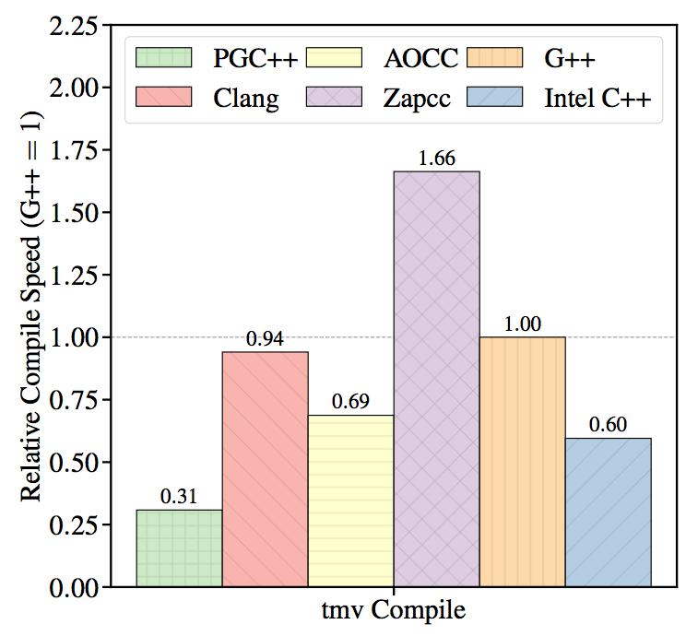
Toolchain
There are flags that can help you improve compilation/linking performance
e.g. MSVC
/debug:fastlink
/Zi vs /Z7

Slide 6
Distributed build
incredibuild (paid software)
fastbuild
distcc (more for gnu compiler)
Caveats:
not everything could be distributed (e.g. pch flags, moc compilation etc)

Slide 7
Advanced compilation techniques
PCH – Precompiled header file
Preprocessed group of headers in advance
SCU – single compilation unit
Put all cpp files in one place
It helps to "glue" compilation units through the preprocessor directives
Allows compile time optimizations vs link time
Caveats
Hard to parallelize might require SCU sharding
Compilation flags must be identical
Doesn't like all compilation flags

Slide 8
Coding techniques
Forward declarations
PIMPL idiom
Reduce interdependency
Extern template instantiations
Extern template void SomeFunction<Type>();
Using anonymous namespaces
They utilize internal linkage hence are not visible to other translation units

Slide 9
Tools to automate
include-what-you-use (IWYU)
cotire
Automatically generates SCU (saves up to 90%)
Automatically generates PCH (saves from 10% up to 40%)
#include <iostream>
#include <cmath>
int main(int, char**)
{
std::cout << __FUNCTION__ << std::endl;
return 0;
}
main.cpp should add these lines:
main.cpp should remove these lines:
- #include <cmath> // lines 2-2
The full include-list for main.cpp:
#include <iostream> // for operator<<, endl, basic_ostream, cout, ostream

Slide 10
joy of legacy codebase
clang-tidy comes with help
modernize-avoid-bind
modernize-deprecated-headers
modernize-loop-convert
modernize-make-shared
modernize-make-unique
modernize-pass-by-value
modernize-raw-string-literal
modernize-redundant-void-arg
modernize-replace-auto-ptr
modernize-shrink-to-fit
modernize-use-auto
modernize-use-bool-literals
modernize-use-default
modernize-use-emplace
modernize-use-nullptr
modernize-use-override
modernize-use-using

Slide 11

Thanks for being with us

