Slide 1
DECENTRALIZED VOTING
Farman Shaik (N200788)
Mulleti Lohith (N200357) Ishaan Kondapalli (N200570) Suhana Shaik (N200694) Thota Poojitha (N200296)

Slide 2
1. Abstract
Voting is a fundamental democratic right, yet traditional systems often face challenges such as accessibility barriers and vulnerabilities to vote tampering. To address these issues, we propose a Decentralized Voting System using the Solana Blockchain. The system is implemented across two websites: the verification website, under admin control, and the voting website, integrated with the Solana blockchain.
During the verification process, voters submit their email and wallet address. The admin validates the voter’s details, and if the verification is successful, tokens are sent to the voter’s wallet, granting them the right to vote. If the admin rejects the verification request, the voter does not receive the tokens, and a verification failure message is displayed. On the voting website, the voter uses the token to cast their one-time vote. Once the vote is cast, the token is consumed, ensuring the one-vote-per-user policy and preventing duplicate voting.
The Solana blockchain plays a key role in recording the entire voting process securely, ensuring transparency, immutability, and tamper-proof data. With Solana’s high throughput and low transaction fees, the system offers a fast, cost-effective, and secure alternative to traditional voting systems. This innovative approach ensures a modern, trustworthy, and efficient electoral process

Slide 3
2. Introduction
Motivation for the work
Traditional voting systems are slow, expensive, and vulnerable to manipulation, causing a global decline in trust.
Many people, including the elderly, differently-abled, and busy professionals, are unable to attend physical polling stations.
Blockchain technology ensures transparency, security, and immutability, eliminating the need for centralized control.
Solana’s high speed, low gas fees, and scalability make it ideal for creating a practical, large-scale decentralized voting system.
Decentralized voting ensures every citizen’s vote is protected, respected, and transparently counted.
Real-time recording and public verification of votes build trust, fairness, and accountability in elections.
This project also provides an opportunity to gain real-world skills in Rust, Anchor, Solana Web3, and React through meaningful application.

Slide 4
Real world Applications
Government Elections
Use: National, state, or local elections
Why Decentralized? Harder to tamper with results, transparency for all, voters can verify without revealing identities.
Corporate Governance
Use: Shareholder voting (e.g., electing board members, major company decisions)
Why Decentralized? Each shareholder votes according to their stake transparently and securely, even remotely.
University Elections
Use: Student body elections, academic board voting
Why Decentralized? Easy participation, fraud prevention, immutable historical records.
Decentralized Autonomous Organizations (DAOs)
Use: Voting on proposals within blockchain-based organizations
Why Decentralized? It's the foundation of DAO governance — trustless and automated

Slide 5
Real world Applications
Polls and Referendums
Use: Public opinion surveys, local decision-making (e.g., city planning votes)
Why Decentralized? Prevent fake votes, allow global participation securely.
Union and Cooperative Voting
Use: Labor unions voting on policies, cooperatives making collective decisions
Why Decentralized? Ensures that every member's vote is counted accurately and fairly.
TV Shows and Public Competitions
Use: Voting for reality show contestants (e.g., The Voice, Big Brother)
Why Decentralized? To prove no manipulation in public votes, restoring audience trust.
NGO and Non-profit Decision Making
Use: Policy changes, fund distribution decisions
Why Decentralized? Donors and members can participate directly and verify fairness.

Slide 6
3. Related Works / Existing Works
Related Works and their Limitations
Research Name | Technologies Used | Limitations
Song et al | Ethereum based Blockchain | Average transaction execution time of around 30 seconds
Barbu et al. (2022) | Decentralized Ledgers | Scalability issues, high energy consumption from certain consensus protocols
Gandhi et al. (2022) | Zero-Knowledge Proofs | Recognized unresolved tensions between full transparency (necessary for public audit) and voter privacy
Prashanth et al. (2023) | Ethereum based Blockchain using secure encryptions like AES, SHA-256 | The architecture faces challenges in legal and regulatory interoperability

Slide 7
Comparison with other Approaches
Our Project uses Solana as it’s Blockchain Technology and it’s advantages are:
High Throughput : Solana supports upto 65,000 TPS
Low Fees : Transaction fees are extremely low compared to Ethereum and USSD.
And additional features include:
Verification Portal : Helps in centralizing the authorization process.
Detailed User Interface : Creates a user-friendly environment that helps user to interact with blockchain system.

Slide 8
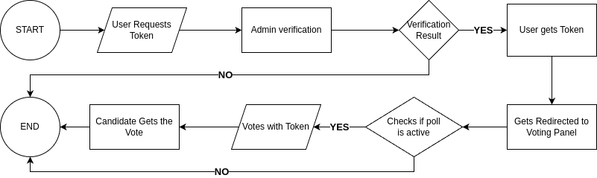
4.Proposed Method
User Voting Flowchart

Slide 9
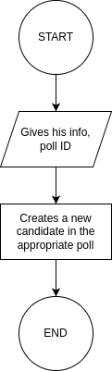
Candidate Registration Flowchart
The process starts when a candidate initiates a request to join a poll.
The candidate provides necessary information (such as personal details) and the poll ID they wish to join.
Upon submission, the system creates a new candidate record under the specified poll.
After successful registration, the process ends, and the candidate becomes available for users to vote for.

Slide 10
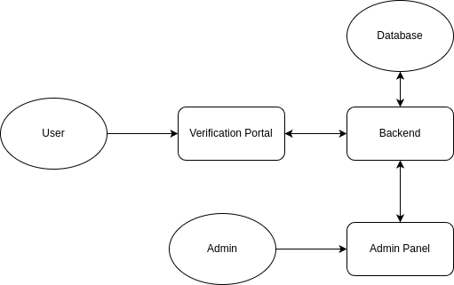
Verification Portal
User:
The person requesting access to voting.
Needs to be verified before participating.
Verification Portal :
A frontend portal where users:
Enter their personal information (e.g., ID, voter registration number).Request a voting token.
Acts as the first checkpoint before entering the voting panel.
Backend:
The server-side system that:
Receives user details from the Verification Portal. Checks the data against the database. Communicates with the Admin Panel if manual approval is needed. Generates and issues voting tokens upon successful verification

Slide 11
Verification Portal
Database
Stores user information such as:
Registered voters, Eligible candidates, Poll information, Backend queries this database to verify the user details.
Admin Panel
Used by admins or moderators.
Functions: Manually approve or reject user token requests.
Manage registered users, candidates, and polls.
Monitor suspicious activity and ensure system security.

Slide 12
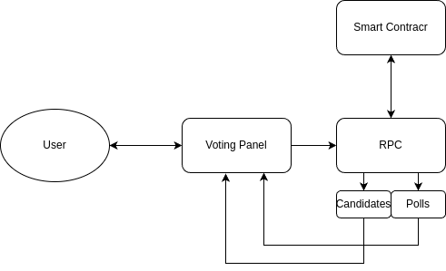
Voting Panel
User:
The person who wants to cast their vote. Already verified and has a valid token to proceed.
Voting Panel :
A frontend interface where the user can:
View available polls and candidates.
Select their choice. Submit their vote.
Designed to be simple and user-friendly.
Smart Contract:
The core logic of the voting system is inside the smart contract.
It ensures that: Votes are recorded securely and immutably.
Only valid tokens are accepted.
The vote is associated with the correct poll and candidate.

Slide 13
Voting Panel
RPC (Remote Procedure Call):
Acts as a bridge between the Voting Panel and the blockchain (smart contract).It sends voting transactions from the frontend to the smart contract. It fetches information like list of polls, candidates, and current vote status.
Candidates and Polls:
Candidates:
List of individuals/entities participating in the
elections.
Polls:
Different voting events where users can cast their votes (e.g., President Election 2025, Class Representative Election).
Both are stored on-chain and fetched/displayed through the Voting Panel.

Slide 14
Algorithm
Start the process.
User Requests Token - The user sends a request to obtain a voting token.
Admin Verification - The admin verifies the user's identity or eligibility.
Verification Result: i. If the verification is successful - Issue a token to the user. ii. If the verification fails - Terminate the process.
User Votes with Token - The user attempts to cast a vote using the issued token.
Check Poll Status - Verify if the poll is currently active. i. If the poll is active - Redirect the user to the voting panel. ii. If the poll is not active - Terminate the process.
Deduct Token - Deduct one token from the user's account upon voting.
Record Vote - Register the vote for the selected candidate.
End the process.

Slide 15
5.Experimental Setup
Technologies/Libraries used
Blockchain Technologies
Solana Blockchain ➔ Secure, decentralized platform with high transaction speed and low fees.
Anchor Framework ➔ Simplifies smart contract development for Solana.
@solana/web3.js ➔ JavaScript library to interact directly with the Solana blockchain.
Frontend Technologies
Next.js ➔ React-based framework for building fast, SEO-optimized voting websites.
React.js ➔ JavaScript library for reusable and dynamic UI components.
Tailwind CSS ➔ Utility-first CSS framework for quick, responsive styling.
Vite ➔ Fast modern frontend build tool (used for verification frontend).

Slide 16
Technologies/Libraries used
Backend Technologies
Node.js ➔ JavaScript runtime environment for building scalable backends.
Express.js ➔ Lightweight web framework to create backend APIs for user verification.
MongoDB ➔ NoSQL database used to store user data securely and efficiently.
Authentication & Wallet Integration
JSON Web Tokens (JWT) ➔ Stateless authentication method to verify users securely.
Solana Wallet Adapter ➔ Connects Solana wallets like Phantom to the voting platform for transaction signing and authentication.
Deployment Platforms
Vercel ➔ Cloud platform used to deploy and host the frontend websites (Voting site and User Verification portal) with CI/CD capabilities and serverless functions.

Slide 17
System Hardware
Minimum Hardware Requirements
Processor:➔ Quad-Core CPU (Intel i5/i7 or AMD Ryzen 5 or better)
RAM:➔ Minimum 8 GB RAM (Recommended: 16 GB for smoother experience)
Storage:➔ SSD with at least 50 GB of free space (Solana CLI, Anchor, Rust toolchains require significant space)
Graphics:➔ Integrated Graphics sufficient (no heavy GPU required)
Internet Connection:➔ Stable broadband for downloading Solana packages and deploying programs
Recommended Software Environment
Operating System:➔ Linux (Ubuntu 20.04+), MacOS, or WSL (Windows Subsystem for Linux)(Native Windows is discouraged for Solana development due to compatibility issues.)Rust Toolchain:➔ Required for building Anchor programs (cargo, rustup, rustc)
Node.js:➔ Version 16.x or higher (for frontend apps and Solana CLI integration)
Anchor CLI:➔ Installed via cargo install --git https://github.com/coral-xyz/anchor anchor-cli
Solana CLI:➔ Installed via sh -c "$(curl -sSfL https://release.solana.com/stable/install)"

Slide 18
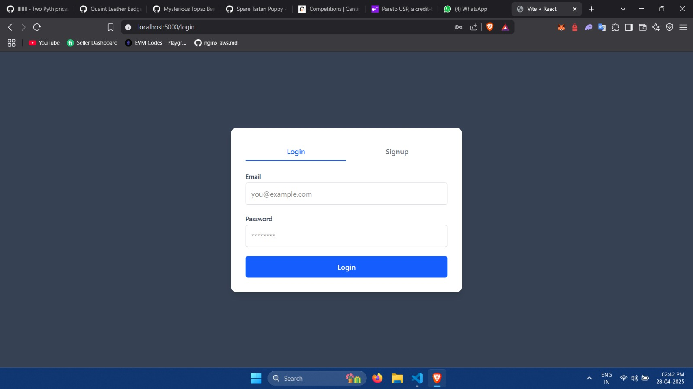
Project Results

Slide 19
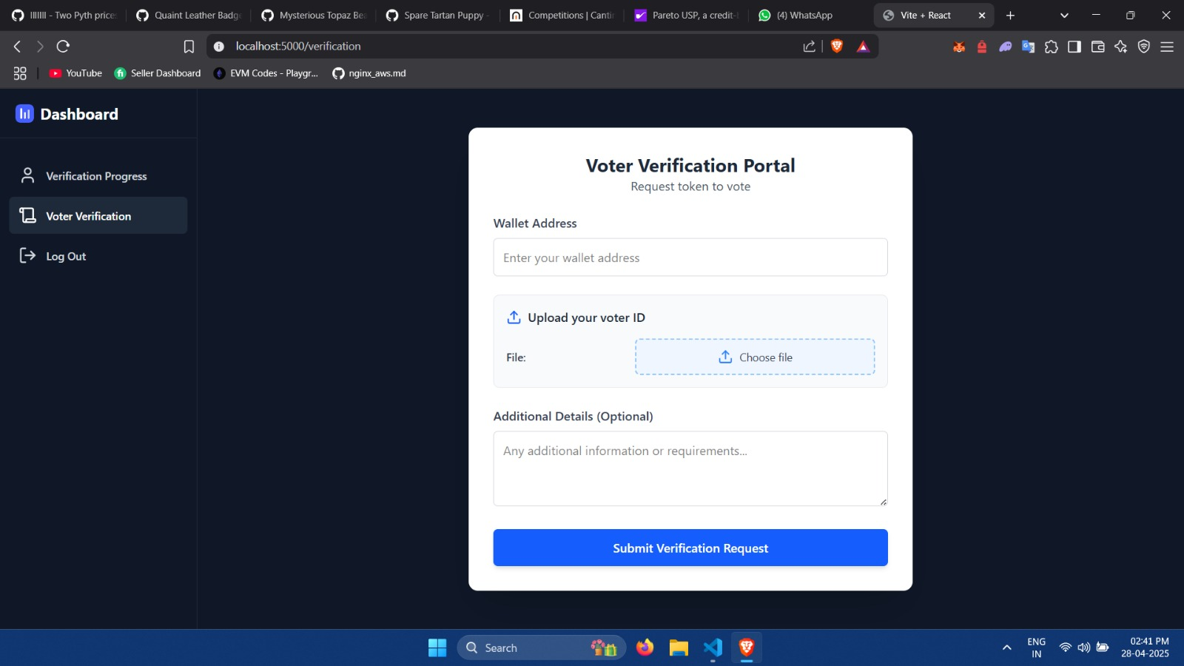

Slide 20
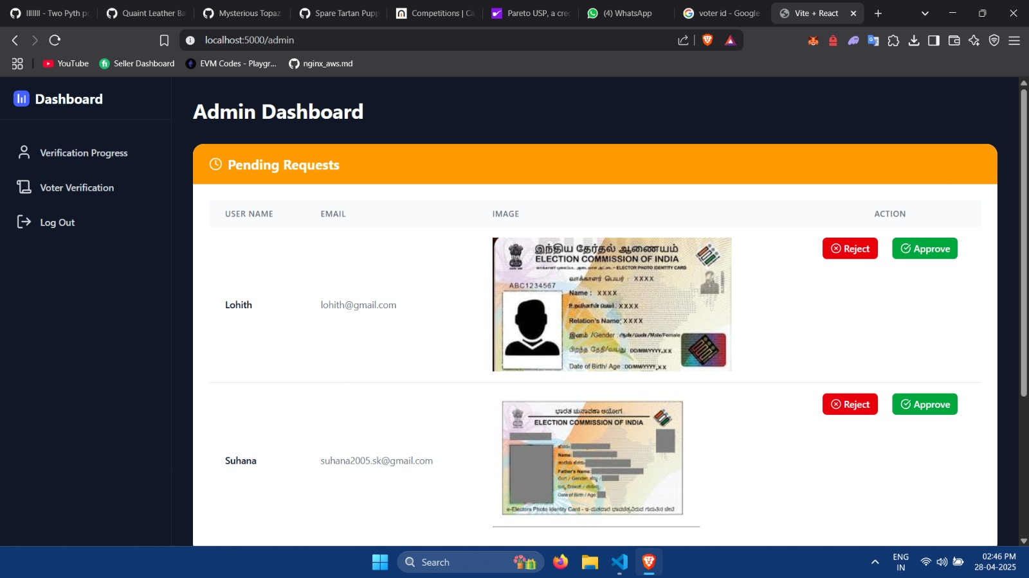

Slide 21
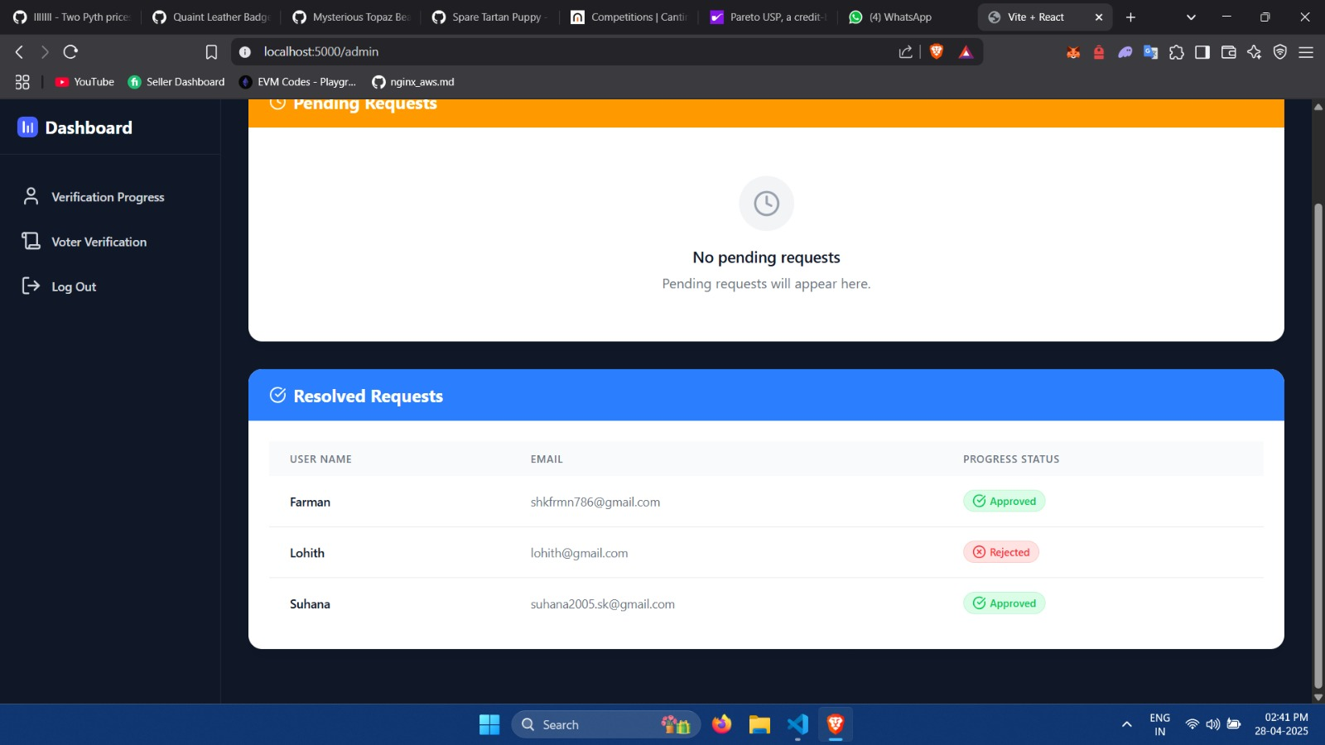

Slide 22
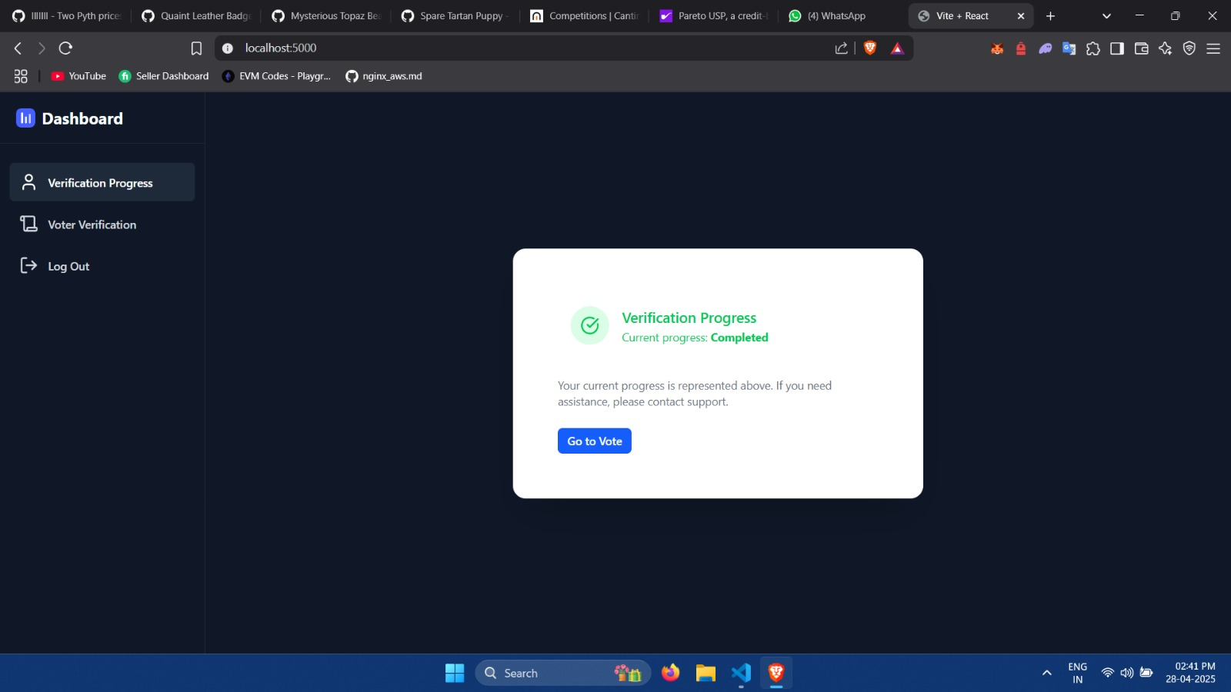

Slide 23
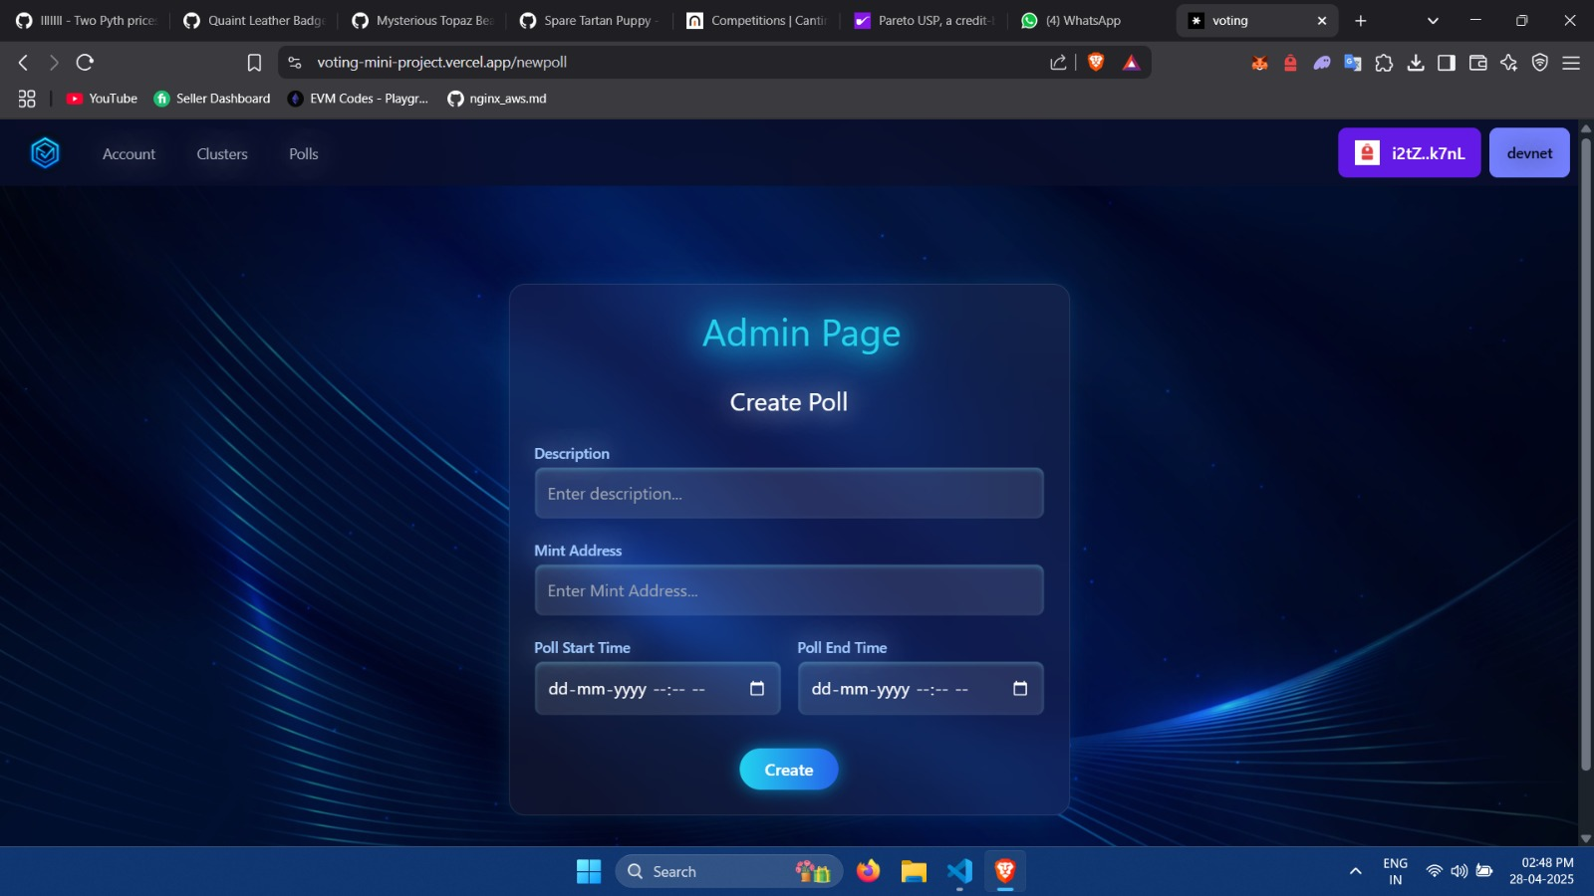

Slide 24
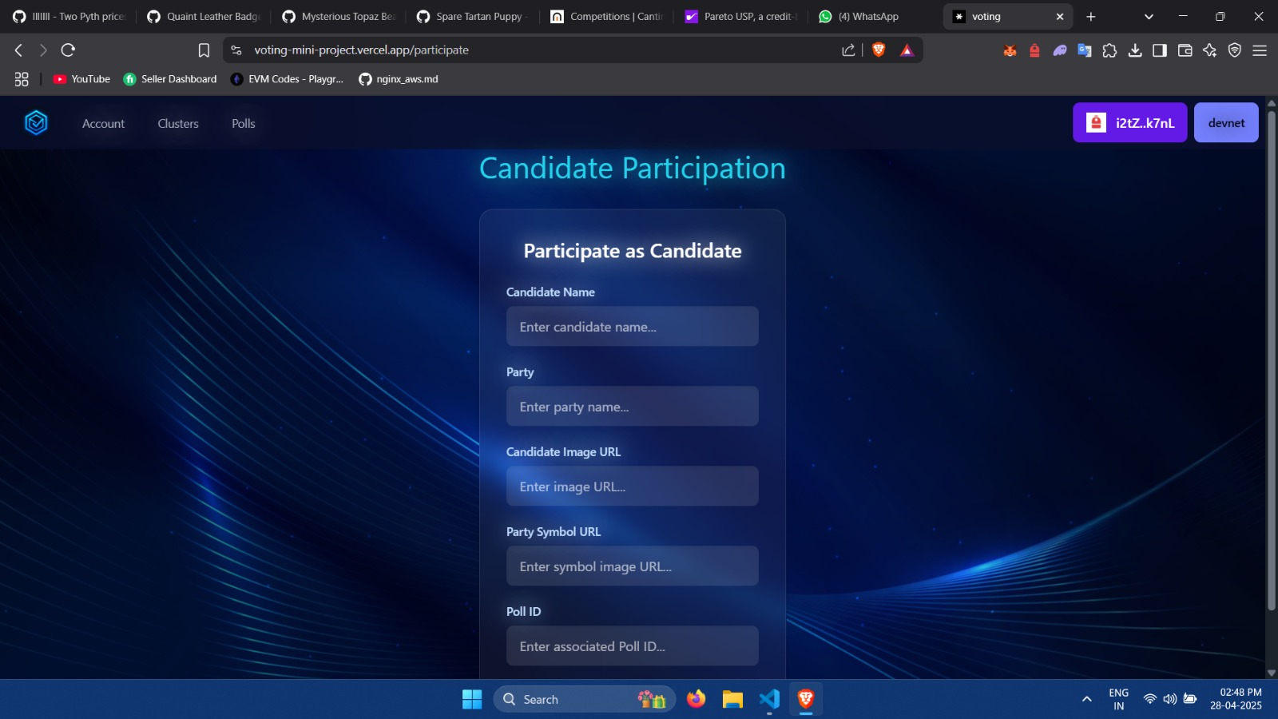

Slide 25
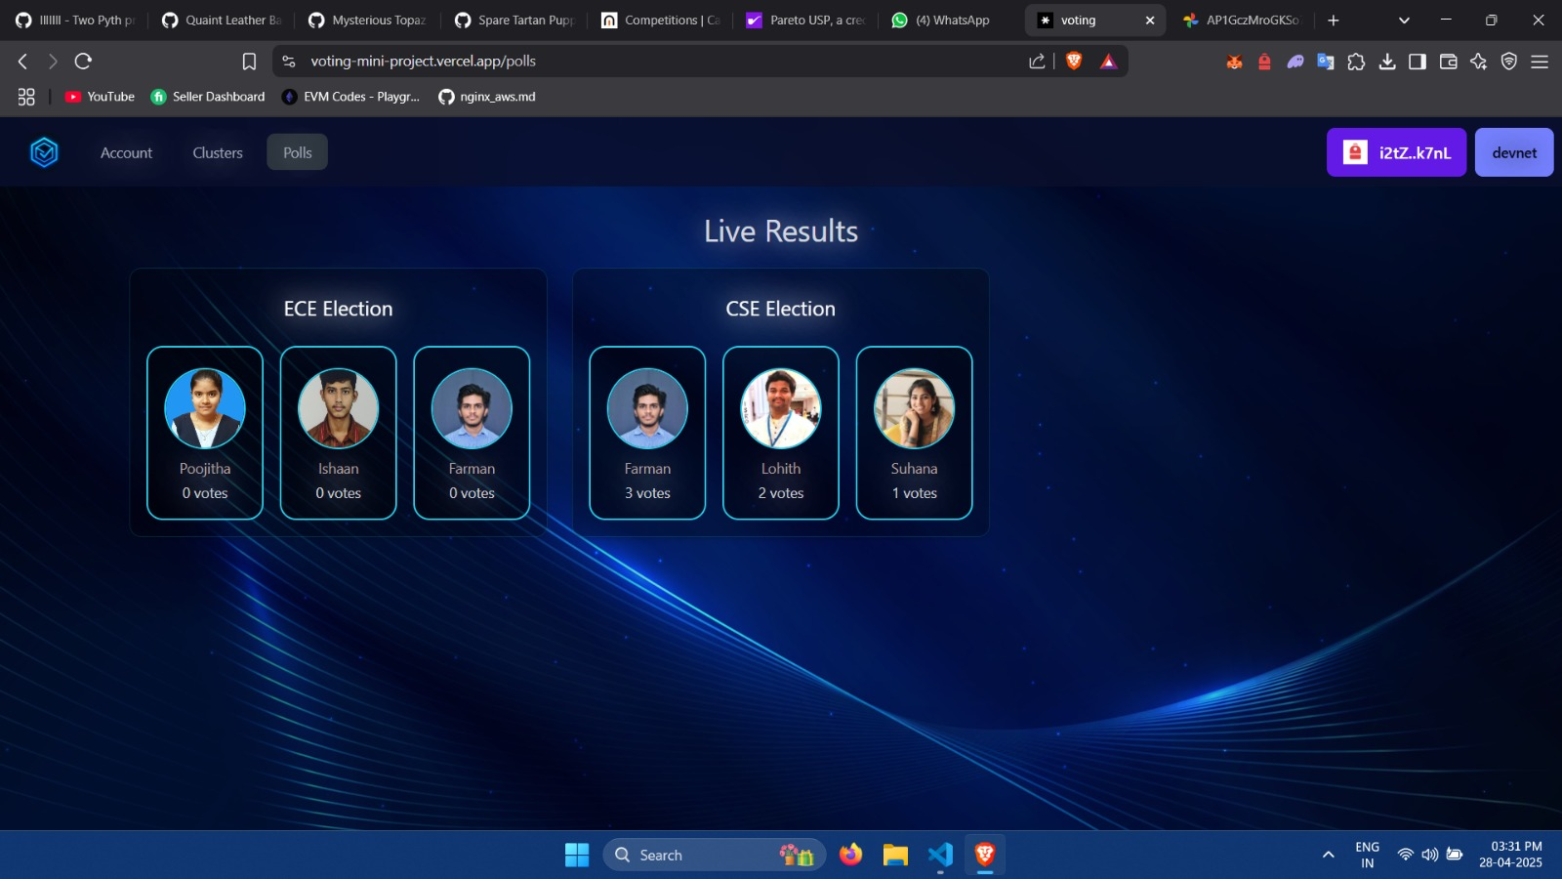

Slide 26
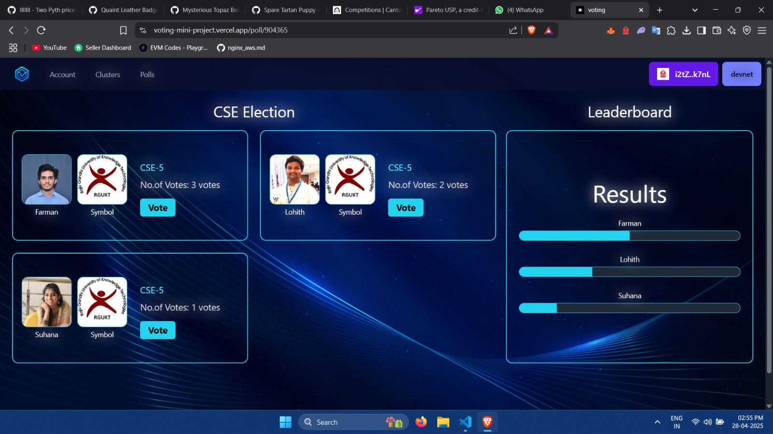

Slide 27
6.Conclusion
In a world where trust, transparency, and security are crucial, our Decentralized Voting System using Solana Blockchain stands as a practical solution to modern voting challenges.
By combining high-speed transactions, tamper-proof smart contracts, and token-based voter verification, we’ve built a system that ensures fairness, integrity, and privacy for every voter.
This project is more than just code
it’s a vision of digital democracy, where voting is not only secure and accessible, but also verifiable, scalable, and decentralized.
With real-world applicability and a strong foundation for innovation, our system can shape the future of secure decision-making in communities, organizations, and governments.

Slide 28
7. Future Scope
1) Notifications and Alerts : Notify users about poll openings , deadlines and result announcements
2) Multi Language support : Allow users to choose their preferred language for accessibility
3) Adding Audio guidelines : Including of audio feature to make user to use our application easily , even though he/she is uneducated
4) Integration of AI : To make the integration process to the admin easier, AI can be integrated into the application

Slide 29
8. References
J. G. Song, S. J. Moon, and J. W. Jang, “A scalable implementation of anonymous voting over ethereum blockchain,” Sensors, vol. 21, 2021. https://www.mdpi.com/ 1424-8220/21/12/3958
D.-C. Barbu, G. Dobrit, a (Ene), S.-V. Oprea, A. Bara, and V. Diaconit, a, “Challenges and Benefits of Blockchain-Based Electronic Voting System,” Romanian Journal of Information Technology and Automatic Control, vol. 32, no. 4, pp. 117–128, 2022. [Online]. Available: https://rria.ici.ro/en/vol-32-no-4-2022/ challenges-and-benefits-of-blockchain-based-electronic-voting-system/
S. S. Gandhi, A. W. Kiwelekar, L. D. Netak, and H. S. Wankhede, “Security Requirement Analysis of Blockchain-Based E-Voting Systems,” arXiv preprint arXiv:2208.01277, 2022. [Online]. Available: https://arxiv.org/abs/2208.01277
U. Prashanth, M. Muneeruddin, T. Bhanuprakash, R. V. Reddy, and S. Kartania, “A Review of a Blockchain E-Voting System for Secure Voting,” International Journal of Engineering Research and Technology (IJERT), vol. 12, no. 8, 2023. [Online]. Available: https://www.ijert.org/ a-review-of-a-blockchain-e-voting-system-for-secure-voting

Slide 30
Thank You!

