Slide 2
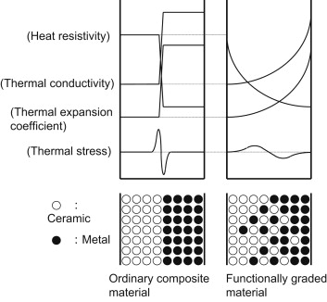
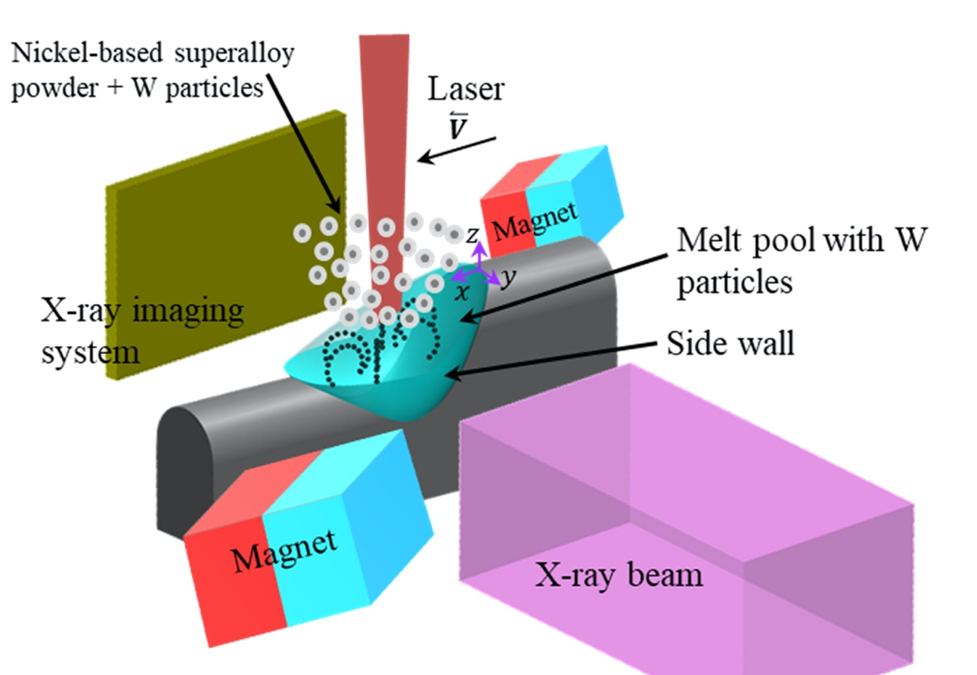
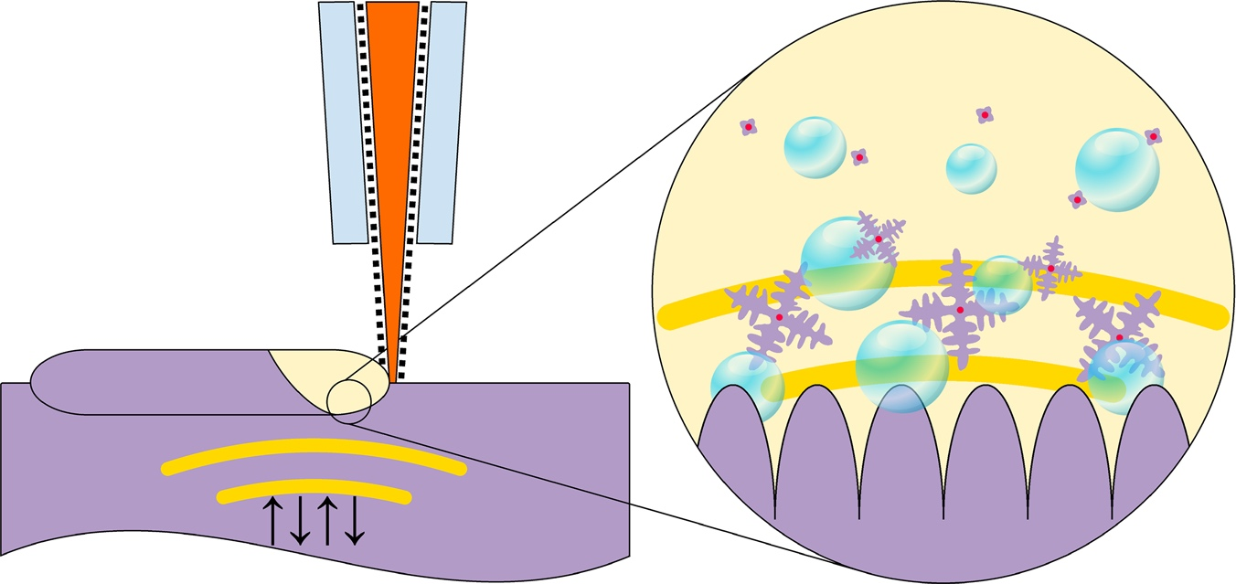
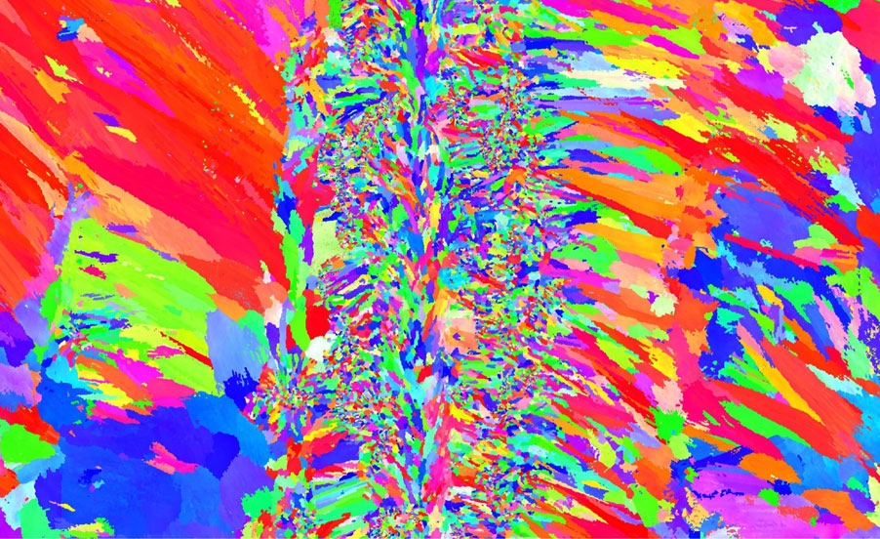
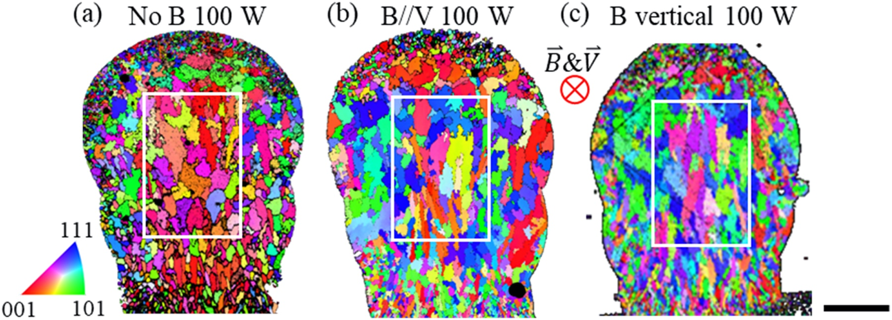
(a)
(b)
(c)
off
on
off
No magnetic field
With magnetic field
Altering Ultra-sonic vibration
Image source:
https://doi.org/10.1038/s41467-019-13874-z

